Slide 1
Predicting subgroup treatment effects for a new study: Organization, results and learnings from a company-internal data challenge
Global Drug Development
Analytics - AMDS
Björn Bornkamp
PSI Conference 2022, Göteborg
June 13, 2022

Slide 2
Organizing team & co-authors
Carsten Müller
Conor Moloney
Giulia Capestro
Jana Starkova
Mark Baillie
Michela Azzarito
Ruvie Martin
Silvia Zaoli

Slide 3
Motivation
Finding subgroups is "the hardest problem there is" (Steve Ruberg)
  Clinical trials not designed for assessing subgroup trt effects (insufficient sample size)
  Subgroup “identification” even harder: Comparing trt effects (assessing interactions)
Many have been in the situation of a study with “borderline” trial results...
  ... but: A subgroup with better treatment effect has been identified
  Shall we run the next trial in the subgroup? What are the chances of success?
Idea of Subgroup Challenge
  Mimick this situation: Participants derive a subgroup based on a pool of studies and predict its efficacy for a true “new trial”: Trial just read out; results not yet published; study data still embargoed

Slide 4
Challenge Setup: Project
Training dataset
4 Phase III randomized clinical trials (~2200 patients) in the compound & disease were provided to all participants on data science platform
Scoring dataset
One new Ph III trial (~400 patients), not available to participants (still restricted on regulatory data platform)
Same inclusion criteria
Same 90+ baseline covariates
Same primary outcome (binary)

Slide 5



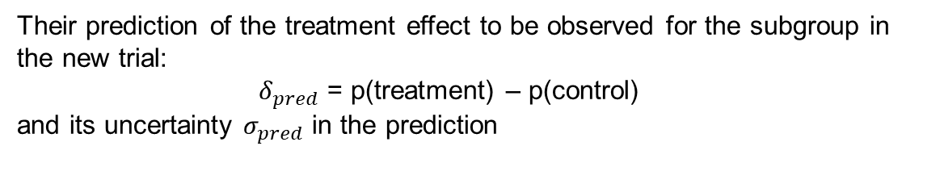
Challenge task
Participants work on 4 studies and had to submit:
A definition of the subgroup for which they predict increased treatment effect in the new trial (ex. “AGE<60”)
Their prediction of the treatment effect to be observed for the subgroup in the new trial:
${ δ}_{pred}$ = p(treatment) – p(control)
and its uncertainty $σ_{pred}$ in the prediction
Their git repository and a description of their methodology, with clinical/biological justification of the subgroup.

Slide 6
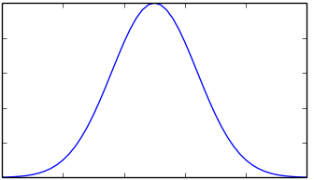

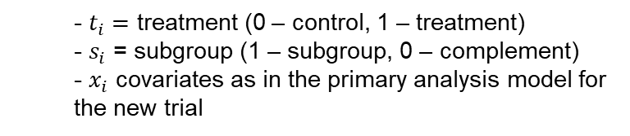

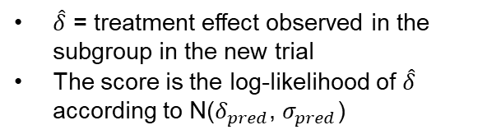
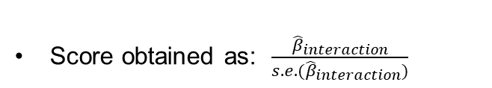
Scoring
Does the subgroup have increase treatment effect in the new trial?
Is the prediction of treatment effect accurate?
Probability p_{i} of patient i to respond modeled as
$\hat{δ}$ = treatment effect observed in the subgroup in the new trial
The score is the log-likelihood of $\hat{δ}$ according to N($δ_{pred}$, $σ_{pred}$)
$$logit (p_{i})=β_{0}+β_{trt}t_{i}+β_{s}s_{i}+β_{interaction}t_{i}s_{i}+x_{i}^{′}β$$
  - $t_{i}=$ treatment (0 – control, 1 – treatment)
  - $s_{i}$ = subgroup (1 – subgroup, 0 – complement)
  - $x_{i}$ covariates as in the primary analysis model for the new trial
Density
Score obtained as: $\frac{{\hat{β}}_{interaction}}{s.e.({\hat{β}}_{interaction})}$
$\hat{δ}$
$$δ_{pred}$$
Treatment difference in subgroup

Slide 7
Scoring good data science practice
1) Science and methodology
  Teams submit description (< 300 words) of subgroup derivation (methodological approach) and clinical justification for chosen subgroup
  Blinded review by senior clinical and statistical management
2) Documentation, reproducibility and knowledge transfer
  Team’s git repository will be scored (code & workflow well documented)
  Review by organizing committee

Slide 8
Technical/logistical conduct
Participants work in git repository on data science platform
In this repository a template Rmd file (with fixed format requirements) needed to be populated with predictions and subgroup justification
Repos were automatically read and predictions evaluated
Member of organizing team had access to restricted folder of the new Phase III trial to score solutions

Slide 9
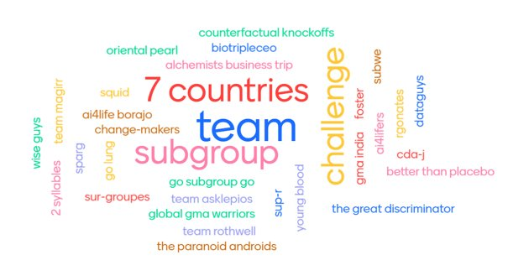
Participants
30 teams ~100 team members​
Most teams from Biostatistics group
Other teams from​
  Business Analytics, Data Science group, Real World Evidence Group​, ...
26 teams submitted a subgroup definition​
  24 “complete” submissions​

Slide 10



Challenge Timelines
KICK OFF
TEST SUBMISSION
TEST SUBMISSION
FINAL SUBMISSION
CHALLENGE WINNER
Day 1
Day 34
Day 37
Day 42
Day 52

Slide 11
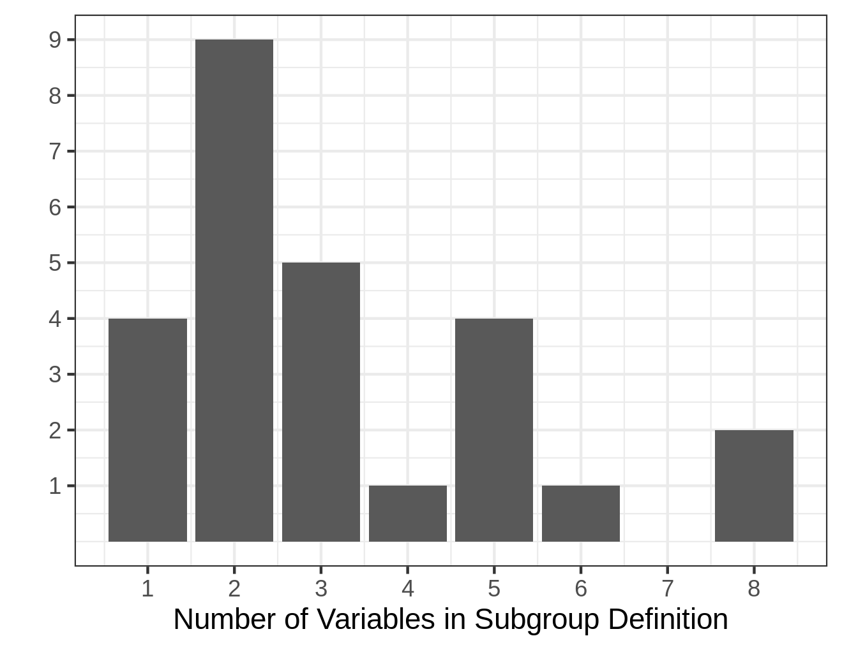
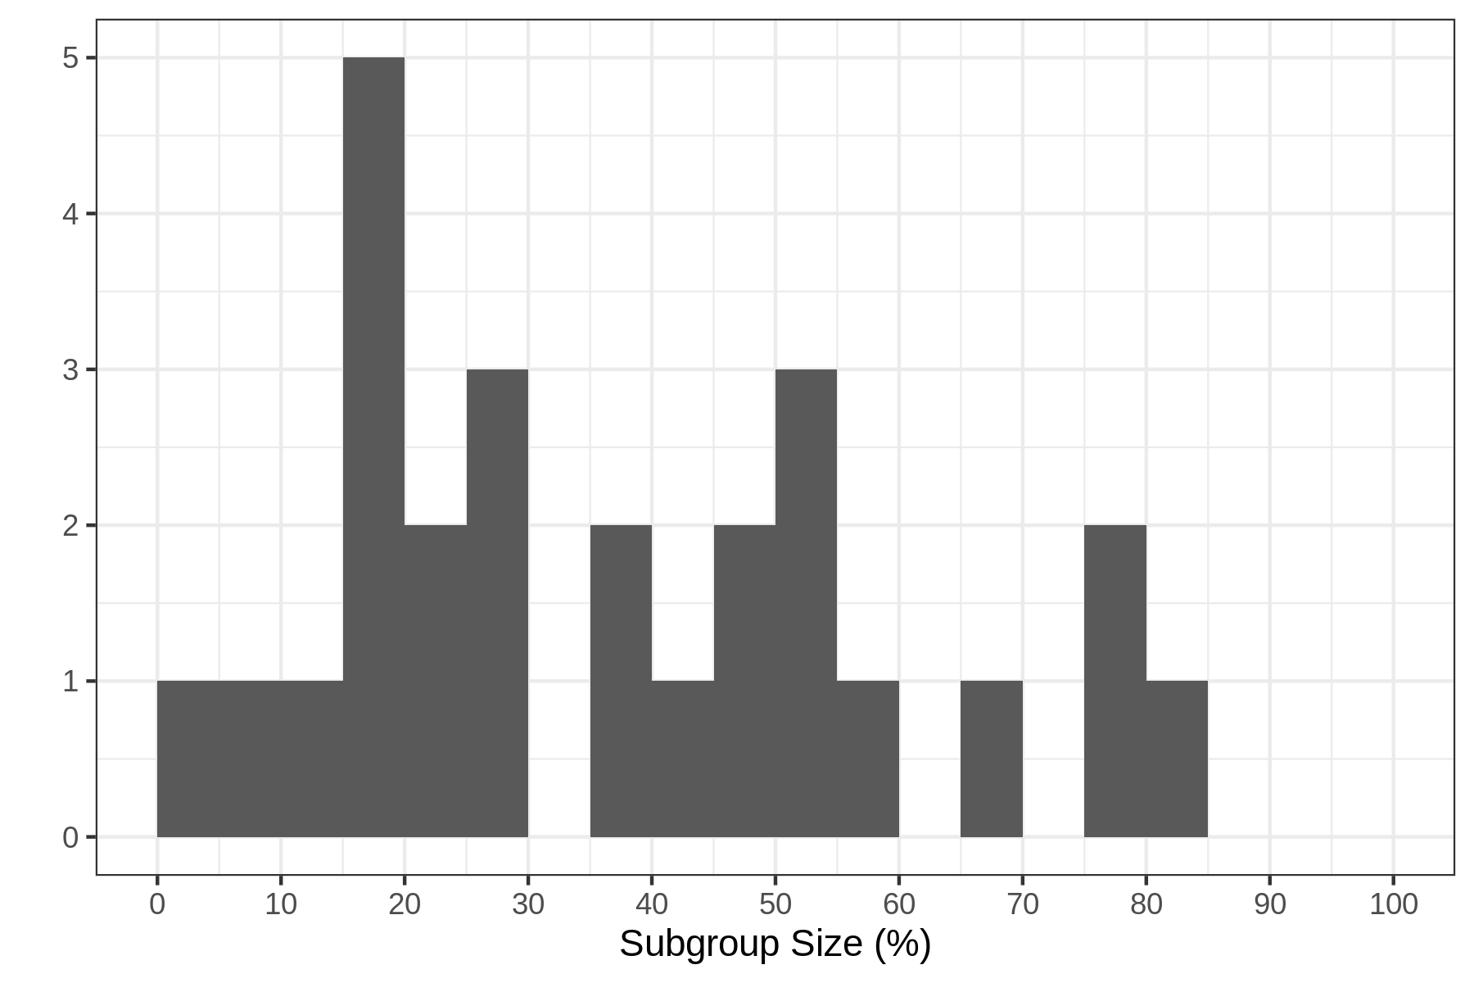
Submitted subgroups

Slide 12
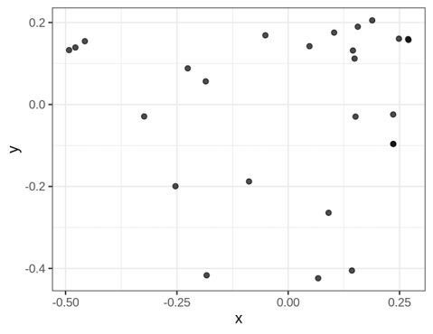



Similarity of submitted subgroups
MDS based on Jaccard distance
  Plotting first two MD dimensions
Proposed subgroups quite different also among top 3

Slide 13
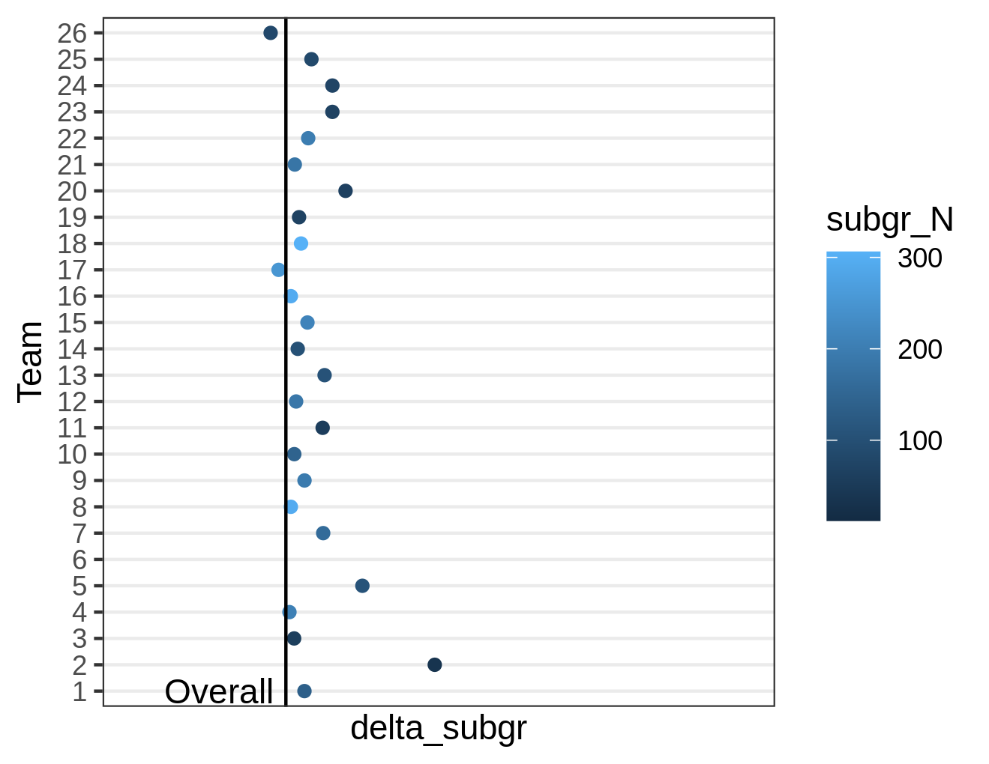
Treatment effect on risk difference scale: Overall & teams
All but two teams achieved a treatment effect better than the overall with their subgroup

Slide 14
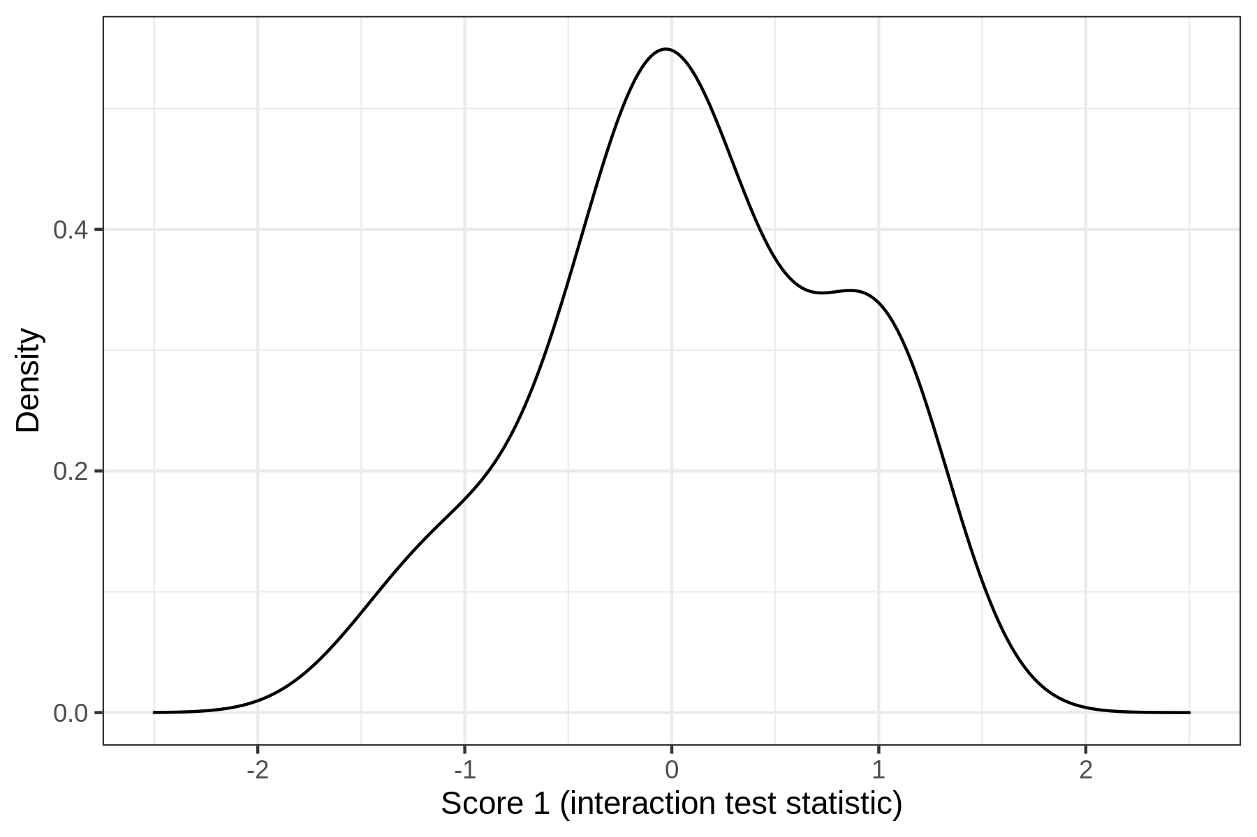
Interaction test statistics (score 1)
Interaction on log-odds scale: harder to optimize
Surprising difference between risk-difference (previous slide) and odds-ratio scale different
→ But still similar trends for teams rank order

Slide 15
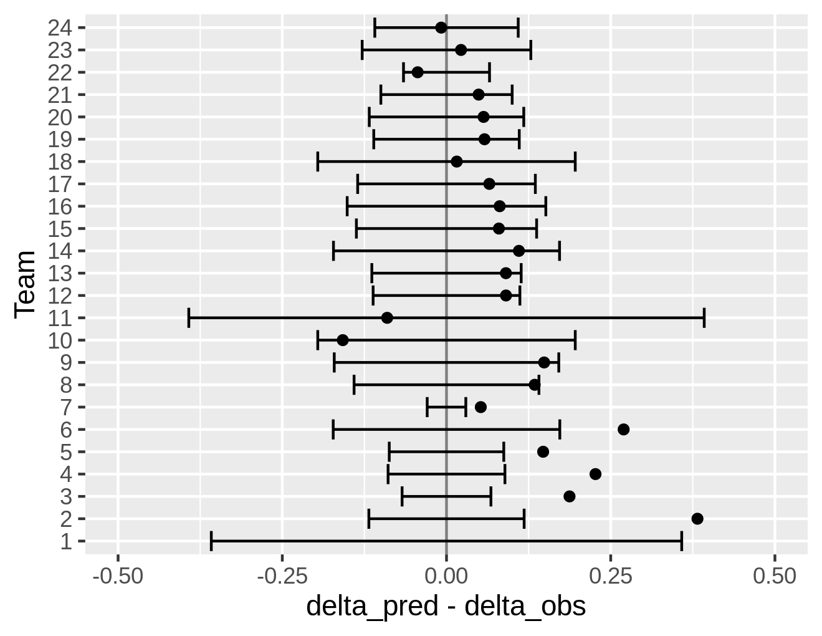
Quality of predictions (score 2)
Plot of difference
delta_predicted - delta_observed
Overestimation of treatment effect for most teams
95% prediction intervals cover observed value for most teams

Slide 16
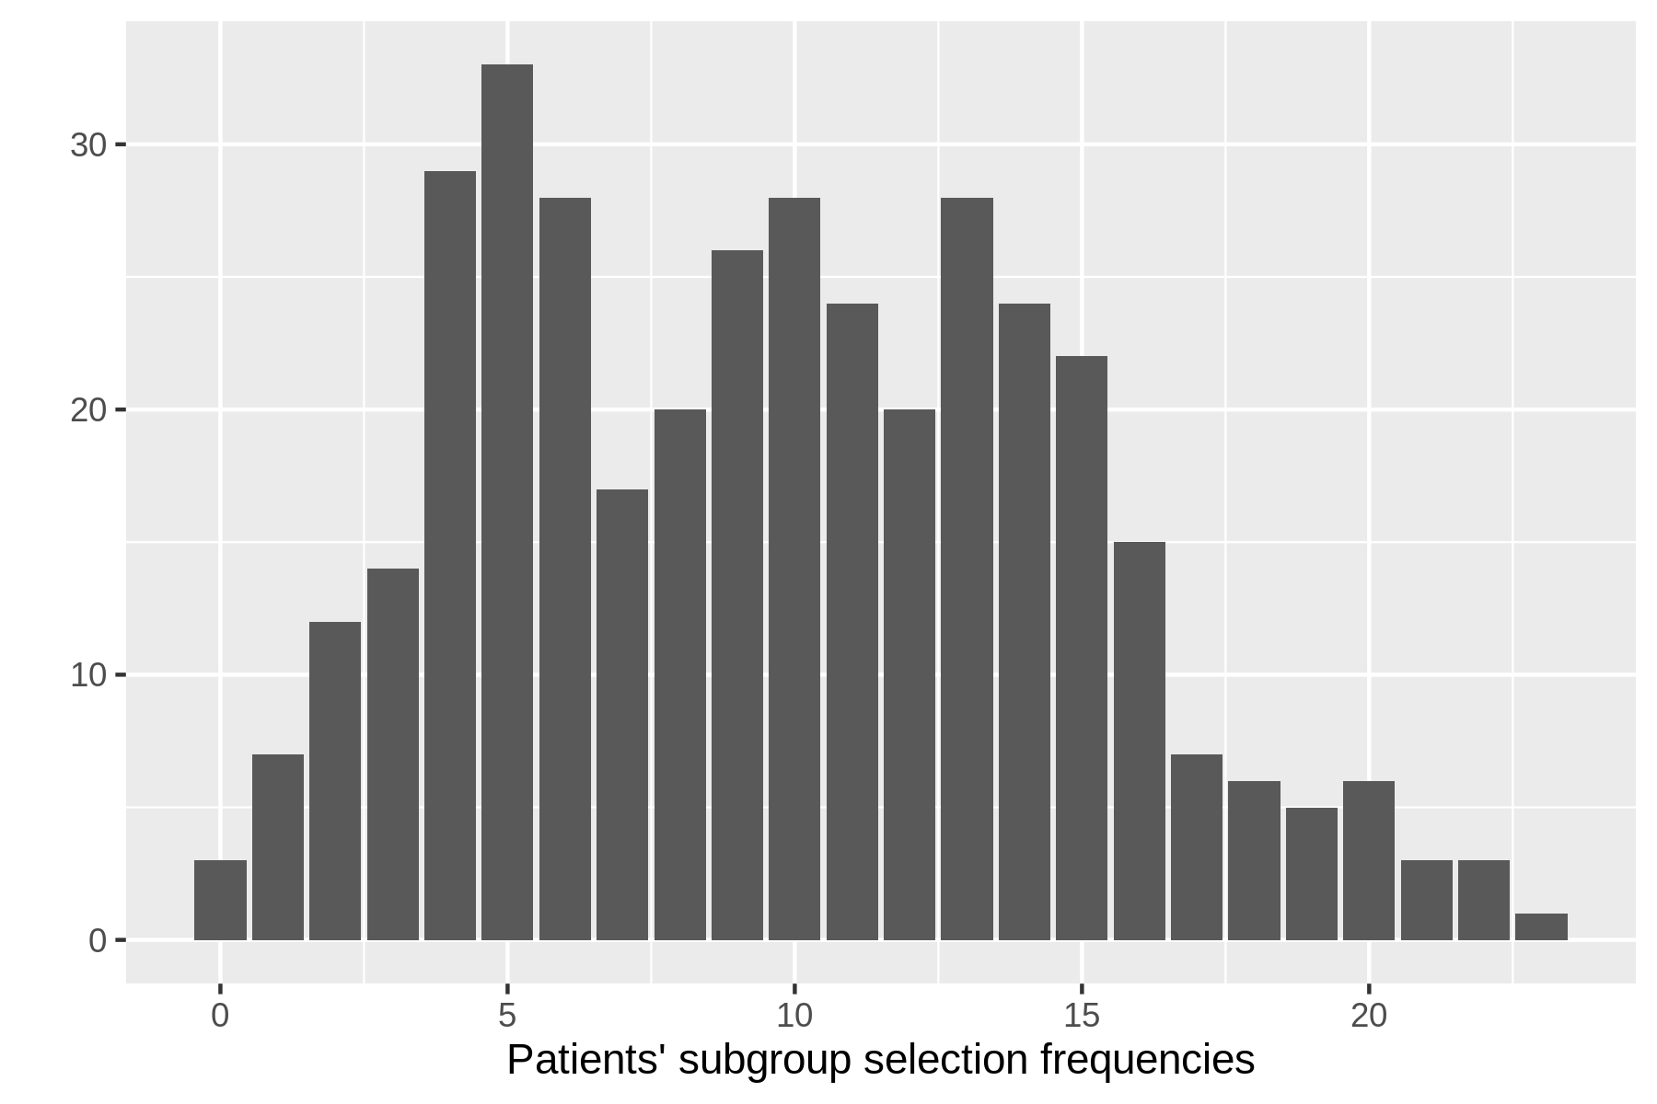
Subgroup selection on patient level
How many teams selected each patient to be part of their subgroup?
Examples
  3 patients were selected by no team to be part of their subgroup
  1 patient was selected by 23 teams
  33 patients were part of 5 teams’ subgroups

Slide 17
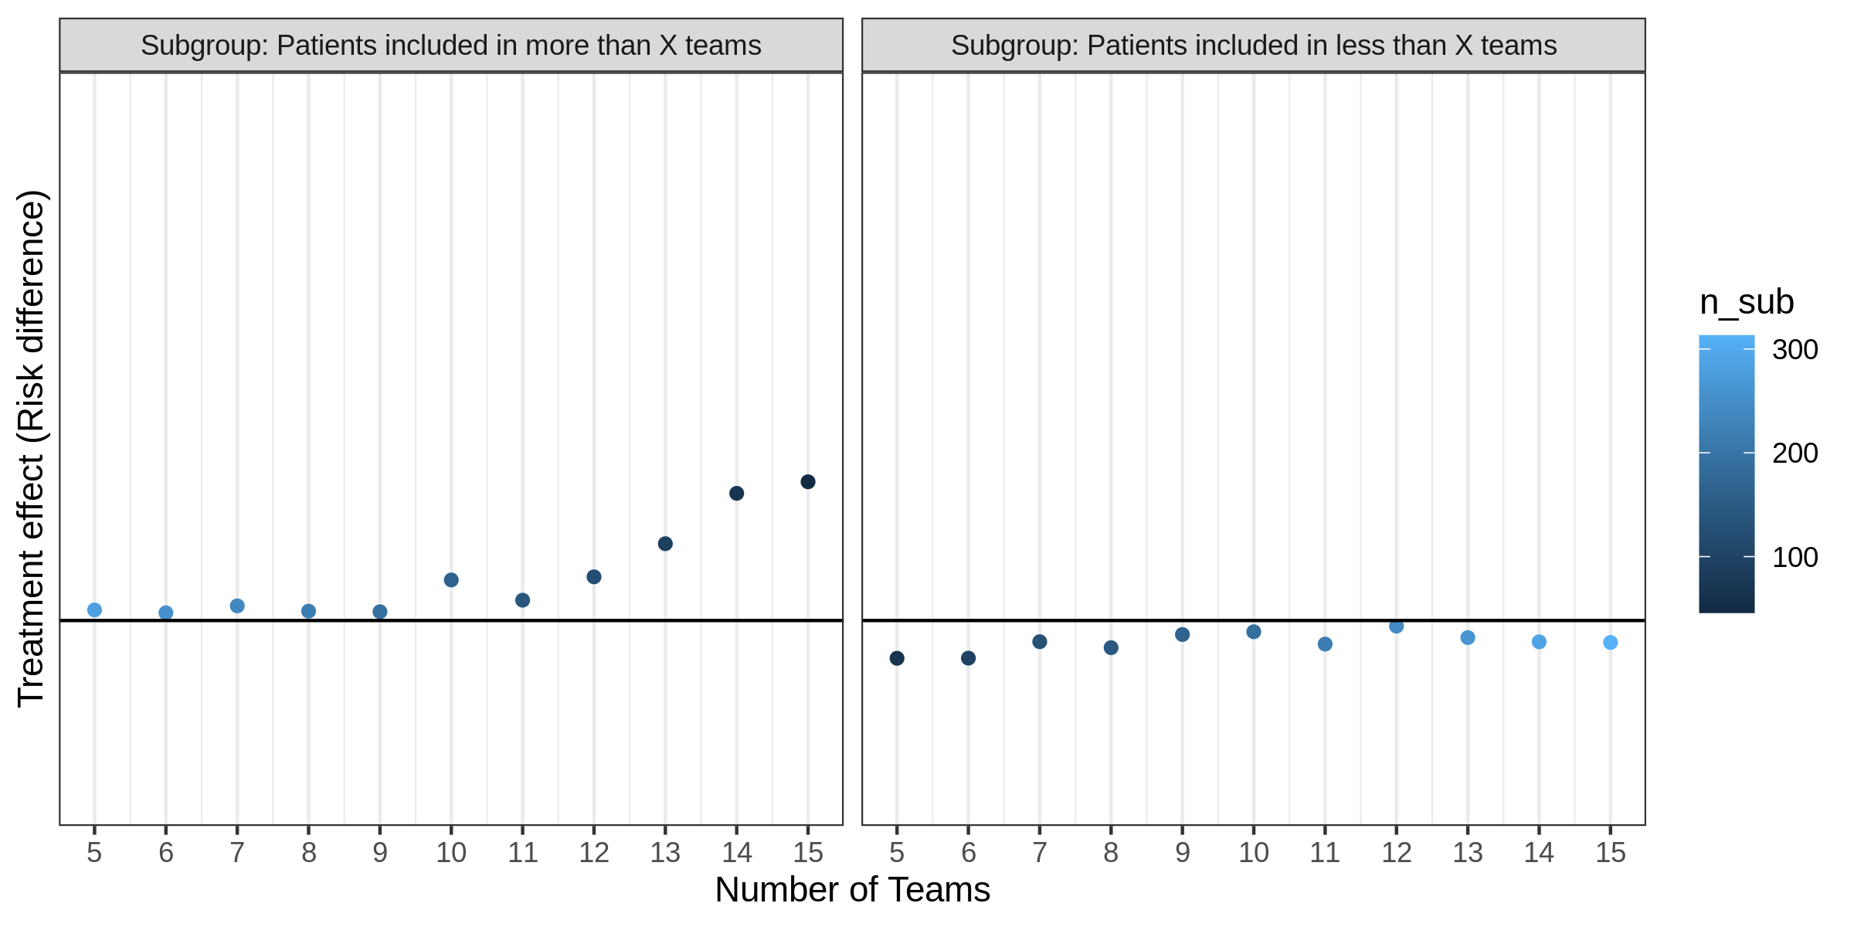
Super-responder (or lousy-responder) subgroups based on team-votes
Overall

Slide 18
Methods conclusions
Methods used by top 5 teams
  Model-based partitioning (MOB)
  LASSO on subgroup variables (pre-defined splits based on quantiles)
  Dose-response modelling with Bayesian shrinkage priors for variable selection
  → Thresholding of identified variables
  Subgroup discovery based machine learning method (pysubgroup)
  Super-Learner + LASSO for var-selection → Thresholding of identified variables
No clear conclusions on subgroup workflow or specific methods performing better or worse
  subgroup identification usually a “mix of methods” hard to categorize
  tree/forest-based versus regression; bias-adjustment; model assessment

Slide 19
Conclusions: Subgroup Identification
"The hardest problem there is" (Steve Ruberg)
26 teams: access to the same data & information & worked on same task
→ quite different subgroups submitted across different teams
Most teams succeeded in finding subgroups with (moderately) increased treatment effect on new study
Magnitude smaller than expected on previous studies (regression to the mean)

Slide 20
Feedback on Subgroup Challenge
Feedback from participants was positive
A “different” way of training
  subgroup identification
  new software tools: onboarding on data science platform, Rmarkdown, git
Sense of community around the globe & collaboration
From feedback survey
  Do you think we should organize further data challenges in the future?
    Answers: 100% yes

Slide 22
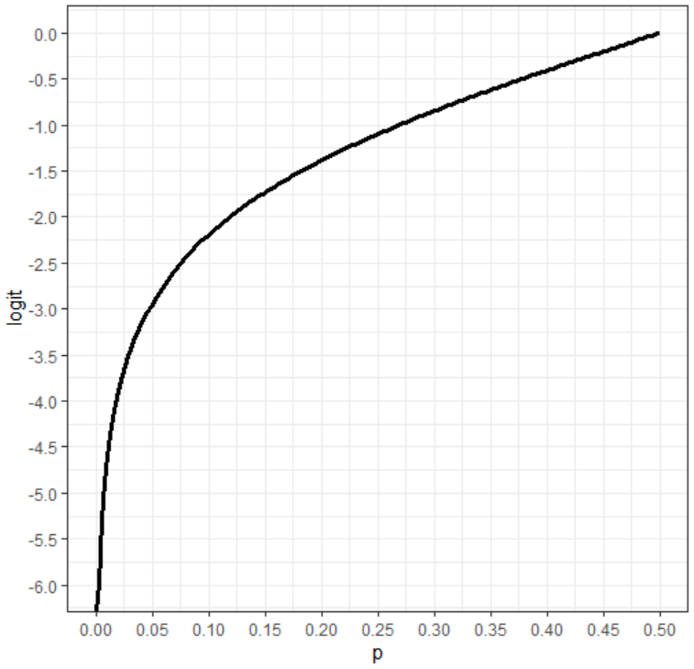
Logit scale
On logit scale better to “minimize” control outcome in subgroup, than optimize maximize treatment outcome in subgroup
Effect “dampened” by division through standard error (standard error of small proportions larger on logit scale)

