Slide 1
Data-Driven Subgroup Identification in Clinical Trials: the Good, the Bad, the Ugly
Paolo Eusebi¹, Xin Huang², Ilya Lipkovich³, Björn Bornkamp⁴, Nicole Krämer⁵, Bohdana Ratitch⁶ & David Svensson⁷
on behalf of the PSI Subgroup SIG
1 Modus Outcomes, 2, 3 Eli Lilly and Company, 4 , 5 Boehringer Ingelheim Gmbh & Co KG, 6 Bayer Inc., 7 AstraZeneca

Slide 2
Disclaimer
The opinions expressed in this presentation are those of the authors, and do not necessarily reflect the official policy of any of the sponsors listed.
All of it is merely methodological discussions under the PSI umbrella, regarding methods in the public domain.

Slide 3
Analyses that explicitly or implicitly incorporate data-driven elements vs confirmatory analysis
Classification | Scope | N subgroups
Confirmatory analysis | Subgroup identification by controlling the Type I error rate in phase 3 clinical trials. | 1-2
Exploratory subgroup evaluation | Assessment of consistency of treatment effect. | 10-20
Post-hoc subgroup evaluation | Assess post-hoc the treatment effect for regulatory inquiries, safety analyses, post-marketing activities, and assessment of heterogeneity in multi-regional studies. | 10-20
Subgroup discovery | Select the most promising subgroups with enhanced efficacy or desirable safety from a large pool of candidate subgroups to inform the design of future trials. | >100
Data-driven approaches
Lipkovich, Ilya, Alex Dmitrienko, and Ralph B D'Agostino Sr. "Tutorial in biostatistics: data‐driven subgroup identification and analysis in clinical trials." Statistics in medicine 36.1 (2017): 136-196.

Slide 4
Strategy & communication

Slide 5
What do you hear when you tell people that you work on subgroup detection?
Stop using these ad-hoc algorithms!
You will only generate spurious results with bad regulatory consequences!
You overfit!
Our trial succeeded!
We must show consistent results across subgroups!
Our trial failed! We must find a subgroup!
You will never be able to reproduce your results!

Slide 6
Communicate effectively about the methodology and handle expectations
Methodology is complex!
Educate stakeholders and guide them through the modeling choices using understandable and correct scientific language.
Do not skip key elements, do not overload with unnecessary technical elements.
Expectations are often high!
Handle carefully the expectations of the stakeholders, discuss implications of the planned analyses beforehand.
Do not inflate expectations.
Bornkamp B., Krämer N., Lipkovich I., Ratitch B., Svensson D. on behalf of the EFSPI Subgroup SIG. "All the things I wish I had known before I tried to detect a subgroup." EFSPI 20XX.

Slide 7
Put things in the full picture and influence the organization
Always start with the why
Have in mind the cascade of consequences and implications
Understand the regulatory and HTA framework by knowing guidelines and learning from case studies.
EMA has a specific guideline
FDA does not have a specific guideline on subgroups but:
  other guidelines provides perspectives and principles (FDA 2019 Enrichment Strategies; FDA 2021 Adjusting for Covariates);
  several studies explored relevant case studies with regulatory implications in different therapeutic areas.
Amatya, Anup K., et al. "Subgroup analyses in oncology trials: regulatory considerations and case examples." Clinical Cancer Research 27.21 (2021): 5753-5756.

Slide 8
Methodology

Slide 9
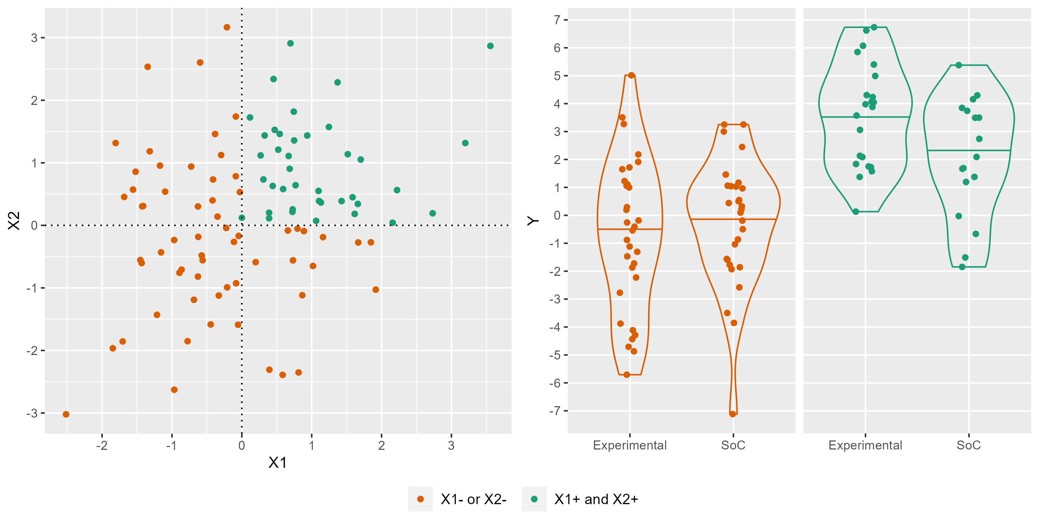
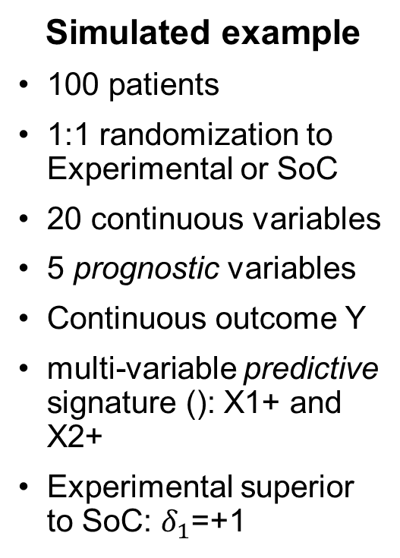
Mind the limitations of basic methods like univariate regressions with interaction test
Simulated example
100 patients
1:1 randomization to Experimental or SoC
20 continuous variables
5 prognostic variables
Continuous outcome Y
multi-variable predictive signature (): X1+ and X2+
Experimental superior to SoC: $δ_{1}$=+1

Slide 10
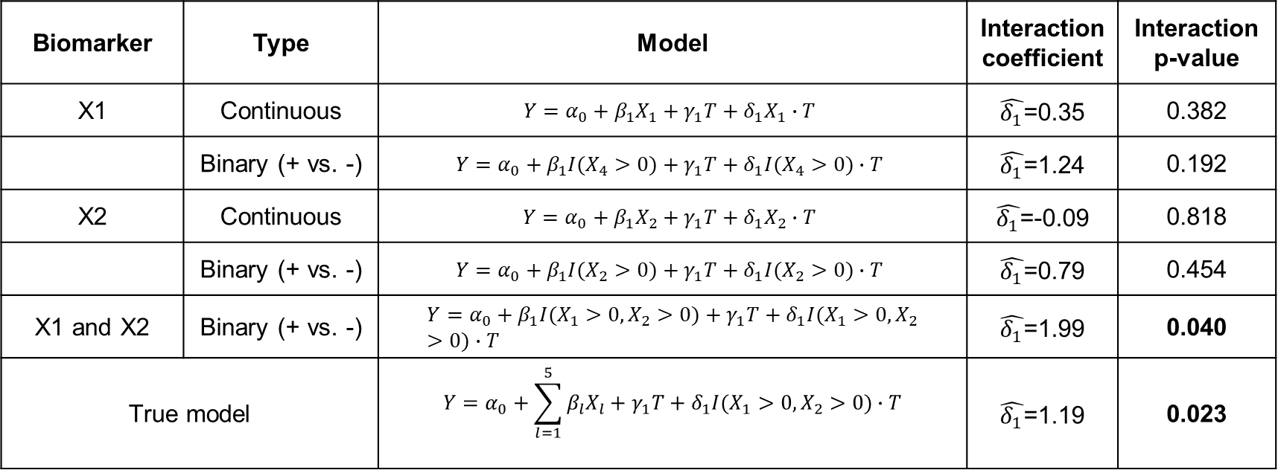
Mind the limitations of basic methods like univariate regressions with interaction test
Simplistic methods lead to spurious findings and biased results
Biomarker | Type | Model | Interaction coefficient | Interaction p-value
X1 | Continuous | $$Y={α_{0}+β_{1}X}_{1}+γ_{1}T+{δ_{1}X}_{1}∙T$$ | $\hat{δ_{1}}$=0.35 | 0.382
 | Binary (+ vs. -) | $$Y={α_{0}+β_{1}I(X}_{4}>0)+γ_{1}T+{δ_{1}I(X}_{4}>0)∙T$$ | $\hat{δ_{1}}$=1.24 | 0.192
X2 | Continuous | $$Y={α_{0}+β_{1}X}_{2}+γ_{1}T+{δ_{1}X}_{2}∙T$$ | $\hat{δ_{1}}$=-0.09 | 0.818
 | Binary (+ vs. -) | $$Y={α_{0}+β_{1}I(X}_{2}>0)+γ_{1}T+{δ_{1}I(X}_{2}>0)∙T$$ | $\hat{δ_{1}}$=0.79 | 0.454
X1 and X2 | Binary (+ vs. -) | $$Y={α_{0}+β_{1}I(X}_{1}>0, X_{2}>0)+γ_{1}T+{δ_{1}I(X}_{1}>0, X_{2}>0)∙T$$ | $\hat{δ_{1}}$=1.99 | 0.040
True model | True model | $$Y=α_{0}+\sum_{l=1}^{5}{β_{l}X_{l}}+γ_{1}T+{δ_{1}I(X}_{1}>0, X_{2}>0)∙T$$ | $\hat{δ_{1}}$=1.19 | 0.023
Lipkovich, Ilya, Alex Dmitrienko, and Ralph B D'Agostino Sr. "Tutorial in biostatistics: data‐driven subgroup identification and analysis in clinical trials." Statistics in medicine 36.1 (2017): 136-196.

Slide 11
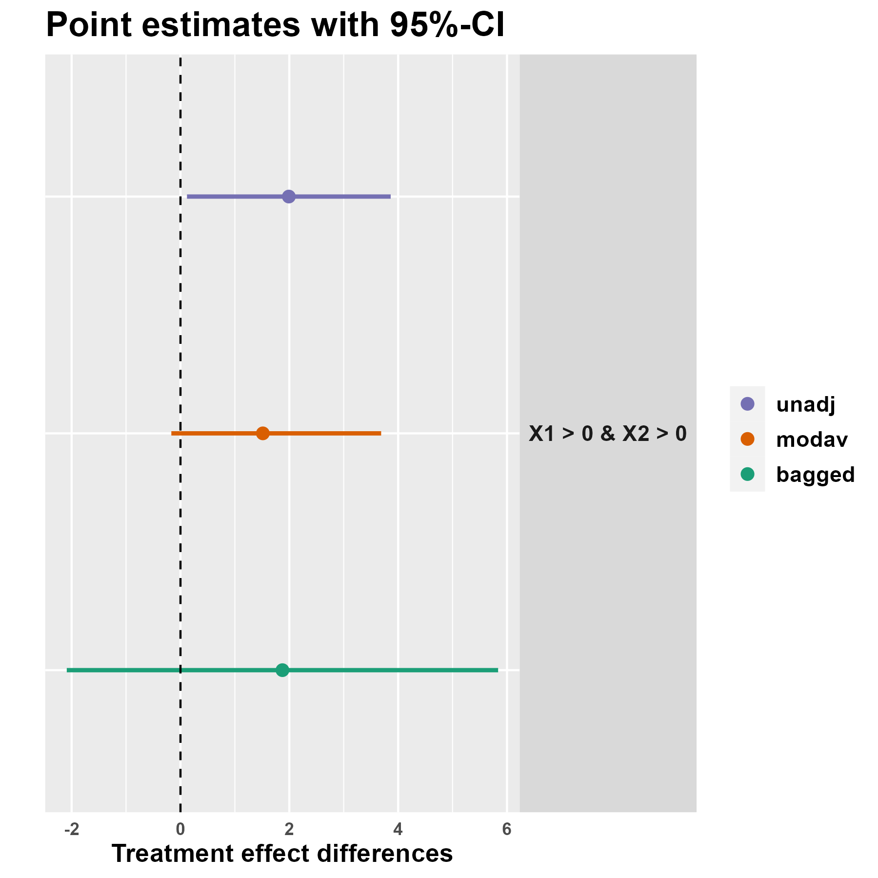
Prevent data overfitting as well as selection bias
Subgroup analysis as a model selection problem.
Prevent overfitting/selection bias.
Example: model averaging and bagging
Caution: tools primarily developed for a small number of pre-specified subgroups.
More to come later in the Yuejia presentation about honest estimates.
Ballarini, Nicolas M., et al. "subtee: An R Package for Subgroup Treatment Effect Estimation in Clinical Trials." Journal of Statistical Software 99 (2021): 1-17.

Slide 12
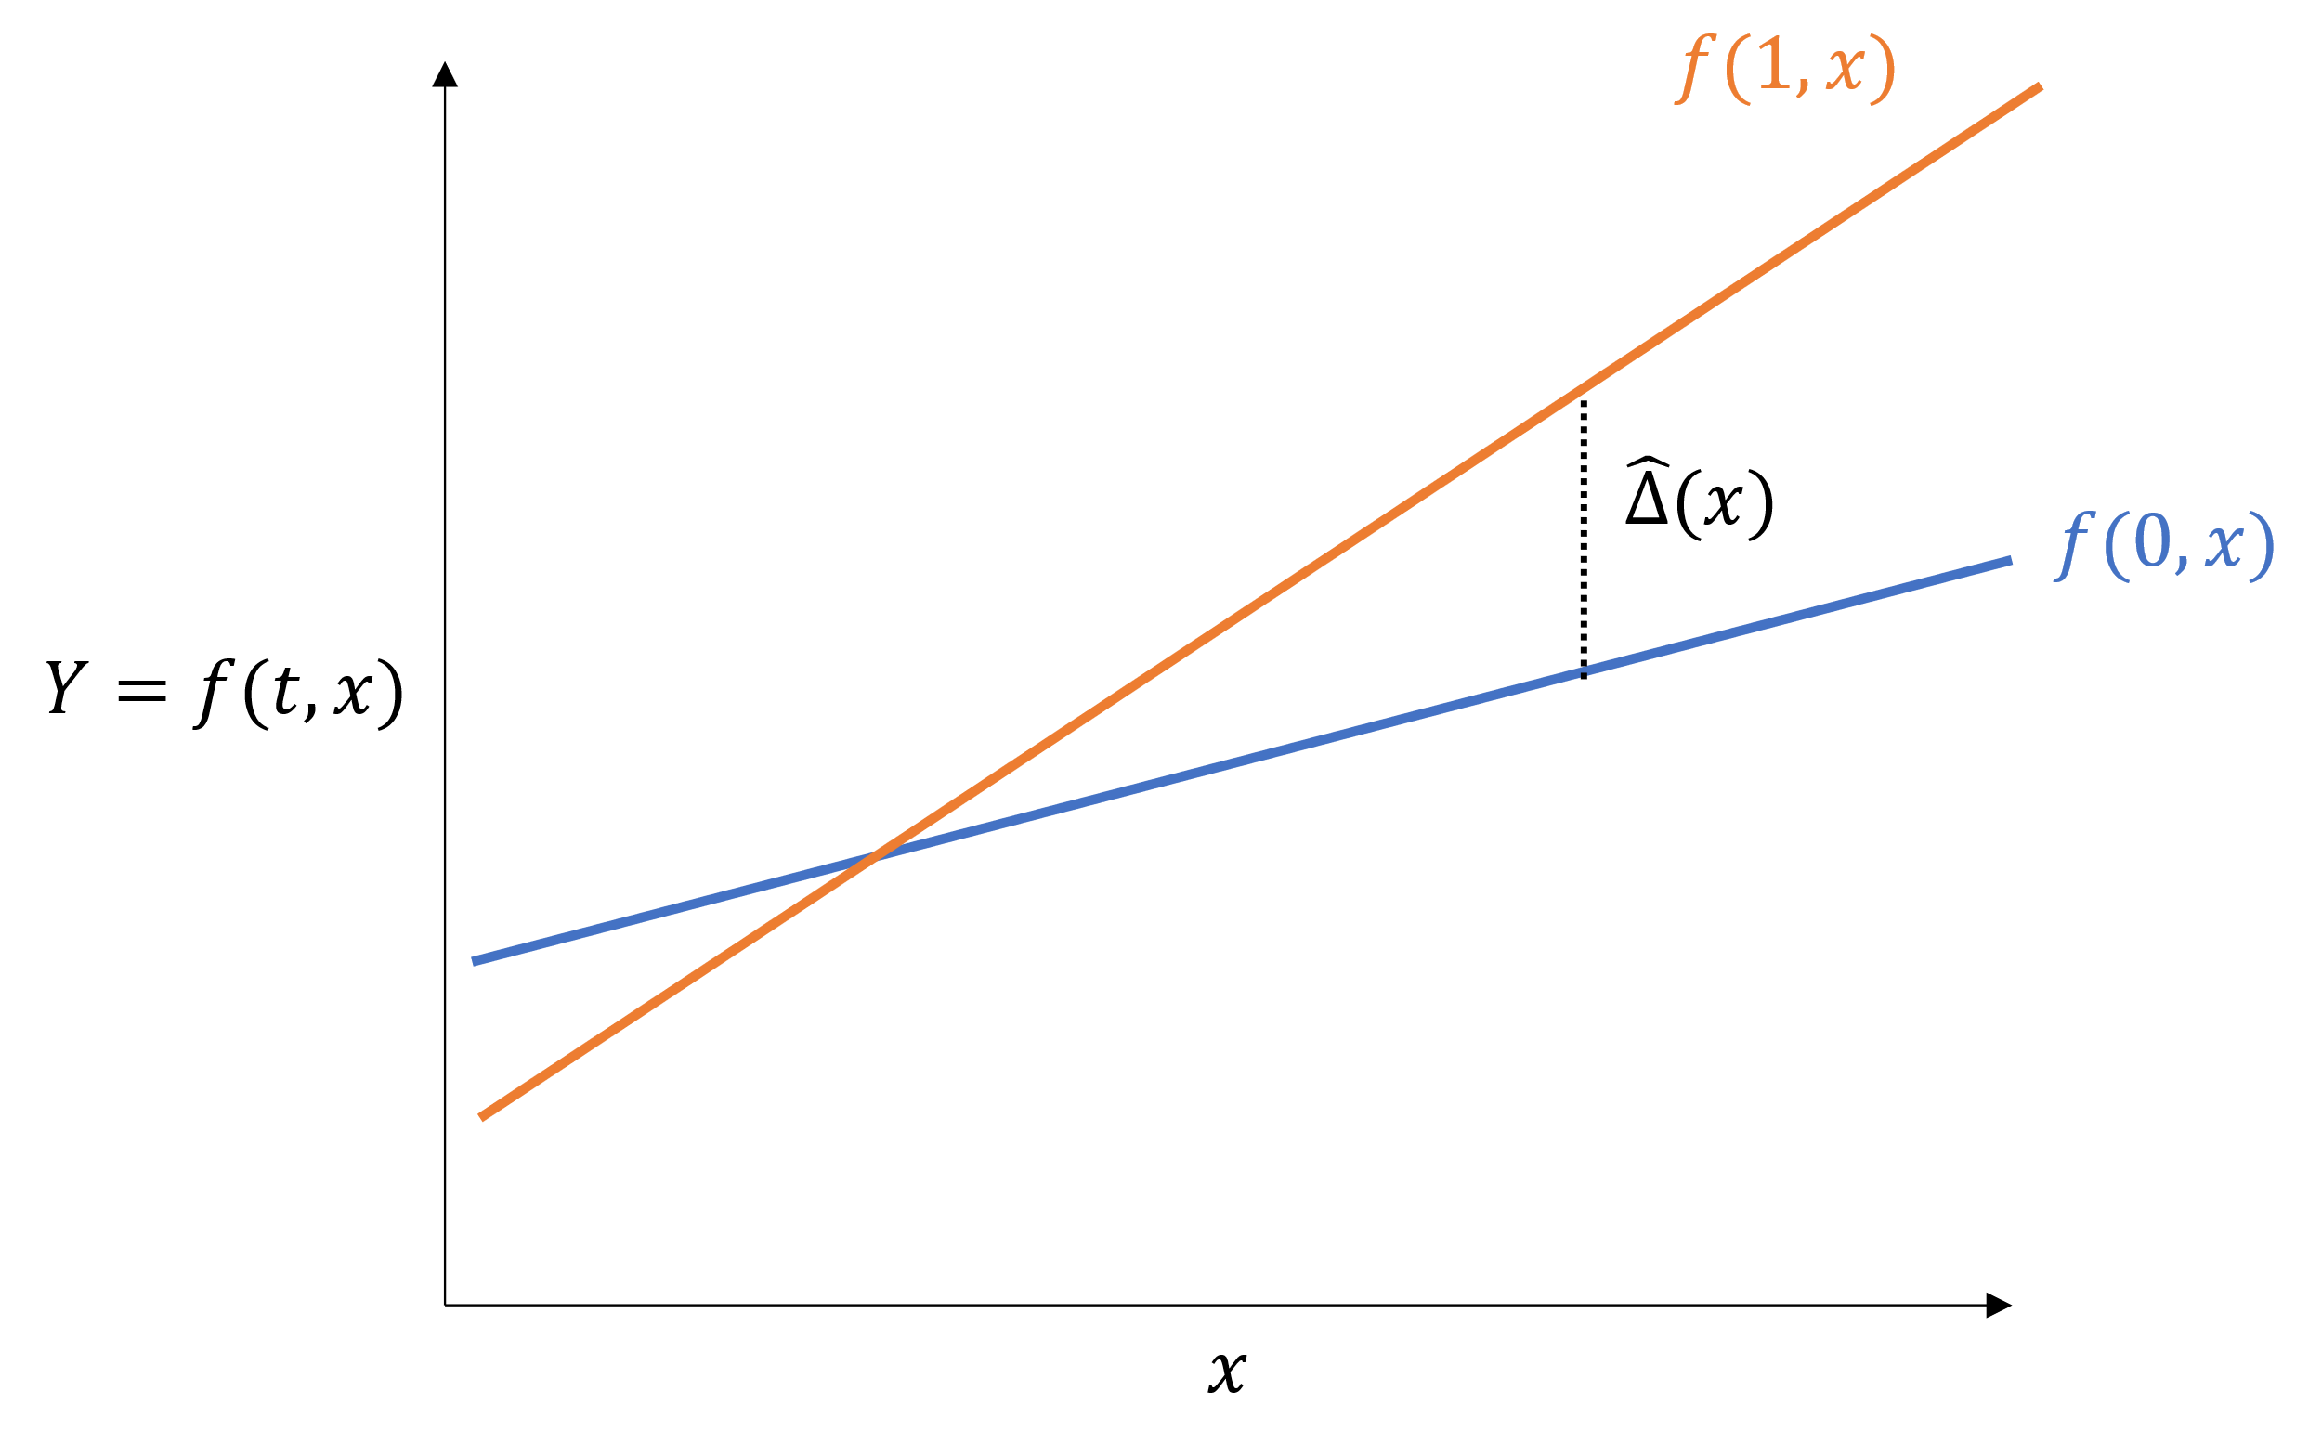
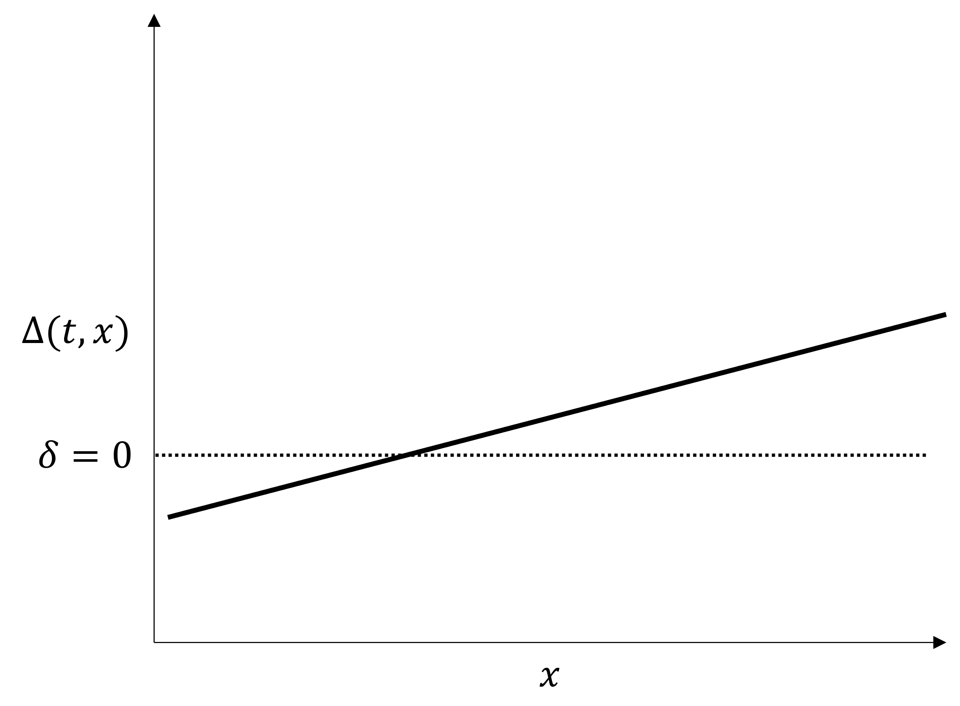
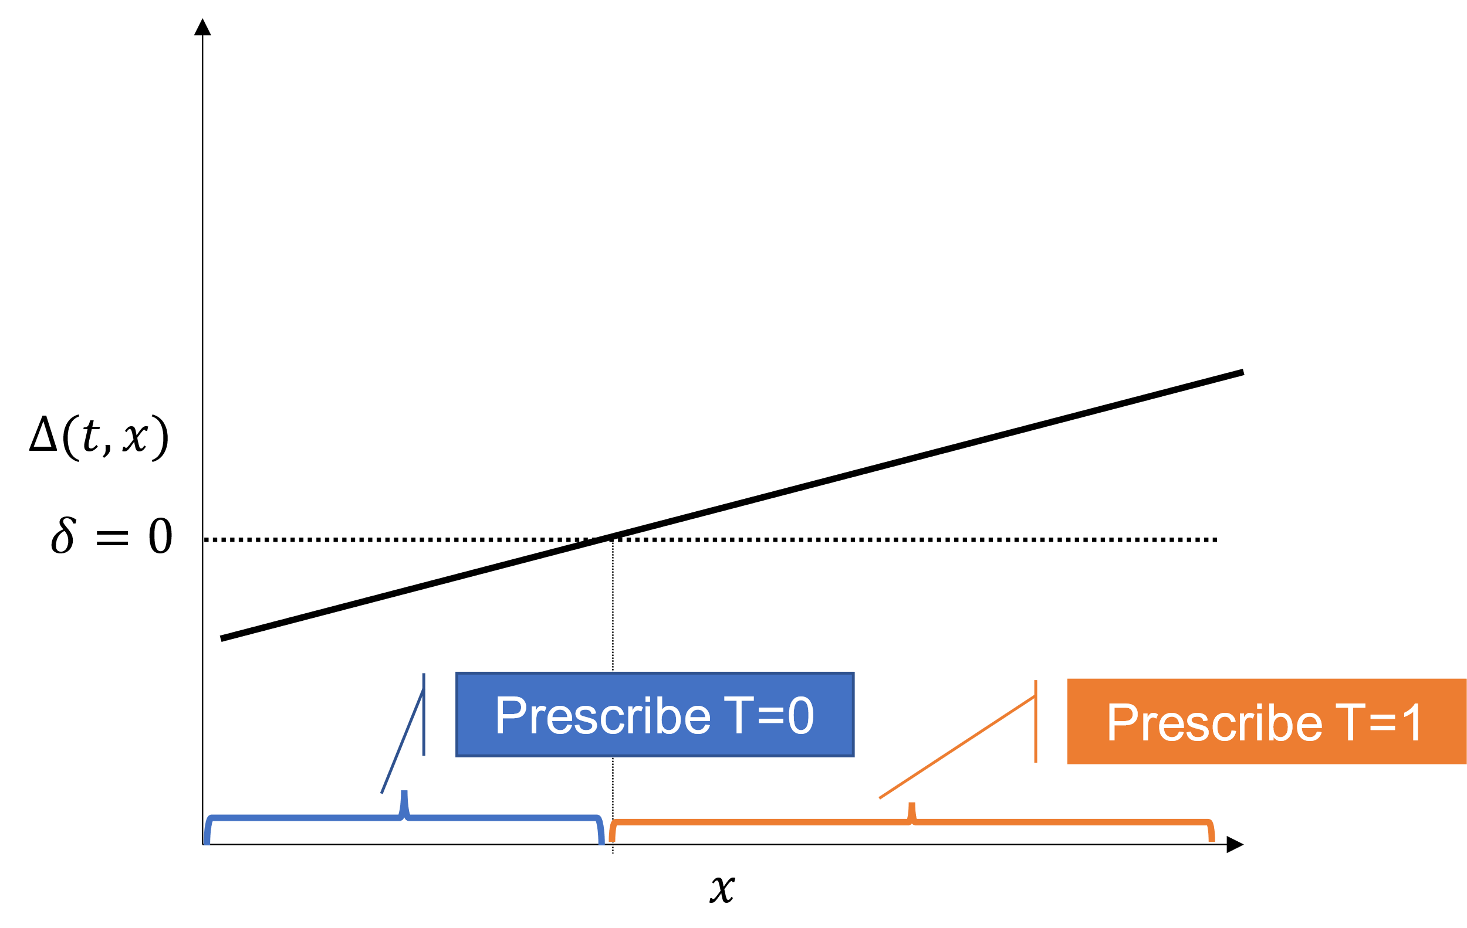
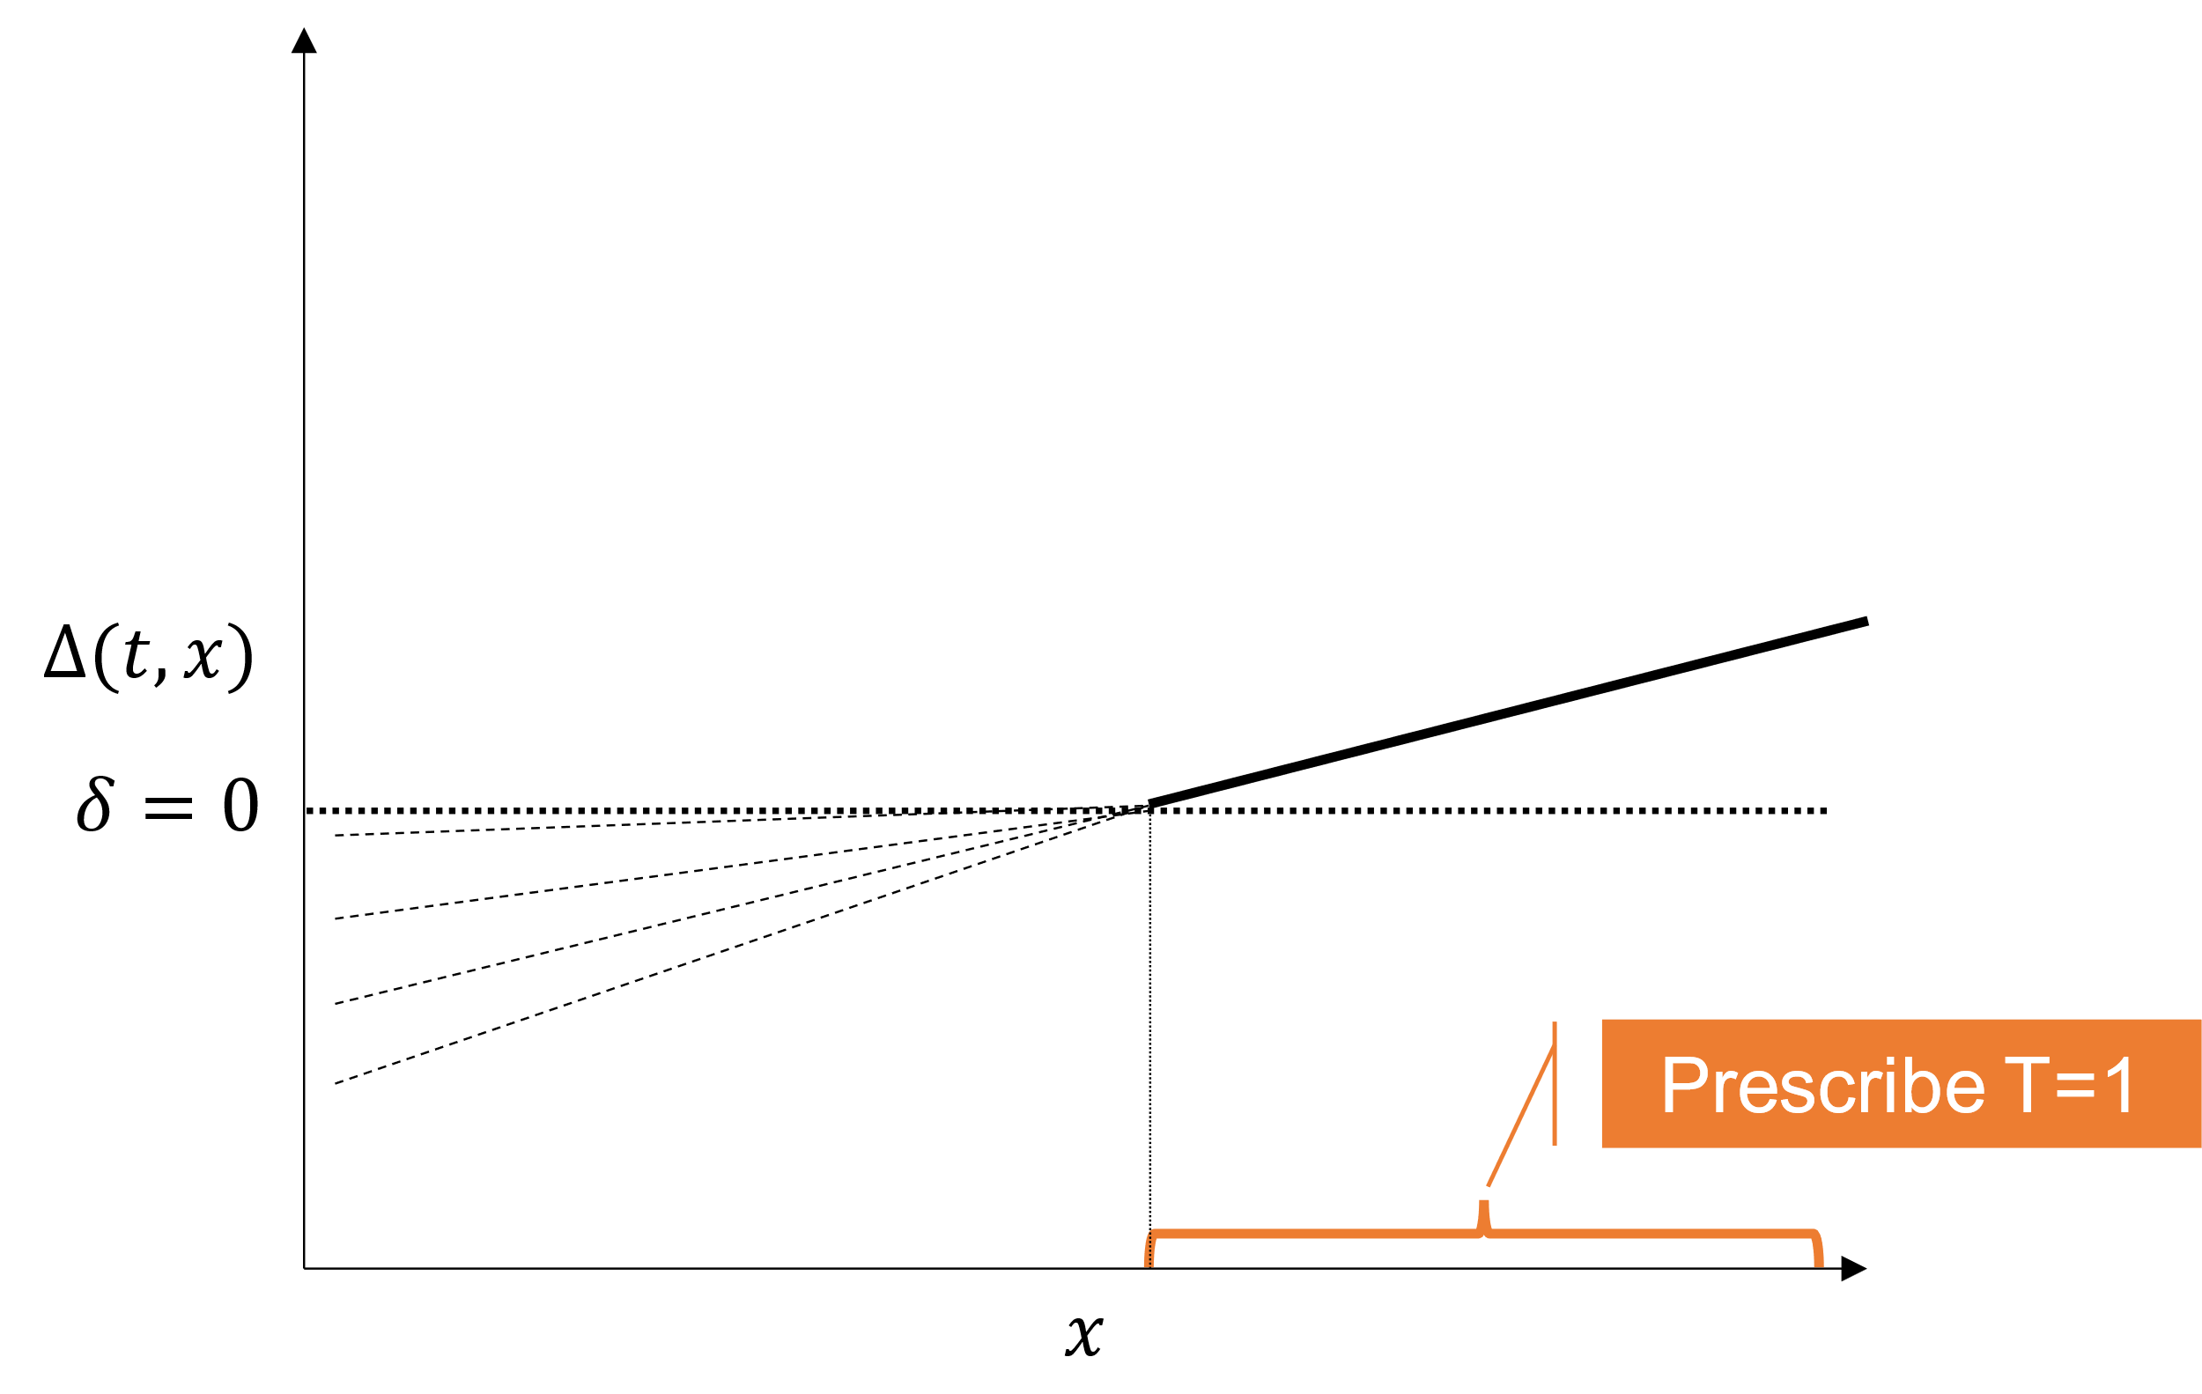
Apply the right methodological framework to the research question of interest
Global outcome modeling
Global treatment effect modeling
Individual treatment regime modeling
Global treatment effect modeling
Lipkovich, Ilya & Alex Dmitrienko "Overview of recent innovations in subgroup identification for personalized medicine and related methods." PSI Subgroup analysis SIG Webinar: Modern approaches to subgroup identification 2021

Slide 13





Apply the right methodological framework to the research question of interest
Global outcome modeling
Scope: global evaluation of outcome as function of prognostic and predictive variables.
Methods: Virtual twins/ FindIT / STIMA / Bayesian approaches etc.
$$f(1, x)$$
$$\hat{∆}(x)$$
$$f(0, x)$$
$$Y=f(t, x)$$
$$x$$
Lipkovich, Ilya & Alex Dmitrienko "Overview of recent innovations in subgroup identification for personalized medicine and related methods." PSI Subgroup analysis SIG Webinar: Modern approaches to subgroup identification 2021

Slide 14
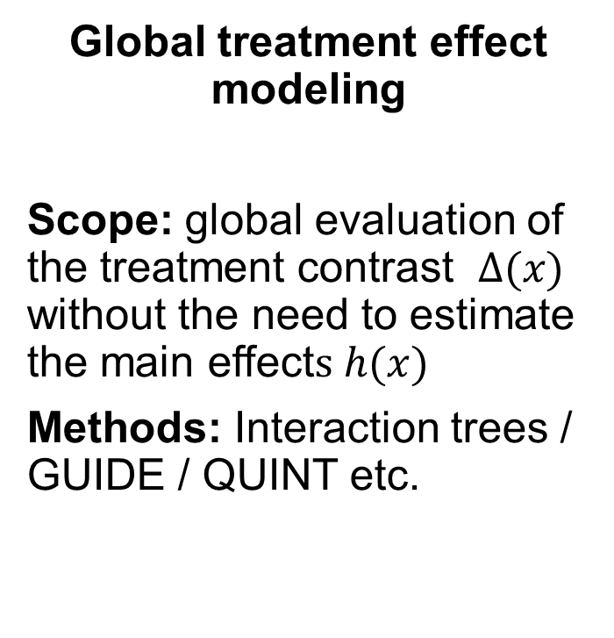


Apply the right methodological framework to the research question of interest
Global treatment effect modeling
Scope: global evaluation of the treatment contrast $∆(x)$ without the need to estimate the main effect$s h(x)$
Methods: Interaction trees / GUIDE / QUINT etc.
$$∆(t, x)$$
$$δ=0$$
$$x$$
Lipkovich, Ilya & Alex Dmitrienko "Overview of recent innovations in subgroup identification for personalized medicine and related methods." PSI Subgroup analysis SIG Webinar: Modern approaches to subgroup identification 2021

Slide 15

Apply the right methodological framework to the research question of interest
Individual treatment regime modeling
Scope: evaluation of the treatment contrast ∆(𝑥) without the need to estimate the main effects ℎ(𝑥)
Methods: OWL / A-Learning etc.
$$∆(t, x)$$
$$δ=0$$
Prescribe T=0
Prescribe T=1
Personalized medicine!
The right treatment for a given patient
$$x$$
Lipkovich, Ilya & Alex Dmitrienko "Overview of recent innovations in subgroup identification for personalized medicine and related methods." PSI Subgroup analysis SIG Webinar: Modern approaches to subgroup identification 2021

Slide 16
Apply the right methodological framework to the research question of interest
Local modeling
Scope: evaluation of the treatment contrast ∆(𝑥) without the need to estimate the main effects ℎ(𝑥)
Methods: SIDES / SIDEScreen etc.
$$∆(t, x)$$
$$δ=0$$
Prescribe T=1
Personalized medicine!
The right patient for a given treatment
$$x$$
Lipkovich, Ilya & Alex Dmitrienko "Overview of recent innovations in subgroup identification for personalized medicine and related methods." PSI Subgroup analysis SIG Webinar: Modern approaches to subgroup identification 2021

Slide 17
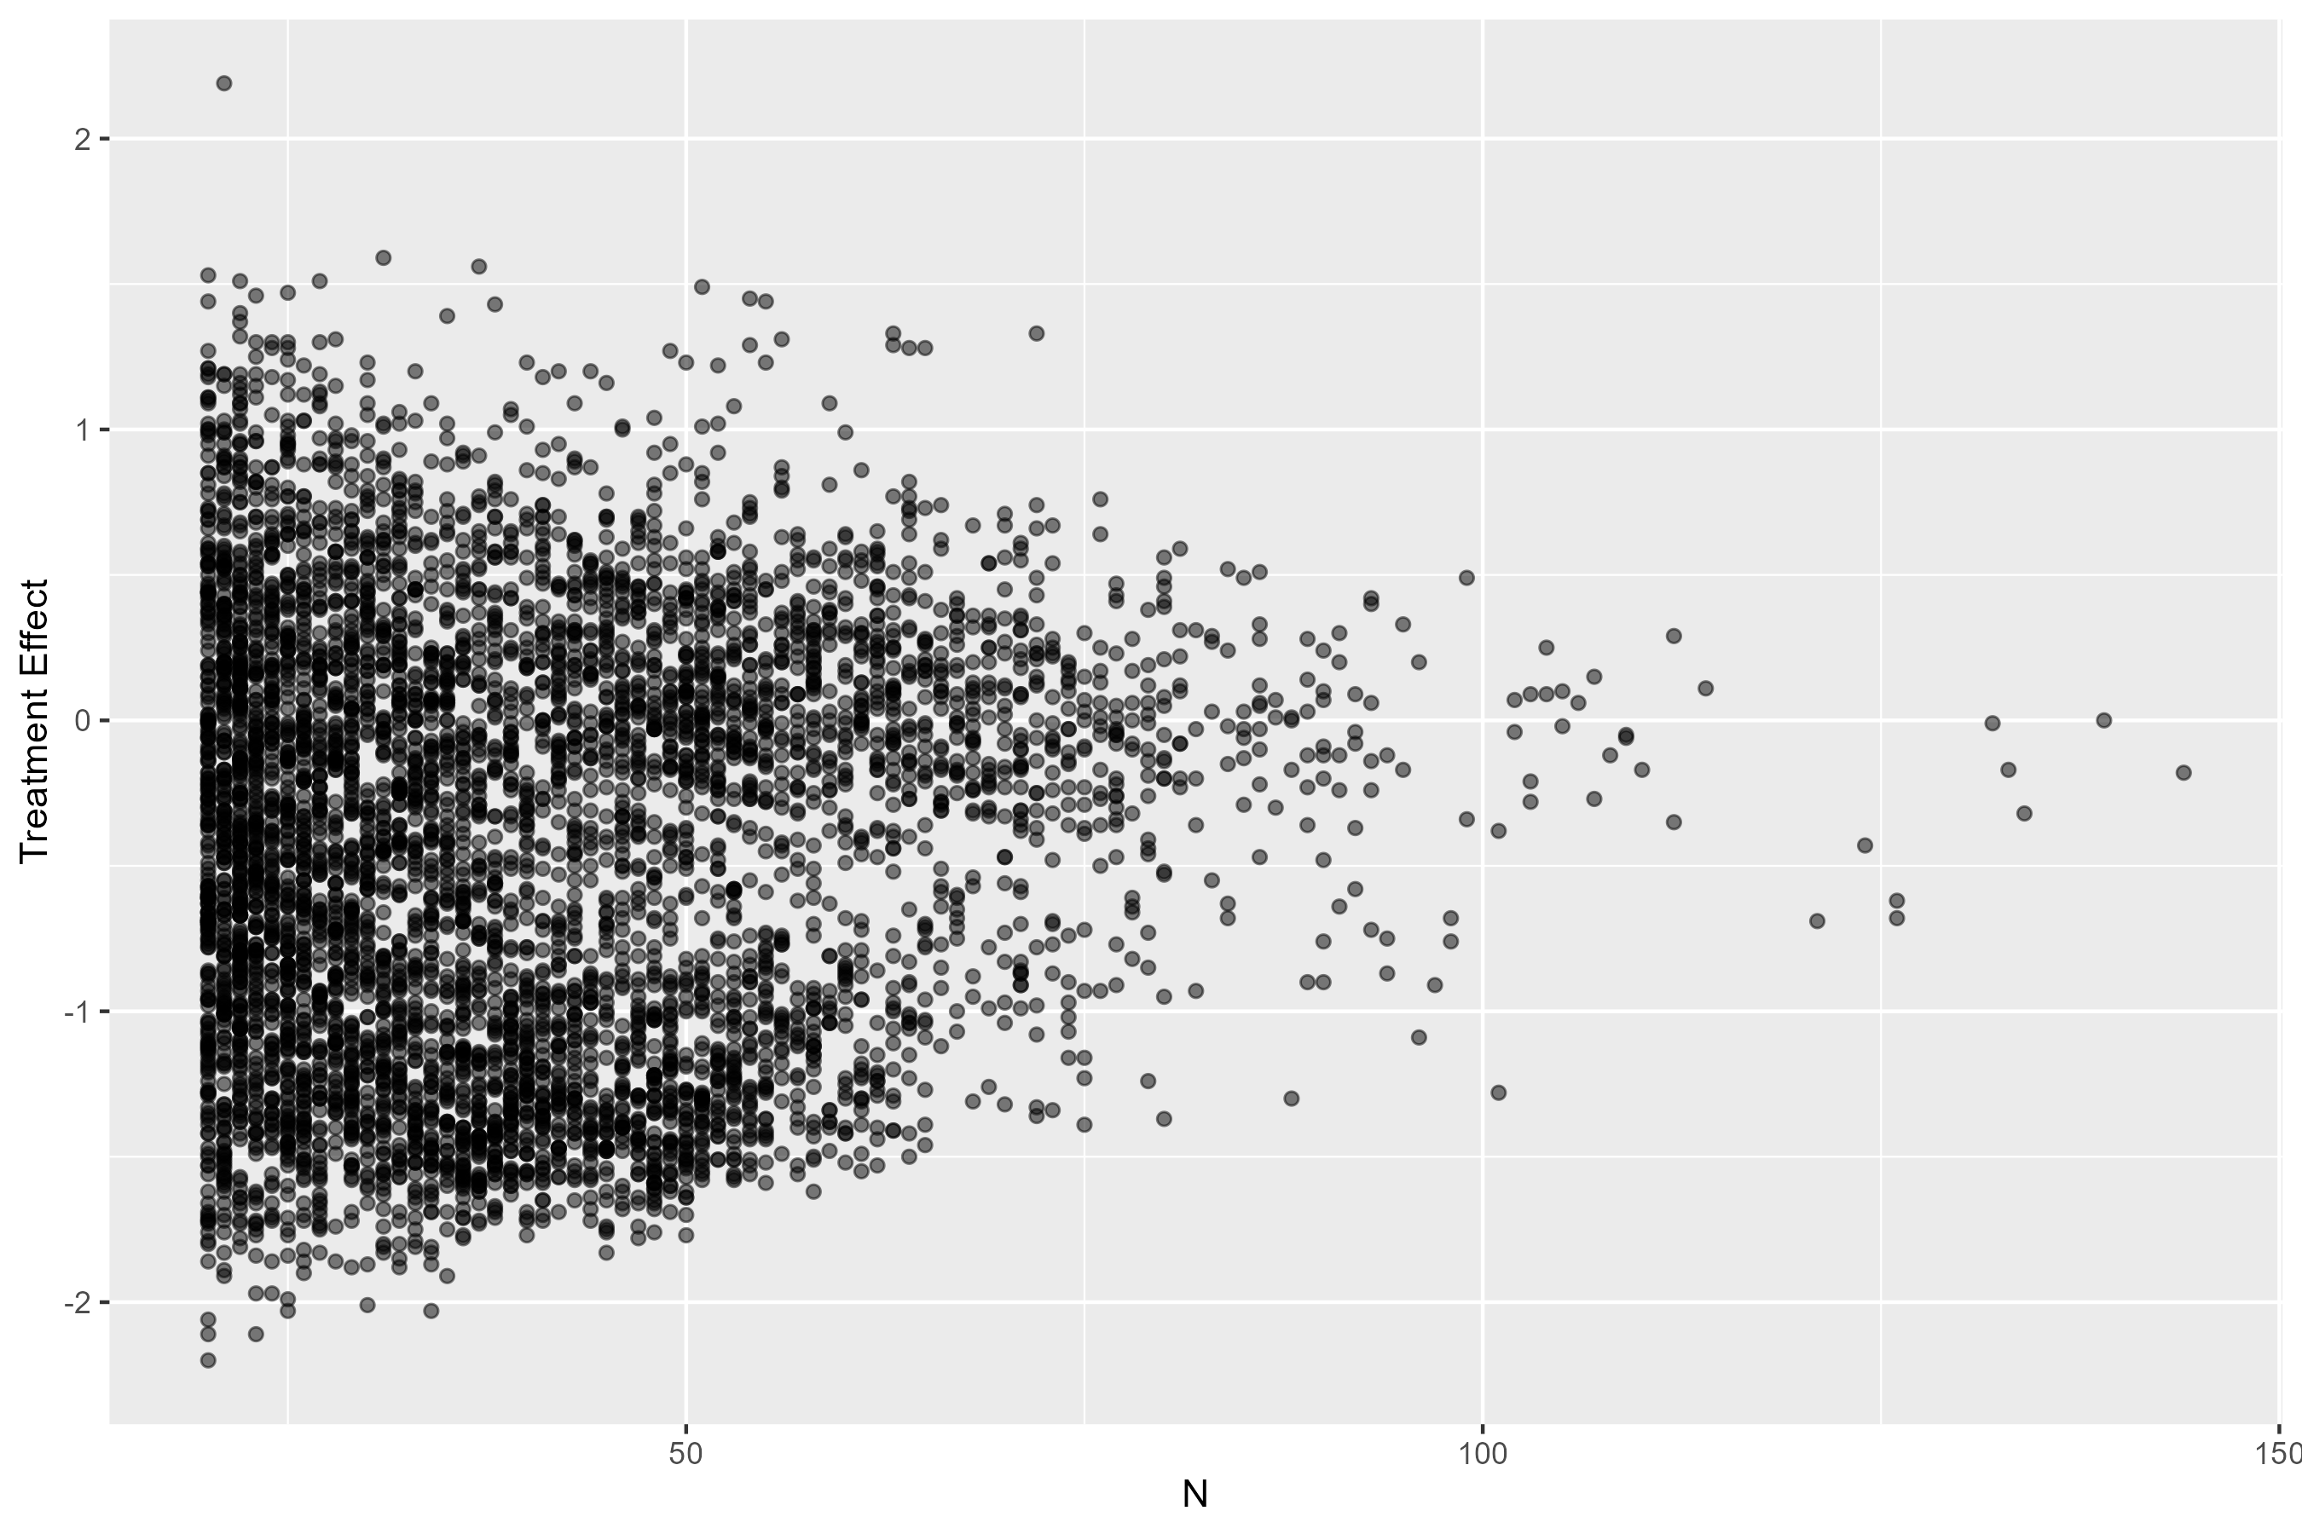
Evaluate the false discovery rate for the entire subgroup search strategy
Example: 20 binary biomarkers, up to 3 level combinations (e.g., X1+, X2+, X3-)
Data-driven does not imply lack of multiplicity control
False positive rate should be controlled at least in a weak sense
Resampling-based approaches can be useful

Slide 18
Use multiplicity adjustment with complexity control: Adaptive SIDES screen as an example
Adaptive SIDES screen is a two-stage recursive partitioning algorithm:
  Stage 1: prescreening of biomarkers based on variable importance
  Stage 2: search in the pre-screened biomarker space
Complexity is controlled at different levels:
  Minimum subgroup size
  Maximal number of covariates that can be used in defining the subgroup (multi-variable signature “length”)
  Number of promising subgroups retained for each parent
  Child-to-parent p-value ratio
  Penalty for local multiple adjustment.
Multiplicity is adjusted
Lipkovich, Ilya, Alex Dmitrienko, and Ralph B D'Agostino Sr. "Tutorial in biostatistics: data‐driven subgroup identification and analysis in clinical trials." Statistics in medicine 36.1 (2017): 136-196.

Slide 19
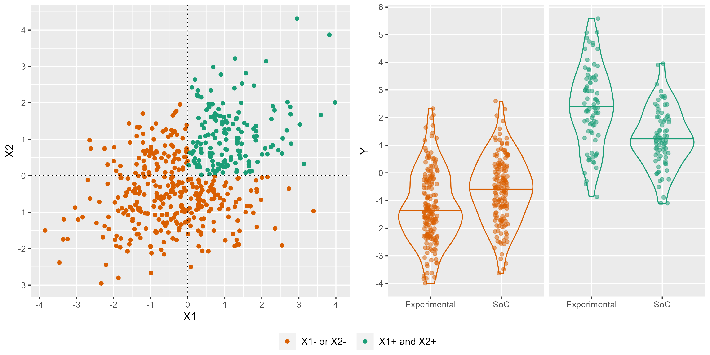
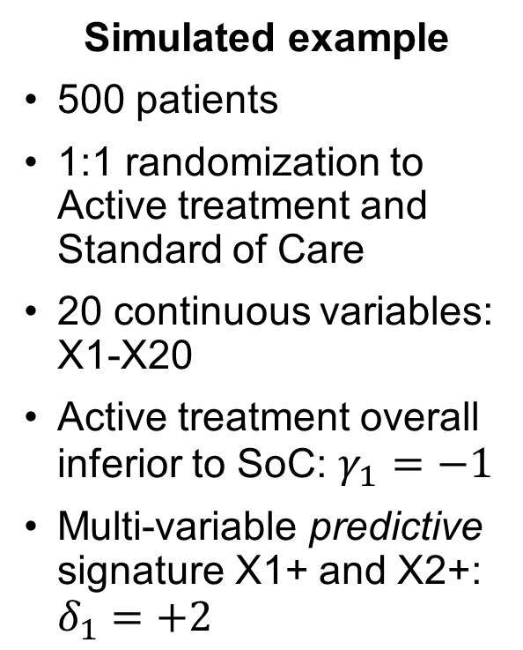
Use multiplicity control in conjunction with complexity control: Adaptive SIDEScreen
Simulated example
500 patients
1:1 randomization to Active treatment and Standard of Care
20 continuous variables: X1-X20
Active treatment overall inferior to SoC: $γ_{1}=−1$
Multi-variable predictive signature X1+ and X2+: $δ_{1}=+2$

Slide 20
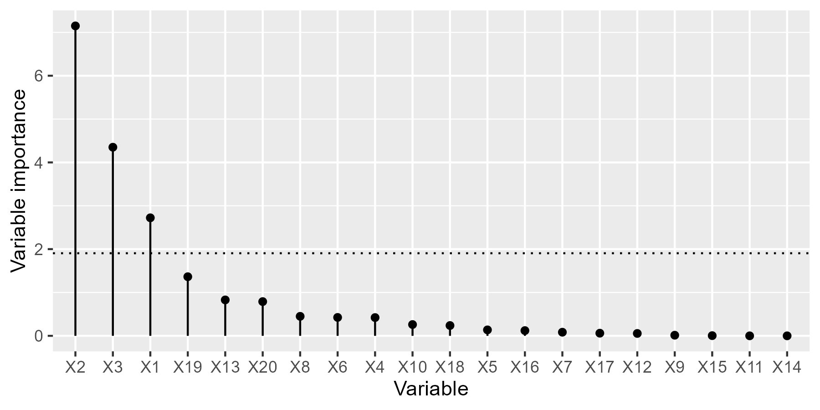
Use multiplicity control in conjunction with complexity control: Adaptive SIDEScreen
Stage 1: prescreening of biomarkers based on variable importance
X1, X2, and X3 above the threshold go to Stage 2
Null mean + null SD

Slide 21
Use multiplicity control in conjunction with complexity control: Adaptive SIDEScreen
Stage 2: final search
Best signature X2>0.13, X1>-0.03 (adjusted p-value=0.002)
X1>0.92, X2>0.15
N=82
X1>0.92
N=125
X1>0.92, X3>0.23
N=87
X1>0.92, X3>0.23, X2>0.39
N=57
X2>0.13, X1>-0.03
N=150
X2>0.13, X1>-0.03, X3>-0.15
N=120
Overall population
N=500
X2>0.13
N=229
X2>0.13, X3>0.43
N=125
X2>0.13, X3>0.43, X1>-0.04
N=95
X3>0.45, X1>-0.29
N=145
X3>0.45 AND X1>-0.29 AND X2>0.09
N=102
X3>0.45
N=204
X3>0.45, X2>0.09
N=126
X3>0.45 AND X2>0.09 AND X1>0.09
N=96

Slide 22

Use multiplicity control in conjunction with complexity control: Adaptive SIDEScreen
Procedure parameters
Minimum subgroup size = 30
Maximal number of covariates that can be used in defining the subgroup (biomarker signature “length”) = 3
Number of promising subgroups retained for each parent = 5
Child-to-parent p-value ratio = 0.5.
Full penalty for local multiple adjustment.
Take home messages
The true predictive signature (X1>0, X2>0) was estimated quite well (X2>0.13, X1>-0.03 ).
Success factors: strong true predictive signature, flexible complexity control, large sample size.

Slide 23
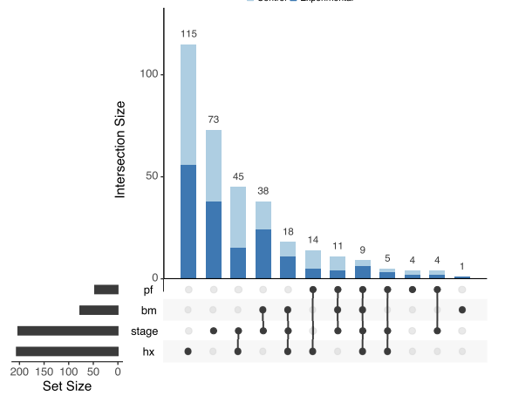
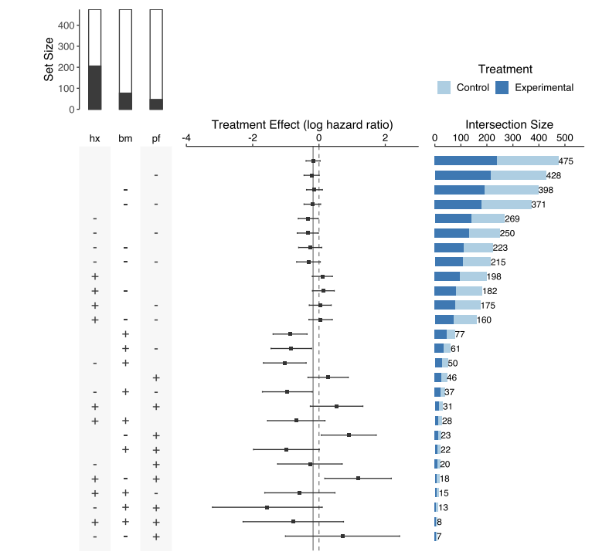
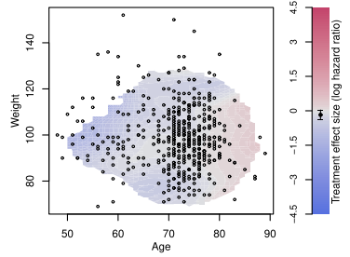
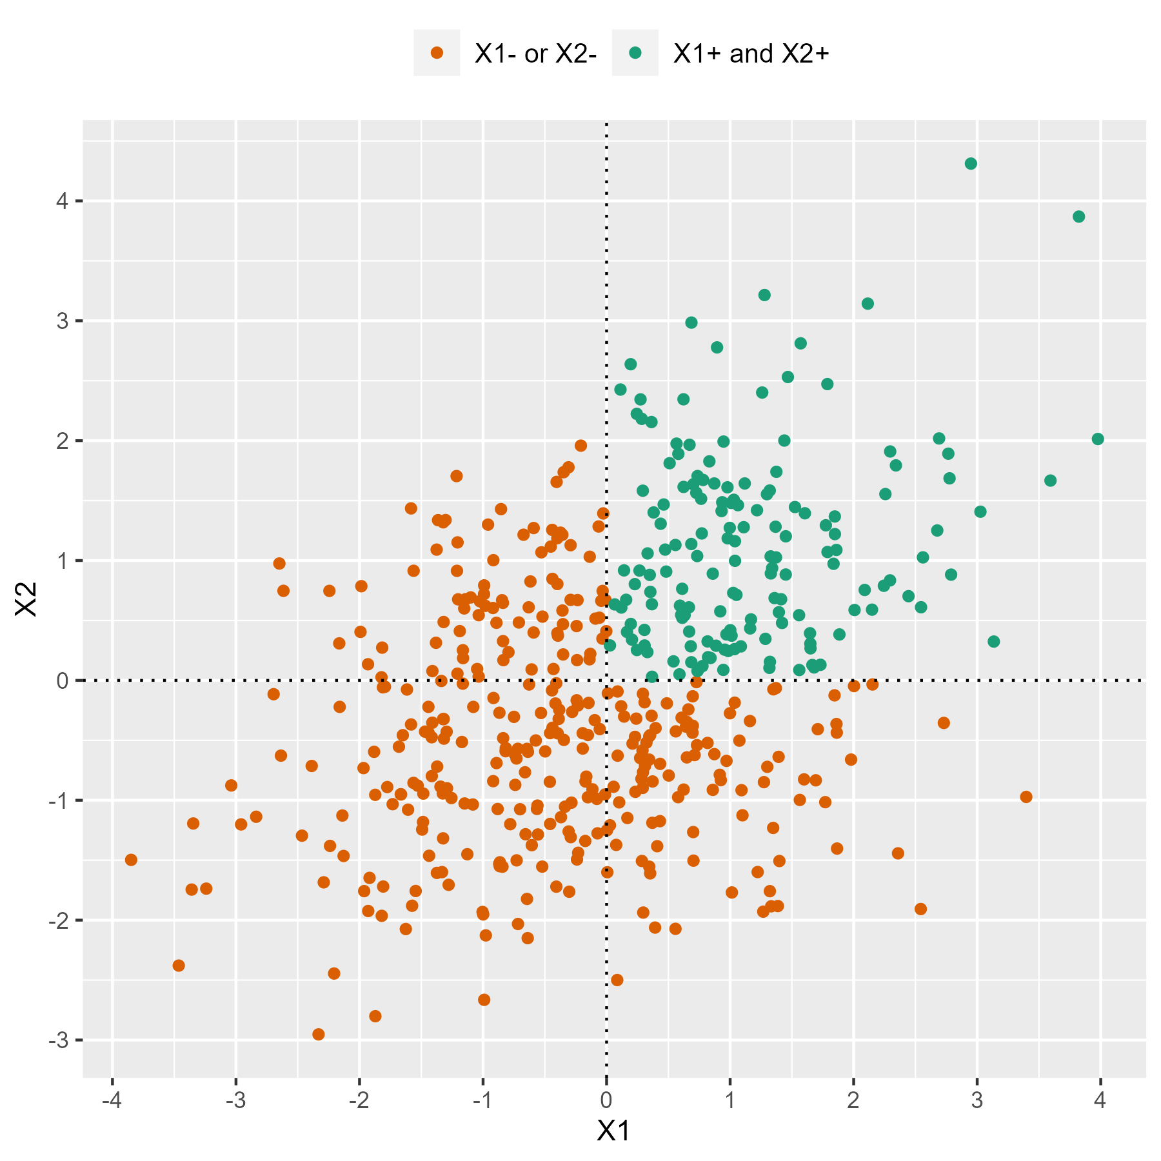
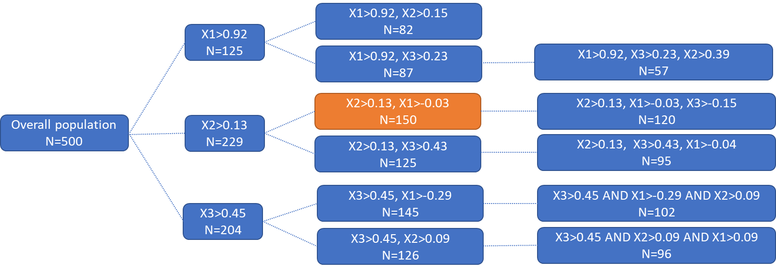
Make use of nice pictures, tables and flowcharts
Ballarini, Nicolás M., et al. "A critical review of graphics for subgroup analyses in clinical trials." Pharmaceutical Statistics 19.5 (2020): 541-560.

Slide 24
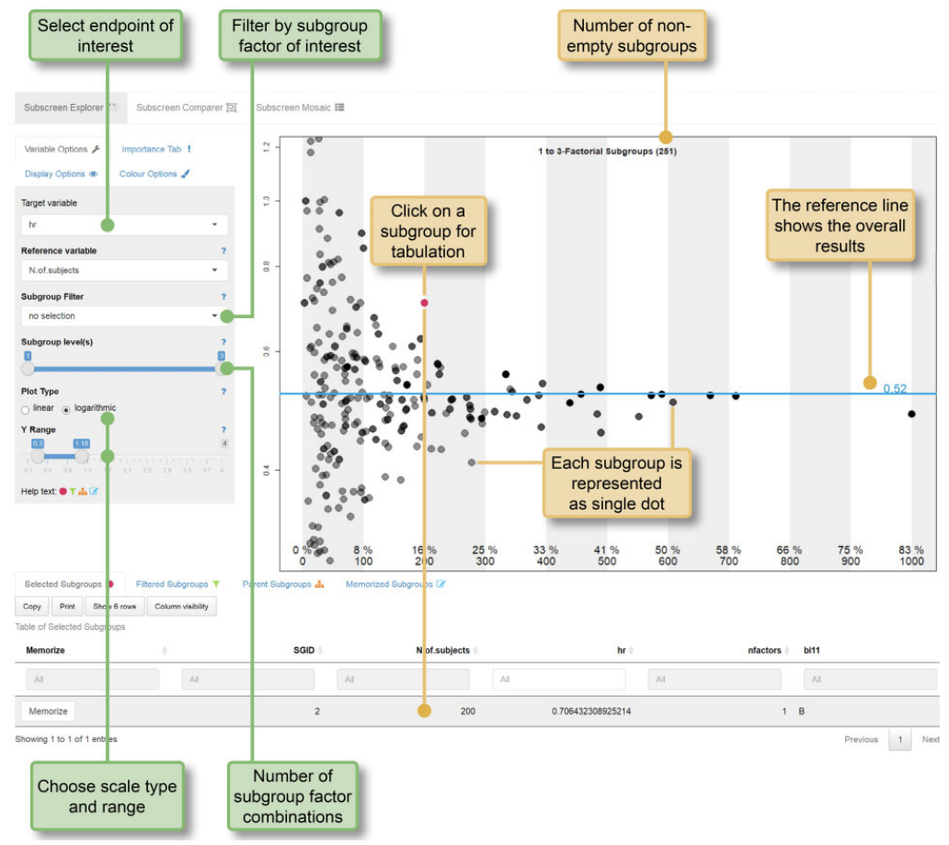
Make judicious use of interactive tools for data exploration
Tools like the subscreen R package allows to explore the full space of subgroups considering more than one level of subgroup factor combinations.
This could facilitate interaction with stakeholders.
Don’t over-interpret the findings!
Assessing treatment effect in an isolated subgroup does not identify a subgroup and results in unreliable estimates: differential treatment effect must be demonstrated.
Muysers, Christoph, et al. "A systematic approach for post hoc subgroup analyses with applications in clinical case studies." Therapeutic innovation & regulatory science 54 (2020): 507-518.

Slide 25
Pool data whenever it is possible by applying the correct methodology
What data to pool?
Simple when we have two nearly identical phase 3 pivotal trials.
Challenging when data comes from randomized or observational data, randomized trials with different design and inclusion criteria, etc.
The benefit of randomization is lost when performing data-driven subgroup analysis.
RCT Phase 2
Experimental treatment
Placebo
RCT Phase 3
Experimental treatment
Placebo
Observational
Experimental treatment
Standard of Care

Slide 26
Pool data whenever it is possible by applying the correct methodology
Evidence synthesis
Statistical learning
Causal inference
Available methodology is built on ideas from causal inference (propensity score matching) and evidence synthesis (network meta-analysis, IPD meta-analyses, indirect evidence comparison)
Whatever the tools it is important to apply sound scientific principles

Slide 27
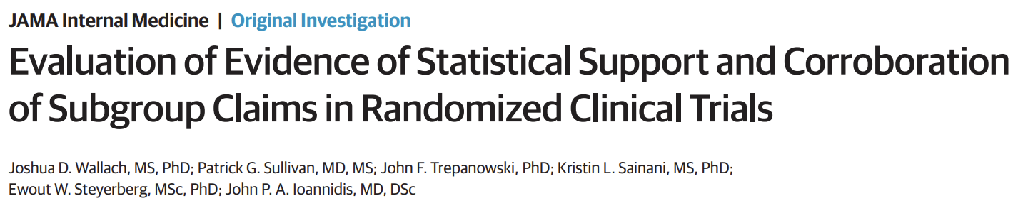
Ensure your strategy is both reproducible and replicable
High chances the subgroup finding will not be replicated according to meta-research reports
A minority of subgroup claims made in the abstracts of RCTs are supported by a significant interaction effect.
For those that have statistical support from an interaction test, most fail to meet other best practices, including pre-specification, stratified randomization, and adjustment for multiple testing.

Slide 28
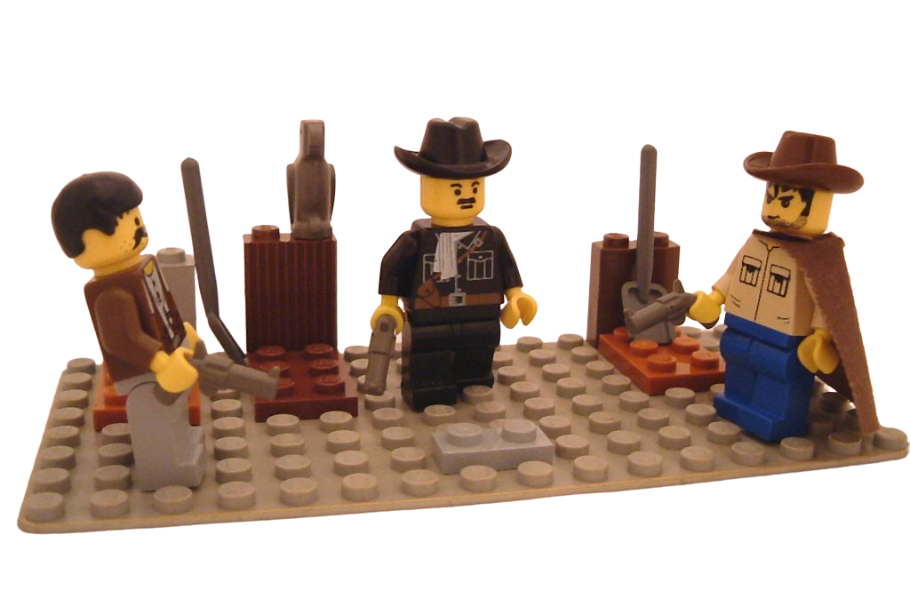
Data-driven approaches: the good, the bad, the ugly
The Bad
Methodology -
The Good
Methodology + Communication +
The Ugly
Methodology + Communication -
https://www.flickr.com/photos/kaptainkobold/1021866852
Attribution-NonCommercial-ShareAlike 2.0 Generic (CC BY-NC-SA 2.0)

Slide 29
References
Amatya, Anup K., et al. "Subgroup analyses in oncology trials: regulatory considerations and case examples." Clinical Cancer Research 27.21 (2021): 5753-5756.
Lipkovich, Ilya, Alex Dmitrienko, and Ralph B D'Agostino Sr. "Tutorial in biostatistics: data‐driven subgroup identification and analysis in clinical trials." Statistics in medicine 36.1 (2017): 136-196.
Wallach, Joshua D., et al. "Evaluation of evidence of statistical support and corroboration of subgroup claims in randomized clinical trials." JAMA internal medicine 177.4 (2017): 554-560.
Muysers, Christoph, et al. "A systematic approach for post hoc subgroup analyses with applications in clinical case studies." Therapeutic innovation & regulatory science 54 (2020): 507-518.
Knopman, David S., David T. Jones, and Michael D. Greicius. "Failure to demonstrate efficacy of aducanumab: An analysis of the EMERGE and ENGAGE trials as reported by Biogen, December 2019." Alzheimer's & Dementia 17.4 (2021): 696-701.
Ballarini, Nicolás M., et al. "A critical review of graphics for subgroup analyses in clinical trials." Pharmaceutical Statistics 19.5 (2020): 541-560.
Ballarini, Nicolas M., et al. "subtee: An R Package for Subgroup Treatment Effect Estimation in Clinical Trials." Journal of Statistical Software 99 (2021): 1-17.

Slide 30
Thanks!!!
If you are interested to join the SIG: psiweb.org/sigs-special-interest-groups/subgroup-analysis

