Slide 1
Modern approaches for evaluating treatment effect heterogeneity from clinical trials and observational data
Ilya Lipkovich (Eli Lilly and Company)
BBS Workshop
29 August 2024
Joint work with David Svensson (AstraZeneca), Bohdana Ratitch (Bayer), and Alex Dmitrienko (Mediana)

Slide 2
Outline
A causal framework for heterogeneous treatment effects (HTE)
Four general approaches for estimating HTEs
What to look at in papers on HTE evaluation?
Post-selection inference on HTE
Summary

Slide 3
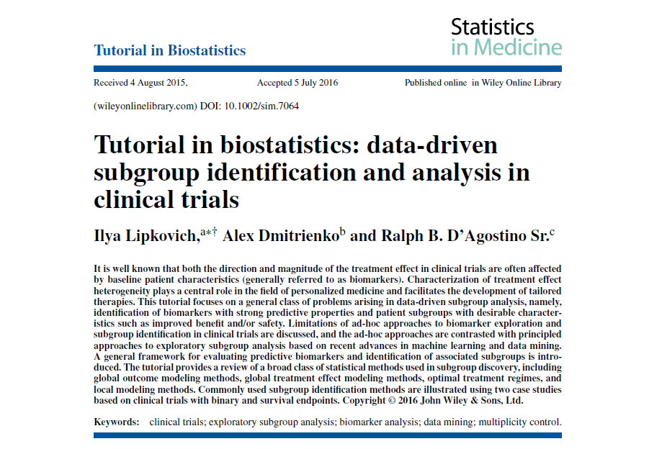

Overview articles

Slide 4

Learning heterogeneity of TE from the data
$$CATE\left(x\right)=Δ\left(x\right)=E\left(Y(1) | X=x\right)−E\left(Y(0) | X=x\right)$$
Causal inference
$X$- possibly high dimensional
Post-selection inference
Machine learning
Multiple hypothesis testing
CATE: Conditional Average Treatment Effect (a.k.a ITE)

Slide 5
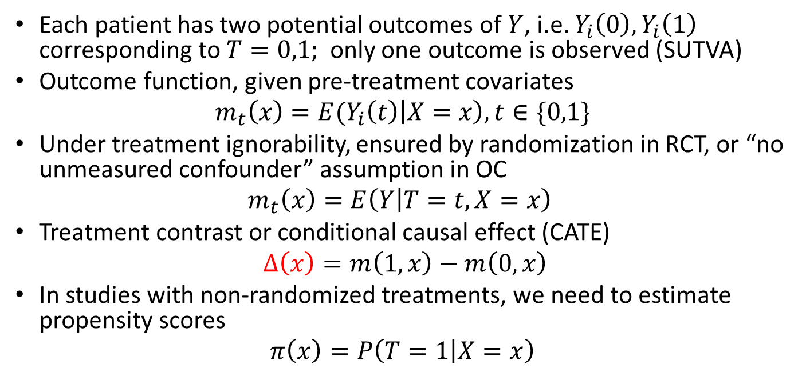
The set up: individual TE
Each patient has two potential outcomes of $Y$, i.e. $Y_{i}\left(0\right),Y_{i}\left(1\right)$ corresponding to $T=0,1;$ only one outcome is observed (SUTVA)
Outcome function, given pre-treatment covariates
$$m_{t}\left(x\right)={E(Y}_{i}\left(t\right)\left|X=x\right),t∈\{0,1\}$$
Under treatment ignorability, ensured by randomization in RCT, or “no unmeasured confounder” assumption in OC
$$m_{t}\left(x\right)=E\left(Y | T=t,X=x\right)$$
Treatment contrast or conditional causal effect (CATE)
$Δ\left(x\right)=m\left(1,x\right)−m\left(0,x\right)$
In studies with non-randomized treatments, we need to estimate propensity scores
$$π\left(x\right)=P\left(T=1 | X=x\right)$$

Slide 6
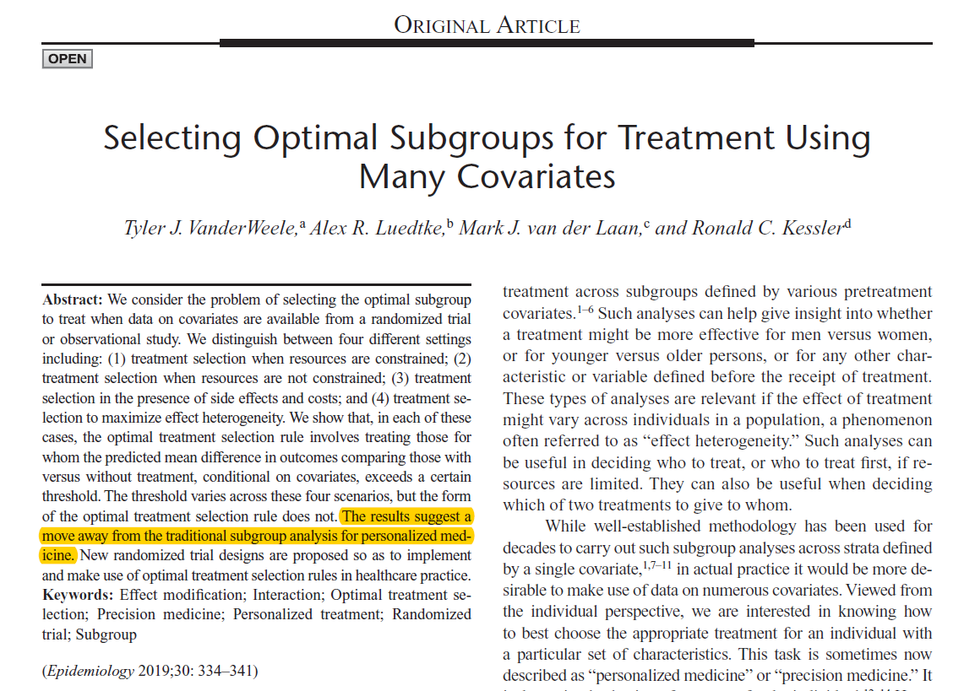
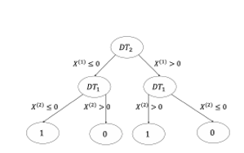
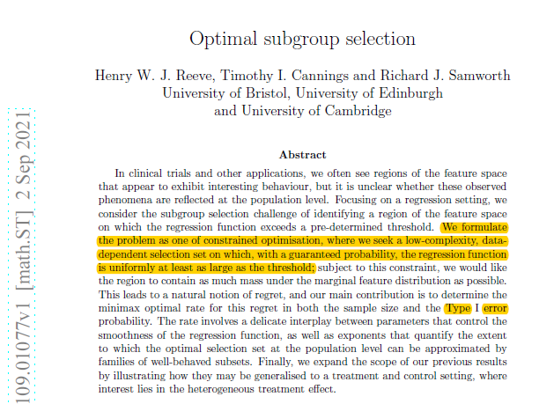
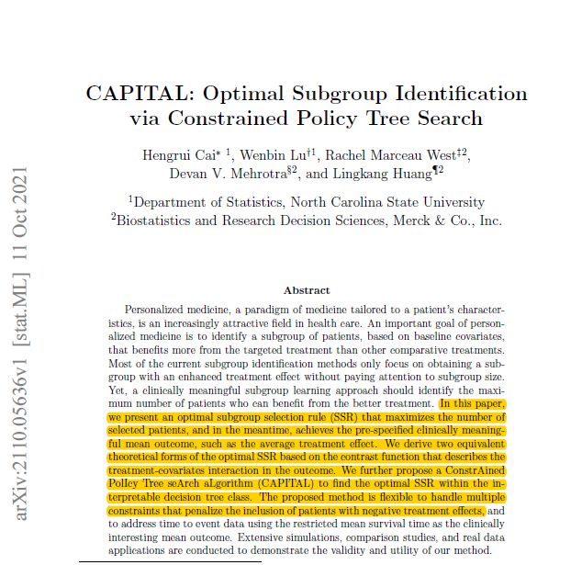


Literature on subgroup identification is diverse
$$\hat{S}\left(x\right)=\{x:\hat{Δ}\left(x\right)>δ\}$$

Slide 7













Typology of Subgroup Identification; Lipkovich et al. (2017)
$$m(t,x)$$
$$Δ(x)$$
$$m(1,x)$$
$$m(0,x)$$
$$\hat{Δ}\left(x\right)$$
$δ$=0
$$x$$
$$x$$
Global outcome modeling: Y
Direct treatment effect modeling
$$Δ(x)$$
$$Δ(x)$$
$δ$=0
$δ$=0
$$x$$
$$x$$
Prescribe B
Prescribe A
Enhanced treatment effect for drug A
Individual treatment regimen modeling: $sign\{Δ$(x)}
Local treatment effect modeling : Subgroup search

Slide 8
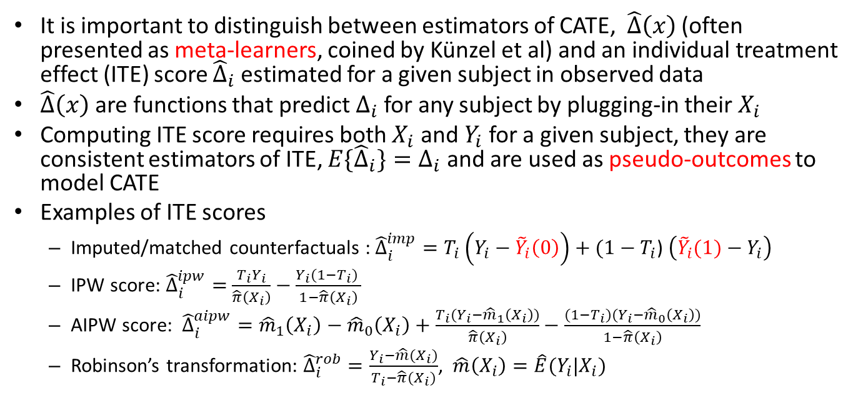
ITE scores vs CATE learners
It is important to distinguish between estimators of CATE, $\hat{Δ}\left(x\right)$ (often presented as meta-learners, coined by Künzel et al) and an individual treatment effect (ITE) score ${\hat{Δ}}_{i}$estimated for a given subject in observed data
$\hat{Δ}\left(x\right)$ are functions that predict $Δ_{i}$for any subject by plugging-in their $X_{i}$
Computing ITE score requires both $X_{i}$ and $Y_{i}$ for a given subject, they are consistent estimators of ITE, ${E\{\hat{Δ}}_{i}\}=Δ_{i}$ and are used as pseudo-outcomes to model CATE
Examples of ITE scores
  Imputed/matched counterfactuals : ${\hat{Δ}}_{i}^{imp}=T_{i}\left({Y_{i}−\tilde{Y}}_{i}\left(0\right)\right)+(1−T_{i}$) $\left({{\tilde{Y}}_{i}(1)−Y}_{i}\right)$
  IPW score: ${\hat{Δ}}_{i}^{ipw}=$ $\frac{T_{i}Y_{i}}{\hat{π}\left(X_{i}\right)}−\frac{{Y_{i}(1−T}_{i}) }{1−\hat{π}\left(X_{i}\right)}$
  AIPW score: ${\hat{Δ}}_{i}^{aipw}={\hat{m}}_{1}\left(X_{i}\right)−{\hat{m}}_{0}\left(X_{i}\right)+\frac{T_{i}(Y_{i}−{\hat{m}}_{1}\left(X_{i}\right))}{\hat{π}\left(X_{i}\right)}−\frac{{(1−T}_{i})(Y_{i}−{\hat{m}}_{0}\left(X_{i}\right))}{1−\hat{π}\left(X_{i}\right)}$
  Robinson’s transformation: ${\hat{Δ}}_{i}^{rob}=\frac{Y_{i}−\hat{m}(X_{i})}{T_{i}−\hat{π}(X_{i})}$, $\hat{m}\left(X_{i}\right)=\hat{E}(Y_{i}|X_{i})$

Slide 9
HTE evaluation
What to look for in papers on HTE?

Slide 10
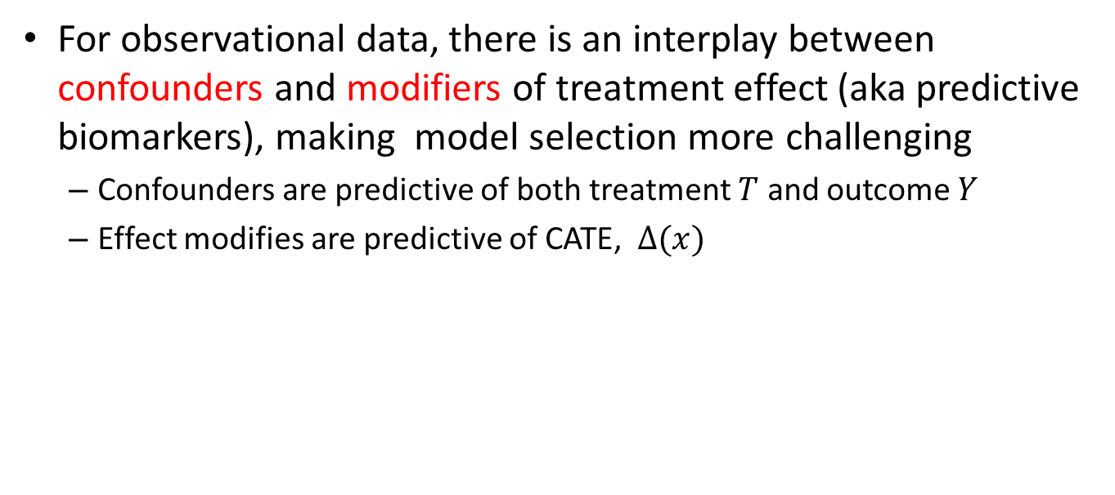
Does it apply only to RCT or to OS as well?
For observational data, there is an interplay between confounders and modifiers of treatment effect (aka predictive biomarkers), making model selection more challenging
  Confounders are predictive of both treatment $T$ and outcome $Y$
  Effect modifies are predictive of CATE, $Δ(x)$

Slide 11
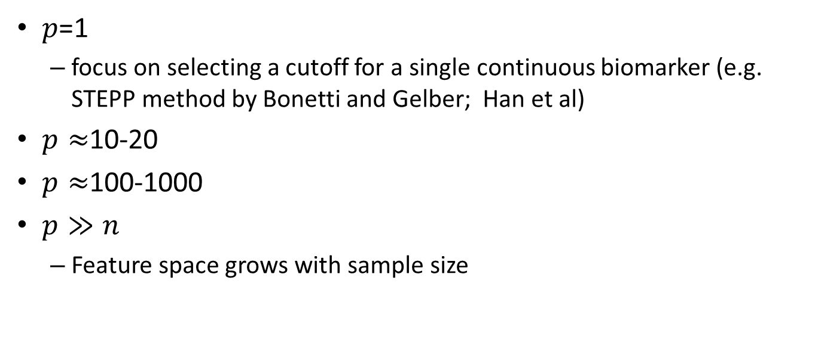
The number of predictors the procedure can handle
$p$=1
  focus on selecting a cutoff for a single continuous biomarker (e.g. STEPP method by Bonetti and Gelber; Han et al)
$p≈$10-20
$p≈$100-1000
$p≫n$
  Feature space grows with sample size

Slide 12
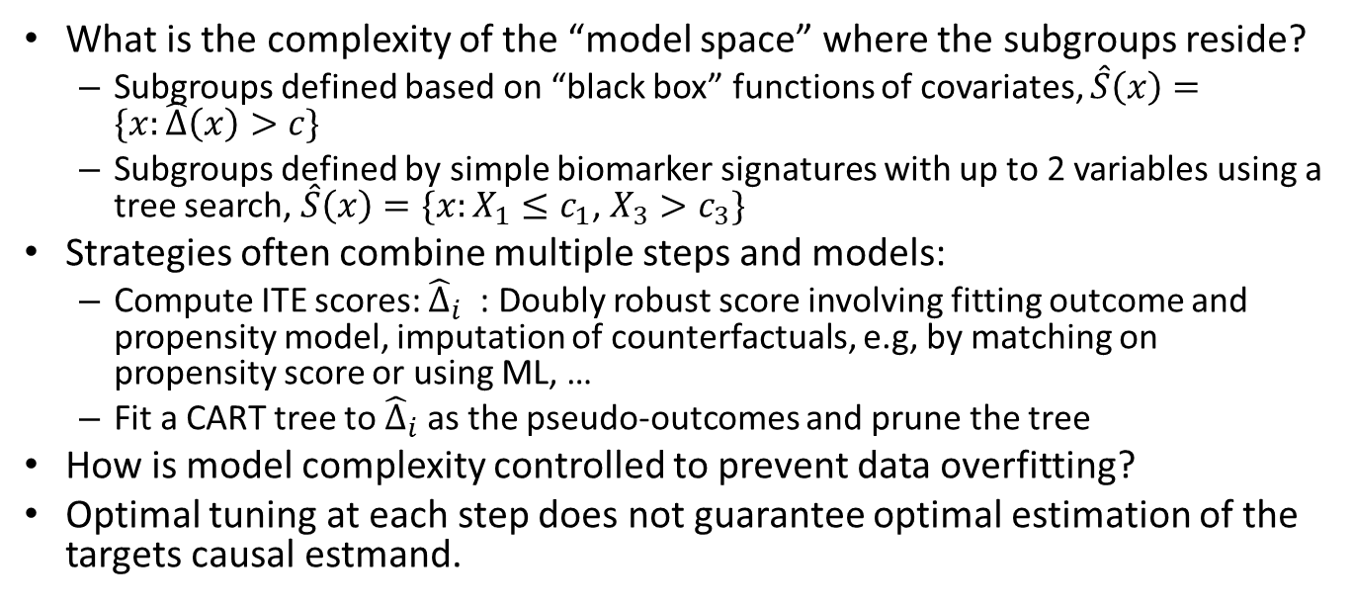
Model complexity
What is the complexity of the “model space” where the subgroups reside?
  Subgroups defined based on “black box” functions of covariates, $\hat{S}\left(x\right)=\{x:\hat{Δ}\left(x\right)>c\}$
  Subgroups defined by simple biomarker signatures with up to 2 variables using a tree search, $\hat{S}\left(x\right)=\{x:X_{1}≤c_{1}$, $X_{3}>c_{3}\}$
Strategies often combine multiple steps and models:
  Compute ITE scores: ${\hat{Δ}}_{i}$ : Doubly robust score involving fitting outcome and propensity model, imputation of counterfactuals, e.g, by matching on propensity score or using ML, …
  Fit a CART tree to ${\hat{Δ}}_{i}$as the pseudo-outcomes and prune the tree
How is model complexity controlled to prevent data overfitting?
Optimal tuning at each step does not guarantee optimal estimation of the targets causal estmand.

Slide 13
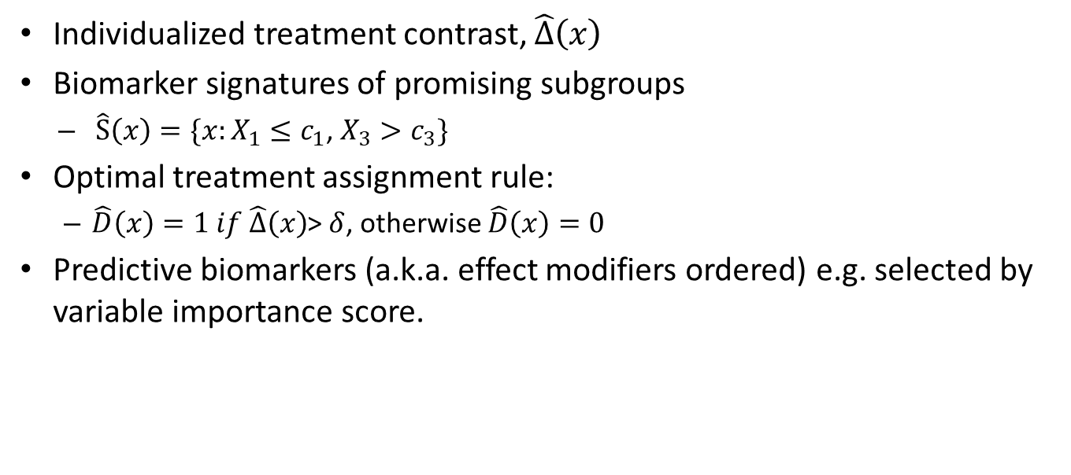
What output does the method produce?
Individualized treatment contrast, $\hat{Δ}\left(x\right)$
Biomarker signatures of promising subgroups
  $\hat{S}\left(x\right)=\{x:X_{1}≤c_{1}$, $X_{3}>c_{3}\}$
Optimal treatment assignment rule:
  $\hat{D}\left(x\right)=1 if \hat{Δ}\left(x\right)$> $δ$, otherwise $\hat{D}\left(x\right)=0$
Predictive biomarkers (a.k.a. effect modifiers ordered) e.g. selected by variable importance score.

Slide 14
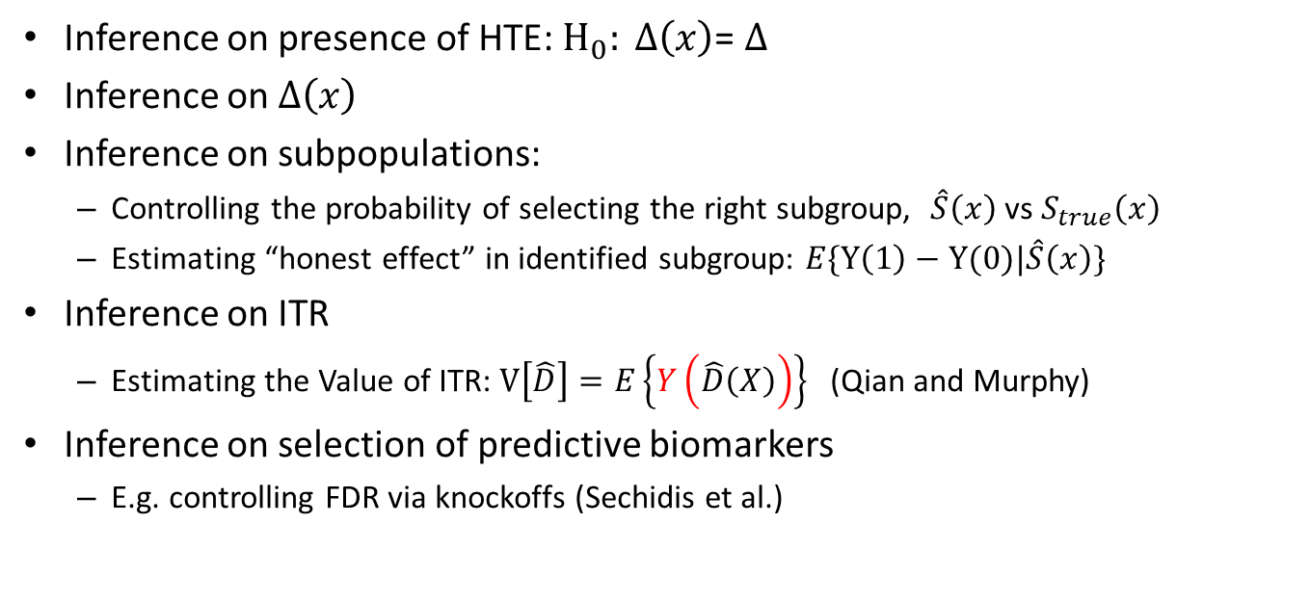
What inference is done, if at all?
Inference on presence of HTE: $H_{0}: Δ\left(x\right)$= $Δ$
Inference on $Δ\left(x\right)$
Inference on subpopulations:
  Controlling the probability of selecting the right subgroup, $\hat{S}\left(x\right)$ vs $S_{true}\left(x\right)$
  Estimating “honest effect” in identified subgroup: $E\{Y\left(1\right)−Y(0)|\hat{S}\left(x\right)\}$
Inference on ITR
  Estimating the Value of ITR: $V\left[\hat{D}\right]=E\left\{Y\left(\hat{D}\left(X\right)\right)\right\}$ (Qian and Murphy)
Inference on selection of predictive biomarkers
  E.g. controlling FDR via knockoffs (Sechidis et al.)

Slide 15
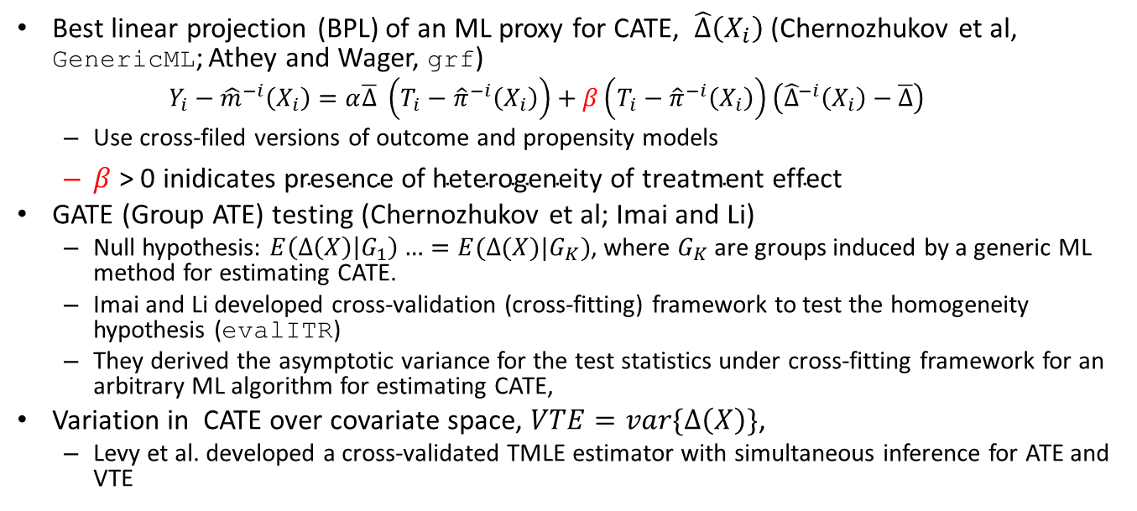
Inference on presence of HTE
Best linear projection (BPL) of an ML proxy for CATE, $\hat{Δ}\left(X_{i}\right)$ (Chernozhukov et al, GenericML; Athey and Wager, grf)
  $$Y_{i}−{\hat{m}}^{−i}\left(X_{i}\right)=α\overline{Δ} \left(T_{i}−{\hat{π}}^{−i}\left(X_{i}\right)\right)+β\left(T_{i}−{\hat{π}}^{−i}\left(X_{i}\right)\right)\left({\hat{Δ}}^{−i}\left(X_{i}\right)−\overline{Δ}\right)$$
  Use cross-filed versions of outcome and propensity models
  $β \text{> 0 }\text{inidicates} \text{presence} \text{of} \text{heterogeneity} \text{of} \text{treatment} \text{effect}$
GATE (Group ATE) testing (Chernozhukov et al; Imai and Li)
  Null hypothesis: $E\left(Δ\left(X\right) | G_{1}\right)…=E(Δ(X)|G_{K})$, where $G_{K}$ are groups induced by a generic ML method for estimating CATE.
  Imai and Li developed cross-validation (cross-fitting) framework to test the homogeneity hypothesis (evalITR)
  They derived the asymptotic variance for the test statistics under cross-fitting framework for an arbitrary ML algorithm for estimating CATE,
Variation in CATE over covariate space, $VTE=var\{Δ\left(X\right)\}$,
  Levy et al. developed a cross-validated TMLE estimator with simultaneous inference for ATE and VTE

Slide 16
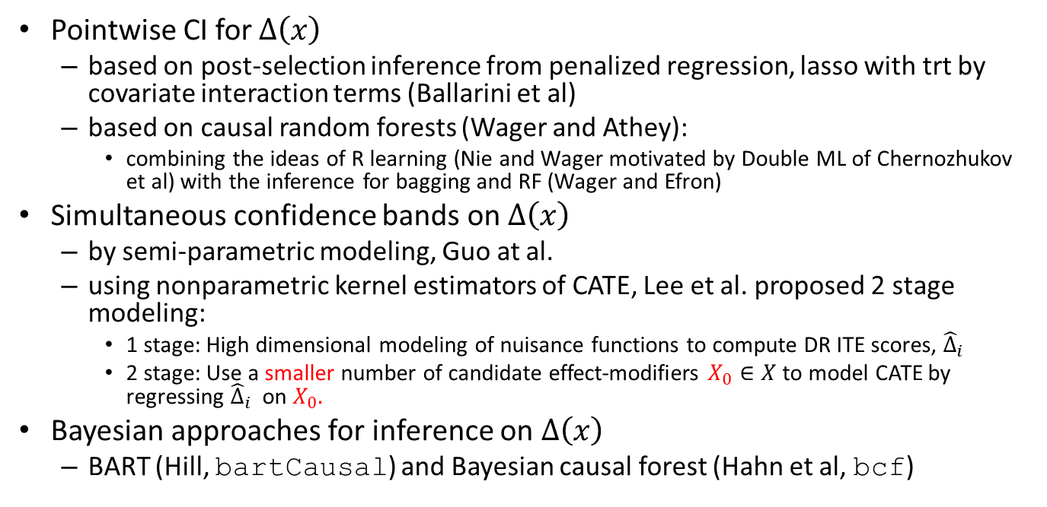
Inference on$Δ\left(x\right)$
Pointwise CI for $Δ\left(x\right)$
  based on post-selection inference from penalized regression, lasso with trt by covariate interaction terms (Ballarini et al)
  based on causal random forests (Wager and Athey):
    combining the ideas of R learning (Nie and Wager motivated by Double ML of Chernozhukov et al) with the inference for bagging and RF (Wager and Efron)
Simultaneous confidence bands on$Δ\left(x\right)$
  by semi-parametric modeling, Guo at al.
  using nonparametric kernel estimators of CATE, Lee et al. proposed 2 stage modeling:
    1 stage: High dimensional modeling of nuisance functions to compute DR ITE scores, ${\hat{Δ}}_{i}$
    2 stage: Use a smaller number of candidate effect-modifiers $X_{0}∈X$to model CATE by regressing ${\hat{Δ}}_{i}$ on $X_{0}.$
Bayesian approaches for inference on $Δ\left(x\right)$
  BART (Hill, bartCausal) and Bayesian causal forest (Hahn et al, bcf)

Slide 17
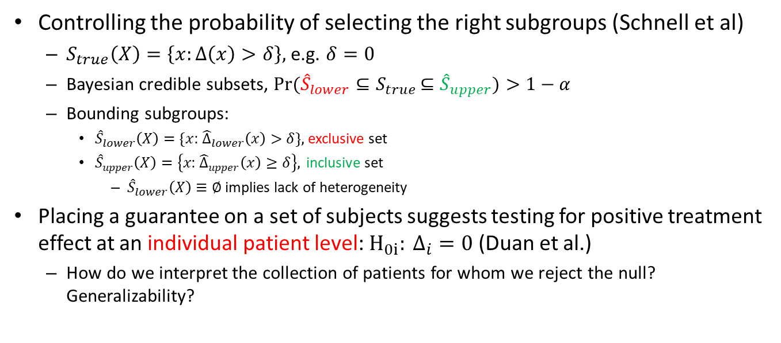
Inference on identified subgroups: what’s the right subgroup?
Controlling the probability of selecting the right subgroups (Schnell et al)
  $S_{true}\left(X\right)=\left\{x:Δ\left(x\right)>δ\right\},$ e.g. $δ=0$
  Bayesian credible subsets, $Pr({{\hat{S}}_{lower}⊆S}_{true}$ $⊆{\hat{S}}_{upper})>1−α$
  Bounding subgroups:
    ${\hat{S}}_{lower}\left(X\right)=\{x$: ${\hat{Δ}}_{lower}\left(x\right)>δ\},$ exclusive set
    ${\hat{S}}_{upper}\left(X\right)=\left\{x\text{: }{\hat{Δ}}_{upper}\left(x\right)≥δ\right\}, \text{inclusive} \text{set}$
      ${\hat{S}}_{lower}\left(X\right)≡∅$ implies lack of heterogeneity
Placing a guarantee on a set of subjects suggests testing for positive treatment effect at an individual patient level: $H_{0i}: Δ_{i}=0$ (Duan et al.)
  How do we interpret the collection of patients for whom we reject the null? Generalizability?

Slide 18
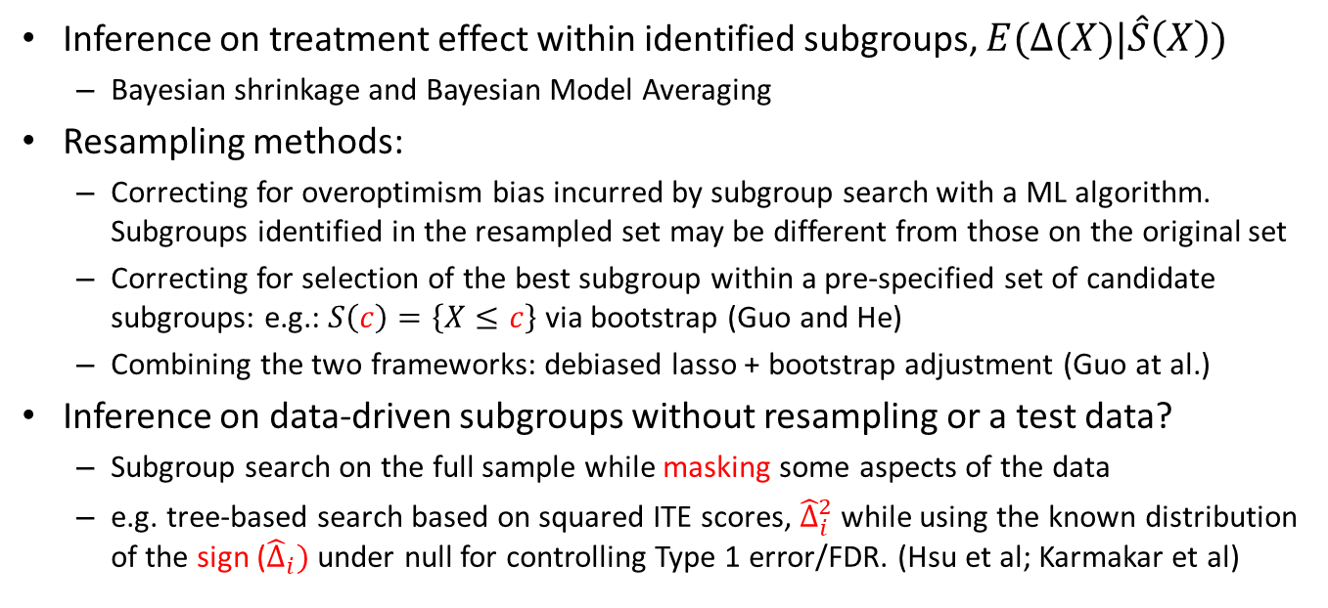
Inference on subgroups: what’s effect within subgroup?
Inference on treatment effect within identified subgroups, $E(Δ(X)|\hat{S}\left(X\right))$
  Bayesian shrinkage and Bayesian Model Averaging
Resampling methods:
  Correcting for overoptimism bias incurred by subgroup search with a ML algorithm. Subgroups identified in the resampled set may be different from those on the original set
  Correcting for selection of the best subgroup within a pre-specified set of candidate subgroups: e.g.: $S\left(c\right)=\left\{X≤c\right\}$ via bootstrap (Guo and He)
  Combining the two frameworks: debiased lasso + bootstrap adjustment (Guo at al.)
Inference on data-driven subgroups without resampling or a test data?
  Subgroup search on the full sample while masking some aspects of the data
  e.g. tree-based search based on squared ITE scores, ${\hat{Δ}}_{i}^{2}$ while using the known distribution of the sign (${\hat{Δ}}_{i})$under null for controlling Type 1 error/FDR. (Hsu et al; Karmakar et al)

Slide 19
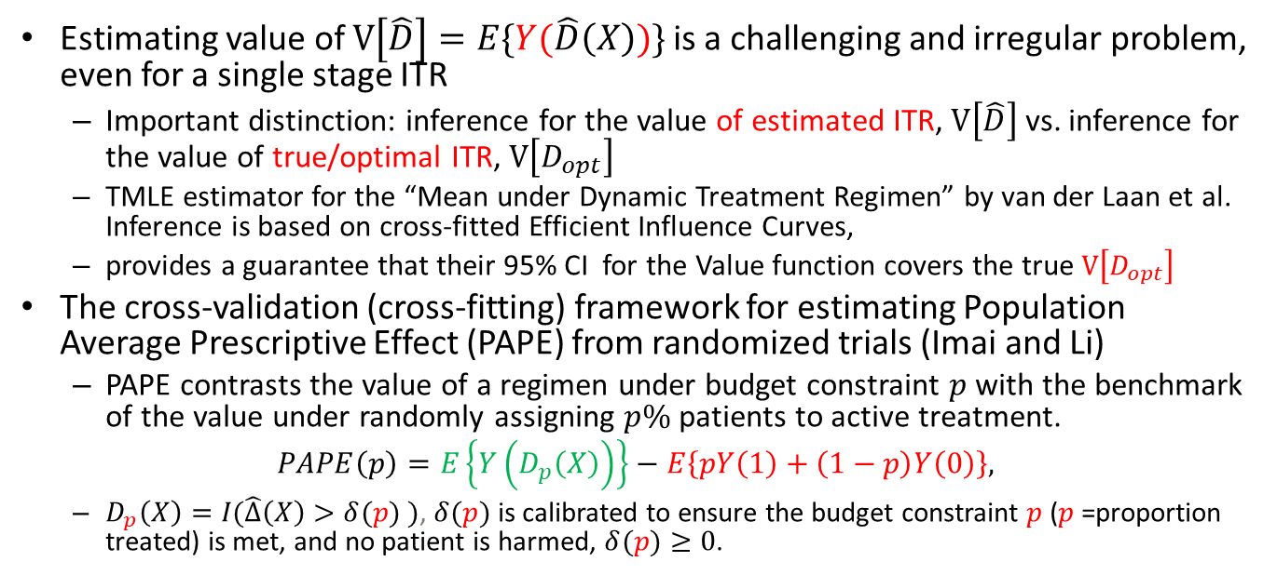
Inference on ITR
Estimating value of $V\left[\hat{D}\right]=E\{Y(\hat{D}\left(X\right))\}$ is a challenging and irregular problem, even for a single stage ITR
  Important distinction: inference for the value of estimated ITR, $V\left[\hat{D}\right]$vs. inference for the value of true/optimal ITR, $V\left[D_{opt}\right]$
  TMLE estimator for the “Mean under Dynamic Treatment Regimen” by van der Laan et al. Inference is based on cross-fitted Efficient Influence Curves,
  provides a guarantee that their 95% CI for the Value function covers the true $V\left[D_{opt}\right]$
The cross-validation (cross-fitting) framework for estimating Population Average Prescriptive Effect (PAPE) from randomized trials (Imai and Li)
  PAPE contrasts the value of a regimen under budget constraint $p$ with the benchmark of the value under randomly assigning $p\%$patients to active treatment.
$$PAPE\left(p\right)=E\left\{Y\left(D_{p}\left(X\right)\right)\right\}−E\left\{pY\left(1\right)+\left(1−p\right)Y\left(0\right)\right\},$$
  $D_{p}\left(X\right)=I(\hat{Δ}\left(X\right)>δ(p) )$, $δ(p)$ is calibrated to ensure the budget constraint $p$ ($p$=proportion treated) is met, and no patient is harmed, $δ(p)≥0$.

Slide 20

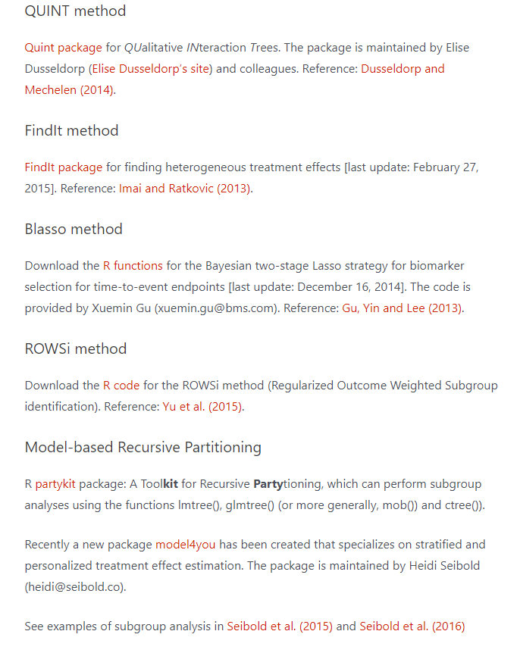
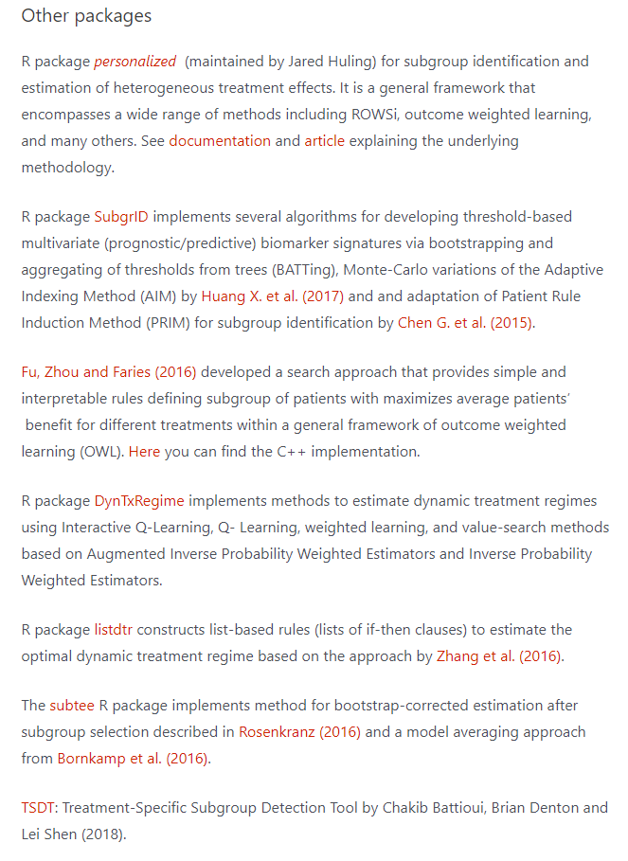
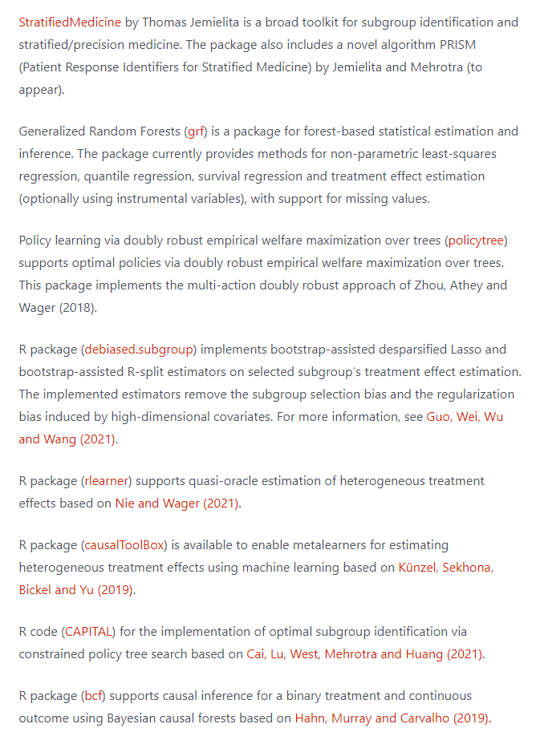
Software for subgroup identification
http://biopharmnet.com/subgroup-analysis-software/

Slide 21
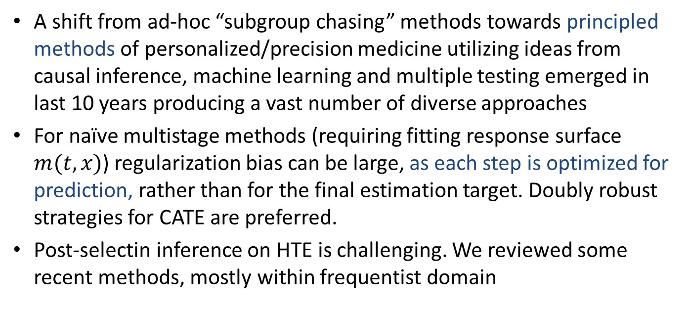
Summary
A shift from ad-hoc “subgroup chasing” methods towards principled methods of personalized/precision medicine utilizing ideas from causal inference, machine learning and multiple testing emerged in last 10 years producing a vast number of diverse approaches
For naïve multistage methods (requiring fitting response surface $m(t,x)$) regularization bias can be large, as each step is optimized for prediction, rather than for the final estimation target. Doubly robust strategies for CATE are preferred.
Post-selectin inference on HTE is challenging. We reviewed some recent methods, mostly within frequentist domain

Slide 22
References
Athey S, Tibshirani J, Wager S. (2019). Generalized random forests. The Annals of Statistics. 47(2): 1148–1178.
Chen S, Tian L, Cai T, Yu M (2017). A general statistical framework for subgroup identification and comparative treatment scoring. Biometrics. 73(4),1199–1209.
Chernozhukov V, Demirer M, Duflo E, and Fernandez-val (2020). Generic machine learning inference on heterogenous treatment effects in randomized experiments. arXiv:1712.04802v4.
Duan B, Wasserman L, Ramdas A. (2023) Interactive identification of individuals with positive treatment effect while controlling false discoveries. arXiv: 2102.10778v2
Hahn PR, Murray JS, Carvalho CM. (2020). Bayesian regression tree models for causal inference: regularization, confounding, and heterogeneous effects. Bayesian Anal. 15(3), 965-1056.
Hsu JY, Zubizarreta JR, Small DS, Rosenbaum PR. (2015). Strong control of the familywise error rate in observational studies that discover effect modification by exploratory methods. Biometrika. 102(4):767-782.
Imai K, Li ML. (2022). Statistical inference for heterogeneous treatment effects discovered by generic machine learning in randomized experiments. arXiv:2203.14511v1 2022.
Imai K, Li ML. (2023) Experimental evaluation of individualized treatment rules. J Am Stat Assoc.;118(541):242-256.
Kennedy EH (2021). Optimal doubly robust estimation of heterogeneous causal effects. arXiv:2004.14497v2.
Künzel SR, Sekhona JS, Bickel PJ and Yu B. (2019). Metalearners for estimating heterogeneous treatment effects using machine learning. Proceedings of the National Academy of Sciences, 116(10), 4156-4165.
Lipkovich I, Dmitrienko A, D’Agostino BR (2017). Tutorial in biostatistics: data-driven subgroup identification and analysis in clinical trials. Stat Med 36,136–196.
Lipkovich I, Svensson D, Ratitch B, Dmitrienko A. (2024) Modern approaches for evaluating treatment effect heterogeneity from clinical trials and observational data. Statistics in Medicine. 1-49. doi:10.1002/sim.10167
Nie X and Wager S. (2021). Quasi-oracle estimation of heterogeneous treatment effects. Biometrika 108(2), 299–319.
Schnell PM, Müller P, Tang Q, Carlin BP. Multiplicity-adjusted semiparametric benefiting subgroup identification in clinical trials. Clin Trials. 2018;15(1):75-86.
Sechidis K, Kormaksson M, Ohlssen D. (2021) Using knockoffs for controlled predictive biomarker identification. Stat Med.;40(25):5453-5473.
Qian M, Murphy S. (2011). Performance guarantees for individualized treatment rules. Annals of Statistics. 39(2): 1180–1210.
Wager S, Athey S (2018). Estimation and inference of heterogeneous treatment effects using random forests. J Am Stat Assoc 113,1228–1242.

Slide 23
Thank you!
Q & A
Ilya.Lipkovich@lilly.com

