Slide 1

A framework for evaluation of Bayesian Dynamic Borrowing designs in pivotal studies
Nicky Best (GSK), Aaron Dane (Danestat Consulting), Julia Niewczas (J&J),
Oliver Sailer (BI), Gaëlle Saint-Hilary (Saryga)​, Simon Wandel (Novartis)
EFSPI / PSI Special Interest Group Historical Data​
PSI Conference, 13 June 2022​

Slide 2
Borrowing External Information in Clinical Trials
Opportunities to increase efficiency of drug development
To increase feasibility/efficiency of trials in “small populations” (e.g. rare/difficult-to-recruit diseases; paediatrics; targeted sub-groups)
In bridging/extrapolation settings when relevant external data already exist
For diseases in larger populations where placebo/control response is well understood, is it necessary to continue to collect large amounts of control data in new trials?
Growing use of external data to increase efficiency in early-phase studies
Regulators increasingly open to use of external data in particular scenarios
  FDA’s Complex Innovative Designs (CID) initiative includes several projects using external data in pivotal studies
Notes:
Small pop - Designing trials to meet conventional evidentiary standards may not be feasible - Balance is needed between what is necessary and what is possible
Reducing number of patients enrolled - which in turn could reduce the cost and duration of the trial - to increase feasibility, limit exposure to a potentially less efficacious agent, and/or to reduce risk by increase power and precision of the treatment estimate
EFSPI/PSI Historical Data Special Interest Group, DIA Bayesian Working Group, Medical Device Innovation Consortium External Evidence Methods,…)
Regulators have been increasingly open to the use of dynamic borrowing in particular scenarios where the implementation of this method was driven by necessity rather than convenience

Slide 3
Borrowing External Information in Clinical Trials
Balancing the benefits and risks
Increasing methodological comfort, even for confirmatory trials
Central difficulty is selection of applicable historical studies / external data sources
  Several data-sharing initiatives (TransCelerate, Project Datasphere, Vivli,…..)
There are benefits and risks to historical borrowing
  Type I error and power can be impacted by the drift
PSI/EFSPI Historical Data SIG has proposed a framework to aid consistent evaluation of the benefits & risks of augmenting an RCT with external trial data using Bayesian Dynamic Borrowing designs
Transparency on assumptions used to design and/or analyse the data from such trials
Improving quality and consistency of briefing documents prepared for Scientific Advice/other regulatory procedures
Ensuring stakeholders have the necessary information to discuss appropriateness of these methodologies in terms of
  Clinical and experimental rationale
  Availability and quality of historical data
  Benefit / risk of performing historical borrowing, e.g power and precision vs Type I error
  Benefit / risk of performing historical borrowing, e.g power and precision vs Type I error
Notes:
Data re-use not appropriate/feasible in every setting, so need to understand risk-benefit trade off to know when it is a “smart risk” to use
No

Slide 4
Agenda
Part 1: Theory and Examples (now)
Overview of Bayesian Dynamic Borrowing (BDB) methods, with focus on robust mixture priors (Nicky)
Case studies (Oliver, Julia, Nicky)
Designing a BDB study: A framework to engage with regulatory authorities (Gaëlle)
Part 2: Workshop (after coffee break)
In breakout groups, work through framework to help prepare for an end-of-phase 2 regulatory advice meeting focusing on leveraging historical control data for a pivotal study (Leads: Simon & Aaron)

Slide 5
Overview of Bayesian Dynamic Borrowing Methods
Presenter: Nicky Best (GSK)

Slide 6





Borrowing External Information in Clinical Trials
Different ways to use external data to augment a new trial
External Controls
Supplement planned sample size with external data
to increase efficiency
Traditional design
Data re-use design
Control
Efficacy (or safety) extrapolation / bridging
-1
0
1
2
3
-1
0
1
2
3
Treatment Effect and 95% CI
Treatment Effect and 95% CI
Replace some planned subjects by external data
to reduce duration and cost
Active
Control
Δ
Traditional design
Data re-use design
$$
$
Trial duration
Trial duration
We do not consider single arm trials with fully external control arm in this presentation
Notes:
So what are some of the ways we can re-use existing data in a new clinical trial, and how does this help?
Can borrow data on control arm or on treatment difference (also safety)
Data re-use (replace) can result in cost/participant savings and/or shorter study durations for the same or similar explanatory power, or data re-use (supplement) can result in increased power/greater precision
Data re-use not appropriate/feasible in every setting, so need to understand risk-benefit trade off to know when it is a “smart risk” to use

Slide 7
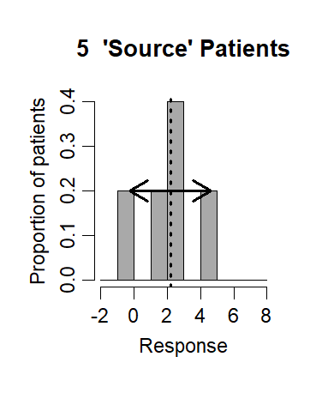
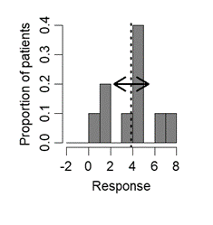
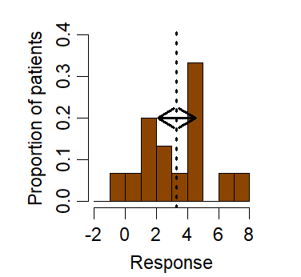
Evidence synthesis: “Borrowing” data (virtual patients) from another source
Target patient population
New Study
5 New Patients
External study
10 External Patients
10 External + 5 New Patients
“Borrowing”
Notes:
In situations where we are pretty confident the historical data are relevant then this is fairly straightforward, this is how it works….
Include as “virtual patients” in a new study

Slide 8
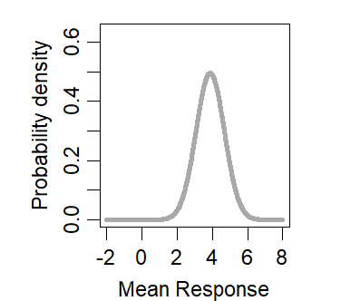
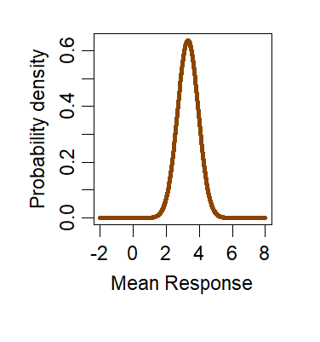
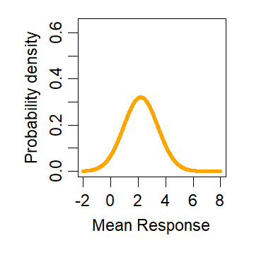
Bayesian inference: a form of evidence synthesis
Mean response based on 10 ‘Source’ Patients
Prior (initial) probability distribution
Mean response based on 10 ‘Source’ + 5 New Patients
Posterior (updated) probability distribution
Bayesian Inference
Mean response based on 5 New Patients
New evidence (study data)
Bayesian analysis using external study data as a prior distribution
► posterior distribution is based on pooling the external and new data

Slide 9
Bayesian Dynamic Borrowing
To deal with Drift
What if the external and new study data are not entirely similar?
  Differences due to sampling variability
  “Real” differences (drift)
    Differences in inclusion/exclusion criteria between source & new studies
    Differences in health care may introduce differences between source & new outcomes
    Different populations/baseline risk factors (ethnicity, age…) involved in source & new studies, etc…
Dynamic borrowing attempts to account for drift between external data & new study population by learning how much information to borrow
  The larger the drift, the less we want to borrow
  The smaller the drift, the more we want to borrow

Slide 10
Statistical methods for dynamic borrowing
Several methods available
Method | Comments
Robust mixture priors* | Transparent: borrowing controlled through prior weight on source component -> has direct interpretation as prior probability that source data is relevant to target population; Computationally simple (for conjugate settings)
Power Priors | Intuitive (power parameter = fraction of source information borrowed) but hard to learn about power parameter, so limited ability for dynamic borrowing
Commensurate Priors | Extension of meta-analysis model; Can be computationally complex and difficult to calibrate (via prior on variance parameter)
Propensity score matching or weighting | Frequentist approach; Requires individual-level data with covariate information; Can be used on their own or as pre-processing step to select subset of source data to use as prior for Bayesian borrowing
*Focus for this session but please have a look at Poster P40 by Josephine Khan to learn about other methods!
Notes:
Refer to Julia’s poster for other methods

Slide 11





Robust Mixture Priors*
Illustration for binary outcome: parameter of interest θ = responder probability
External study data: y_{S} responders out of N_{S} subjects
Assumption
Prediction (prior belief) about responder rate in new population
Prior probability (weight) on each assumption
New Study data likelihood for responder rate
Posterior (updated) estimate of responder rate in new population
Posterior (updated) probability (weight) on each assumption
Observe y_{T} responders out of N_{T} subjects
Beta(y_{S}, N_{S}-y_{S})
Beta(y_{S}+ y_{T}, N_{S}-y_{S}+ N_{T}-y_{T})
Assuming External Study data are relevant
w
w*
Bayesian updating
Beta(0.5, 0.5)
Beta(0.5+ y_{T}, 0.5+ N_{T}-y_{T})
“In case we are mistaken” prediction assuming External Study data not relevant
1-w
1-w*
Bayesian updating
Notes:
Vague prior cannot be entirely flat in reality for mathematical reasons, we recommend «unit information»

Slide 12

Robust Mixture Priors
Illustration for binary outcome: parameter of interest θ = responder probability
External study data: y_{S} responders out of N_{S} subjects
Assumption
Prediction (prior belief) about responder rate in new population
Prior probability (weight) on each assumption
New Study data likelihood for responder rate
Posterior (updated) estimate of responder rate in new population
Posterior (updated) probability (weight) on each assumption
Observe y_{T} responders out of N_{T} subjects
Beta(y_{S}, N_{S}-y_{S})
Beta(y_{S}+ y_{T}, N_{S}-y_{S}+ N_{T}-y_{T})
Assuming Source External data are relevant
The weight also gets updated:
$w^{∗}\left(y\right)= \frac{w∙f_{I}(y_{T})}{w∙f_{I}\left(y_{T}\right)+(1−w)∙f_{V}\left(y_{T}\right)}$
w
Marginal likelihood (probability) of target study data under informative prior
w*
Bayesian updating
Beta(0.5, 0.5)
Beta(0.5+ y_{T}, 0.5+ N_{T}-y_{T})
“In case we are mistaken” prediction assuming Source Study data not relevant
Marginal likelihood (probability) of target study data under vague prior
1-w
1-w*
Bayesian updating

Slide 13
Robust Mixture Priors
Illustration for binary outcome: parameter of interest θ = responder probability
External study data: y_{S} responders out of N_{S} subjects
Assumption
Prediction (prior belief) about responder rate in new population
Prior probability (weight) on each assumption
New Study data likelihood for responder rate
Posterior (updated) estimate of responder rate in new population
Posterior (updated) probability (weight) on each assumption
Observe y_{T} responders out of N_{T} subjects
Beta(y_{S}, N_{S}-y_{S})
Beta(y_{S}+ y_{T}, N_{S}-y_{S}+ N_{T}-y_{T})
Assuming External Study data are relevant
w
w*
Bayesian updating
“Test then Pool” approach:
  If w* > 0.5, use posterior from External Study prior for inference

Slide 14
Robust Mixture Priors
Illustration for binary outcome: parameter of interest θ = responder probability
External study data: y_{S} responders out of N_{S} subjects
Assumption
Prediction (prior belief) about responder rate in new population
Prior probability (weight) on each assumption
New Study data likelihood for responder rate
Posterior (updated) estimate of responder rate in new population
Posterior (updated) probability (weight) on each assumption
Observe y_{T} responders out of N_{T} subjects
“Test then Pool” approach:
  Else if w* < 0.5 (1-w* > 0.5), use posterior from Vague prior for inference
Beta(0.5, 0.5)
Beta(0.5+ y_{T}, 0.5+ N_{T}-y_{T})
“In case we are mistaken” prediction assuming External Study data not relevant
1-w
1-w*
Bayesian updating

Slide 15


Robust Mixture Priors
Illustration for binary outcome: parameter of interest θ = responder probability
External study data: y_{S} responders out of N_{S} subjects
Assumption
Prediction (prior belief) about responder rate in new population
Prior probability (weight) on each assumption
New Study data likelihood for responder rate
Posterior (updated) estimate of responder rate in new population
Posterior (updated) probability (weight) on each assumption
Observe y_{T} responders out of N_{T} subjects
Beta(y_{S}, N_{S}-y_{S})
Assuming External Study data are relevant
w
w* Beta(y_{S}+ y_{T}, N_{S}-y_{S}+ N_{T}-y_{T})
+ (1-w*) Beta(0.5+ y_{T}, 0.5+ N_{T}-y_{T})
w*
w Beta(y_{S}, N_{S}-y_{S})
+ (1-w) Beta(0.5, 0.5)
Beta(0.5, 0.5)
Bayesian updating
“In case we are mistaken” prediction assuming External Study data not relevant
1-w
1-w*
Notes:
Instead of having to pick one or other set of assumptions when making inference, the Bayesian framework explicitly allows us to reflect the uncertainty about the relevance of each assumption
We can construct a prior which is a weighted mixture of the 2 different prior assumptions….

Slide 16
Robust Mixture Priors
Illustration for binary outcome: parameter of interest θ = responder probability
External study data: y_{S} responders out of N_{S} subjects
Assumption
Prediction (prior belief) about responder rate in new population
Prior probability (weight) on each assumption
New Study data likelihood for responder rate
Posterior (updated) estimate of responder rate in new population
Posterior (updated) probability (weight) on each assumption
Observe y_{T} responders out of N_{T} subjects
“Model Averaging” approach:
  Prior = weighted mixture of the informative and vague prior assumptions
  Posterior = weighted mixture of informative and vague posteriors with
  updated weights w* and (1-w*)
  Equivalent to Robust Mixture Prior method
Beta(y_{S}, N_{S}-y_{S})
Assuming Source Study data are relevant
w
w* Beta(y_{S}+ y_{T}, N_{S}-y_{S}+ N_{T}-y_{T})
+ (1-w*) Beta(0.5+ y_{T}, 0.5+ N_{T}-y_{T})
w*
w Beta(y_{S}, N_{S}-y_{S})
+ (1-w) Beta(0.5, 0.5)
Beta(0.5, 0.5)
Bayesian updating
“In case we are mistaken” prediction assuming External Study data not relevant
1-w
1-w*

Slide 17
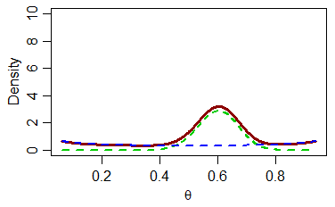
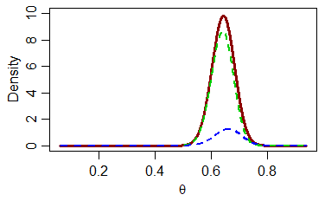
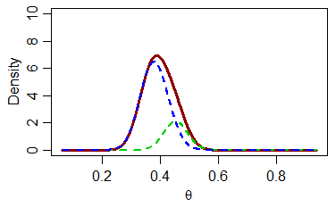
Example of robust mixture analysis for binary outcome
Prior weights
w* (info) = 0.5
(1-w*) (vague) = 0.5
Prior mixture for responder rate (θ) based on External Study data with y_{S} = 30 out of N_{S} =50 responders
Posterior mixture for responder rate (θ) if y_{T} = 66 out of N_{T} =100 responders are observed in New Study
Posterior mixture for responder rate (θ) if y_{T} = 38 out of N_{T} =100 responders are observed in New Study
Posterior weights
w* (info) = 0.85
(1-w*) (vague) = 0.15
Posterior weights
w* (info) = 0.21
(1-w*) (vague) = 0.79
Notes:
Negative EbSS ═>variance of posterior based on mixture prior is greater than variance based on new study data alone.
Divergence between external and new study data leads to increased uncertainty about true responder rate

Slide 18
How much information is borrowed from the prior?
2 useful metrics
Posterior (updated) weight on the external data (informative component)
  Can be interpreted as the probability that the external data are relevant (exchangeable) to the new study population, given the assumed prior probability of relevance and the observed level of consistency between the new and external data
  Posterior weight of X% does not mean that X% of the external data sample size is borrowed

Slide 19
How much information is borrowed from the prior?
2 useful metrics
Effective sample size (ESS) borrowed from the prior
  Measures the information gained from the prior in terms of how many additional subjects (with the same mean and between-subject variability as the new study subjects) the prior is worth
  No unique definition of ESS for non-conjugate priors
    Several alternatives in literature and implemented in RBesT R package (moment, Morita, ELIR)
  With dynamic borrowing, the amount of information borrowed from the prior depends on the new study data
    Effective borrowed Sample Size after observing new study data =
    (Posterior ESS – N)
    where N = new study sample size

Slide 20
Example of ESS for binary outcome
Prior weights
w* (info) = 0.5
(1-w*) (vague) = 0.5
Prior mixture for responder rate (θ) based on External Study data with y_{S} = 30 out of N_{S} =50 responders
Prior ESS = 15
(ELIR method)
Posterior mixture for responder rate (θ) if y_{T} = 66 out of N_{T} =100 responders are observed in New Study
Posterior mixture for responder rate (θ) if y_{T} = 38 out of N_{T} =100 responders are observed in New Study
Posterior weights
w* (info) = 0.85
(1-w*) (vague) = 0.15
Posterior weights
w* (info) = 0.21
(1-w*) (vague) = 0.79
Posterior ESS = 136
EbSS = 136 – 100 = 36
Posterior ESS = 79
EbSS = 79 – 100 = −21
Notes:
Negative EbSS ═>variance of posterior based on mixture prior is greater than variance based on new study data alone.
Divergence between external and new study data leads to increased uncertainty about true responder rate
ELIR fulfils predictive consistency. The predictive consistency of the ESS requires that the ESS of a prior is the same as averaging the posterior ESS after a fixed amount of events over the prior predictive distribution from which the number of forward simulated events is subtracted

Slide 21
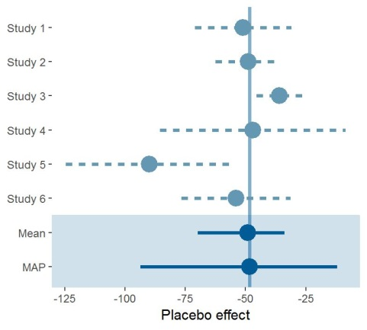
Multiple External Studies
Meta-Analytic Predictive (MAP) Priors
Several external studies available
Random-effects meta-analysis accounts for between-trial variability
Focus on the predictive effect
  true effect expected in the next study
  serves as prior for the actual study → MAP (meta-analytic predictive) prior
Example
N
74
166
238
20
25
58

Slide 22
Case Studies

Slide 23
Example 1: Bayesian dynamic borrowing of historical control data in a randomised phase II study
Presenter: Oliver Sailer (Boehringer Ingelheim)
Content: Luca Richeldi et al. NEJM 2022,
Florian Voss & BI 1015550 Statistics team at Boehringer Ingelheim

Slide 24
Trial of a Preferential Phosphodiesterase 4B Inhibitor for Idiopathic Pulmonary Fibrosis
Luca Richeldi
Fondazione Policlinico Universitario A. Gemelli IRCCS, Università Cattolica del Sacro Cuore, Rome, Italy
On behalf of Arata Azuma, Vincent Cottin, Christian Hesslinger, Susanne Stowasser, Claudia Valenzuela, Marlies S. Wijsenbeek, Donald F. Zoz, Florian Voss, Toby M. Maher
15th May 2022

Slide 25


Aim
In this Phase II study, we investigated the efficacy and safety of BI 1015550,
an oral preferential inhibitor of PDE4B, in patients with IPF without and with background antifibrotics
IPF, idiopathic pulmonary fibrosis; PDE4B, phosphodiesterase 4B.
Richeldi L, et al. N Engl J Med. 2022.

Slide 26


Phase 2 study investigated the efficacy and safety of
BI 1015550 in patients with IPF
Primary endpoint
Change from baseline in FVC in mL at 12 weeks
Primary analysis Bayesian analysis
Secondary endpoint Percentage of patients with
treatment-emergent adverse events
Treatment period (12 week)
Follow-up
(1 week)
BI 1015550 18 mg BID
(n=97)
R
(2:1)
Placebo
(n=50)
Patients with IPF
Randomization was stratified based on use of background antifibroticsª
(without or with) at baseline
ªReceived a stable dose of nintedanib or pirfenidone for at least 8 weeks prior to screening.
BID, twice daily; FVC, forced vital capacity; IPF, idiopathic pulmonary fibrosis.
Richeldi L, et al. N Engl J Med. 2022.

Slide 27
Analyses
The primary endpoint was evaluated separately in patients without and with background antifibrotics at baseline in a two-step procedure:
1
Data from the current trial were analyzed with a restricted maximum
likelihood-based approach using an MMRM
2
The pre-specified primary analysis of FVC change was based on a Bayesian approach
combining MMRM estimates and historical data for the placebo arms
Bayesian analysis: historical data from the nintedanib IPF trials were incorporated for the placebo
arms as prior information to reduce the number of patients randomized to placebo
TOMORROW, INPULSIS-1 and -2, INMARK, INSTAGE, INJOURNEY and NCT01979952
FVC, forced vital capacity; IPF, idiopathic pulmonary fibrosis; MMRM, mixed model with repeated measurements.
Richeldi L, et al. N Engl J Med. 2022.

Slide 28


Primary analysis: Bayesian analysis incorporating historical data
Informative priors were chosen for the placebo groups
Observed data
Informative prior
Data from the current trial and prior information were combined via Bayesian analysis to derive posterior distribution for treatment difference
Bayesian analysis
Based on the posterior distribution, the median, 95% credible intervals and probabilities that BI 1015550 were superior to placebo were calculated
Primary endpoint
Posterior distribution
Richeldi L, et al. N Engl J Med. 2022.

Slide 29
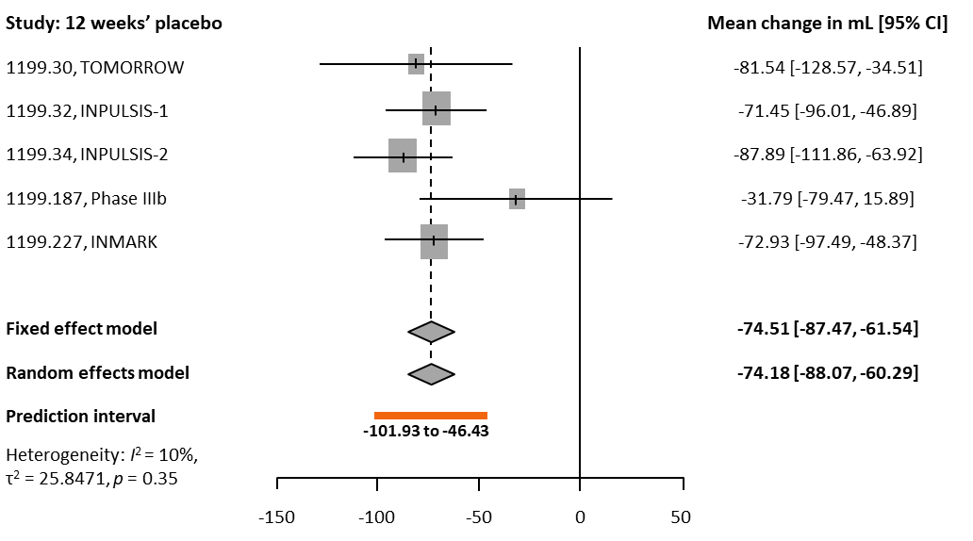
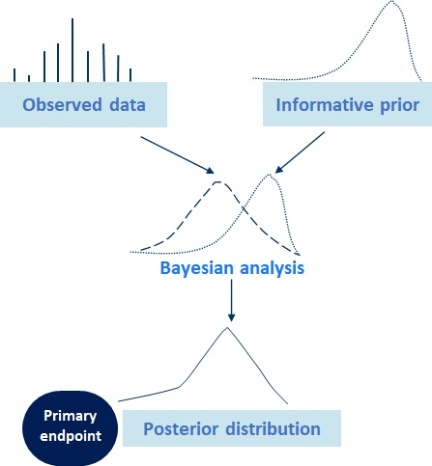
Historical data for placebo group: stratum without background antifibrotics
The prior used for analysis was a meta-analytic predictive prior based on Bayesian meta-analysis.
CI, confidence interval; FVC, forced vital capacity.
Richeldi L, et al. N Engl J Med. 2022.

Slide 30
Robust mixture prior calculation
Robust MAP approach (Schmidli 2014 Biometrics) as implemented in R package RBesT (Weber 2020 JSS)
MAP prior from Bayesian hierarchical model
Approximated by mixture of normal distributions
Robustified to allow for dynamic borrowing depending on prior-data conflict, using a weakly informative component
Additional aspect: Variance inflation in all components to achieve target prior ESS = 20
„There was confidence that the data is of relevance, but due to the size of the available historical studies and the size of the placebo group, the prior was chosen in such a way that it will not dominate the analysis.“ (Richeldi 2022 NEJM)

Slide 31
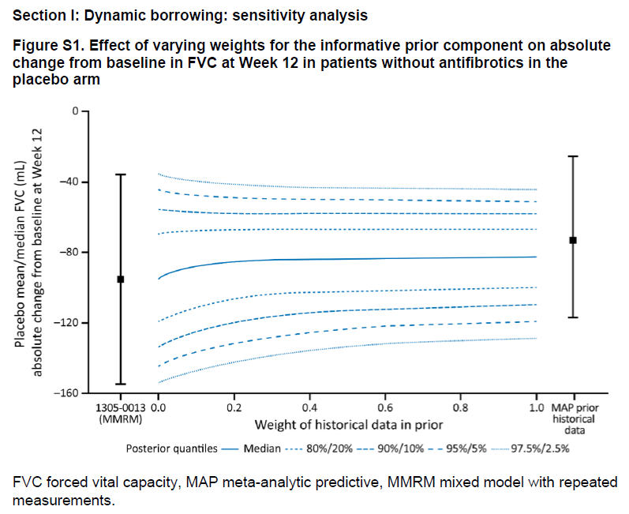
Robust mixture prior calculation
Weight of robust component assesed by sensitivity analysis
Considering both data scenarios and frequentist operating characteristics
Figure S1 (Richeldi 2022 NEJM): post-hoc sensitivity analysis

Slide 32
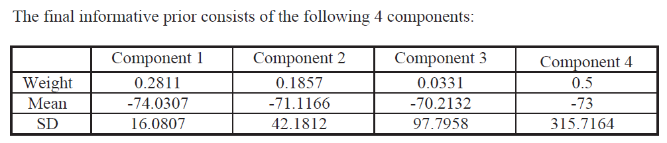
Robust mixture prior calculation
Richeldi 2022 NEJM

Slide 33
Phase 2 study with BI 1015550:
Change in FVC at Week 12 by MMRM analysis
Without background antifibrotics
With background antifibrotics
(n=47) (n=25)
(n=48) (n=25)
60
40
20
6.1
2.7
0
-20
-40
Mean (95% CI) change from baseline in FVC (mL) at Week 12
-60
-80
-77.7
-100
-95.6
-120
-140
-160
∆101.7 mL
(95% CI 25.0, 178.4 nominal P=0.010)
∆80.4 mL
(95% CI 20.9, 140.0 nominal P=0.009)
BI 1015550
Placebo
CI, confidence interval; FVC, forced vital capacity; MMRM, mixed model for repeated measures.
Figure taken from the New England Journal of Medicine, Richeldi L, Azuma A, Cottin V, et al., Trial of a Preferential Phosphodiesterase 4B Inhibitor for Idiopathic Pulmonary Fibrosis. Copyright © (2022) Massachusetts Medical Society. Reprinted with permission.
Richeldi L, et al. N Engl J Med. 2022.

Slide 34
Phase 2 study with BI 1015550:
Change in FVC at Week 12 by Bayesian analysis
Without background antifibrotics
With background antifibrotics
60
40
20
5.7
2.7
0
-20
-40
Median (95% CrI) change from baseline in FVC (mL) at Week 12
-60
-59.2
-80
-100
-81.7
-120
-140
∆62.4 mL
(95% CrI 6.3, 125.5)
-160
∆88.4 mL
(95% CrI 29.5, 154.2)
BI 1015550
Placebo
99.8% probability that
BI 1015550 is superior
to placebo
98.6% probability that
BI 1015550 is superior
to placebo
CI, confidence interval; FVC, forced vital capacity; MMRM, mixed model for repeated measures.
Figure taken from the New England Journal of Medicine, Richeldi L, Azuma A, Cottin V, et al., Trial of a Preferential Phosphodiesterase 4B Inhibitor for Idiopathic Pulmonary Fibrosis. Copyright © (2022) Massachusetts Medical Society. Reprinted with permission.
Richeldi L, et al. N Engl J Med. 2022.

Slide 35

Conclusions
Treatment with BI 1015550, either alone or with background antifibrotics, prevented a decline in lung function in patients with IPF as measured by FVC
The Bayesian analysis led to more conservative estimates of the magnitude of treatment effect but supported the robustness and increased confidence in results
Safety and tolerability of BI 1015550 was acceptable, and alongside the beneficial effects on FVC, warrants further clinical development as a treatment for IPF and other forms of progressive pulmonary fibrosis
FVC, forced vital capacity; IPF, idiopathic pulmonary fibrosis.
Richeldi L, et al. N Engl J Med. 2022.

Slide 36
Example 2: Bayesian dynamic borrowing of external control data as a supportive OS analysis
Presenter: Julia Niewczas (J&J)

Slide 37
Two Oncology Studies in the same indication
Consider a setting in which a sponsor plans two Phase 3 studies in the same indication in the same population
  Two studies in a highly similar population with the majority of patients receiving the same control treatment
  Primary endpoint is Progression Free Survival
  Key secondary endpoint is Overall Survival (OS)
  Same Stratification Factors
  Same inclusion/exclusion criteria

Slide 38
Study 1 Design
Study 2 Design
Arm A: Drug B
(N = 225)
Arm A: Drug A
(N = 250)
N1 Subjects
Randomization 1:1
N= 550
Randomization 1:1
Arm B: Investigator’s choice
Drug C or Drug D
(N = 225)
Arm B: Drug C
(N = 250)
Primary endpoint is Progression Free Survival
Key secondary endpoint is Overall Survival (OS)
Same Stratification Factors
Same inclusion/exclusion criteria

Slide 39
Statistical design timelines for Overall Survival
Study 1: Drug A vs Drug C
N= 550
mOS: 38 vs 50.5mo (HR=0.75)
Power 70%
2-sided alpha=5% KDM rho=2
PFS FA
OS IA1
# OS events=95 IF=30%
OS IA2
# events=222, IF=70%
OS Final Analysis
# events317
LPI 22 mo
~ 25mo
~ 48 mo
~ 75 mo
Study 2: Drug B vs Drug C/D
N= 450
mOS: 38 vs 54mo (HR=0.7)
Power >80%
2-sided alpha=5% KDM rho=2
PFS FA
OS IA1
# OS events=82, IF=30%
OS Final Analysis
# events=272
OS IA2
# OS events=190, IF=70%
LPI 18 mo
~ 22 mo
~ 45 mo
~ 70mo

Slide 40
Proposal for OS analysis
We propose to combine OS data from Study 1 with control-arm survival information from Study 2 provided this pooling of survival data is statistically valid.
Trend is important to support registration however there is slow accrual of events. Therefore, the additional Drug C data from Study 2 will enable earlier determination of the benefit/risk of Drug A on the OS endpoint.

Slide 41
Simulations within our setting
Study 1 assumptions
    mOS Drug C = 38mo vs mOS Drug A = 50.5mo
    Analysis at 75mo corresponding to 317 events
Study 2 assumptions
    mOS Drug C = 38mo vs mOS Drug B = 54mo
    Analysis at 70mo corresponding to 272 events
Borrow from Study 2 to Study 1, 450pts total in Study 2
Assuming 150 (66.7%) patients borrowed
    Corresponding to 99 events at Final Analysis

Slide 42
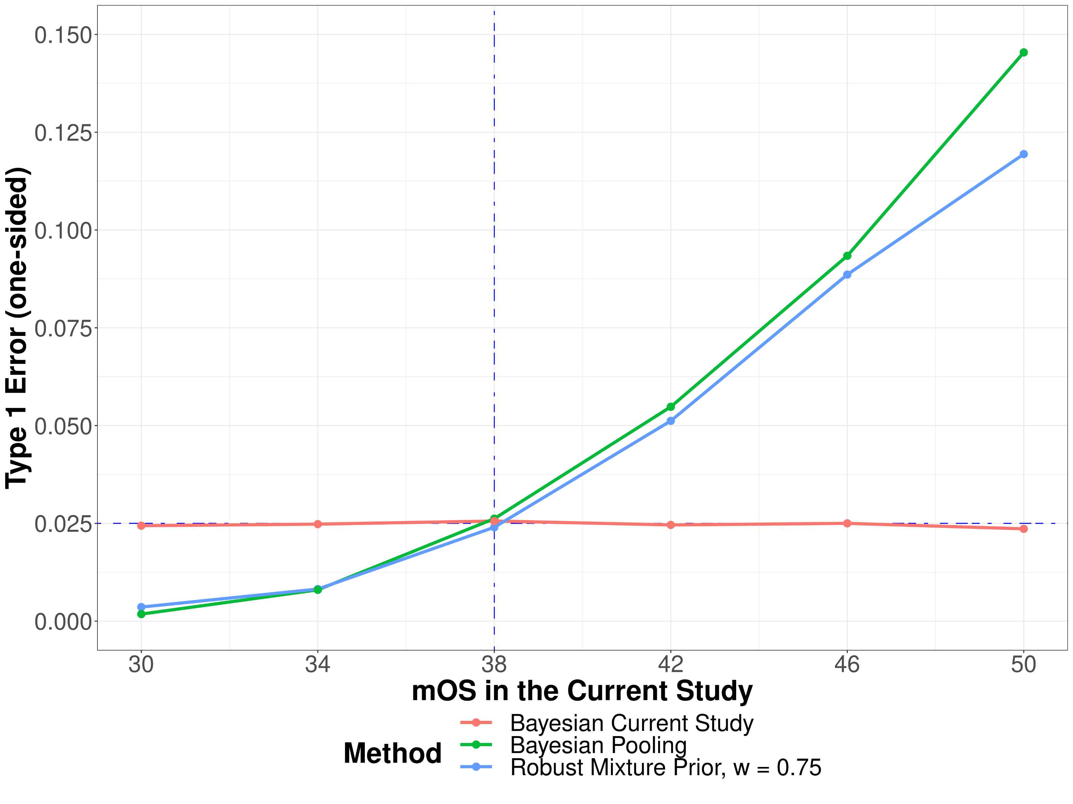
Results
HR of control arms of 0.75!
Type 1 Error Depending on mOS
Method | Power (%) IA1 | Power (%) IA2 | Power (%) FA
Bayesian Current Study | 7.8% | 44.4% | 69.8%
Bayesian Pooling | 10.2% | 53.3% | 79.3%
Robust mixture prior w=0.75 | 10.0% | 52.7% | 78.8%
Power under alternative hypothesis assuming mOS on Drug C = 38mo in both studies and the Hazard Ratio of 0.75

Slide 43
Conclusions
Incorporation of external OS information on the control could provide additional information on benefit/risk assessment
Could be used as a supplemental analysis
Type 1 error inflation will exist
  ... but we may need to care for the likelihood of scenarios with inflation.
Large external control -> heavily influences the posterior even for small w

Slide 44
Example 3: Benlysta for Systemic lupus erythematosus (SLE) in paediatric patients
Presenter: Nicky Best (GSK)

Slide 45
Example 3: Benlysta for SLE in paediatric patients
Benlysta is approved for treatment of adults with active, autoantibody-positive systemic lupus erythematosus (SLE), which was supported by two pivotal Phase 3 studies
The PLUTO study was carried out in children aged 5-17 with SLE as part of the paediatric post-marketing requirement.
Paediatric lupus is very rare, and shares the same pathophysiology and disease manifestations as adult SLE.
  A fully powered study with a large sample size was not feasible.
  Consideration should be given to avoid exposing children to placebo-controlled trials unnecessarily.
  Study was designed using a bridging strategy to show directional consistency in efficacy and safety with adults, and was not powered for any hypothesis testing.
  It was agreed with regulators to collect data from ~90 subjects and summarise results descriptively.

Slide 46
FDA review of Benlysta paediatric submission
PLUTO study completed in 2018 and GSK submitted an application to FDA for a paediatric label expansion in October 2018, with approval received in April 2019
During the pre-NDA meeting, FDA made some analysis requests:
  FDA noted that the previous adult studies “may provide some useful information that is relevant to the paediatric population”
  Recommended that sponsor conduct sensitivity analyses using Bayesian dynamic borrowing (Bayesian mixture prior) which utilizes efficacy information from the adult studies
  Specifically requested a “tipping point” style analysis to quantify how much prior belief (range of prior weights) in the applicability of the Adult result it would take in order for the Paediatric study data to look convincing

Slide 47
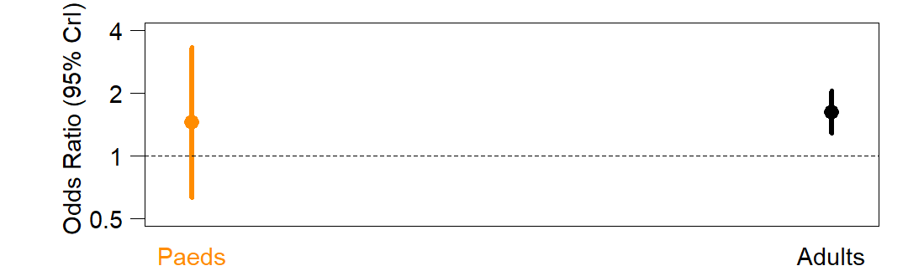
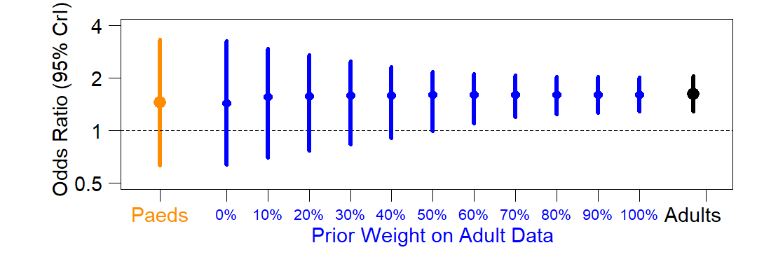
Tipping point Bayesian dynamic mixture prior analysis of Benlysta paediatric study: SRI Responder endpoint
Paediatric
Data
(N=92)
Tipping point:
55% prior weight
Adult
Ph3 Data
(N=1125)
Favours Benlysta
Favours Placebo

Slide 48
Analysis of Credibility
Tipping point approach is a type of “analysis of credibility”
  identify properties of the prior distribution needed to achieve a certain posterior statement for the data at hand
  used to assess the plausibility of scientific claims and findings
The weight corresponding to the tipping point = minimum prior belief in the relevance of the adult data needed to find the evidence from the paediatric study convincing
Allows a range of decision-makers – who may hold different prior beliefs – to assess the credibility of the evidence in the paediatric population.
Held, L. (2019). The assessment of intrinsic credibility and a new argument for p < 0.005. R. Soc. open sci. 6:181534
Matthews R. (2018). Beyond ‘significance’: principles and practice of the analysis of credibility. R. Soc. open sci. 5, 171047
Good, I.J. (1950). Pobability and the Weighing of Evidence. Griffin, London, UK
Notes:
Mention Oliver’s talk

Slide 49
FDA conclusion
“Based on discussion and feedback obtained from the clinical team, it appears reasonable to assume at least 55% weight on the relevance of the adult information to the pediatric population and we can therefore conclude that there is at least 97.5% posterior probability that Benlysta has a positive treatment effect in pediatric subjects”
https://www.fda.gov/media/127912/download

Slide 50


Example 4: B-SAFE App: integrating historical clinical trial safety data in the adverse event analysis of a new clinical trial
Presenter: Oliver Sailer (Boehringer Ingelheim)
QUIC
A Global BDS-TMCP Initiative

Slide 51
B-SAFE App: integrating historical clinical trial safety data in the adverse event analysis of a new clinical trial
B-SAFE is a cross-functional collaboration integrating historical clinical trial safety data in the adverse event analysis of a new clinical trial at Boehringer Ingelheim.
  Pilot R Shiny App developed for a RCT comparing a new respiratory compound to SOC.
Interactively guides users through a Bayesian safety analysis of adverse event (AE) incidence proportions and incidence rates
  MAP prior models for binary data and exponential distribution (Schmidli 2014 Biometrics, Roychoudhury & Neuenschwander 2020 StatMed)
Summary tables are provided that correspond to traditional AE summary tables and that also allow probabilistic comparisons of safety between treatment arms.

Slide 52
Other examples
Robust MAP prior to borrow adult data on investigational treatment and adult & paediatric data on active comparator for NI Ph3 trial in paediatric MS (Novartis)
Robust mixture prior to borrow treatment effect of approved respiratory medicine from pivotal Ph3 trial in bridging study for China (GSK – presented at PSI 2021)
Robust mixture prior to borrow healthy volunteers data on receptor occupancy to design a PoC study in patients in immuno-inflammation (Servier – see poster)​

Slide 53
Designing a BDB study:
A framework to engage with regulatory authorities
Presenter: Gaëlle Saint-Hilary (Saryga)

Slide 54

A piece of cake...
Working assumption: scenario where both regulators and industry agree this is a reasonable case for using dynamic borrowing and that there are high quality external data, that covariates are similarly distributed etc
The objective of this presentation is mainly to present a recipe for one flavour of icing (Bayesian dynamic borrowing)
Bayesian dynamic borrowing, operating characteristics and sensitivity analyses
Reasonable case for external / historical data

Slide 55
Focus of this presentation
Case-studies to illustrate a proposed framework
to evaluate and present an augmented RCT for one ‘flavour’ of icing
(Bayesian dynamic borrowing)
Recipe to evaluate and present design characteristics
Recipe to evaluate and present results

Slide 56
Structured evaluation & presentation of design characteristics
  Proposed framework
  Rationale for the chosen design
  Operating characteristics of the chosen design
  Operating characteristics to help select design parameters
  Illustrative results of the chosen design under selected data scenarios
Framework to be presented at the design stage, suitable for any method
Pre-specification of design points that achieve ‘desirable’ frequentist operating characteristics
Comparison with a classical frequentist design

Slide 57
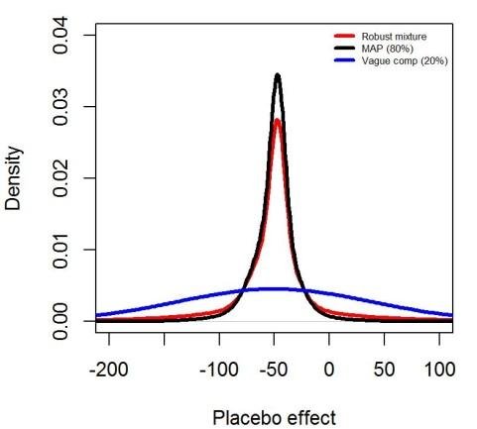
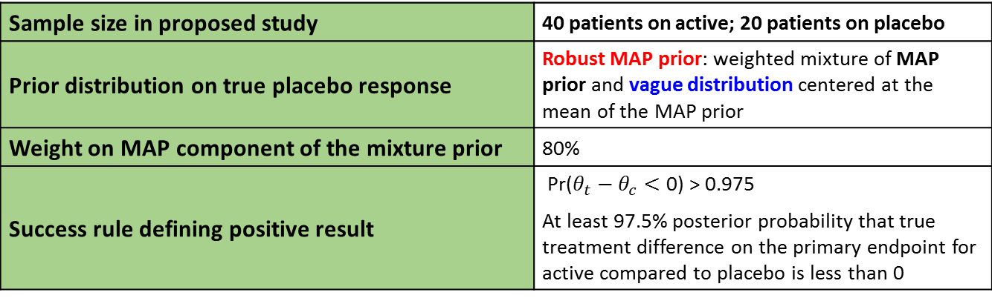
Case-study 1: borrowing from historical control data
Double-blind, randomised study, experimental vs placebo (2:1 ratio)
Primary endpoint:
  Improvement = negative values
  Normally distributed
Historical placebo data: 6 studies with 671 patients in total
Objective of using a BDB design: take advantage of the available evidence to estimate the treatment effect with precision while reducing the number of patients exposed to placebo
Key elements of the proposed BDB design:
Sample size in proposed study | 40 patients on active; 20 patients on placebo
Prior distribution on true placebo response | Robust MAP prior: weighted mixture of MAP prior and vague distribution centered at the mean of the MAP prior
Weight on MAP component of the mixture prior | 80%
Success rule defining positive result | $\text{Pr}\text{(}θ_{t}−θ_{c}<\text{0)}\text{ > }\text{0.9}\text{7}\text{5}$ At least 97.5% posterior probability that true treatment difference on the primary endpoint for active compared to placebo is less than 0

Slide 58
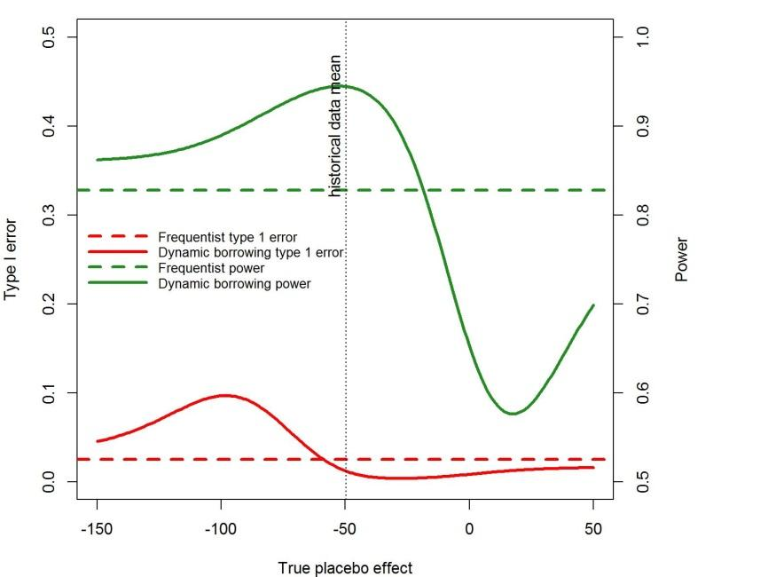
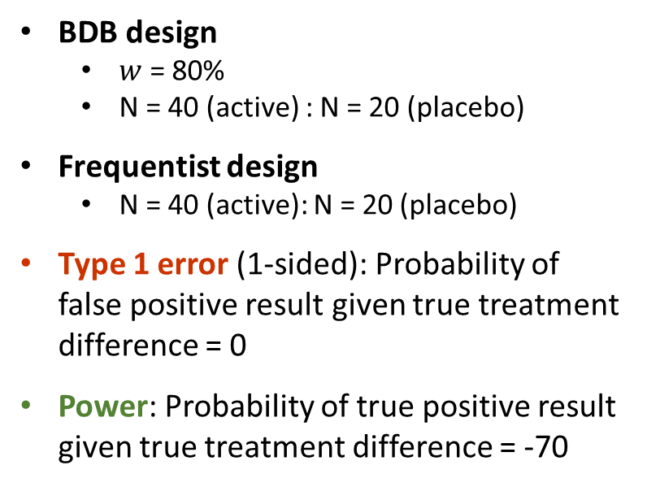
Presentation of design characteristics (case-study 1)
BDB design
  $w$ = 80%
  N = 40 (active) : N = 20 (placebo)
Frequentist design
  N = 40 (active): N = 20 (placebo)
Type 1 error (1-sided): Probability of false positive result given true treatment difference = 0
Power: Probability of true positive result given true treatment difference = -70
Walley RJ, Grieve AP. Optimising the trade-off between type I and II error rates in the Bayesian context. Pharm Stat. 2021 Jul;20(4):710-720.

Slide 59
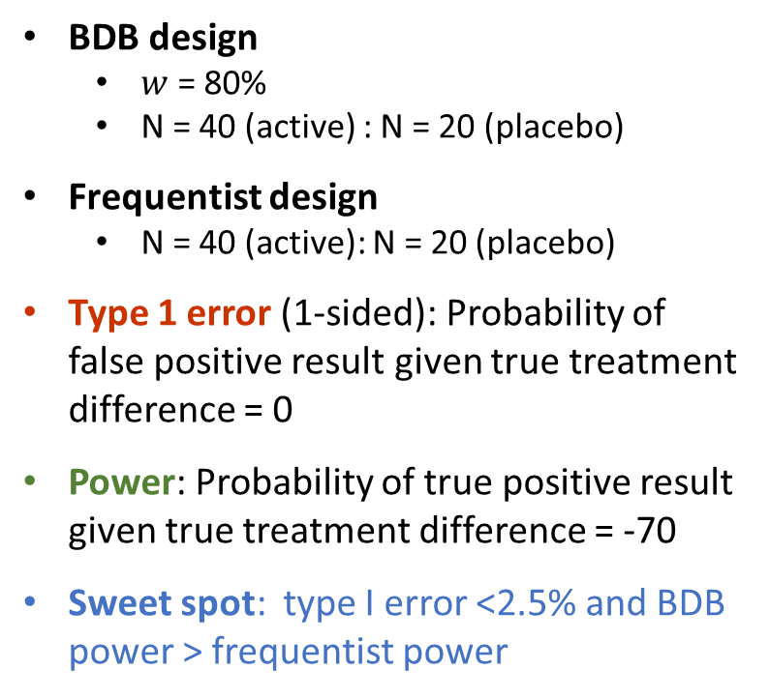
Presentation of design characteristics (case-study 1)
Power given no drift
BDB design
  $w$ = 80%
  N = 40 (active) : N = 20 (placebo)
Frequentist design
  N = 40 (active): N = 20 (placebo)
Type 1 error (1-sided): Probability of false positive result given true treatment difference = 0
Power: Probability of true positive result given true treatment difference = -70
Sweet spot: type I error <2.5% and BDB power > frequentist power
Max type I error
Type 1 error given no drift
Type I error > 5%
Sweet spot

Slide 60
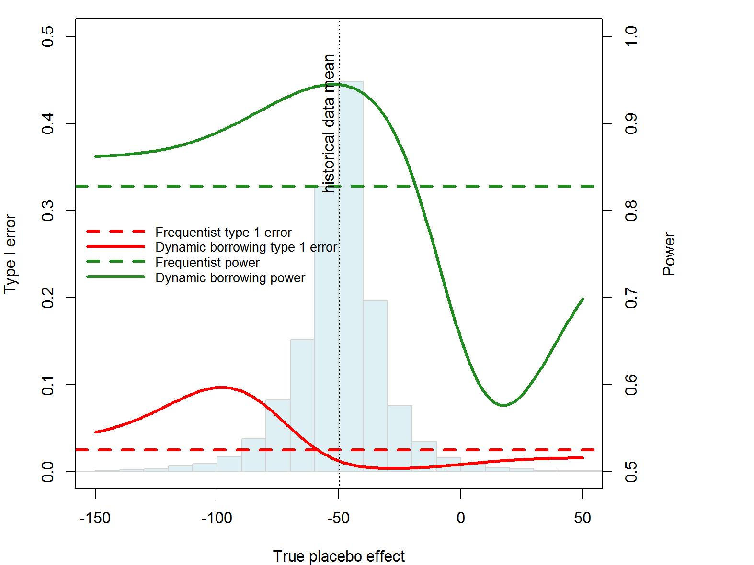
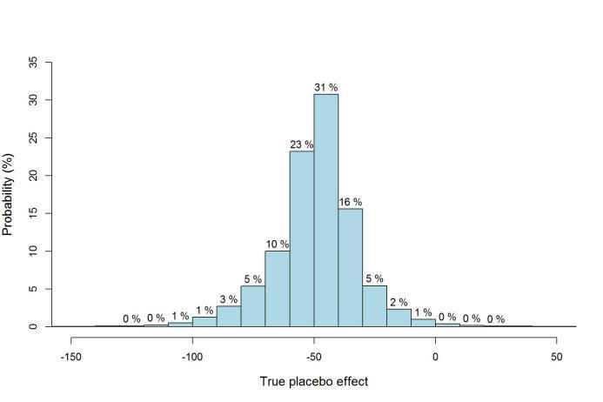
Presentation of design characteristics (case-study 1)
Based on the MAP prior
1.3% risk of true pbo effect ≤ -100 (max type I error)
10.4% risk of type 1 error >5%
71.1% probability for the sweet spot
What we know on the placebo effect:
MAP prior density histogram
Max type I error
Type I error > 5%
Sweet spot
✓ Basis for discussion with health authorities
(“Are these probabilities acceptable in this case?”)

Slide 61
Focus on Type I error metrics (case-study 1)
Pointwise type 1 error and Average type 1 error
BDB design Pointwise type 1 error | no drift Max pointwise type 1 error Average type 1 error, over MAP prior Average type 1 error, over robust MAP prior Frequentist design | 1.3% 10.0% 2.0% 2.3% 2.5%
Power given no drift
Averaged over plausible distributions
Analogy with Power and Assurance = average power
BDB design Power | no drift Max power Average power, over MAP prior Average power, over robust MAP prior Frequentist design | 95% 95% 93% 91% 83%
Max type I error
Type 1 error given no drift
Discussion with health authorities to agree what scenarios are possible
Summarises the risk of making an incorrect decision in favour of treatment benefit

Slide 62
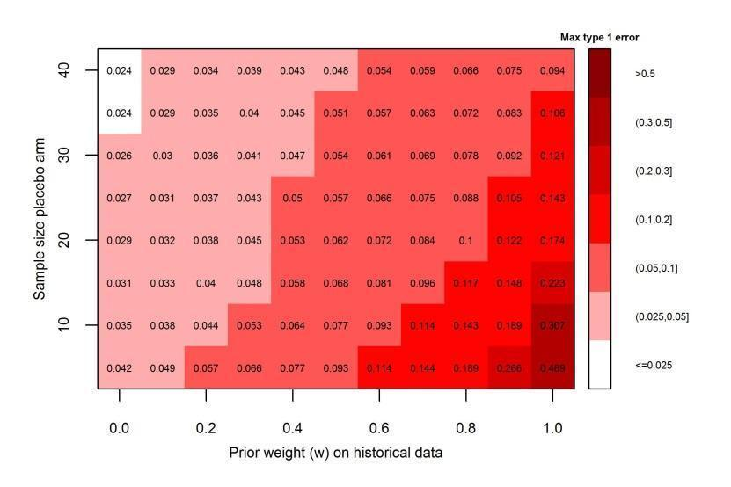
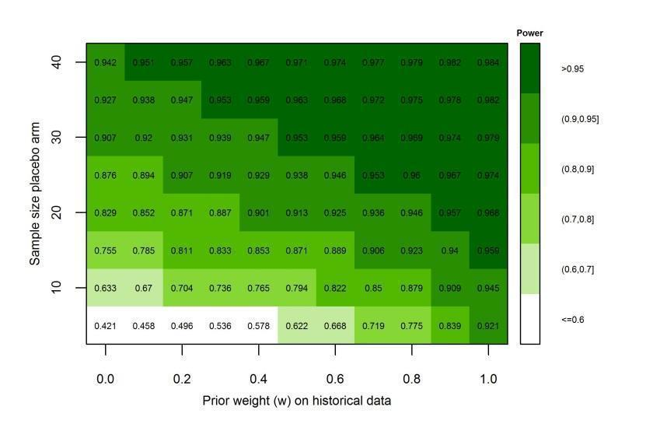

Presentation of design characteristics (case-study 1)
Operating characteristics to help select the design parameters
Maximal type I error
Varying the true placebo effect between -150 and 50
Power
Assuming a true placebo effect = -50 (consistent with historical data) and a true treatment difference = -70
0.10
0.946
= chosen BDB design, $w$ =80%; N=40 (active): N = 20 (placebo)
✓ Understand the impact of different assumptions on the risk of false positive and false negative conclusions

Slide 63
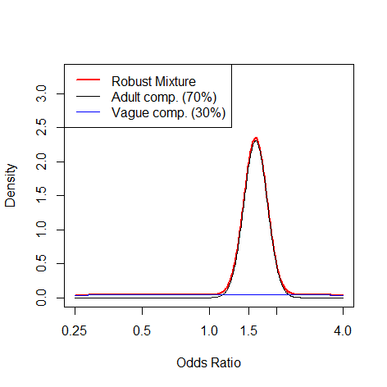
Case-study 2: borrowing historical data on a treatment difference
Bridging study with partial extrapolation of efficacy from adults to children
Disease is very rare in children, challenging recruitment setting
Paediatric study: Double-blind, randomised trial, experimental vs placebo
Primary endpoint:
  Disease activity responder index, summarized by Odds Ratio for active v placebo (assumed Normally distributed on log scale)
Historical adult data from same sponsor: Pooled results on primary endpoint from 2 pivotal Ph3 studies
Objective of using a BDB design: supplement paediatric data with data from adult population to improve power and precision of paediatric efficacy estimates in setting where paediatric and adult treatment effects are expected to be similar
Key elements of the proposed BDB design:
Sample size in proposed paediatric study | 50 patients on active; 50 patients on placebo
Prior distribution on true placebo response | Robust MAP prior: weighted mixture of posterior distribution of treatment effect from adult study and vague distribution centered on 0
Weight on MAP component of the mixture prior | 70%
Success rule defining positive result | At least 97.5% posterior probability that true odds ratio of response on the primary endpoint for active compared to placebo is greater than 1

Slide 64
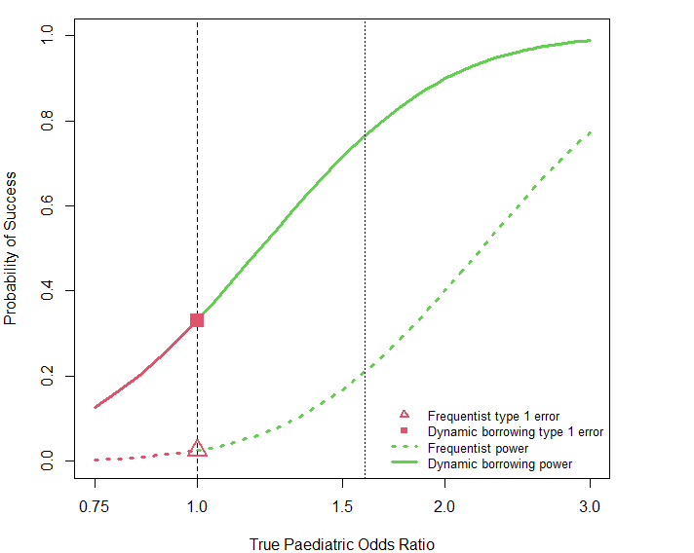
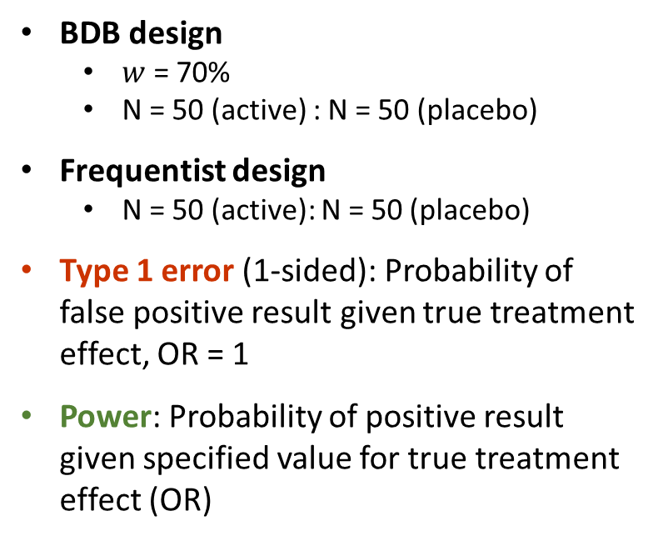
Presentation of design characteristics (case-study 2)
BDB design
  $w$ = 70%
  N = 50 (active) : N = 50 (placebo)
Frequentist design
  N = 50 (active): N = 50 (placebo)
Type 1 error (1-sided): Probability of false positive result given true treatment effect, OR = 1
Power: Probability of positive result given specified value for true treatment effect (OR)
77%
Null OR
Adult data OR
33%
21%
2.5%
Note: borrowing information on the treatment effect inevitably increases the type 1 error (no sweet spot)

Slide 65
Presentation of design characteristics: Summary
‘Calibrated Bayes’ approach: select design points that achieve ‘desirable’ frequentist operating characteristics
Design points to be specified in a BDB design with an informative prior may include:
  Informative and vague components of the robust mixture prior
  Initial weight on the historical data (informative prior component)
  Decision rule
  Sample size
In general, there are several combinations of these design points that will achieve ‘desirable’ frequentist operating characteristics
The proposed framework supports the pre-specification of these design points, with scientific and technical rationales
We recommend that sponsors present this framework to enable a robust discussion with health authorities to evaluate the risk-benefit of a BDB design

Slide 66
Structured evaluation & presentation of results
Proposed framework
Results of primary analysis
  Tabular/graphical summaries of data, prior and posterior, with and without borrowing on historical data
  Prior & posterior probability of efficacy
  Prior & posterior weight on evidence informed by the historical data
  Assessment of concordance between historical and current data
Sensitivity analyses
  Designed to assess robustness to key assumptions:
  Tipping point analysis varying prior weight allocated to historical data
  Discussion of main potential sources of bias (drift) and sensitivity analysis to reasonable assumptions
  Additional supportive analyses as needed

Slide 67
Reporting of primary analysis: Summaries of data, prior & posterior (case-study 1)
Key elements to be included when reporting results of primary analysis in each MAA:
Evidence source | Treatment difference: Active-Placebo |  | Active effect |  | Placebo effect
Primary analysis - posterior | -46.3 | (-81.7, -6.6) | -98.8 | (-126.0, -71.5) | -51.4 | (-82.3, -30.1)
Current study only | -40.0 | (-88.3, 8.3) | -100 | (-127.6, -72.4) | -60.0 | (-99.6, -20.4)
Historical MAP prior for placebo effect | - | - | - | - | -48.5 | (-92.8, -10.9)
Robust MAP prior for placebo effect | - | - | - | - | -48.2 | (-153.6, 52.9)
Posterior median and equal-tailed Bayesian posterior 95% credible interval (CrI) are reported for the primary analysis and the historical placebo response, and maximum likelihood estimate and Wald 95% confidence intervals (CI) are reported for the separate analysis based on the current study data only.
Permits comparison of primary Bayesian analysis (row 1) with:
    result of a classical frequentist analysis of current study data alone (row 2)
    result based on the prior information alone (rows 3 & 4)
    to enable transparent assessment of contribution of each source of evidence

Slide 68
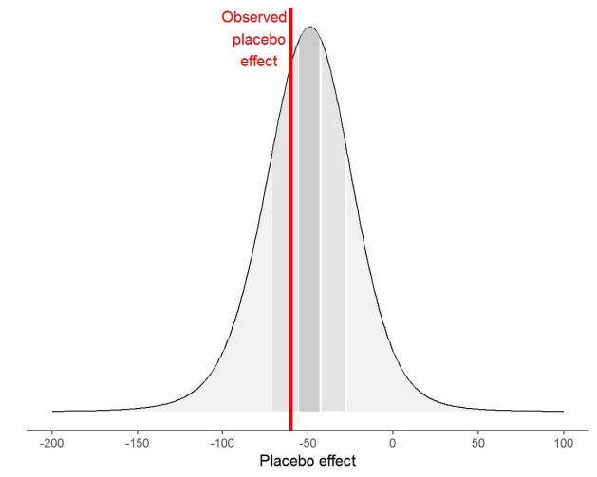
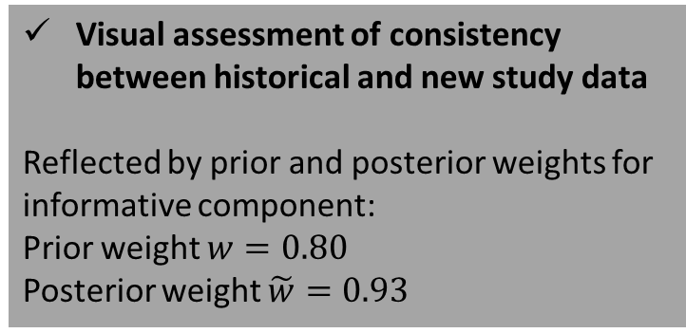
Reporting of primary analysis: Concordance of data and prior (case-study 1)
Prior predictive distribution (pre-specified): predicted distribution of observed placebo effect in new study, assuming true effect is consistent with historical prior
Observed placebo effect in new study
    Visual assessment of consistency between historical and new study data
    Reflected by prior and posterior weights for informative component:
    Prior weight $w=0.80$
    Posterior weight $\tilde{w}=0.93$

Slide 69
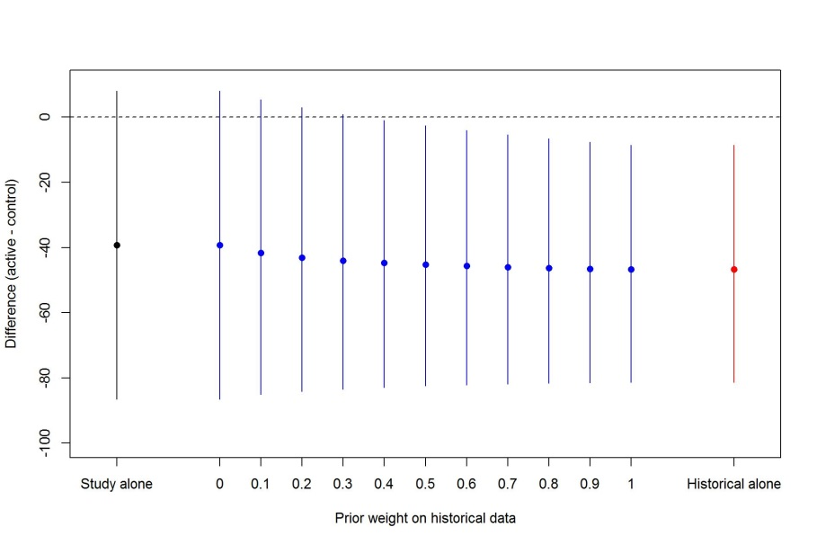
Sensitivity analysis: Tipping point analysis to varying prior weight (case-study 1)
    Visual comparison of prior, new study data and posterior under full range of assumptions about relevance of prior information
    How sceptical must we be about the relevance of the historical data in order to change the study conclusion?
Tipping point
Pre-specified prior weight for primary analysis
Range of prior weights for which the study conclusion (met primary success rule) is robust

Slide 70
Presentation of results: Summary
Results of primary analysis
  Summaries of the results with and without borrowing on historical data to enable transparent assessment of contribution of each source of evidence
  Sensitivity analyses
  Should be pre-specified to avoid ‘cherry picking’ results based on post-hoc assumptions
  Designed to assess robustness to key assumptions
  Additional supportive analyses as needed to characterise e.g. time trends, differences in background therapy, assessment procedures etc. between historical and current setting

Slide 71
Agenda
Part 1: Theory and Examples (now)
Overview of Bayesian Dynamic Borrowing (BDB) methods, with focus on robust mixture priors (Nicky)
Case studies (Oliver, Julia, Nicky)
Designing a BDB study: A framework to engage with regulatory authorities (Gaëlle)
Part 2: Workshop (after coffee break)
In breakout groups, work through framework to help prepare for an end-of-phase 2 regulatory advice meeting focusing on leveraging historical control data for a pivotal study (Leads: Simon & Aaron)

Slide 72
Back-up

Slide 73
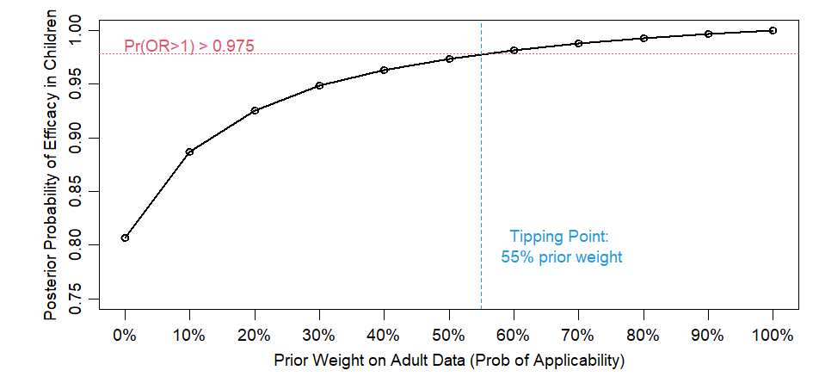
Tipping point Bayesian dynamic mixture prior analysis of Benlysta paediatric study

Slide 74
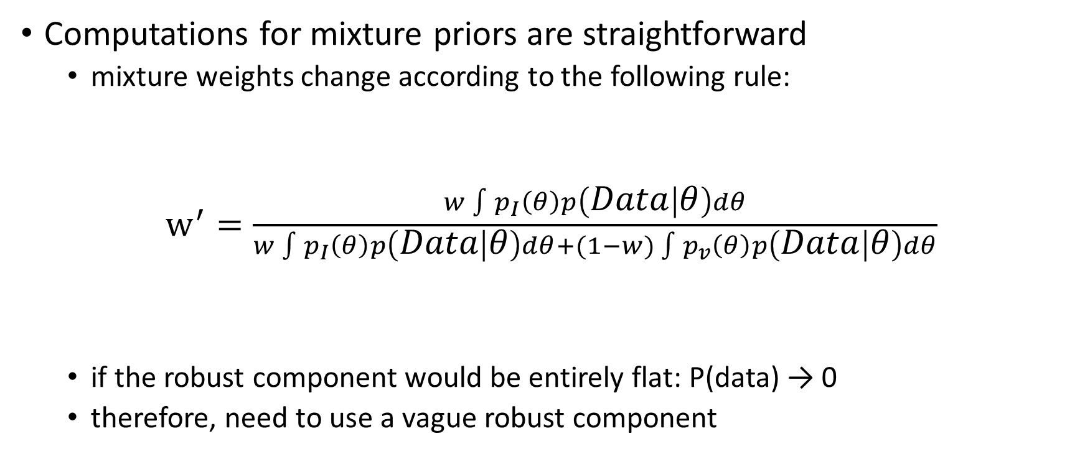
Explain why improper vague prior doesn’t work
Computations for mixture priors are straightforward
  mixture weights change according to the following rule:
$w^{′}=\frac{w\int{p_{I}\left(θ\right)p\left(Data | θ\right)dθ}}{w\int{p_{I}\left(θ\right)p\left(Data | θ\right)dθ}+(1−w)\int{p_{v}\left(θ\right)p\left(Data | θ\right)dθ}}$
  if the robust component would be entirely flat: P(data) → 0
  therefore, need to use a vague robust component
probability of data given prior p_{I}
weight before data observed
normalizing factor

Slide 75
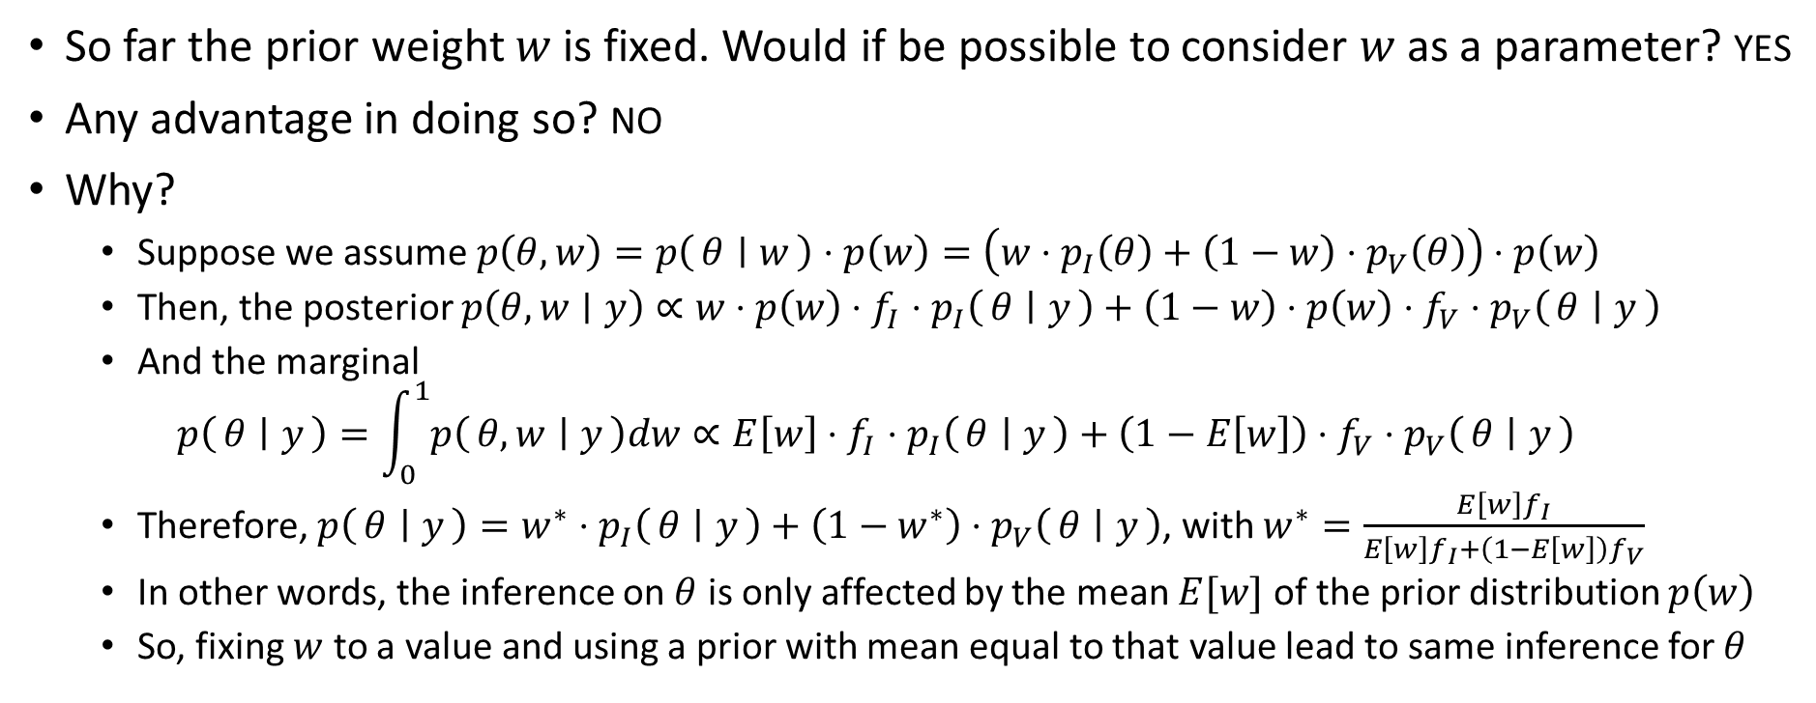
Can the prior weight be treated as a parameter?
So far the prior weight $w$ is fixed. Would if be possible to consider $w$ as a parameter? YES
Any advantage in doing so? NO
Why?
  Suppose we assume $p\left(θ, w\right)=p\left(θ ∣ w\right)⋅p\left(w\right)=\left(w⋅p_{I}\left(θ\right)+\left(1−w\right)⋅p_{V}\left(θ\right)\right)⋅p\left(w\right)$
  Then, the posterior $p\left(θ, w∣y\right)∝w⋅{p\left(w\right)⋅f_{I}⋅p}_{I}\left(θ ∣ y\right)+\left(1−w\right)⋅p\left(w\right)⋅f_{V}⋅p_{V}\left(θ ∣ y\right)$
  And the marginal
  $$p\left(θ ∣ y\right)=\int_{0}^{1}{p\left(θ, w ∣ y\right)dw}∝E\left[w\right]⋅f_{I}⋅p_{I}\left(θ ∣ y\right)+\left(1−E\left[w\right]\right)⋅f_{V}⋅p_{V}\left(θ ∣ y\right)$$
  Therefore, $p\left(θ ∣ y\right)=w^{∗}⋅p_{I}\left(θ ∣ y\right)+\left(1−w^{∗}\right)⋅p_{V}\left(θ ∣ y\right)$, with $w^{∗}=\frac{E\left[w\right]f_{I}}{E\left[w\right]f_{I}+\left(1−E\left[w\right]\right)f_{V}}$
  In other words, the inference on $θ$ is only affected by the mean $E[w]$ of the prior distribution $p\left(w\right)$
  So, fixing $w$ to a value and using a prior with mean equal to that value lead to same inference for $θ$

Slide 76
Structured evaluation & presentation of design characteristics: Rationale for the chosen design
Provide scientific rationale to support relevance of historical data to target study population
Pre-specify and justify initial weight to place on historical data
Pre-specify sample size for target study
Pre-specify
Bayesian success criteria
e.g.
Pr(trt better control | data) > 97.5%
Prior
Evidence before actual trial
Likelihood
Evidence from actual trial
Posterior
Combined evidence
«+»
=
✓ Scientific rationale for all components of the design

Slide 77
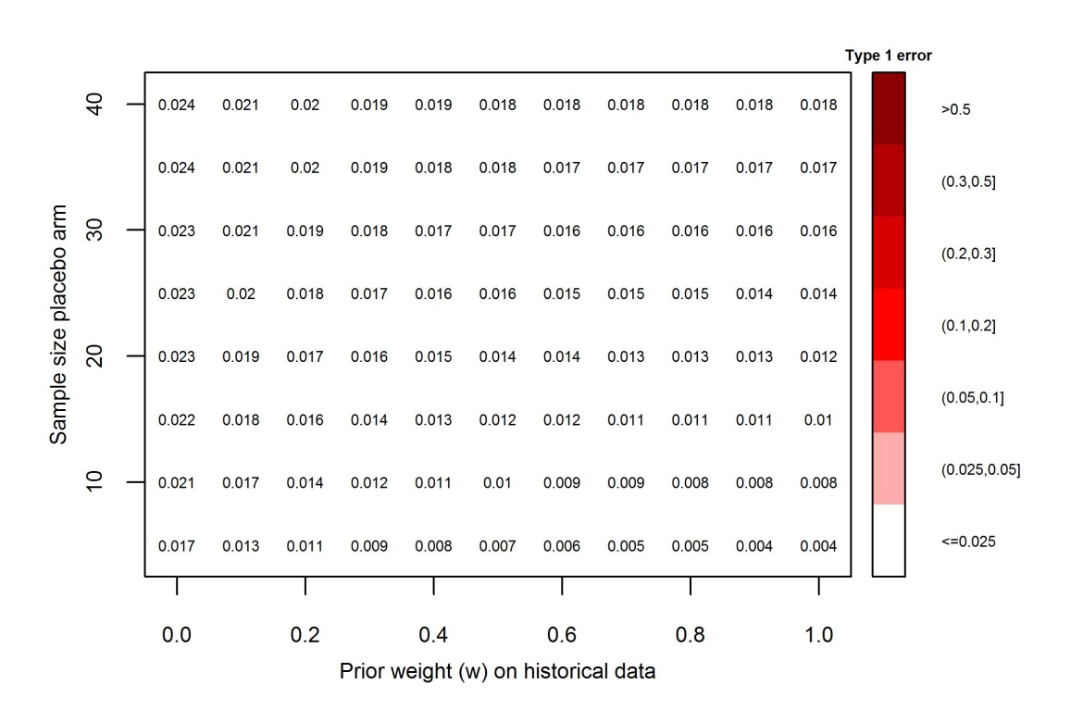
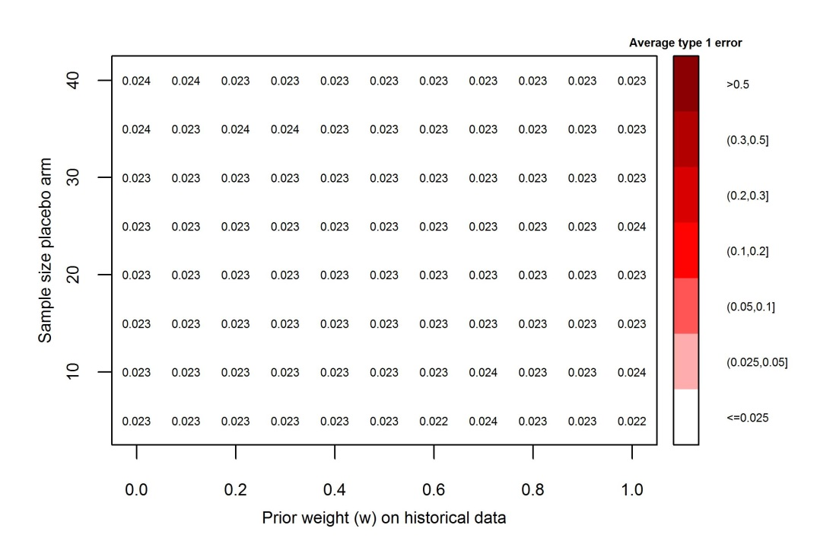
Presentation of design characteristics (case-study 1)
Operating characteristics to help select the design parameters
Type I error | no drift
True placebo effect = - 50
Average type I error
Over the robust MAP prior
= chosen BDB design, $w$ =80%; N=40 (active): N = 20 (placebo)
✓ Understand the impact of different assumptions on the risk of false positive and false negative conclusions

Slide 78
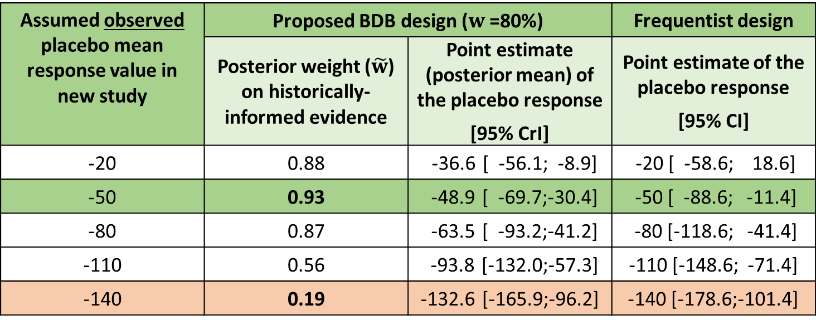
Presentation of design characteristics (case-study 1)
Illustrative results under selected data scenarios
Assumed observed placebo mean response value in new study | Proposed BDB design ($w$ =80%) |  | Frequentist design
 | Posterior weight ($\tilde{w}$) on historically-informed evidence | Point estimate (posterior mean) of the placebo response [95% CrI] | Point estimate of the placebo response [95% CI]
-20 | 0.88 | -36.6 [ -56.1; -8.9] | -20 [ -58.6; 18.6]
-50 | 0.93 | -48.9 [ -69.7;-30.4] | -50 [ -88.6; -11.4]
-80 | 0.87 | -63.5 [ -93.2;-41.2] | -80 [-118.6; -41.4]
-110 | 0.56 | -93.8 [-132.0;-57.3] | -110 [-148.6; -71.4]
-140 | 0.19 | -132.6 [-165.9;-96.2] | -140 [-178.6;-101.4]
Observed placebo mean:
Worse than in historical data
Consistent with historical data
Prior-data conflict
Better than in historical data
Behaviour of the chosen design given various possible observed outcomes from the new study
Compares it with those of a classical frequentist design
Notes:
If you read out the study and observed value is outside sweet spot – sweet spot is truth which we don’t know – need to balance view that current study represents truth v historical studies represent truth. Could have conflict in other direction as well

Slide 79
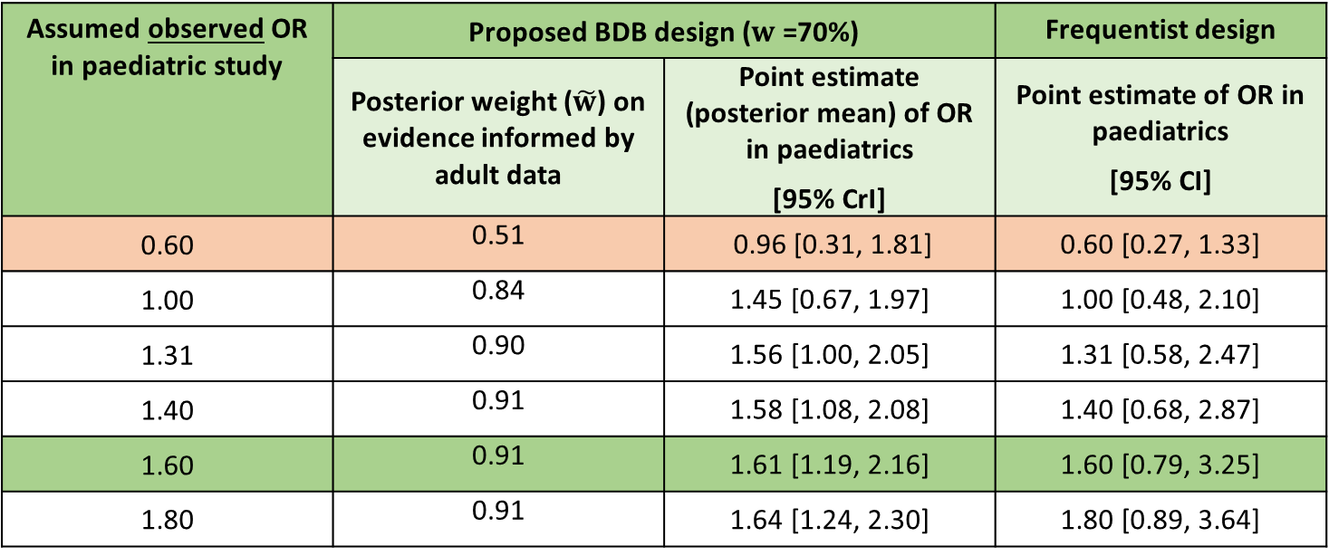
Presentation of design characteristics (case-study 2)
Illustrative results under selected data scenarios
Assumed observed OR in paediatric study | Proposed BDB design ($w$ =70%) |  | Frequentist design
 | Posterior weight ($\tilde{w}$) on evidence informed by adult data | Point estimate (posterior mean) of OR in paediatrics [95% CrI] | Point estimate of OR in paediatrics [95% CI]
0.60 | 0.51 | 0.96 [0.31, 1.81] | 0.60 [0.27, 1.33]
1.00 | 0.84 | 1.45 [0.67, 1.97] | 1.00 [0.48, 2.10]
1.31 | 0.90 | 1.56 [1.00, 2.05] | 1.31 [0.58, 2.47]
1.40 | 0.91 | 1.58 [1.08, 2.08] | 1.40 [0.68, 2.87]
1.60 | 0.91 | 1.61 [1.19, 2.16] | 1.60 [0.79, 3.25]
1.80 | 0.91 | 1.64 [1.24, 2.30] | 1.80 [0.89, 3.64]
Observed paediatric OR:
Prior-data conflict
Worse than in adult data
Minimum detectable effect
Consistent with adult data
Better than in adult data
Behaviour of the chosen design given various possible observed outcomes from the new study
Compares it with those of a classical frequentist design
Notes:
If you read out the study and observed value is outside sweet spot – sweet spot is truth which we don’t know – need to balance view that current study represents truth v historical studies represent truth. Could have conflict in other direction as well

Slide 80
Reporting of primary analysis: Summaries of data, prior & posterior (case-study 1)
Key elements to be included when reporting results of primary analysis in each MAA:
Evidence source | Treatment difference: Active-Placebo |  | Pr(Treat diff) <0 | Active effect |  | Placebo effect
Primary analysis - posterior | -46.3 | (-81.7, -6.6) | 0.988 | -98.8 | (-126.0, -71.5) | -51.4 | (-82.3, -30.1)
Current study only | -40.0 | (-88.3, 8.3) | 1-sided p-value =0.055 | -100 | (-127.6, -72.4) | -60.0 | (-99.6, -20.4)
Historical MAP prior for placebo effect Posterior for treatment effect | -49.2 | (-94.8, 1.1) | 0.973 | - | - | -48.5 | (-92.8, -10.9)
Robust MAP prior for placebo effect Posterior for treatment effect | -49.2 | (-152.5, 55.7) | 0.920 | - | - | -48.2 | (-153.6, 52.9)
Posterior median and equal-tailed Bayesian posterior 95% credible interval (CrI) are reported for the primary analysis and the historical placebo response, and maximum likelihood estimate and Wald 95% confidence intervals (CI) are reported for the separate analysis based on the current study data only.
Permits comparison of primary Bayesian analysis (row 1) with:
    result of a classical frequentist analysis of current study data alone (row 2)
    result based on the prior information alone (rows 3 & 4)
    to enable transparent assessment of contribution of each source of evidence
Notes:
Slightly more conservative using unit-info prior for treatment arm than fully vague prior
Pr(treat diff) > 0 for current study only under vague priors = 0.945

Slide 81
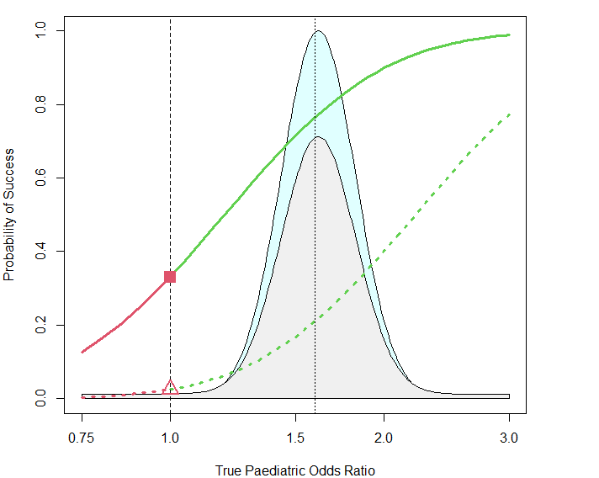
Presentation of design characteristics (case-study 2)
Operating characteristics
Type 1 error (1-sided) | True OR=1 | BDB design Frequentist design | 33% 2.5%
Prior probability of no treatment benefit: Pr(True OR ≤ 1) | Under adult prior Under robust mixture prior | <0.004% 15%
Probability of obtaining a false positive result (Probability of paediatric OR ≤ 1 AND obtaining a false positive result) | Under adult prior Under robust mixture prior | <0.0015% 5%
Power and Assurance = average power
BDB design: Power | no drift (OR=1.6) Average power, over ADULT prior Average power, over robust ADULT prior Frequentist Power | no drift (OR=1.6) Design: Average power, over ADULT prior Average power, over robust ADULT prior | 77% 76% 68% 21% 23% 28%
Adult prior
Robust adult prior
Discussion with health authorities to agree what scenarios are possible
Summarises the risk of making an incorrect decision in favour of treatment benefit
Prob OR ≤ 1 = AUC of prior below 1

Slide 82
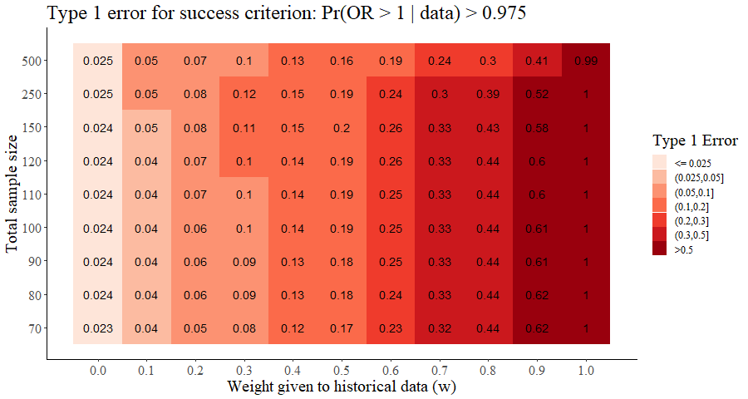
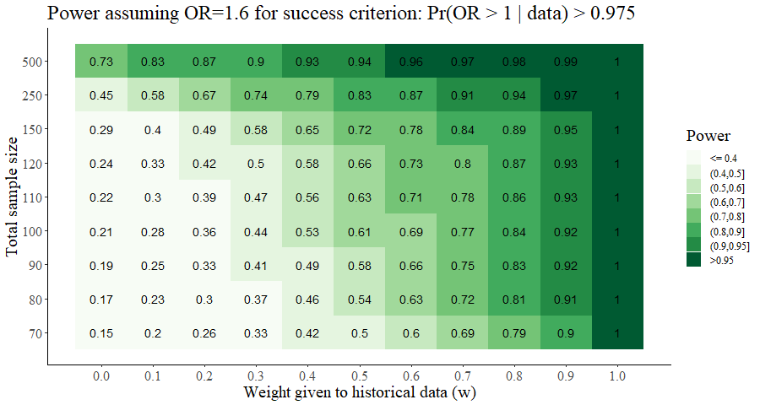
Presentation of design characteristics (case-study 2)
Operating characteristics to help select the design parameters
Type I error
Power
Assuming a true treatment effect of OR = 1.6
0.33
0.77
= chosen BDB design, $w$ =70%; N=50 (active): N = 50 (placebo)
✓ Understand the impact of different assumptions on the risk of false positive and false negative conclusions

Slide 83
Reporting of primary analysis: Summaries of data, prior & posterior (case-study 2)
Evidence source | Odds Ratio (95% CrI)
Primary analysis - posterior | 1.61 | (1.21, 2.07)
Paediatric study only | 1.50 | (0.68, 3.29)
Adult prior only | 1.62 | (1.28, 2.05)
Robust adult prior only | 1.60 | (0.02, 52.6)
Posterior median and equal-tailed Bayesian posterior 95% credible interval (CrI) are reported for the primary analysis and the adult prior, and maximum likelihood estimate and Wald 95% confidence intervals (CI) are reported for the separate analysis based on the current paediatric study data only.
Permits comparison of primary Bayesian analysis with:
    result of a classical frequentist analysis of current study data alone
    result based on the prior information alone
    to enable transparent assessment of contribution of each source of evidence

Slide 84
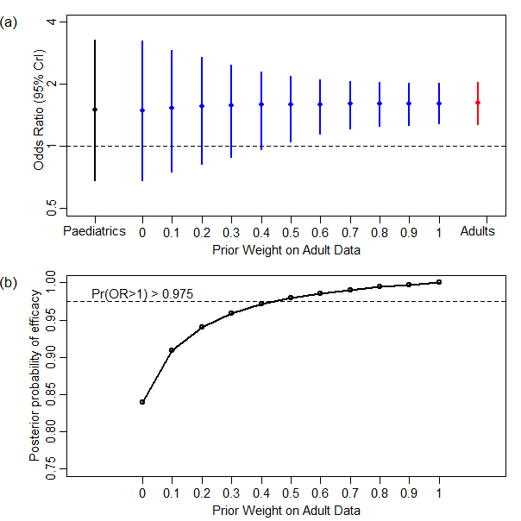
Sensitivity analysis: Tipping point analysis to varying prior weight (case-study 2)
    Visual comparison of prior, new study data and posterior under full range of assumptions about relevance of prior information
    How sceptical must we be about the relevance of the historical data in order to change the study conclusion?
Tipping point
Pre-specified prior weight for primary analysis
Range of prior weights for which the study conclusion (met primary success rule) is robust

