Slide 1




Using observational data to emulate trials
Elizabeth Williamson
Associate Professor of Biostatistics
Medical Statistics Department, London School of Hygiene & Tropical Medicine
PSI Virtual Conference
Wed, May 27, 2020

Slide 2
Acknowledgements
Example 1
  The MACRO team
  Spiros Denaxas, UCL
  James Carpenter, LSHTM
Example 2
  Kevin Wing, James Carpenter, Liam Smeeth, Ian Douglas, Lesley Wise, LSHTM, UK
  Jennifer K Quint, Imperial College London, UK
  Sebastian Schneeweiss, Harvard Medical School, Division of Pharmacoepidemiology and Pharmacoeconomics, Department of Medicine, Brigham and Women's Hospital, Boston, Massachusetts, USA

Slide 3
Overview
Routinely collected data contain a wealth of information, which can provide an important and useful complement to trial data
Ways in which these data may be used include
  Inform the planning of future RCT
    E.g. safety of planned trial
    Hypothesis generation
    Estimation of parameters for power calculations
  Generalising RCTs
    Extending results to wider populations which were excluded from trials
When using routinely collected data to address these questions, it can be helpful to explicitly phrase these investigations in terms of “emulations of a hypothetical randomised trial” (García-Albéniz , Eur J Epi, 2017, Danaei et al, SMMR, 2017).
Today: present two examples of trial emulation, each undertaken for a different purpose

Slide 4
Example 1: Informing A RCT
To estimate the effect of macrolide antibiotic prescription on all cause and cardiovascular mortality

Slide 5
MACRO
Defining best Management for Adults with Chronic RhinOsinusitis)
  NIHR-funded programme of work
  establish best practice for adults with chronic rhinosinusitis (CRS)
The 7-year programme comprises workstreams to
  explore NHS care pathways
  undertake a randomised controlled trial to evaluate a longer-term course of macrolide antibiotics and endoscopic sinus surgery for patients with CRS
Macrolides
  Macrolide antibiotics have been shown to have anti-inflammatory and immunomodulatory properties, reducing the pro-inflammatory cytokines critical in CRS (Head 2016, Oakley 2017)
  International guidelines recommend the use of low-dose, long-term macrolides in selected patients with CRS but the evidence is weak (Videler 2011, Wallwork 2006)
  A survey of 158 UK ENT surgeons (2013) found that 92% prescribed antibiotics prior to ESS surgery, with 16% prescribing 12 weeks’ macrolide treatment (Sylvester, 2013)
Reference: Blackshaw et al, Trials, 2019

Slide 6
Cardiovascular risks and macrolides
However, concerns have been raised about potential cardiovascular risks from the use of full-dose, short-term macrolides (e.g. Winkel, 2016)
Macrolides may cause prolongation of the QT interval which can lead to arrhythmia and myocardial infarction.
However, previous studies primarily considered patient populations with high risk of cardiovascular events
Study (safety) question:
Is macrolide antibiotic prescription associated with an increased risk of all-cause and cardiac death, and cardiovascular outcomes, compared to penicillin prescription, in patients with chronic rhinosinusitis?

Slide 7
Hypothetical trial design
Aim | To estimate the effect of macrolide antibiotic prescription compared with penicillin prescription on risk of all-cause and cardiac death, and cardiovascular outcomes, in patients with chronic rhinosinusitis
Eligibility | 16 to 80 years of age Diagnosis of CRS No recorded antibiotic prescription of any type in the last four weeks (a washout period) Provide informed consent to participate
Treatment strategy | Antibiotic prescription (dose guidelines provided) of penicillin or a macrolide

Slide 8
Hypothetical trial design
Assignment | Randomly assign patients to either penicillin or a macrolide
Follow-up | From baseline until death, loss to follow-up, 9 years after baseline, or end of study (administrative censoring end 2016). Sensitivity: censor at 30 days.
Outcome | Primary: all-cause mortality, Secondary: cardiovascular mortality, myocardial infarction
Estimand | Intention-to-treat (compare groups irrespective of subsequent antibiotics taken)
Analysis | Compare risks in group assigned macrolide to group assigned penicillin (unadjusted model)

Slide 9
Trial emulation
Aim to emulate the desired (hypothetical) trial using electronic health record data
Setting: Clinical Practice Research Datalink (CPRD) linked with
Office for National Statistics (ONS) mortality data, and
Hospital Episodes Statistics (HES)
Population: Adult patients with chronic rhinosinusitis,
1997-2016
prescribed 1+ macrolide or penicillin

Slide 10
Trial emulation
 | Hypothetical trial | Emulated trial
Aim | To estimate the effect of macrolide antibiotic prescription compared with penicillin prescription on risk of all-cause and cardiac death, and cardiovascular outcomes, in patients with chronic rhinosinusitis | Same
Eligibility | 16 to 80 years of age Diagnosis of CRS No recorded antibiotic prescription of any type in the last four weeks (a washout period) Provide informed consent to participate | Same, except consent not sought
Treatment strategy | Antibiotic prescription (dose guidelines provided) of penicillin or a macrolide | Same, except dose at discretion of clinician

Slide 11
Trial emulation
 | Hypothetical trial | Emulated trial
Assignment | Randomly assign patients to either penicillin or a macrolide | Patients non-randomly offered prescription, based on: demographics, prior prescription history, prior diagnoses and calendar time.
Follow-up | From baseline until death, loss to follow-up, 9 years after baseline, or end of study (administrative censoring end 2016). Sensitivity: censor at 30 days. | Same
Outcome | Primary: all-cause mortality, Secondary: cardiovascular mortality, myocardial infarction | Same
Estimand | Intention-to-treat (compare groups irrespective of subsequent antibiotics taken) | Same
Analysis | Compare risks in group assigned macrolide to group assigned penicillin (unadjusted model) | Same comparison, adjusted for variables above

Slide 12
Study overview: confounders
Demographics
  Age, sex, BMI, smoking status, alcohol consumption, region, socio-economic status, frequency of GP consultations in last year
Prior prescription of:
  antidepressants, warfarin or digoxin, anti-arrhythmic drugs, anticoagulants, antiplatelet drugs, β-adrenoceptor blockers, lipid regulating drugs, diuretics, nitrates, non-steroidal anti-inflammatories (NSAIDs) and anti-hypertensive drugs including angiotensin-converting enzyme inhibitors.
Prior diagnosis of:
  atrial fibrillation, cancer, COPD, diabetes, dyslipidaemia, hypertension, cardiovascular disease, and asthma, were also identified (CALIBER)
Updated over time
Reference: Denaxas et al, Int J Epi, 2012

Slide 13
Emulated trial design
Series of observational pseudo trials
Study period split into non-overlapping 30-day periods (219 time intervals).
Each interval considered a “recruitment period” for a pseudo-trial.
At each prescription, a patient was assessed for eligibility.
  If eligible at that point, the patient entered that pseudo-trial (in the arm corresponding to prescription).
Patients could enter each pseudo-trial only once, but could enter multiple pseudo-trials over the whole study period.
Analysis
  Cox proportional hazards regression
  Timescale: time since entering pseudo trial
  Age at entry and pseudo-trial modelled using splines
  Robust standard errors (can enter multiple pseudo-trials)
Reference: Denaxas et al, Int J Epi, 2012

Slide 14
Results
66,331 unique patients,
  23,465 of whom joined a pseudo trial in the macrolide group
  57,876 of whom joined a pseudo trial in the penicillin group
  (thus 15,010 did both)
Total of 320,798 prescriptions were included in the final analysis.
Balance of patient characteristics
  Females, patients with prior use of antidepressants, a history of chronic obstructive pulmonary disease or asthma were more likely to receive a macrolide antibiotic
  Differences were fairly small.
Median follow-up years (25th to 75th percentile: 2.0 to 7.4 years).
Patients participated in median of 3 pseudo-trials (25th to 75th percentile: 2 to 6).

Slide 15
 | HR (95% CI) | P
All cause mortality
Unadjusted | 1.04 (0.95, 1.13) | 0.446
Full follow-up | 0.99 (0.91, 1.09) | 0.865
Censored 30 days | 0.93 (0.70, 1.24) | 0.628
CVD mortality
Unadjusted | 1.01 (0.83, 1.23) | 0.890
Full follow-up | 1.00 (0.82, 1.21) | 0.961
Censored 30 days | 0.99 (0.56, 1.77) | 0.983
MI
Unadjusted | 1.10 (0.94, 1.29) | 0.252
Full follow-up | 1.09 (0.93, 1.28) | 0.300
Censored 30 days | 1.60 (0.95, 2.68) | 0.077

Slide 16
Conclusions
The trial emulation showed little evidence of long term risks in this population, but a short term MI risk
Modifications made to planned trial:
  Additional exclusions from MACRO trial:
    prior history of ischaemic heart disease and
    aged over 65 years with diabetes
    prolongation of QT interval (baseline electrocardiogram added to the trial screening process)

Slide 17
Example 2: Generalising RCTs
To estimate Real World Effects of medications for Chronic Obstructive Pulmonary Disease

Slide 18
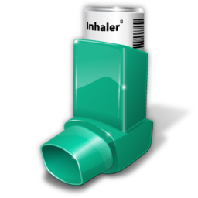
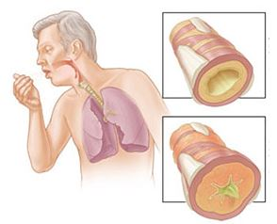
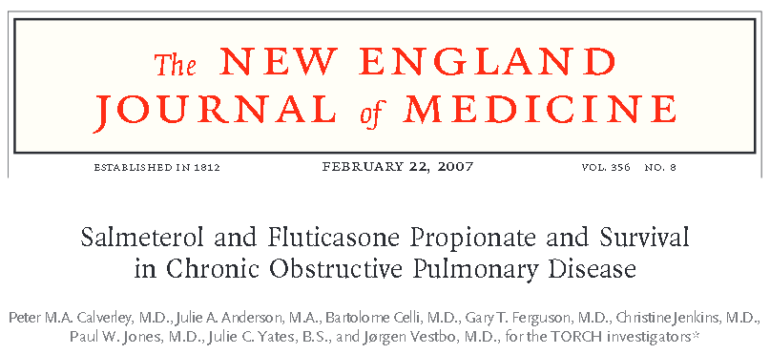
Chronic Obstructive Pulmonary Disease (COPD)
Acute COPD exacerbations often result in hospitalisation
Long term pharmacological treatment generally required
↓ exacerbations
3 commonly used types:
  Long-acting beta-agonists (LABA)
  Inhaled corticosteroids (ICS)
  Long-acting muscarinic antagonists (LAMAs)
Seretide (widely used)
  Salmeterol (an ICS) & fluticasone propionate (a LABA)
  Evidence for use: GSK’s TORCH trial (2007):
Notes:
Chronic obstructive pulmonary disease (COPD) affects 3 million UK citizens, WHO – 3rd on the list of causes of death worldwide.
Progressive disease characterised by airflow obstruction that is not fully reversible.
Acute exacerbations (rapid and sustained worsening of symptoms - severe coughing, shortness of breath and chest congestion) require urgent treatment, and often hospitalisation.
Smoking cessation is the most effective intervention, but long term pharmacological treatment is also generally required. [From NIHR grant scientific abstract section and ISAC]

Slide 19
Motivation
A large number of patients with COPD in the general population would have been excluded from or were underrepresented in the TORCH trial
In particular, patients with milder COPD were not included
Aim
  To emulate the TORCH trial using electronic health record data (CPRD linked to HES) to identify major sources of bias (confounding by indication)
  To then use the same trial emulation methods (without the TORCH aspect) to specific patient groups who would have been excluded from the TORCH trial

Slide 20
TORCH RCT results for rate of exacerbations
N=6112 (approx n=1500 per group)
Comparison | Rate Ratio (95% CI)
Seretide* vs placebo | 0.75 (0.69-0.81)
Seretide vs salmeterol | 0.88 (0.81-0.95)
Seretide vs fluticasone propionate | 0.91 (0.84-0.99)
*Seretide=salmeterol (an ICS) & fluticasone propionate (a LABA) in combination

Slide 21
TORCH trial design
Aim | To estimate the effect of a combination regimen (salmeterol at a dose of 50 μg plus fluticasone propionate at a dose of 500 μg twice daily) compared to placebo, salmeterol alone, or fluticasone propionate alone on 3-year risk of death and rate of exacerbations.
Eligibility | Inclusion criteria current or former smokers (>10-pack-year) 40 to 80 years diagnosis of COPD, pre-bronchodilator FEV₁ < 60% predicted value; FEV₁ : FVC <= 0.70 FEV₁ increase <10% predicted with 400 μg of albuterol Written informed consent

Slide 22
TORCH trial design
Eligibility | Exclusion, many, including Asthma diagnosis within the previous 5 years Other lung conditions Other COPD therapies (long-acting bronchodilator, oral corticosteroids) History of substance abuse Oxygen therapy Chance of death or interference with study Current therapy with an oral corticosteroid Record for an exacerbation during the trial “run-in” period

Slide 23
TORCH trial design
Treatment strategy | Salmeterol at a dose of 50 μg plus fluticasone propionate at a dose of 500 μg twice daily
Assignment | Randomly assign patients to either combination, salmeterol alone, fluticasone propionate, or placebo
Follow-up | From baseline until death, loss to follow-up, 3 years after baseline.
Outcome | Primary: all-cause mortality, Secondary: exacerbations
Estimand | Intention-to-treat (compare groups irrespective of subsequent treatment)
Analysis | Compare risks and rates between randomised groups

Slide 24
Emulation of TORCH trial design
 | TORCH trial | Emulated trial
Aim | To estimate the effect of a combination regimen (salmeterol at a dose of 50 μg plus fluticasone propionate at a dose of 500 μg twice daily) compared to placebo, salmeterol alone, or fluticasone propionate alone on 3-year risk of death and rate of exacerbations. | To estimate the effect of a combination regimen compared to placebo, salmeterol alone, or fluticasone propionate alone on rate of exacerbations.
Eligibility | Inclusion criteria current or former smokers (>10-pack-year) 40 to 80 years diagnosis of COPD pre-bronchodilator FEV₁ < 60% predicted value FEV₁ : FVC <= 0.70 FEV₁ increase <10% predicted with 400 μg of albuterol Written informed consent | Inclusion criteria smokers 40 to 80 years diagnosis of COPD FEV₁ , FVC measured FEV₁ < 60% predicted value FEV₁ : FVC <= 0.70

Slide 25
Emulation of TORCH trial design
 | TORCH trial | Emulated trial
Eligibility | Exclusion, many, including Asthma diagnosis within the previous 5 years Other lung conditions Other COPD therapies (long-acting bronchodilator, oral corticosteroids) History of substance abuse Oxygen therapy Chance of death or interference with study Current therapy with an oral corticosteroid Record for an exacerbation during the trial “run-in” period | Some (not listed) not imposed, e.g. α-1 antitrypsin deficiency Some defined differently

Slide 26
Emulation of TORCH trial design
 | TORCH trial | Emulated trial
Treatment strategy | Salmeterol at a dose of 50 μg plus fluticasone propionate at a dose of 500 μg twice daily, separate therapy, or placebo | Salmeterol plus fluticasone propionate Separate therapy Neither
Assignment | Randomly assign patients to either combination, salmeterol alone, fluticasone propionate, or placebo | Patients prescribed treatments according to demographics, prior medications and diagnoses.
Follow-up | From baseline until death, loss to follow-up, 3 years after baseline. | Same
Outcome | Primary: all-cause mortality, Secondary: exacerbations | Exacerbations only (nb: only known if treatment sought)
Estimand | Intention-to-treat (compare groups irrespective of subsequent treatment) | Same
Analysis | Compare risks and rates between randomised groups | Adjusted analysis

Slide 27
Effect modification
We want to emulate a RCT but with an additional step of matching the baseline characteristics to the trial population included in TORCH, to guard against differences resulting from heterogeneity in treatment effects
Steps: Seretide vs nothing (placebo)
  For each TORCH participant, identify a comparable CPRD patient
      Not receiving Seretide (or salmeterol or fluticasone propionate)
      “eligible” for trial
      “comparable” – 1:1 matched on characteristics likely to affect treatment effect
        Age, sex, BMI
        Exacerbation history
        Cardiovascular disease
        Lung function
  For each selected CPRD patient, select a comparable Seretide-exposed CPRD patient
      Receiving Seretide
      “eligible” for trial
      “comparable” – Propensity-Score Matched on all confounders

Slide 28
1 person
1. 1st date of
study eligibility
(person meets
all TORCH
criteria)
2. Eligible to enter
study as
an untreated
participant
3. Eligible to enter study as a treated
participant
4. Eligible to enter
study as an untreated
participant
5. Eligible to enter
study as a
treated
participant
1 week
No FP/Sal
FP/Sal

Slide 29
Results – “eligible” entry points
N=73,889 patients in HES-linked CPRD with a COPD diagnosis 2004-2016
n=61,899 after applying TORCH age restrictions (age 40-80 yrs)
n=56,169 after removing non-smokers
n=37,055 of whom have lung function measured (FEV₁, FEV₁/FVC₂)
n=18,715 after removing those with FEV₁≥60%, FEV₁/FVC>0.7
n=18,715
Unexposed (to Seretide)
Exposed (to Seretide)
20,829 records (from n=11,285 people)
11,593 records (from n=4,788 people)

Slide 30


Results – matching CPRD to TORCH data
n=20,829 unexposed records
1:1 matched on:
Age
Sex
BMI
Exacerbation history
Cardiovascular disease
Lung function
n=6,112 people from the
TORCH COPD trial
n=5,212 TORCH-matched
unexposed people
n=900 people from
TORCH not matchable
Notes:
1. Initially included matching on previous COPD drug treatment but very difficult to match using this variable (marker for different things at the time the trial was done)

Slide 31
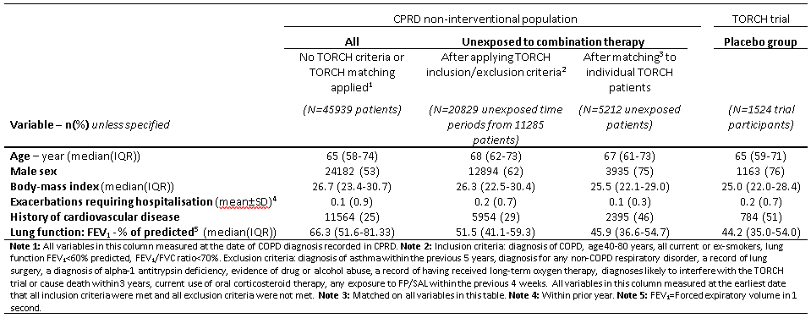
Results – matching unexposed records to TORCH participants

Slide 32
Results – analysis of exacerbations
Comparison | Rate Ratio (95% CI)
TORCH Seretide* vs placebo | 0.75 (0.69-0.81)
CPRD Seretide vs no seretide
Crude | 1.44 (1.36-1.53)
Matched on propensity score | 1.25 (1.14-1.37)
Strong confounding by indication
Patients in CPRD not receiving treatment had fewer exacerbations (i.e. were less sick)

Slide 33
Results – analysis of exacerbations
Comparison | Rate Ratio (95% CI)
TORCH Seretide* vs salmeterol | 0.88 (0.81-0.95)
CPRD Seretide vs no salmeterol
Crude | 0.80 (0.72-0.88)
Matched on propensity score | 0.84 (0.73-0.97)

Slide 34
Conclusions

Slide 35
Trial emulation
Real world data – complementary to RCTs
Trial emulation can be a useful framework in which to embed causal questions using real world data
Useful statistical considerations
  Allowing patients to repeatedly participate in pseudo-trials increases power
  Can map the distribution of baseline characteristics in the emulated trial to match a real trial, to guard against treatment effect heterogeneity

Slide 36
References – emulating trials
Danaei et al. Observational data for comparative effectiveness research: an emulation of randomised trials to estimate the effect of statins on primary prevention of coronary heart disease. SMMR, 2013, 22(1):70-96.
García-Albéniz X, Hsu J, Hernán MA. The value of explicitly emulating a target trial when using real world evidence: an application to colorectal cancer screening. European Journal of Epidemiology, 2017, 32(6):495-500

Slide 37
References – macrolides
Blackshaw H, Vennik J, Philpott C, et al. Expert panel process to optimise the design of a randomised controlled trial in chronic rhinosinusitis (the MACRO programme) Trials, 2019; 20: 230.
Winkel P, Hilden J, Hansen JF, Kastrup J, Kolmos HJ, Kjoller E, Jensen GB, Skoog M, Lindschou. J, Gluud C et al: Clarithromycin for stable coronary heart disease increases all-cause and cardiovascular mortality and cerebrovascular morbidity over 10 years in the CLARICOR randomised, blinded clinical trial. Int J Cardiol 2015, 182:459-465
Oakley GM, Harvey RJ, Lund VJ. The role of macrolides in chronic rhinosinusitis (CRSsNP and CRSwNP). Curr Allergy Asthma Rep. 2017;17(5):30.
Head K, Chong LY, Piromchai P, Hopkins C, Philpott C, Schilder AG, Burton MJ. Systemic and topical antibiotics for chronic rhinosinusitis. Cochrane Database Syst Rev. 2016;4:CD011994.
Videler WJ, Badia L, Harvey RJ, Gane S, Georgalas C, van der Meulen FW, Menger DJ, Lehtonen MT, Toppila-Salmi SK, Vento SI, et al. Lack of efficacy of long-term, low-dose azithromycin in chronic rhinosinusitis: a randomized controlled trial. Allergy. 2011;66(11):1457–1468.
Wallwork B, Coman W, Mackay-Sim A, Greiff L, Cervin A. A double-blind, randomized, placebo-controlled trial of macrolide in the treatment of chronic rhinosinusitis. Laryngoscope. 2006;116(2):189–193.
Sylvester DC, Carr S, Nix P. Maximal medical therapy for chronic rhinosinusitis: a survey of otolaryngology consultants in the United Kingdom. Int Forum Allergy Rhinol. 2013;3(2):129–132
Denaxas SC, George J, Herrett E, Shah AD, Kalra D, Hingorani AD, Kivimaki M, Timmis AD, Smeeth L, Hemingway H: Data Resource Profile: Cardiovascular disease research using linked bespoke studies and electronic health records (CALIBER). Int J Epidemiol 2012, 41(6):1625-1638.

Slide 38
References – COPD
http://www.soundcare.ca/pm_copd.htm (COPD patient image)
https://www.who.int/news-room/fact-sheets/detail/the-top-10-causes-of-death
Healthcare Commission (2006) Clearing the air: a national study of chronic obstructive pulmonary disease. London: Healthcare Commission
Calverley, P. M., Anderson, J. A., Celli, B. R., Ferguson, G. T., Jenkins, C., Jones, P. W., … Vestbo, J. (2007). Salmeterol and Fluticasone Propionate and Survival in Chronic Obstructive Pulmonary Disease. New England Journal of Medicine, 356(8), 775–789.
Tashkin, D. P., Celli, B., Senn, S., Burkhart, D., Kesten, S., Menjoge, S., & Decramer, M. (2008). A 4-Year Trial of Tiotropium in Chronic Obstructive Pulmonary Disease. New England Journal of Medicine, 359(15), 1543–1554.
Wing, K; Williamson, E; Carpenter, JR; Wise, L; Schneeweiss, S; Smeeth, L; Quint, JK; Douglas, I; (2018) Real-world effects of medications for chronic obstructive pulmonary disease: protocol for a UK population-based non-interventional cohort study with validation against randomised trial results. BMJ open, 8 (3). e019475. ISSN 2044-6055 DOI: https://doi.org/10.1136/bmjopen-2017-019475

