Slide 1
Enrichment Designs with
Survival Data
An adaptive design to examine treatment effects in patient subgroups
Jack Keeler
Ack: Dr Fang Wan & Dr Thomas Burnett – Lancaster University
Notes:
Background: New starter, almost 1 year, project was my MSc diss at Lancaster uni under supervision of Dr Fang Wan (Dr TB thanks for tech. check_
Method chosen was chosen because my focus was on conveying to non-stat

Slide 2
Agenda
Motivation
Group Sequential Design Incorporating Subgroup Selection (GSDS)
Hypothetical Trial I
Hypothetical Trial II
Conclusion

Slide 3






Motivation
Not Effective
Subgroup Prevalence: 55%
Effective
Subgroup Prevalence: 20%
Effective
Subgroup Prevalence: 15%
Full Population
Effective
Subgroup Prevalence: 10%
Notes:
Take a ‘basket trial’ with a ‘basket’ of cancers
If we analyze full pop. When the true treatment effect (with prevalence's) is as shown, we have two scenarios

Slide 4



  Enrichment Trials
  Why?
Not Exploratory
Remove exploratory nature of most subgroup analysis
Speed up discovery of differences (unlike post-trial monitoring)
Lack of Information
Usually not enough information from Phase I/II to be absolutely sure
More Ethical
If we limit ineffective subgroups’ exposure to ineffective treatments, more ethical.

Slide 5
Group Sequential Designs
Jennison, C. and Turnbull, B. (2000)
Reject Null: Treatment Effective
S
1
2
Analysis
Do Not Reject Null: Treatment Ineffective

Slide 6




Hypothesis Tests
Null Hypothesis
$$H_{0,i}: θ_{i}=0$$
The treatment is not effective for subgroup $i$
Alternative Hypothesis
$$H_{1,i}: θ_{i}>0$$
The treatment is effective for subgroup $i$

Slide 7

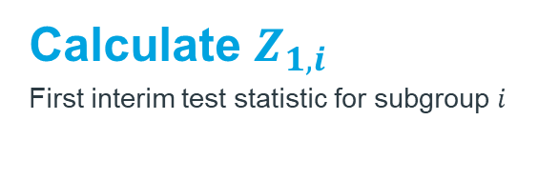
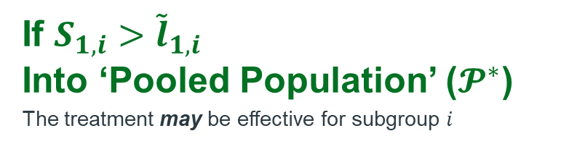
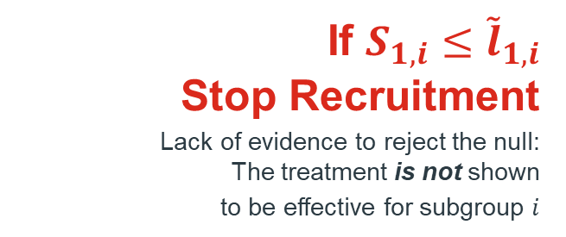
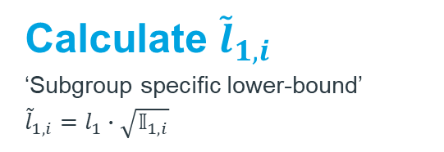
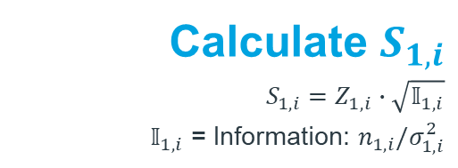
Group Sequential Design Incorporating Subgroup Selection (GSDS):
Enrichment Decisions -Magnusson and Turnull (2013)
1
Calculate $Z_{1,i}$
First interim test statistic for subgroup $i$
Calculate $S_{1,i}$
$$S_{1,i}=Z_{1,i}∙\sqrt{𝕀_{1,i}}$$
$𝕀_{1,i}$ = Information: $n_{1,i}/σ_{1,i}^{2}$
2
3
Calculate ${\tilde{l}}_{1,i}$
‘Subgroup specific lower-bound’
${\tilde{l}}_{1,i}=l_{1}∙\sqrt{𝕀_{1,i}}$
If $S_{1,i}≤{\tilde{l}}_{1,i}$
Stop Recruitment
Lack of evidence to reject the null:
The treatment is not shown
to be effective for subgroup $i$
If $S_{1,i}>{\tilde{l}}_{1,i}$
Into ‘Pooled Population’ ($𝓟^{∗}$)
The treatment may be effective for subgroup $i$
Notes:
Chosen over other methods because (may be other more optimal designs)
Extension of group seq.
Code bank (as opposed to likelihood-based methods)
Z is normal dist, using gs theory, there's a canonical joint dist.
Aim is TO REMOVE INEFECTIVE

Slide 8

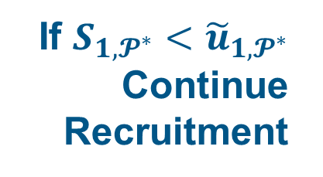
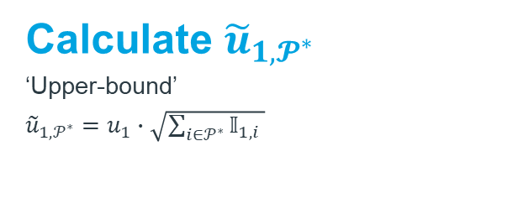
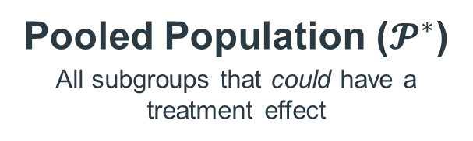
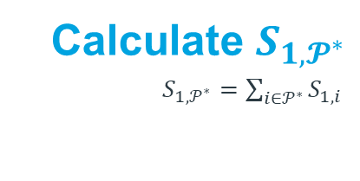
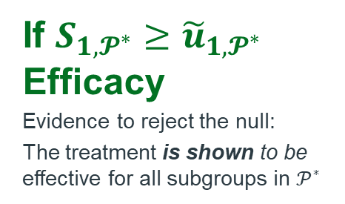
GSDS Continued – Continuation Decisions
Calculate $S_{1,𝓟^{∗}}$
$S_{1,𝒫^{∗}}=\sum_{i{∈𝒫}^{∗}}{S_{1,i }}$
1
2
Calculate ${\tilde{u}}_{1,𝓟^{∗}}$
‘Upper-bound’
${\tilde{u}}_{1,𝒫^{∗}}=u_{1}∙\sqrt{\sum_{i{∈𝒫}^{∗}}{𝕀_{1,i }}}$
If $S_{1,𝓟^{∗}}<{\tilde{u}}_{1,𝓟^{∗}}$ Continue Recruitment
If $S_{1,𝓟^{∗}}≥{\tilde{u}}_{1,𝓟^{∗}}$
Efficacy
Evidence to reject the null:
The treatment is shown to be effective for all subgroups in $𝒫^{∗}$
Pooled Population ($𝓟^{∗}$)
All subgroups that could have a treatment effect

Slide 9




Boundaries: NOT Usual Group Sequential Boundaries
Dependent on which subgroups will make up $𝓟^{∗}$
Notes:
Have Prob(p* will be A) or Prob(P* will be B) …

Slide 10



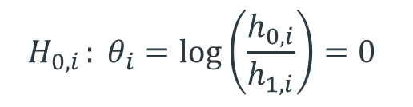
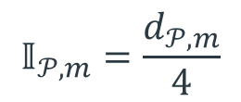
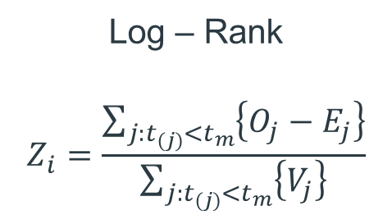
Survival GSDS
An extension of the ‘normal’ case…
Null Hypothesis
Test Statistic
Events Required
$$H_{0,i }: θ_{i}=\log\left(\frac{h_{0,i}}{h_{1,i}}\right)=0$$
$$𝕀_{𝒫,m}=\frac{d_{𝒫,m}}{4}$$
Log – Rank
$$Z_{i}=\frac{\sum_{j:t_{(j)}<t_{m}}{\left\{O_{j}−E_{j}\right\}}}{\sum_{j:t_{(j)}<t_{m}}{\left\{V_{j}\right\}}}$$
Notes:
Can still use can. Joint dist. -> Log-Rank is normal under h0
Info: Assume that n is big, independent events, similar numbers at risk

Slide 11

‘Survivors’
Ethical
Left Truncate
Still use Kaplan Meier
Lower Sample Size
Still use Log-Rank

Slide 12
Hypothetical Trial I
Disease: Colorectal Cancer
Subgroups: KRAS Gene Mutations
Treatment: Cetuximab
Comparison: Placebo

Slide 13
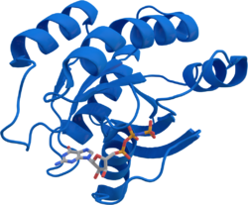
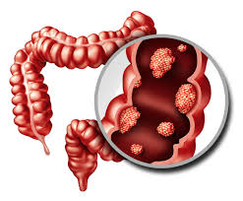
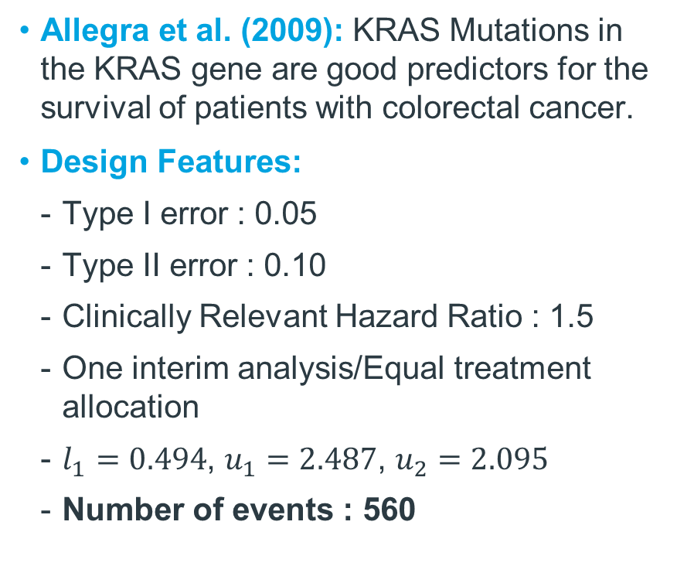
Hypothetical Trial I
Hypothetical Trial I
KRAS Mutations
Is Cetuximab effective in increasing survival time for patients with colorectal cancer?
Subgroup
Prevalence
Allegra et al. (2009): KRAS Mutations in the KRAS gene are good predictors for the survival of patients with colorectal cancer.
Design Features:
  Type I error : 0.05
  Type II error : 0.10
  Clinically Relevant Hazard Ratio : 1.5
  One interim analysis/Equal treatment allocation
  $l_{1}=0.494$, $u_{1}=2.487$, $u_{2}=2.095$
  Number of events : 560
Notes:
Chosen 0.1 because of I (at uni) was unaware of 0.2 being a more suitable pick, especially given what will happen a few slides over -> would run again, but massively intensive had to use Math's department ‘Penguins cluster’ supercomputer thing.

Slide 14
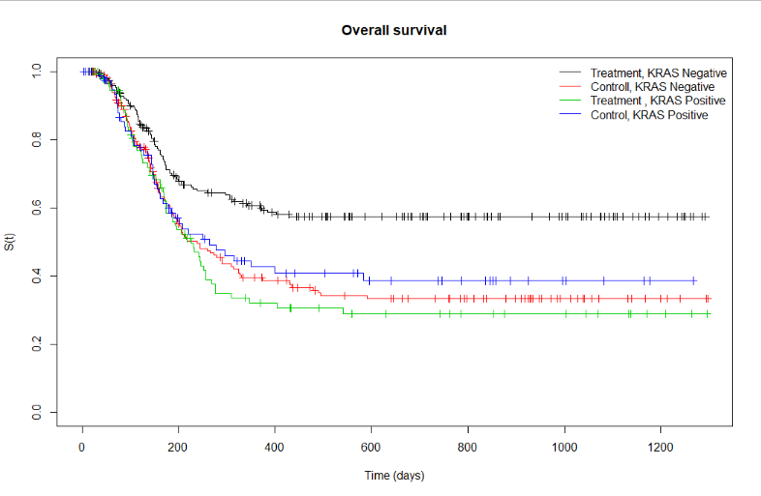

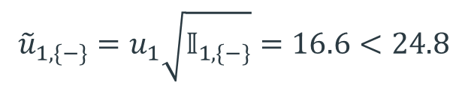
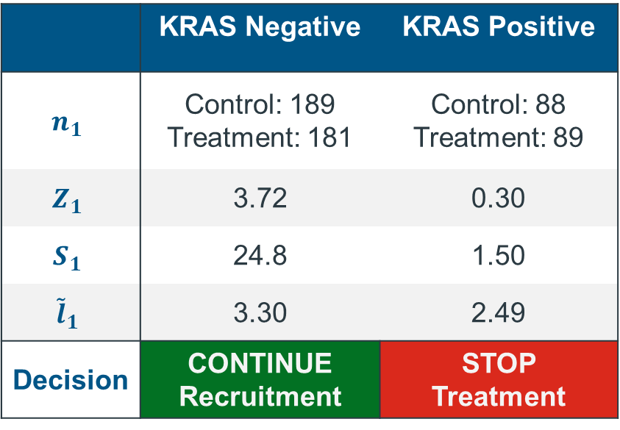
Hypothetical Trial I
Hypothetical Trial I
KRAS Mutations
At First Interim
KM Curves
Analysis
 | KRAS Negative | KRAS Positive
$$n_{1}$$ | Control: 189 Treatment: 181 | Control: 88 Treatment: 89
$$Z_{1}$$ | 3.72 | 0.30
$$S_{1}$$ | 24.8 | 1.50
$${\tilde{l}}_{1}$$ | 3.30 | 2.49
Decision | CONTINUE Recruitment | STOP Treatment
$${\tilde{u}}_{1,\{−\}}=u_{1}\sqrt{𝕀_{1,\{−\}}}=16.6<24.8$$
Reject Null in KRAS Negative Subgroup and stop trial

Slide 15
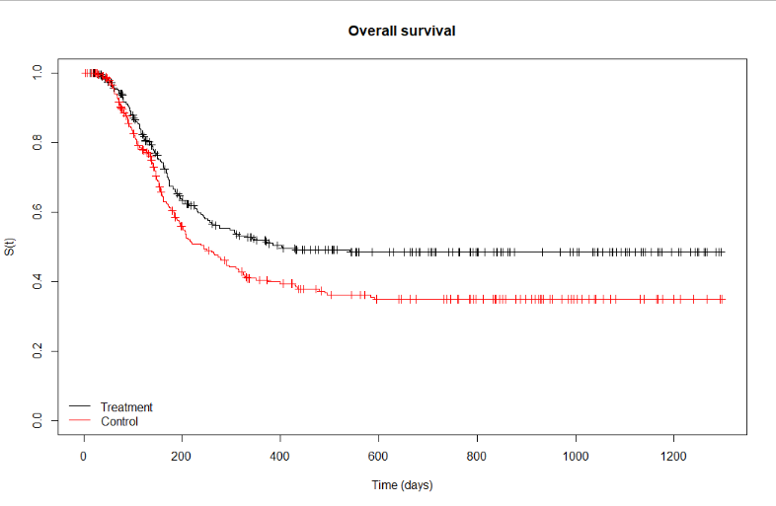
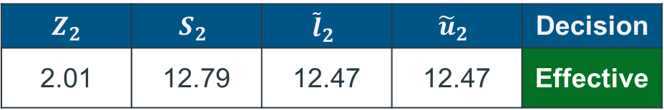
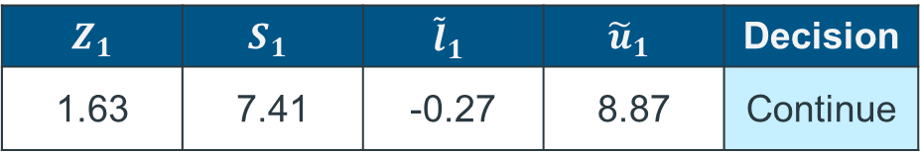
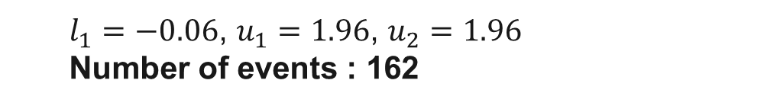
Hypothetical Trial I
Hypothetical Trial I
KRAS Mutations
Full population analysis (Not considering subgroups)
KM Curves
Design
  $l_{1}=−0.06$, $u_{1}=1.96$, $u_{2}=1.96$
  Number of events : 162
Analysis: Interim 1
$$Z_{1}$$ | $$S_{1}$$ | $${\tilde{l}}_{1}$$ | $${\tilde{u}}_{1}$$ | Decision
1.63 | 7.41 | -0.27 | 8.87 | Continue
Analysis: Interim 2
$$Z_{2}$$ | $$S_{2}$$ | $${\tilde{l}}_{2}$$ | $${\tilde{u}}_{2}$$ | Decision
2.01 | 12.79 | 12.47 | 12.47 | Effective
‘FALSE HOPE’
Notes:
HR for whole pop was 1.4 (for biopos it was 0.96), you’d be selling it with, 40% increase in survival with drug.

Slide 16
Hypothetical Trial II
Disease: Breast Cancer
Subgroups: Stage of Breast Cancer
Treatment: Partial Mastectomy and Radiation Therapy
Comparison: Full Mastectomy

Slide 17
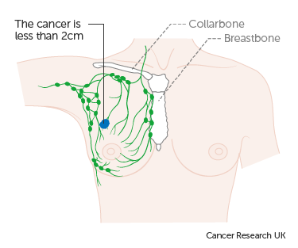
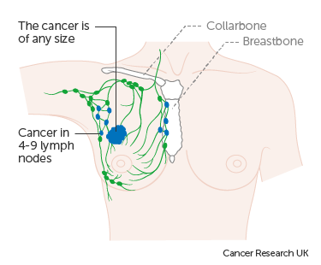
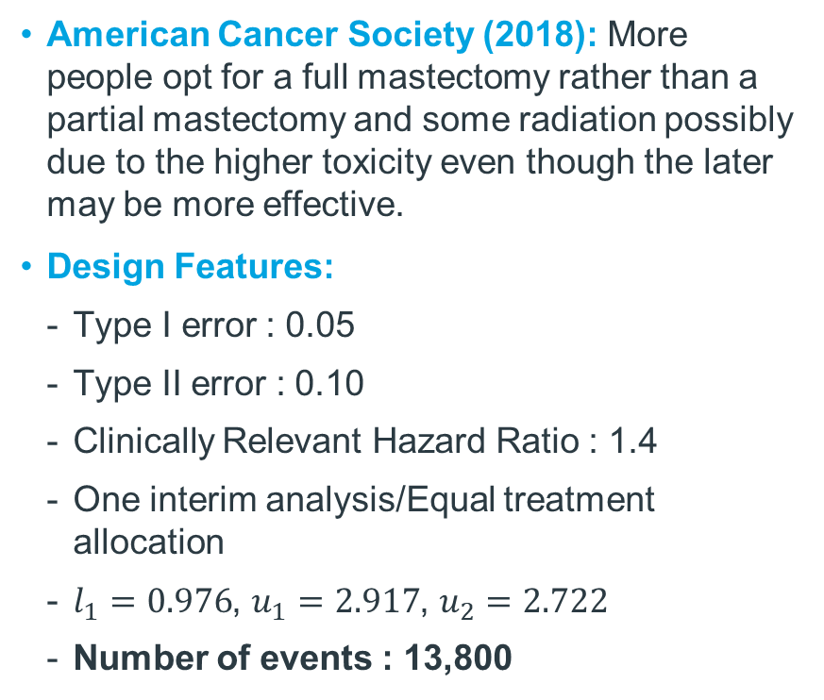
Hypothetical Trial II
Hypothetical Trial II
Breast Cancer Stages
Is a partial mastectomy plus some from of radiation more effective in increasing time to cancer recurrences then a full mastectomy in breast cancer patients?
Subgroup
Prevalence
American Cancer Society (2018): More people opt for a full mastectomy rather than a partial mastectomy and some radiation possibly due to the higher toxicity even though the later may be more effective.
Design Features:
  Type I error : 0.05
  Type II error : 0.10
  Clinically Relevant Hazard Ratio : 1.4
  One interim analysis/Equal treatment allocation
  $l_{1}=0.976$, $u_{1}=2.917$, $u_{2}=2.722$
  Number of events : 13,800
Stage I
Stage III

Slide 18

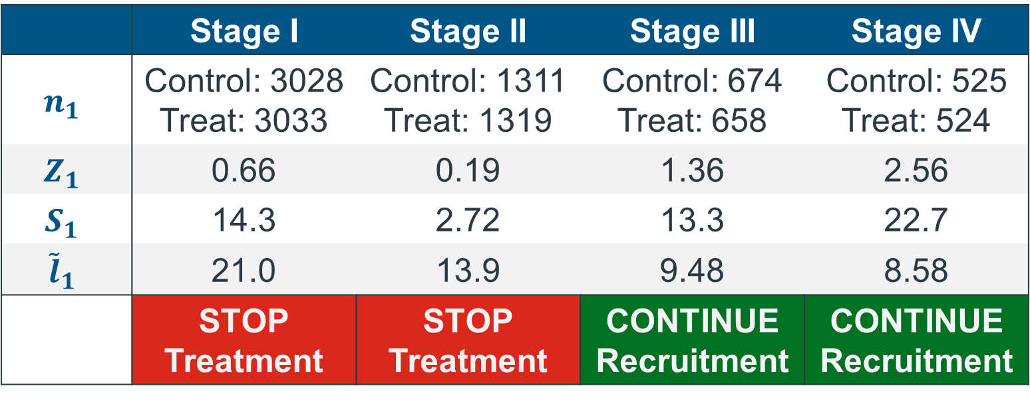
Hypothetical Trial II
Hypothetical Trial II
Breast Cancer Stages
At First Interim
Analysis
 | Stage I | Stage II | Stage III | Stage IV
$$n_{1}$$ | Control: 3028 Treat: 3033 | Control: 1311 Treat: 1319 | Control: 674 Treat: 658 | Control: 525 Treat: 524
$$Z_{1}$$ | 0.66 | 0.19 | 1.36 | 2.56
$$S_{1}$$ | 14.3 | 2.72 | 13.3 | 22.7
$${\tilde{l}}_{1}$$ | 21.0 | 13.9 | 9.48 | 8.58
 | STOP Treatment | STOP Treatment | CONTINUE Recruitment | CONTINUE Recruitment
${\tilde{u}}_{1,\{3,4\}}=u_{1}\sqrt{𝕀_{1,3}+𝕀_{1,4}}=38.6 ≮36.1=13.3+22.7$
Cannot yet reject null in the Stage III & IV subgroups, continue trial

Slide 19
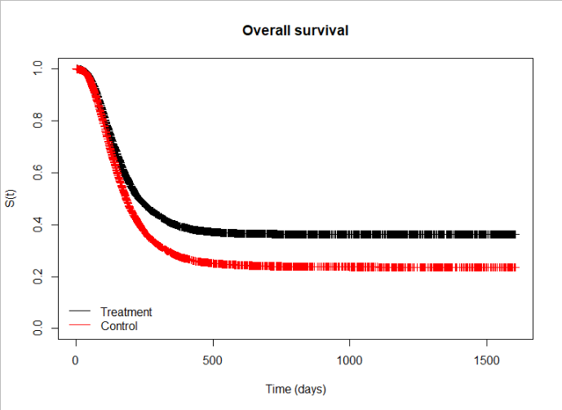
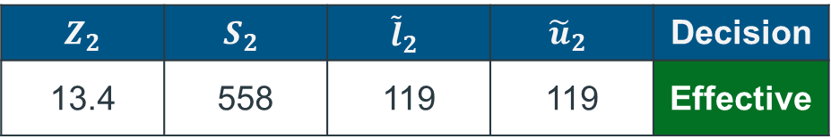
Hypothetical Trial II
Hypothetical Trial II
Breast Cancer Stages
At Second Interim
KM Curves
Analysis
$$Z_{2}$$ | $$S_{2}$$ | $${\tilde{l}}_{2}$$ | $${\tilde{u}}_{2}$$ | Decision
13.4 | 558 | 119 | 119 | Effective

Slide 20
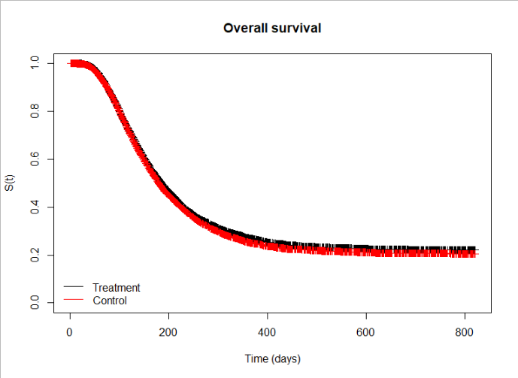
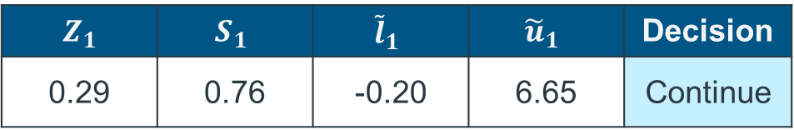
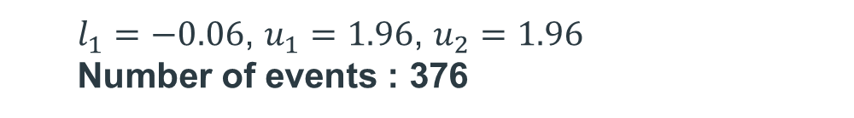
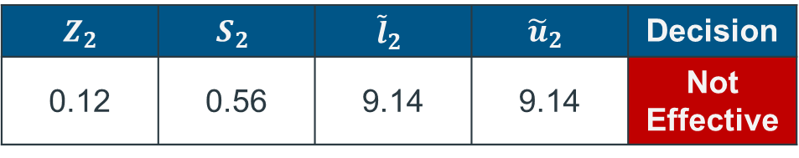
Hypothetical Trial II
Hypothetical Trial II
Breast Cancer Stages
Full population analysis (Not considering subgroups)
KM Curves
Design
  $l_{1}=−0.06$, $u_{1}=1.96$, $u_{2}=1.96$
  Number of events : 376
Analysis: Interim 1
$$Z_{1}$$ | $$S_{1}$$ | $${\tilde{l}}_{1}$$ | $${\tilde{u}}_{1}$$ | Decision
0.29 | 0.76 | -0.20 | 6.65 | Continue
Analysis: Interim 2
$$Z_{2}$$ | $$S_{2}$$ | $${\tilde{l}}_{2}$$ | $${\tilde{u}}_{2}$$ | Decision
0.12 | 0.56 | 9.14 | 9.14 | Not Effective

Slide 21








Final Thoughts
Is a GSDS Design a Good Idea For My Trial?
Is there a chance of seeing a difference?
Assumptions?
Prevalence of subgroups
Ease of subgroup identification
.
Do the advantages outweigh the disadvantages?
.

Slide 22



Where Can I Learn More?
Adaptive Enrichment Designs for Clinical Trials
Simon, N. and Simon, R. (2013).
Nonparametric adaptive enrichment
designs using categorical surrogate data.
Bruckner, M., Burger, H. U., and Brannath, W. (2018)
Reflection Paper on Methodological Issues in Confirmatory Trials with Adaptive Designs
Group Sequential Design
Incorporating Subgroup Selection
Magnusson, B. P. and Turnbull, B. W. (2013)
Enrichment Strategies for Clinical Trials to Support Determination of Effectiveness of Human Drugs and Biological Products

Slide 23
References
Allegra, C., Jessup, J., Somereld, M., Hamilton, S., Hammond, E., Hayes, D., Mcallister, P., Morton, R., and Schilsky, R. (2009). American society of clinical oncology provisional clinical opinion: Testing for kras gene mutations in patients with metastatic colorectal carcinoma to predict response to anti-epidermal growth factor receptor monoclonal antibody therapy. Journal Of Clinical Oncology, 27(12):2091-2096.
American Cancer Society (2018). Breast Cancer Facts and Figures 2017-2018. Atlanta:American Cancer Society.
Brückner, M., Burger, H. U., and Brannath, W. (2018). Nonparametric adaptive enrichment designs using categorical surrogate data. Statistics in Medicine, 37(29):4507-4524.
Jennison, C. and Turnbull, B. (2000). Group sequential methods with applications to clinical trials. Chapman I& Hall/CRC, Boca Raton.
Magnusson, B. P. and Turnbull, B. W. (2013). Group sequential enrichment design incorporating subgroup selection. Statistics in Medicine, 32(16):2695-2714.
Simon, N. and Simon, R. (2013). Adaptive enrichment designs for clinical trials. Biostatistics (Oxford, England), 14(4).

