Slide 1
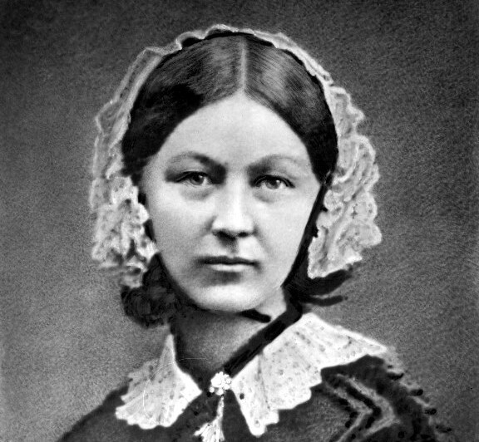
Florence Nightingale, pigeonholes and mustard seeds: using data to improve health from the time of the Crimea to the time of the coronavirus
PSI Conference
8th June 2020
Deborah Ashby
President, Royal Statistical Society
Director of the School of Public Health, Imperial College London

Slide 2
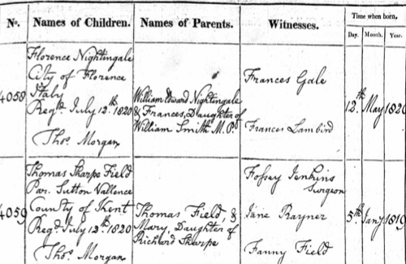
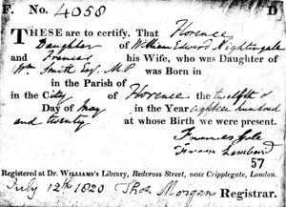

Slide 3
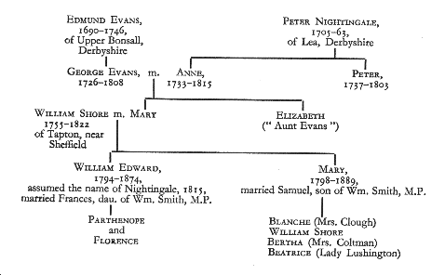

Slide 4
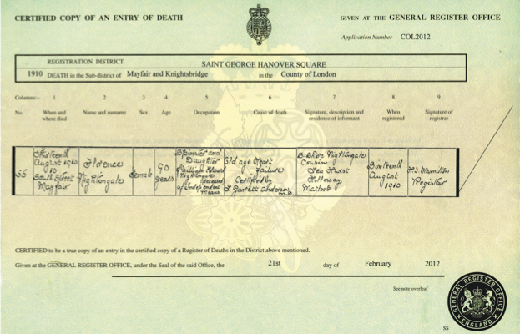

Slide 5
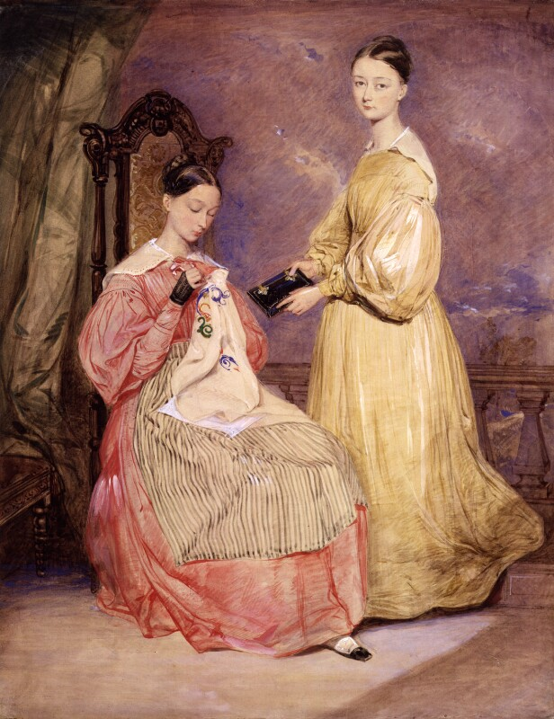
Florence Nightingale: early education
Taught with Parthenope by her Cambridge-educated father
Curriculum- Latin, Greek, history, philosophy, mathematics, modern languages and music
Parthenope preferred sketching, Florence’s Greek was good enough to later help Benjamin Jowett in his translation of Plato’s Dialogues
Notes:
Florence and (Frances) Parthenopepe c 1836 By William White - National Portrait Gallery, Public Domain, https://commons.wikimedia.org/w/index.php?curid=82762195

Slide 6
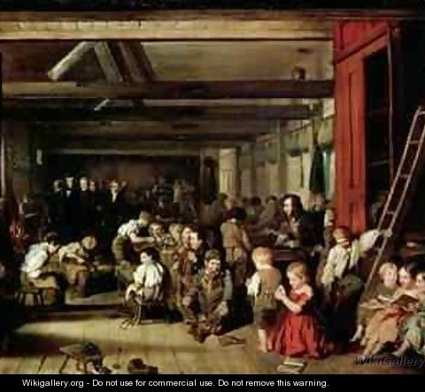
Florence Nightingale: the young adult
At 17 had a mystical experience, her ‘calling’ that she was not destined for a conventional life
1845: wanted to learn about nursing at Salisbury Infirmary ‘It was as if I wanted to be a kitchen maid’; concluded only widowhood or poverty could give an educated woman a reason to work
1848: taught her ‘little thieves’ at a Ragged School in Westminster- opened her eyes to poverty, but family objected. Again.
Notes:
The First Ragged School Westminster (Blaikley)

Slide 7
Florence Nightingale: the nurse-in-waiting
1849: after cultural tour of Egypt and Greece, visited a hospital, orphanage and school at Kaiserworth near Dusseldorf, staffed by ‘deaconesses’ trained by the founding pastor and his wife, Theodor and Caroline Fliedner
1850: trained as a nurse at Kaiserworth- against strong family opposition
1851-4: couldn't find an outlet for her training on her return- so visited hospital throughout UK and Europe, collecting information- analysing and reflecting on hospital reports and government publications on public health
1853: Lady Superintendent of an Institution for Sick Gentlewomen, No1 Upper Harley Street
1854-56: Crimean War – the Lady of the Lamp

Slide 8
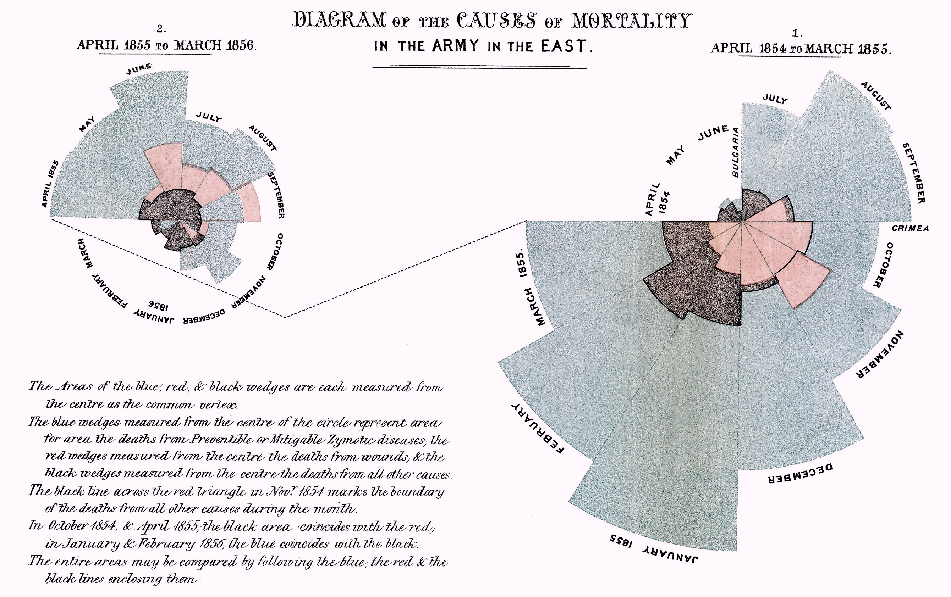
Notes:
Wikimedia – public domains

Slide 9
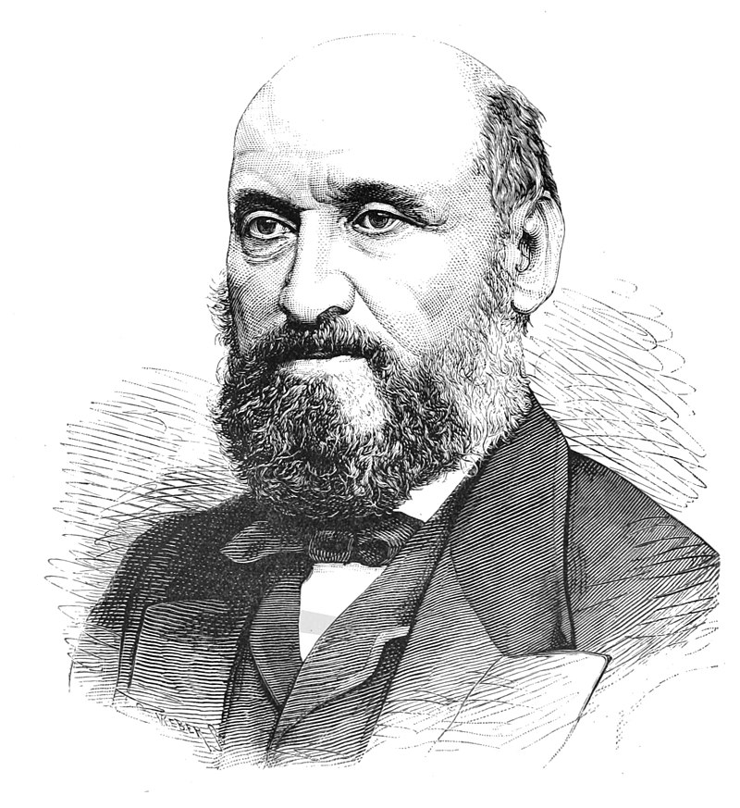
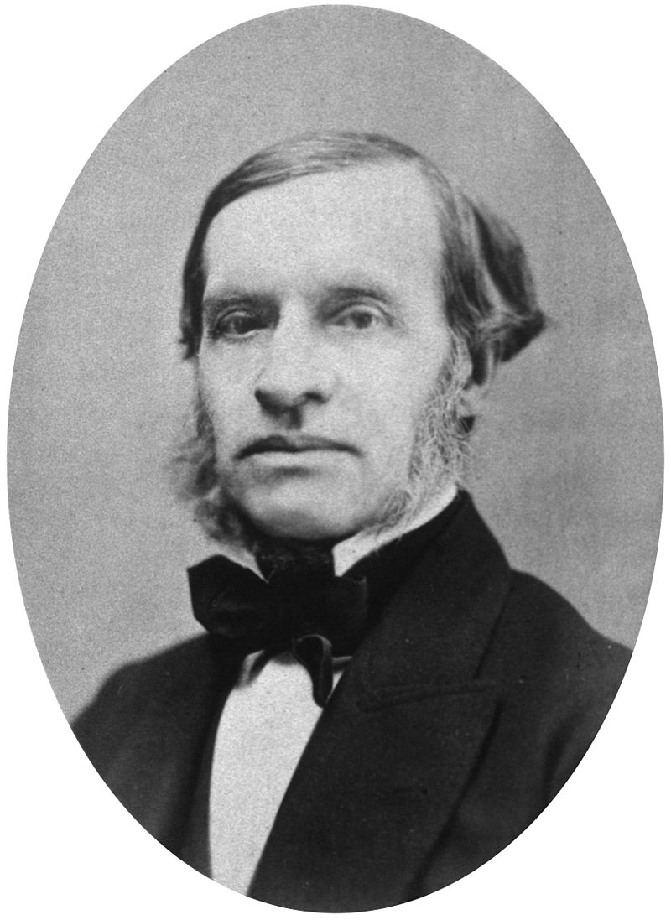
Florence Nightingale:
Fellow of the
Statistical Society of London

Slide 10
Florence Nightingale: action woman
By 30 ‘During the middle portion of my life, college education, acquirement [of knowledge] I longed for- but that was temporary’
Inspired supporters to set up The Nightingale Fund for reform of civil hospitals by establishing an institute for training of nurses and hospital attenders
Campaigned for a full commission of enquiry into Crimean deaths – 16000 from disease cf 4000 from battle

Slide 11
Florence Nightingale: the feminist
especially critical of the education available to women, and the limited expectations society had of their role
“The time is come when women must do something more than the "domestic hearth," which means nursing the infants, keeping a pretty house, having a good dinner and an entertaining party.”
“Why have women passion, intellect, moral activity — these three — and a place in society where no one of the three can be exercised?”

Slide 12
Florence Nightingale: passionate about education
Championed education of British soldiers
Championed education of Army doctors
Set up Nightingale School of Nursing at St Thomas’s
  Detailed instructions
  To be taught by practictioners
  Influence spread as ‘graduates’ took senior roles and went worldwide
Thanks to Alex Attewell (1998)

Slide 13
Florence Nightingale: passionate about education
A keen interest in
  the village elementary school near family home in Derbyshire
  education in schools in British colonies
  Education in workhouses for poor
Common themes- practical education, hands-on, manual skills

Slide 14
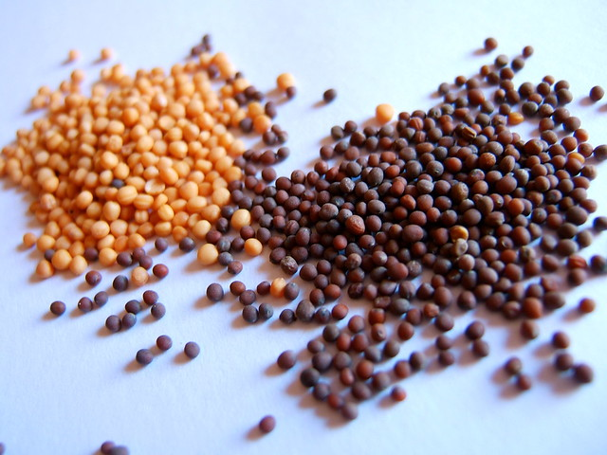
Florence Nightingale: passionate about education
primarily interested in action
in the context of sanitary reform and promotion of sanitary education in India, which was going slowly,
“I never lose an opportunity of urging a practical beginning, however small, for it is wonderful how often in such matters the mustard-seed germinates and roots itself.”
Notes:
Copyright free

Slide 15
Florence Nightingale: theory of education
‘Education is to teach men not to know, but to do’.
“Observation tells how the patient is; reflection tells what is to be done; training tells how it is to be done. Training and experience are, of course, necessary to teach us, too, how to observe, what to observe; how to think, what to think” (Nightingale, 1882).
‘every five or ten years […] really requires a second training nowadays’

Slide 16
Florence Nightingale: passionate about statistics
“Statistics is the most important science in the whole world: for upon it depends the practical application of every other science and of every art: the one science essential to all political and social administration, all education, all organization based on experience, for it only gives results of our experience.”

Slide 17
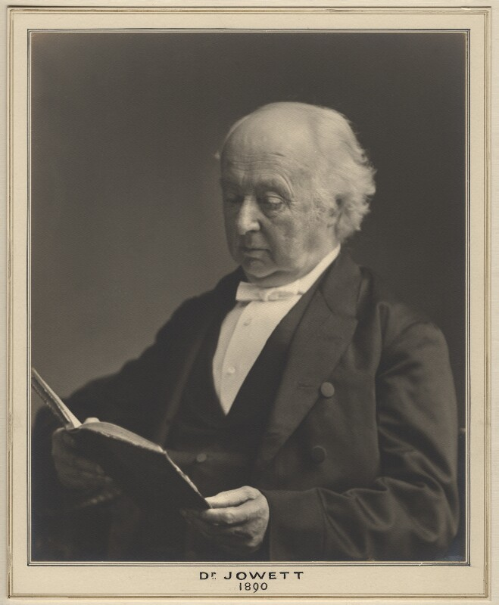
Florence Nightingale: education for politicians
letter to Benjamin Jowett (1891)
“Our chief point was that the enormous amount of statistics at this moment available at their disposal (or in their pigeon holes which means not at their disposal) is almost absolutely useless. Why? Because the Cabinet ministers...their subordinates, the large majority of whom have received a university education, have received no education whatever on the point upon which all legislation and all administration must—to be progressive and not vibratory—ultimately be based. We do not want a great arithmetical law; we want to know what we are doing in things which must be tested by results.”
Notes:
Pixabay copyright free

Slide 18

Florence Nightingale: education for politicians
letter to Benjamin Jowett (1891)
“Our chief point was that the enormous amount of statistics at this moment available at their disposal (or in their pigeon holes which means not at their disposal) is almost absolutely useless. Why? Because the Cabinet ministers...their subordinates, the large majority of whom have received a university education, have received no education whatever on the point upon which all legislation and all administration must—to be progressive and not vibratory—ultimately be based. We do not want a great arithmetical law; we want to know what we are doing in things which must be tested by results.”
Notes:
Pixabay copyright free

Slide 19
Florence Nightingale: passionate about education
Proposed introducing statistics into studies at the University of Oxford….
… by setting up Professorship of Applied Statistics
to address the need for statistics relating to education, penology, workhouses and India

Slide 20


Pigeon-holes and Mustard Seeds

Slide 21
Educating politicians: RSS Data Manifesto
First published 2014, and the third version 2019 for the December election.
10 recommendations to the UK government on how it can improve data for policymaking, democracy and for the prosperity of society as a whole, including.
“Politicians, policymakers and other professionals working in public services (such as regulators, teachers and doctors) should be given basic training in data handling, statistics and interpreting evidence”

Slide 22
Building statistical capacity
Florence Nightingale’s ambition to increase statistical capacity more relevant than ever
Need depth of training, and step change in quantity of people trained
Royal Society report on Data Science Skills (2019)
Statisticians need to understand ML and AI, and vice versa
Important role for online MOOC’s to full degrees

Slide 23
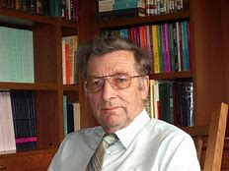
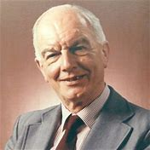
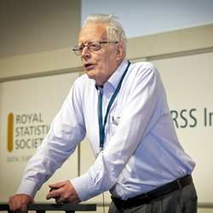
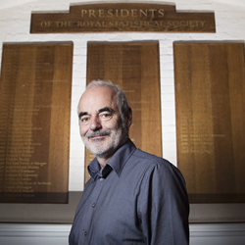
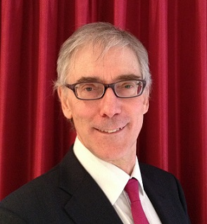
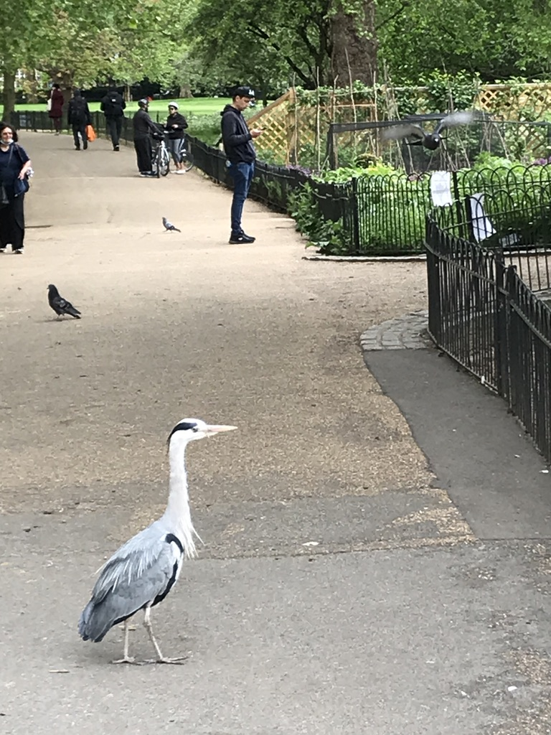
Building statistical capacity

Slide 24
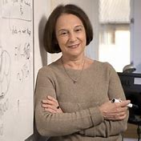
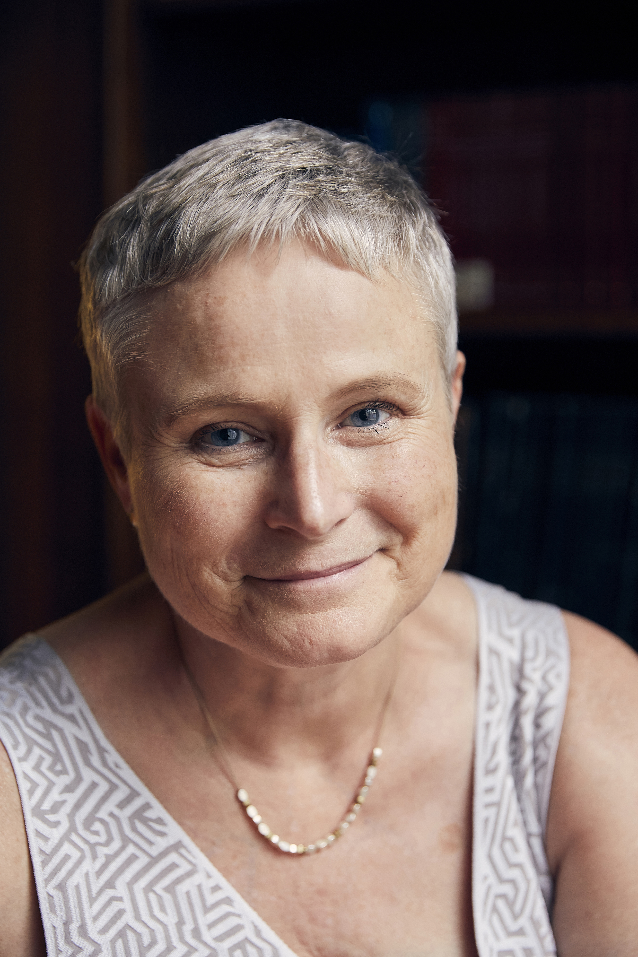
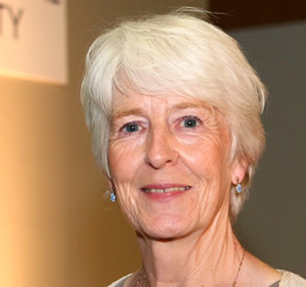
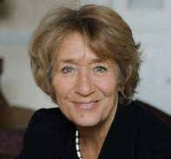
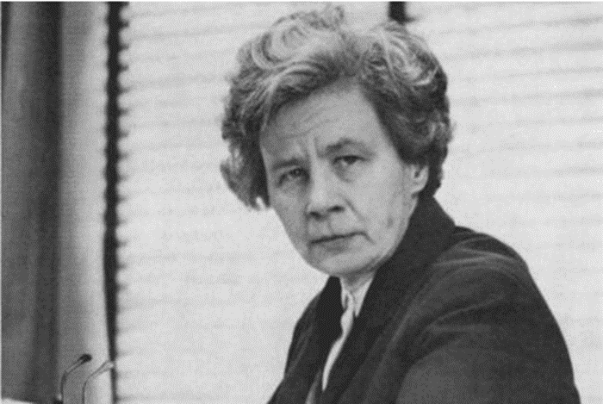
Notes:
No permission for photos

Slide 25
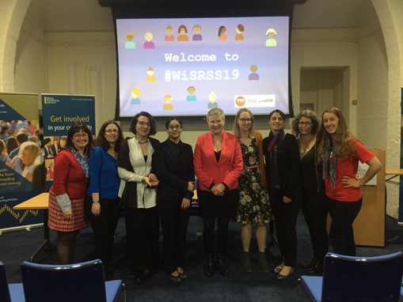
Building statistical capacity
Notes:
No permission for photos

Slide 26
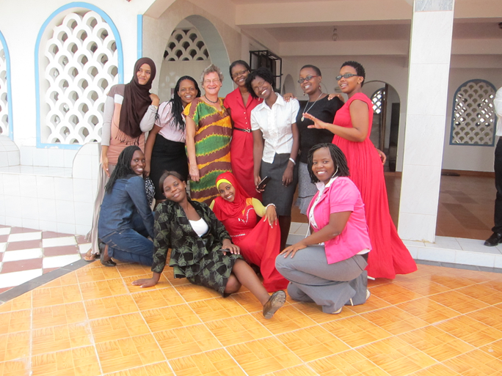
Building statistical capacity
UKRI CDT’s
NIHR investment
Training courses
Statisticians for Society
AIMS

Slide 27
Building statistical capacity
The breath of approaches and applications → increasing need for high level statistical expertise including the ability to work in highly multi-disciplinary scientific and legal frameworks
Kingman (2018): skills required have come to another level both in terms of depth and the numbers of people needed
If we can rise to the challenge, the potential for using data for the public good is enormous

Slide 28

Pigeon-holes and Mustard Seeds

Slide 29
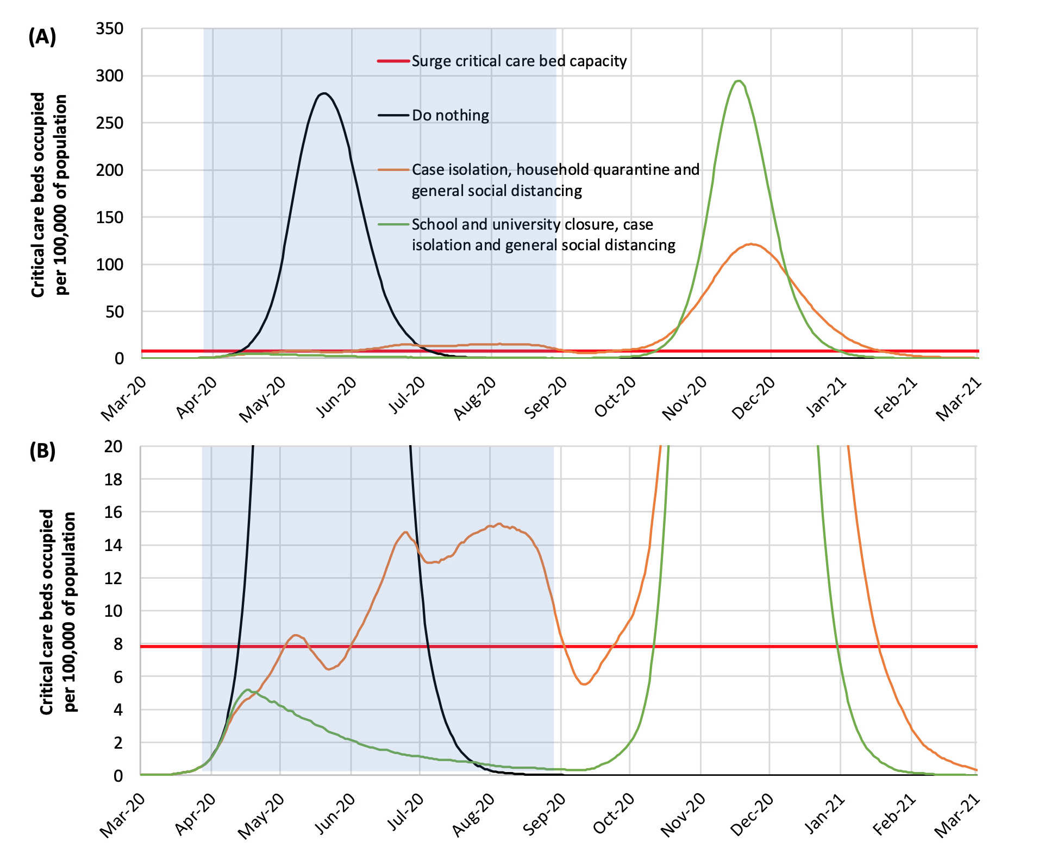
Modelling to inform policy
Report 9: Impact of non-pharmaceutical interventions (NPIs) to reduce COVID-19 mortality and healthcare demand
(Ferguson et al, 16 March 2020)

Slide 30
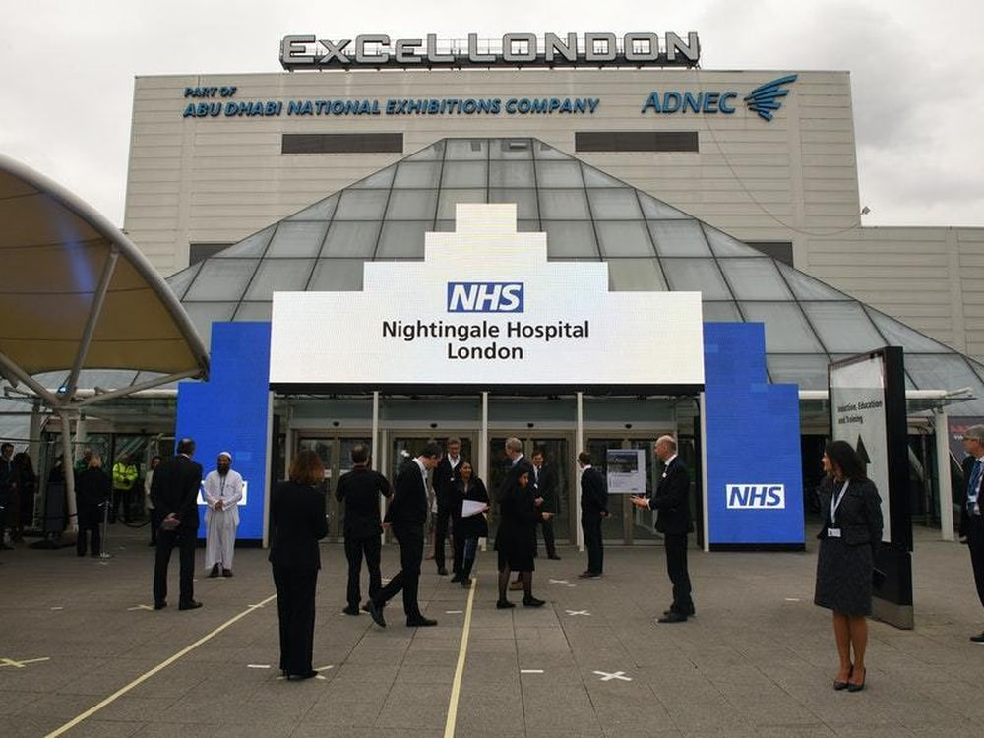
Florence Nightingale: action woman

Slide 31
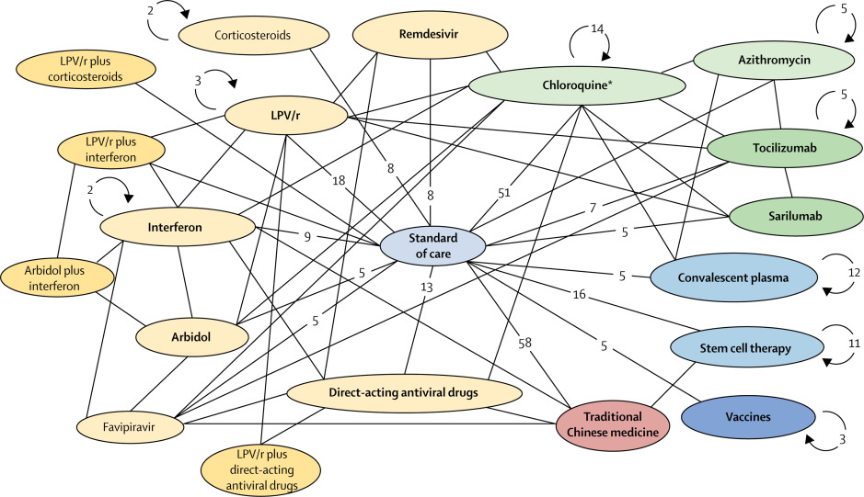
Evidence network of COVID-19 clinical trials of top 15 interventions
Notes:
Evidence network of COVID-19 clinical trials of top 15 interventions
Circles (node) represent interventions or intervention groups (categories). Lines between two circles indicate comparisons in clinical trials. The numbers on the lines are the number of clinical trials making the specific comparison. Circular arrows and numbers indicate the number of non-comparative clinical trials in which that intervention is included. A few trials examining combination therapies are excluded from the figure due to space limitations. COVID-19=coronavirus disease 2019. LPV/r (lopinivir–ritonavir). *Includes trials on hydroxychloroquine and chloroquine.

Slide 32
COVID 19: The key three UK national trials
PRINCIPLE (higher risk patients in primary care trial) www.principletrial.org
RECOVERY (in hospital trial) https://www.recoverytrial.net/
REMAP-CAP (critically ill patient trial) https://www.remapcap.org/

Slide 33
RSS Covid-19 Task Force
co-chairs Sylvia Richardson and David Spiegelhalter
the design of data collection,
diagnostic studies,
modelling,
forecasting,
treatment studies,
the enhancement of public understanding,
and other areas.
https://rss.org.uk/policy-campaigns/policy/covid-19-task-force/

Slide 34
Florence Nightingale: legacy
“There was a great deal of romantic feeling about you 23 years ago when you returned home from the Crimea […] and now you work on in silence, and nobody knows how many lives are saved by your nurses in hospitals; how many thousand soldiers […] are now alive owing to your forethought and diligence; how many natives of India in this generation and in generations to come have been preserved from famine and oppression and the load of debt by the energy of a sick lady who can scarcely rise from her bed. The world does not know all this or think about it. But I know it and often think about it. “
( Benjamin Jowett, 31 December 1879)

Slide 35
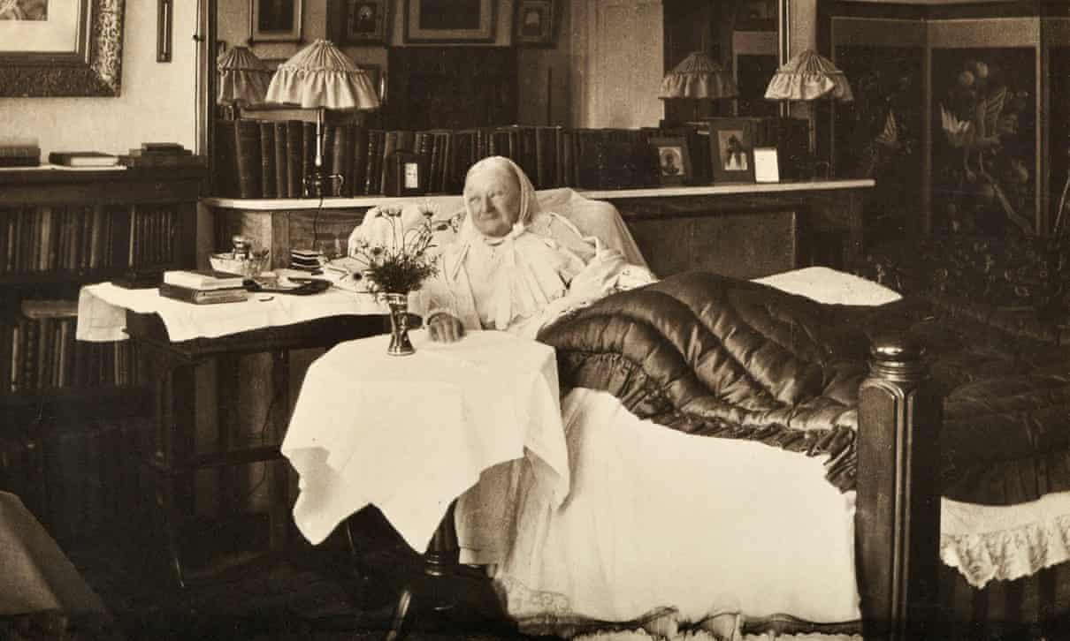
Florence Nightingale 1906: #lockdown role model
Notes:
The 86-year-old Florence Nightingale in bed, 1906. Photograph: The Press Office/PA Media

Slide 36
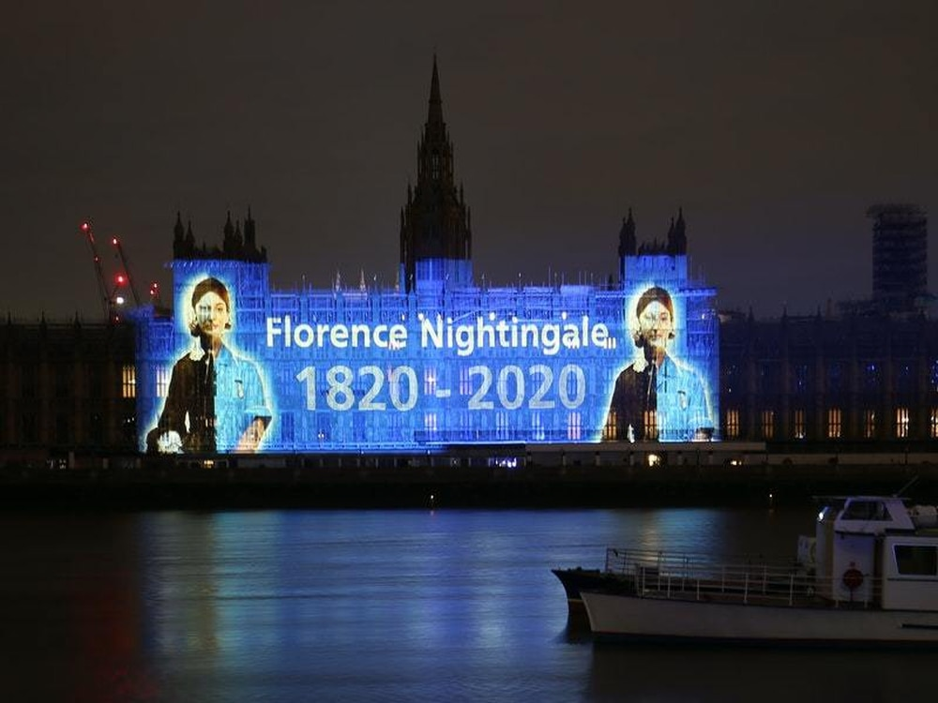
Florence Nightingale: education for politicians

Slide 37
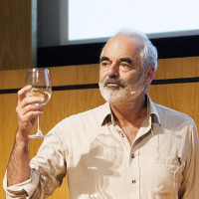

Happy 200th Birthday, Florence!

