Slide 1
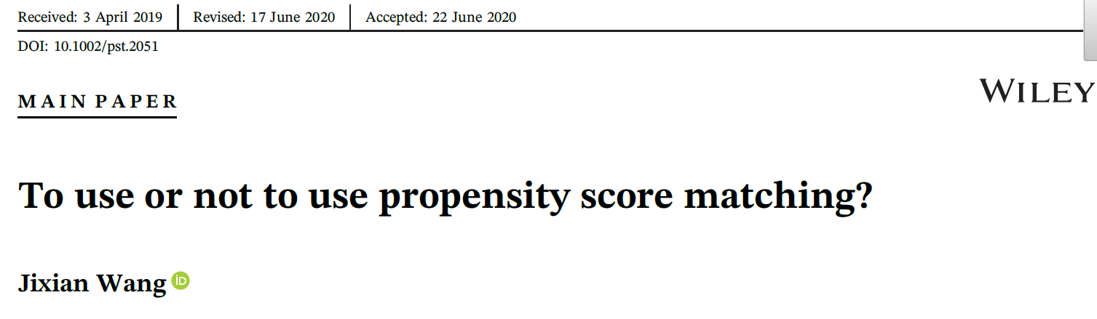
To use or not to use propensity score matching?
Jason (Jixian) Wang
Bristol Myers Squibb, Switzerland
PSI journal club, 22 June, 2023

Slide 2
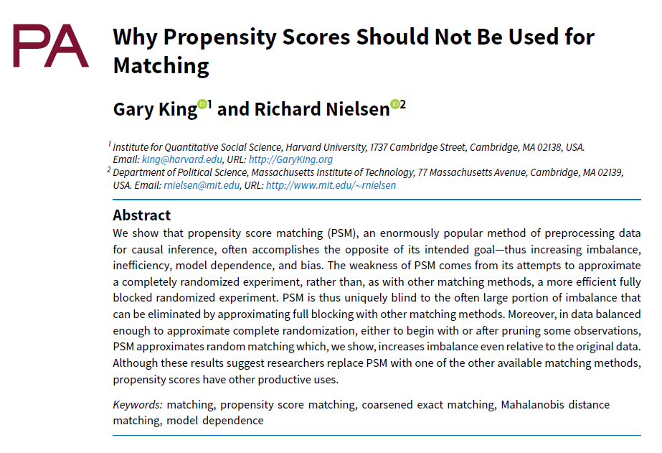

Slide 3
Outline
What can go wrong with propensity score matching (PSM)?
Is it a problem with propensity score or matching, or the combination?
What is the promise of PSM?
What are alternatives?
When and how to use PSM and recommendations.

Slide 4
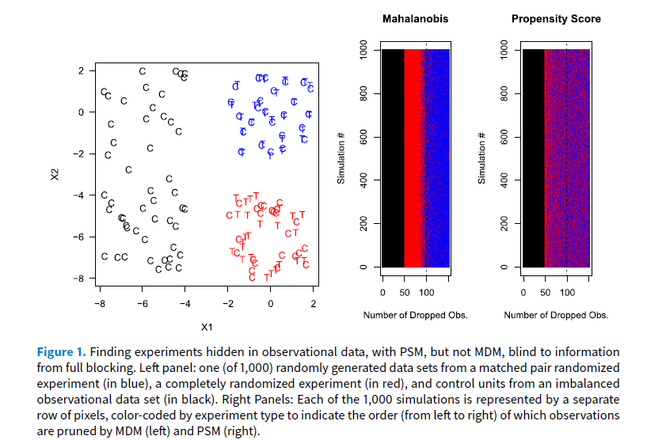
What can go wrong with PSM?
Source: King and Nielsen (2019)

Slide 5
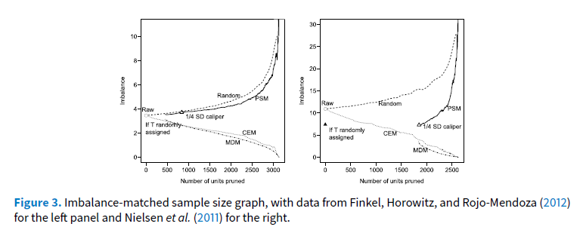
Empirical evidence in King and Neilsen (2019)
PSM may randomly throw away data points
But why imbalance increases?
Suppose we have an RCT and want gender balance.
This can be easily achieved by say n=100.
What if we randomly throw away 90% of them?

Slide 6
Can PS weighting (IPW) solve the problem?
What IPW would do?
  The black ones get very small weights.
  The red and blue ones get similar weights.
  Instead of randomly dropping some of the red and blue ones, IPW weights them equally (a reason for why King said IPW is OK).
The fundamental issue here is that PS can’t tell who are the red and who are the blue.
Can we improve PSM?
  Stop pruning (reducing caliper) after drop all black ones.
  In practice, stop pruning when you don’t see much improvement in PS balance.
  This may not be easy with PS, but one can check the covariates directly.
Source: King and Nielsen (2019)

Slide 7
PSM to balance covariates
King’s major criticism to PSM is that it may not balance each covariates.
Indeed this is the case (eg, in his example), but is not premised by PSM.
What it does promise is equal percent bias reduction (EPBR) when the outcome Y and PS are linear functions of covariates (Rubin, 1976; Rubin & Thomas, 1992).
EPBR in words: On average, if PS imbalance is reduced by S% after PSM, the bias in Y is also reduced by S%.
Direct corollary: On average, the imbalance of any covariate also reduces by S%.
This might be counter-intuitive, as often a well-balanced covariate may become imbalanced after PSM.
The key word here is “on average”; It is not a per-study guarantee, especially when the study is small.

Slide 8
Conditional EPBR and per-study guarantee
In fact, we can show that PSM promises more (Wang, 2021).
EPBR holds conditional on a specific (per-study) matching:
  For a specific study, if imbalance in PS is reduced by S% after a PSM, on average, the bias in Y among the matched is also reduced by S%.
EPBR is probably approximately correct (PAC):
  For a specific study, if PS imbalance is reduced by S% after a PSM,
  Pr(|bias(Y)m - S x bias(Y)o|> δ) -> 0 when the sample size ->infinity.
  (bias(Y)m/o is the bias of matched (m) and original (o) sample, δ>0)
Compared to the well-known fact that a prefect PSM makes your data as if they were from a quasi- randomization, the above provide properties of PSM after imperfect matching.

Slide 9
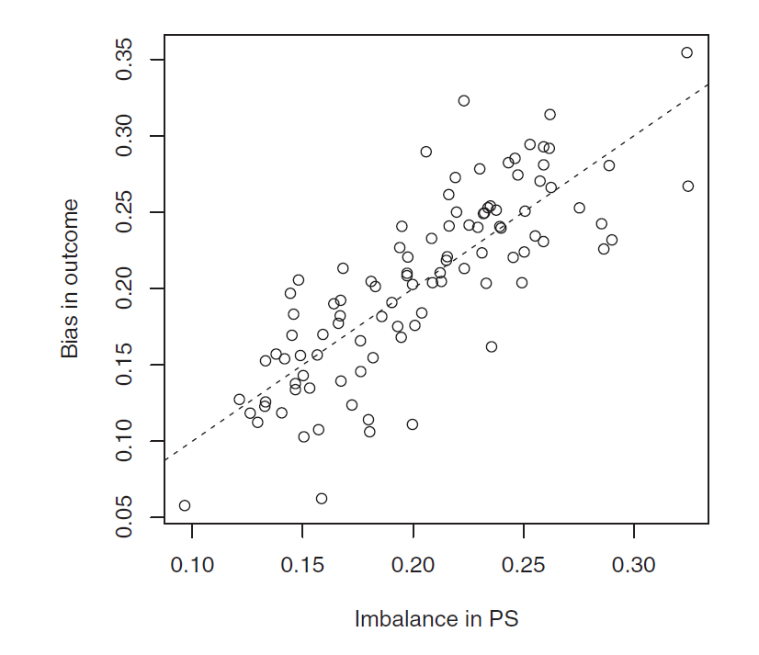
EPBR is probably approximately correct: An illustration
A simulation of 100 studies (100 treated, 500 control subjects) to show EPBR is PAC
Most biases are below the blue line.
Dash line shows EPBR. The prob of bias is above the blue line is very small.
δ

Slide 10
Recommendations
Use PSM when matching on multiple covariates and/or direct adjustment with an outcome model are difficult or impossible. This may happen in drug safety studies in which the number of covariates is large, exposure-covariate data are rich, but safety events are rare;
Plan PSM carefully and evaluate its effect with available information at study planning stage;
Choose caliper width taking matching and population biases into account;
Evaluate imbalance in PS and key factors before and after matching, especially those originally well balanced;
Include prognostic factors into the PS model, even when they are far from statistically significant in the PS model.
Matching with categorical factors and coarsen covariates into categorical variables if appropriate (CEM, Iacus et al., 2011);
Direct adjustment for key prognostic factors after PSM;
Match on both PS and prognostic score (Hansen, 2008), if feasible.
Match on PS and key prognostic factors even they are well balanced before matching;
Directly or indirectly match key prognostic factors which may have a complex role in the prognostic score and balance the others.

Slide 11
Summary and discussion
PSM is a powerful tool if used properly for the right tasks.
The right question should be when and how to use PSM rather than to use or not to use it.
Pre-specifying a caliper is a practical challenge.
It is important and often feasible to plan PSM properly even before having access to full data.
Multiple methods should be applied, and their results reported in detail and transparently.
How to analyze matched data is also important, especially for estimation (Austin, 2014).

Slide 12
Reference
Wang J. (2021). To use or not to use propensity score matching?. Pharmaceutical statistics, 20(1), 15–24. https://doi.org/10.1002/pst.2051
Rosenbaum PR, Rubin DB. The central role of the propensity score in observational studies for causal effects. Biometrika. 1983;70:41-55.
King G, Nielsen R. Why propensity scores should not be used for matching. Political Analysis. 2019;27:435-454.
Iacus SM, King G, Porro G. Multivariate matching methods that are monotonic imbalance bounding. J Am Stat Assoc. 2011;106:345-361.
Iacus SM, King G, Porro G. Causal inference without balance checking: coarsened exact matching. Political Analysis. 2011;20(1):1–24.
Rubin DB. Multivariate matching methods that are equal percent bias reducing, I: some examples. Biometrics. 1976;32:109-120.
Rubin DB. Multivariate matching methods that are equal percent bias reducing, II: maximums on bias reduction for fixed sampled sizes. Biometrics. 1976;32:121-132.
Rubin DB, Thomas N. Affinely invariant matching methods with ellipsoidal distributions. Ann Statist. 1992;20:1079-1093.
Rubin, DB., & Thomas N. Characterizing the Effect of Matching Using Linear Propensity Score Methods with Normal Distributions. Biometrika. 1992;79:797–809.
Hansen BB. The prognostic analogue of the propensity score. Biometrika. 2008;95:481-488.
Austin PC. The use of propensity score methods with survival or time-to-event outcomes: reporting measures of effect similar to those used in randomized experiments. Stat Med. 2014;33:1242-1258.

Slide 13
Backup

Slide 14
Are pruning and matching the same?
Suppose we use PSM for two populations with reasonably overlapped propensity scores (PS) with a full matching and caliper width d.
Start with very large d, we can match everyone.
Reducing the caliper, we drop (prune) those with no overlapped PS.

Slide 15
Alternatives to PSM
 | Matching/stratification | Weighting | Others
Propensity score based | PSM | IPW | PS as covariate; Doubly robust estimators
Other distance based (MD, entropy) | MDM, prognostic score matching | Entropy balancing (MAIC).
Covariates based |  | Estimation calibration. | Direct adjustment

