Slide 1
How patient preference studies can inform drug development decisions
Quantitative Safety & Epidemiology
Sheila Dickinson
PSI Webinar
October 2020

Slide 2
Disclaimer
The views and opinions expressed in this presentation are those of the author and do not necessarily reflect the official policy or position of Novartis or any of its officers.

Slide 3
Outline
Background: why do a patient preference study?
Two types of decisions that can be informed by a patient preference study
Introduction to an outline structure for considering patient preference studies; brief example
Summary

Slide 4
Why do a patient preference study?
Medical products are developed for patients.
Industry, regulatory authorities, HTA bodies, reimbursement agencies are increasingly looking to take patients’ views into account.
Patient preference studies are one tool to do this.

Slide 5
A closer look at the regulatory interest in patients’ views
FDA activities
FDA are currently writing 4 guidelines on Patient-focused Drug Development.
EMA activities
CHMP workplan for 2020 aims to <<incorporate additional and regular processes to capture and include patient views and preferences within CHMP benefit/risk evaluations>>
ICH M4E(R2) guidance on Clinical Overview
<<Information about the patient perspective may be considered when describing the therapeutic context, benefits, risks, and the benefit-risk assessment>>
CDRH have guidance specifically on patient preference information
CDRH = Center for Devices and Radiological Health
CHMP = Committee for Human Medicinal Products

Slide 6
Outline
Background: why do a patient preference study?
Two types of decisions that can be informed by a patient preference study
Introduction to an outline structure for considering patient preference studies; brief example
Summary

Slide 7
Decision where patient preferences can help: choice of patient-relevant endpoints
Example 1 of reasons to investigate patient-relevant endpoints: for an indication without established endpoints
Some indications (e.g. orphan diseases, indications without approved treatments) don’t have established endpoints.
In these cases, patients’ views can inform the decision about appropriate endpoints.
Example 2 of reasons to investigate patient-relevant endpoints: when re-visiting established endpoints
Some indications have established endpoints (e.g. indications with many approved treatments).
The established endpoints might not reflect all aspects of the disease which matter to patients.
Notes:
Output of a preference study could be weighting, across the study population, of different attributes within a disease.

Slide 8
Decision where patient preferences can help: acceptability of benefit-risk trade-offs
Trt D
Choice of treatment D depends on the trade-off between the additional benefit and additional risk relative to treatments A-C.
A patient preference study can help assess the acceptability of this trade-off.
Trt C
Trt A
Risk
Trt B
Benefit
Adapted from diagram in the MDIC Patient centered benefit-risk project report
Notes:
Output of a preference study looking at acceptability of benefit-risk could be a marriage of clinical + preference data; you use the preference data to say “for this amount of benefit + this amount of risk, then N% of patients would find this benefit-risk trade-off acceptable”. Some of you might be familiar with the Rituximab drug from Roche, where they compared patients’ views on an s.c. formulation vs. an i.v. formulation, and the drug label has information about what proportion of patients preferred each formulation.
Lots of other ways of analyzing this type of study; can also consider analysis of Maximum Acceptable Risk for a specified level of benefit; Minimum Required Benefit for a specified level of risk etc.

Slide 9
Not all benefit-risk assessments will be helped by having patient preference data
Trt C
Trt A
Risk
Treatment D has better benefit-risk profile than treatments A-C: more benefit, less risk.
(No obvious need for a patient preference study to support Treatment D.)
Trt B
Trt D
Benefit
Adapted from diagram in the MDIC Patient centered benefit-risk project report

Slide 10
Summary: 2 scenarios where patient preference study can add value (1/2)
Effects table
Scenario 1 where preference study can add value: understanding patient-relevant endpoints.
i.e. patients’ views can inform the thinking on key benefits
 | Treatment | Control
Favourable effects
Key Benefit 1
Key Benefit 2
Etc.
Unfavourable effects
Key Risk 1
Key Risk 2
Etc.
Notes:
Regulatory assessment still needs the clinical data! But preference data can help the decision about which clinical endpoints to study.

Slide 11
Summary: 2 scenarios where patient preference study can add value (2/2)
Effects table
 | Treatment | Control
Favourable effects
Key Benefit 1 | Large effect | Small effect
Key Benefit 2 | Large effect | Small effect
Etc.
Unfavourable effects
Key Risk 1 | Some patients experience this risk | Minimal
Key Risk 2 | Some patients experience this risk | Minimal
Etc.
Scenario 2 where preference study can add value: understanding patients’ views on the acceptability of benefit-risk trade-offs
Notes:
Again, the regulatory decision still needs the clinical data! But the preference data can be further useful input to the regulatory decision, as the preference data can show whether this is a benefit-risk trade-off that some patients would find acceptable.
Speaker notes: there are other types of decisions that can be informed by patient preferences. E.g. scoring of PRO instruments; acceptability of benefit-risk uncertainties.

Slide 12
Outline
Background: why do a patient preference study?
Two types of decisions that can be informed by a patient preference study
Introduction to an outline structure for considering patient preference studies; brief example
Summary

Slide 13
Structure for thinking about patient preference studies
1. Research question
2. Organisation, design, conduct of preference study
3. Application of preference data to inform decision-making
High-level version of a diagram from Van Overbeeke E, et al. Factors and situations influencing the value of patient preference studies along the medical product lifecycle: a literature review. Drug discovery today. 2019;24(1):57-68
Notes:
This also helps us understand when to run a patient preference study.
If you have a research question about the acceptability of benefit-risk trade-off, and you’d like to use your preference study results to support a submission to the regulators, then the timing of the preference study needs to ensure the results are available before your submission. E.g. you might do the preference study in parallel to your phase 3 study.
If we have a research question about patient-relevant endpoints, and you’d like to use your preference study results to support a decision about the choice of endpoints in your pivotal study, then the timing of the preference study needs to ensure the results are available prior to the start of your pivotal study. E.g. you might do the preference study ahead your phase 3 clinical study.
And just to explain also that a preference study can be embedded within a clinical study. You can think of a preference study as a form of patient survey, and we very often ask patients to complete questionnaires (or PROs) within a clinical study. So one option is to include a preference study as a patient questionnaire within an existing clinical study. Another option is to run a preference study as a stand-alone study i.e. separate to any clinical studies.

Slide 14
A closer look at the research question
Decision-maker + decision
Type of preference-sensitive situation
Research question
Which patients
e.g. Industry decision about choice of endpoints;
regulatory decision about approval etc.
e.g. understanding patient-relevant endpoints;
acceptability of benefit-risk trade-offs
e.g. adult patients with disease X; patients with indication Y who require 2nd-line treatment

Slide 15
Today’s upcoming talks
Decision-maker + decision
Type of preference-sensitive situation
Research question
Which patients
Rachael’s talk: preference study looking at an “acceptability of benefit-risk trade-off” situation.
Gaëlle’s talk: a methodology suitable for a preference study looking at an “acceptability of benefit-risk trade-off” situation.
e.g. Industry decision about choice of endpoints;
regulatory decision about approval etc.
e.g. understanding patient-relevant endpoints;
acceptability of benefit-risk trade-offs
e.g. adult patients with disease X; patients with indication Y who require 2nd-line treatment

Slide 16
Example research question: assessing what matters to patients with COPD
Decision-maker + decision
Type of preference-sensitive situation
Research question
Which patients
Industry decision about choice of endpoints
Understanding patient-relevant endpoints
Adult patients with Chronic Obstructive Pulmonary Disease (COPD)
Re-visiting established endpoints in an indication

Slide 17
Context for this research question
There are established endpoints used in studies of Chronic Obstructive Pulmonary Disease (COPD), which include:
FEV1 (Forced Expiratory Volume in 1 second)
Exacerbations
But: what if these endpoints don’t capture everything that matters to patients with COPD?

Slide 18
This question was addressed with both qualitative and quantitative studies
Qualitative patient preference studies
Social media listening study
Quantitative patient preference study
Discrete Choice Experiment (DCE) study
Online bulletin board

Slide 19
Two qualitative patient preference studies in patients with COPD
Social media listening study
Methods: search on social media for COPD-related terms
Results: most frequently mentioned terms were cough, mucus and shortness of breath
Online bulletin board
Methods: two 2-week, moderated, online communities, each with 10 patients with COPD, exploring themes around the impact of cough and mucus
Results: cough and mucus disrupted patients’ lives

Slide 20
Follow-up to the qualitative studies: a quantitative patient preference study
Scientific Advice from NICE
Qualitative studies
Qualitative research highlighted burden of cough and mucus, as well as shortness of breath, in patients with COPD
Quantitative study
Discrete Choice Experiment (DCE) study
Target population: 1,050 patients with COPD
Objective: to assess patients’ views on relative importance of COPD symptoms and conventional COPD endpoints
Expected impact: better understanding of patient-relevant endpoints

Slide 21
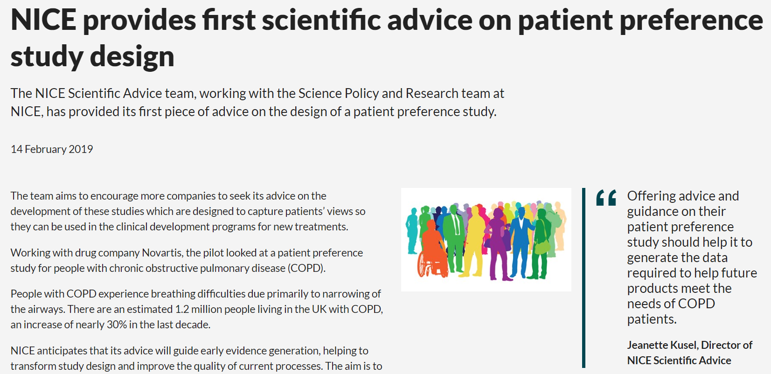
Scientific Advice from NICE

Slide 22
Outline
Background: why do a patient preference study?
Two types of decisions that can be informed by a patient preference study
Introduction to an outline structure for considering patient preference studies; brief example
Summary

Slide 23
Summary
Emerging consensus that patients’ views are relevant to drug development activities
Patient preference studies are one tool to understand patients’ views
2 scenarios where patient preference studies can add value: to understand patient-relevant endpoints; to understand acceptability of benefit-risk trade-offs

Slide 24
References
de Bekker-Grob, et al (2018) Giving patients' preferences a voice in the medical product lifecycle: why, when and how?: The public-private PREFER project: Work package 2 ISPOR Value & Outcomes Spotlight, 4(3): 19-21
Cook et al, Patients' perspectives on COPD: findings from a social media listening study. ERJ Open Research Feb 2019, 5 (1) 00128-2018; DOI: 10.1183/23120541.00128-2018
Cook, Nigel et al. Impact of cough and mucus on COPD patients: primary insights from an exploratory study with an Online Patient Community. International journal of chronic obstructive pulmonary disease vol. 14 1365-1376. 24 Jun. 2019, doi:10.2147/COPD.S202580
Cook, N. et al (2019). PP128 Quantifying The Relative Importance Of Chronic Obstructive Pulmonary Disease Symptoms To Patients. International Journal of Technology Assessment in Health Care, 35(S1), 61-61. doi:10.1017/S0266462319002460
Medical Device Innovation Consortium (MDIC) Patient Centered Benefit-Risk Project Report: A Framework for Incorporating Information on Patient Preferences regarding Benefit and Risk into Regulatory Assessments of New Medical Technology. Medical Device Innovation Consortium 2015
Van Overbeeke E, et al. Factors and situations influencing the value of patient preference studies along the medical product lifecycle: a literature review. Drug discovery today. 2019;24(1):57-68
Link to EMA Day 80 Assessment Report template (which includes the Effects Table):
https://www.ema.europa.eu/documents/template-form/day-80-assessment-report-overview-d120-loq-template-guidance-rev-1019_en.doc

Slide 26
What are patient preferences?
Patient preferences are “qualitative or quantitative assessments of the relative desirability or acceptability to patients of specified alternatives or choices among outcomes or other attributes that differ among alternative health interventions”
Patient preferences ≠ Patient Reported Outcomes

Slide 27
A closer look at HTA interest in patient preference studies

