Slide 1
Can You Secure Market Access with Single Arm Trials?
A Pharma pipedream, or closing in on reality?
Alex Simpson
Roche
All views expressed in this talk are my own and do not necessarily represent the views of Roche as a whole
11/04/2024

Slide 2
Outline
Why is this topic important?
Why use a SAT?
How are SATs evaluated by HTA agencies?
Worked Examples
Tips for success
Summary

Slide 3
Why is this topic important?

Slide 4



Why achieving Market Access with SATs is important?
Why should you listen to me?
SATs are becoming more widely used in pharmaceutical drug development pipelines
Targeting disease areas with greater unmet needs- rare diseases and highly targeted patient populations
SATS are becoming more widely recognised by healthcare regulators
In certain situations, there is precedent for regulatory agencies to accept SATs as pivotal evidence
SATs are problematic for HTA agencies to derive “value-for-money” conclusions from
Currently prohibits patient access to medications that have been approved via SATs

Slide 5
Why use a Single Arm Trial?

Slide 6




When an RCT is not feasible or practical
Resolving Long Term Uncertainty
Absence of meaningful comparator
Small sample sizes
Practical and ethical issues with randomisation

Slide 7
When an RCT is not feasible or practical
Resolving Long Term Uncertainty
Absence of meaningful comparator
Small sample sizes
Practical and ethical issues with randomisation
Not all of these are justifications to conduct a SAT however….

Slide 8
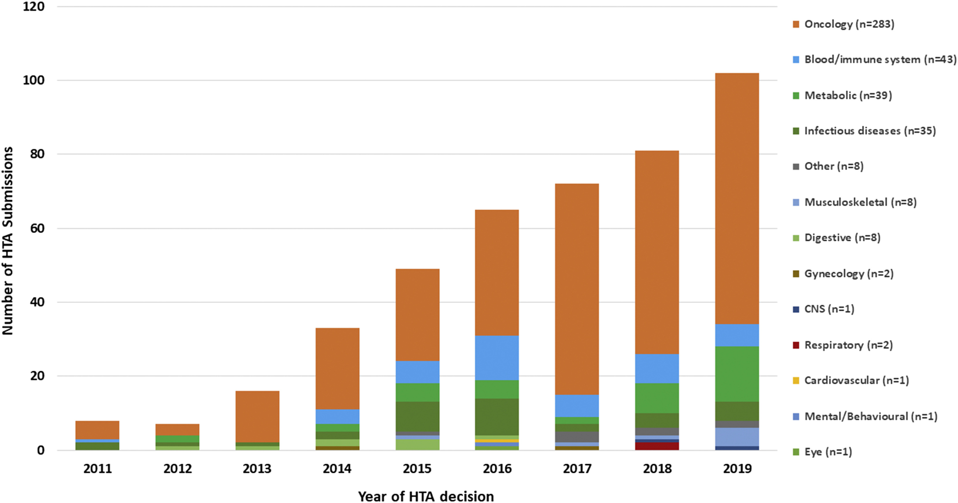
SAT usage has been increasing
Driven by onco drugs
Targeted therapies with large effect sizes
Single arm trial submissions to HTA bodies; Globally, 2011-2019
Patel, Dony, et al. "Use of external comparators for health technology assessment submissions based on single-arm trials." Value in Health 24.8 (2021): 1118-1125..

Slide 9
Regulatory approval based on SAT evidence has been increasing too
Goring (2019)
2005 -> 2017: non-randomised study designs used in submission in 43 indications across oncology, stem cell transplants and rare metabolic diseases

Slide 10
Regulatory approval based on SAT evidence has been increasing too
Goring (2019)
2005 -> 2017: non-randomised study designs used in submission in 43 indications across oncology, stem cell transplants and rare metabolic diseases
The FDA approved 98% of submissions, with EMA approving 79%
But: a need for post-approval confirmatory RCTs or additional non-randomised evidence
Abbreviations: EMA, European Medicines Agency; FDA, Food and Drug Administration;.
Hatswell AJ, Baio G, Berlin JA, Irs A, Freemantle N. Regulatory approval of pharmaceuticals without a randomised controlled study: analysis of EMA and FDA approvals 1999–2014. BMJ open. 2016 Jun 1;6(6):e011666.‹#›
Goring S, Taylor A, Müller K, Li TJ, Korol EE, Levy AR, Freemantle N. Characteristics of non-randomised studies using comparisons with external controls submitted for regulatory approval in the USA and Europe: a systematic review. BMJ open. 2019 Feb 1;9(2):e024895.

Slide 11
Regulatory approval based on SAT evidence has been increasing too
Riberio (2023)
1992-> 2020: Assessment of 254 FDA accelerated approvals, searching for approvals based on SATs for oncology

Slide 12
Regulatory approval based on SAT evidence has been increasing too
Riberio (2023)
1992-> 2020: Assessment of 254 FDA accelerated approvals, searching for approvals based on SATs for oncology
119 (47%) of the approvals were for oncology indications based on SATs
Majority of approvals (61%) occurred between 2010-2020
  Approvals based on SAT have been increasing through time
Ribeiro, Tatiane Bomfim, et al. "Increasing FDA accelerated approval of single-arm trials in oncology (1992 to 2020)." Journal of Clinical Epidemiology (2023).

Slide 13
But HTA approvals have not been keeping up
Patel (2021)
2011-> 2019: Assessment of SAT-based HTA submissions. Used publicly available data (e.g., from HTA websites) to look at the decision outcomes

Slide 14
But HTA approvals have not been keeping up
Patel (2021)
2011-> 2019: Assessment of SAT-based HTA submissions. Used publicly available data (e.g., from HTA websites) to look at the decision outcomes
433 SAT-based HTA submissions identified
52% contained EC data with RCTs (24%) and RWD (20%)
  40% contained no EC data!
Overall acceptance rate was 48% (59% with RWD EC data)
Patel, Dony, et al. "Use of external comparators for health technology assessment submissions based on single-arm trials." Value in Health 24.8 (2021): 1118-1125..

Slide 15
Approval Gap
There’s somewhat of a gap between approval of new medicines via regulatory pathway and the HTA pathway when a SAT has been used as pivotal evidence
  Not exclusive to SAT evidence alone BTW
But the biggest problem is the lack of comparator, and how comparative evidence is ultimately sequestered
Lipska, Iga, A. M. Hövels, and N. McAuslane. "The association between European Medicines Agency approval and health technology assessment recommendation." Value in Health 16.7 (2013): A455.

Slide 16
How are SATs evaluated by HTA agencies?

Slide 17
Why SATs are problematic for the HTA evaluation
Does the product demonstrate
added value over current treatment?
Does efficacy outweigh safety?
SAFETY
EFFICACY
DRUG A
DRUG B
REGULATORS
HTA AGENCIES/PAYERS
SAME DRUG
EFFICACY, SAFETY & VALUE
Positive benefit-risk of a new drug
Unmet need | Is the product needed?
Clinical effectiveness | Does it work?
Safety | Is it safe?
Restrictions | In which population does it best work?
Comparative effectiveness | How well does it work vs SoC?
QoL | Does it improve a patient’s QoL?
Cost-effectiveness | Is it worth it?
Patients perspective | What is the patient’s view
Budget impact | Can we afford it?
More sophisticated packages of evidence are required to justify
value, price and reimbursement to payer decision-makers
Abbreviations: HTA, health technology assessment; QoL, quality of life; SoC, standard of care; RWE, real world evidence
References: Adapted from EUnetHTA.
Notes:
Generating evidence to support regulatory approval is no longer sufficient; payers decide whether it will be reimbursed and at what price
While consensus has been achieved regarding required regulatory data (such as the EMA centralized approvals), comparatively it is more difficult achieving a consensus across market access data requirements with substantial differences between regions and countries
To achieve positive market access understanding the country specific needs of different healthcare systems and subsequently the needs of the various payers and decision makers is essential.
Payers are strengthening their assessment of value in innovative medicines by introducing challenging evidence requirements before a final price can be negotiated.
More and more sophisticated packages of evidence are required to justify value, price and reimbursement to payer decision-makers

Slide 18
Why SATs are problematic for the HTA evaluation
As we saw, HTA’s considering the following sorts of questions when evaluating new therapies:
Unmet need | Is the product needed?
Clinical effectiveness | Does it work?
Safety | Is it safe?
Restrictions | In which population does it best work?
Comparative effectiveness | How well does it work vs SoC?
QoL | Does it improve a patient’s QoL?
Cost-effectiveness | Is it worth it?
Patients perspective | What is the patient’s view
Budget impact | Can we afford it?
However, very difficult, if not impossible, to answer these questions with SAT evidence alone.
A comparator is essential

Slide 19
Quick overview of methods used to make the comparison
Given a SAT, what methods can be used to make a comparison
- (Network) meta-analysis
- Indirect treatment comparisons
-Simulated treatment comparisons
- Matching-adjusted indirect comparisons
RCT-based comparisons
IPD available
- External control arm
(Adjusted on individual level)
RWD-based comparisons
-Simulated treatment comparisons
- Matching-adjusted indirect comparisons (Adjusted on a population level)
No IPD

Slide 20
Worked Examples

Slide 21
Strimvelis for ADA-SCID
Background
Gene therapy for adenosine deaminase deficiency-severe combined immunodeficiency (ADA-SCID)
  Patients lack adenosine deaminase and it means their immune systems do not function properly
Strimvelis clinical efficacy was obtained from 4 small, Phase I/II, open label, non-randomised SATs and a long term follow-up study from these 4 trials
Aspects of ADA-SCID that made the clinical assessment challenging:
Absence of meaningful comparator
Practical and ethical issues with randomisation
Rare Patient Population
Incidence of 1 in 200,000 to
1 in 1,000,000
Heterogeneous treatment pathway
Short untreated life expectancy

Slide 22
Strimvelis for ADA-SCID
What comparative evidence was used
Trial evidence came from 4 small, open-label, non-randomised SATs
  Combined to produce an integrated study population (n=18)
Comparative evidence obtained from an historical external control arm study, evaluating stem cell transplant (HSCT) as an intervention in ADA-SCID patients
  Used to compare primary endpoint of OS with Strimvelis vs HSCT

Slide 23
Strimvelis for ADA-SCID
HTA Acceptance
NICE approved Strimvelis through the Highly Specialised Technologies (HST) process in 2017
  Higher ICER threshold for rare diseases
Noted that a formal indirect comparison was not possible due to:
  Lack of comparator
  Small patient numbers
  Lack of external data
Risk of bias and high degree of uncertainty was noted
  External comparator was deemed the most appropriate comparator, given the circumstances
Approval also aided by non-clinical evidence facets such as:
  Impact on quality of life
  Strimvelis being the first of its kind therapy in the treatment of ADA-SCID
Side Note
Strimvelis has since ceased being commercialised due to low sales volume
An Italian non-profit organisation took over the rights in 2023 to ensure continued patient access

Slide 24
Libtayo for aCSCC
Background
Monoclonal antibody treatment for metastatic or locally advanced cutaneous squamous cell carcinoma (aCSCC)
  Immunotherapy used as a treatment option for advanced disease when surgery and radiation are unsuccessful
Pivotal evidence for Libtayo came from a Phase II SAT in 193 patients evaluating ORR as primary endpoint
Aspects of aCSCC that made the clinical assessment challenging:
Absence of meaningful comparator
Unresolved uncertainty from RCT
Rare Patient Population
aCSCC represents 5% of CSCC cases
No established treatment for aCSCC
With no standard of care and

Slide 25
Libtayo for aCSCC
What comparative evidence was used
Lack of analysable patients owing to low disease prevalence and lack of a single meaningful standard of care means limited options for any direct comparisons or anchored indirect treatment comparisons
Historical external control used, again coming from a previously completed external control arm study
  Compared Libtayo Phase II study (N=193) with 190 patients from RWD
  ORR of 44% in SAT vs 25.6% in RWD external control
  Few patients actually received Libtayo at the recommended fixed dose
    Protocol variation resulted in request for confirmatory prospective single-arm study
Non-randomised data from 2 chart reviews was also presented to HTAs

Slide 26
Libtayo for aCSCC
HTA acceptance
CHMP noted their preference for RCT’s, but SAT accepted on grounds of scientific advance and under the promise of more prospective data coming later
ORR benefit deemed clinically meaningful by EMA in the end
NICE appraised Libtayo in 2019 via the Single Technology Appraisal route
  Recommended as option when curative surgery or radiotherapy not available via Cancer Drugs Fund
  However, was not recommended for routine use due to uncertainties with evidence provided
    Protocol deviations
    Lack of reliable comparator
    Differences in external population characteristics vs target population
Too much uncertainty to be approved!

Slide 27



Libtayo for aCSCC
HTA acceptance
✅ (sort of)
❌
❌
Subsequent assessment as an “end-of-life modifier”
Newly collected RWD demonstrated median life expectancy extension by 3 months, meeting end-of-life criteria
Non-randomised data ultimately used to contextualise survival benefit
HAS recommended in 2020, but low clinical benefit cited
Only safety data from Ph I study and RWD chart review looked at
Approved on basis that price provided is less than standard of care, or induces cost-saving to healthcare system
Unadjusted comparison of ORR and RWD was provided. IQWiG judged no additional benefit
Magnitude of survival benefit not enough to move the needle for IQWiG
Lack of patient relevant outcomes also noted
Could be approved if price does not exceed standard of care

Slide 28
Tips for Success

Slide 29
Tips for Success
Points which are often raised when presenting SAT evidence as pivotal
Transparency is vital
  Pre-registration of protocols to perform the comparison
  Discuss evidence generation plans with stakeholders (i.e., your HTA agency)
Database landscaping and feasibility assessments for EC studies
  Ensure data source meets the stringent needs which are required for making external comparisons
Follow the guidance!
  The FDA/ EMA and some HTA bodies (e.g., NICE, HAS, CATH) have guidance relating to the submission of SAT evidence- make sure it is used!
Know your audience
  Different HTA bodies have different requirements
  Comparisons to local populations/ studies are the ideal
  Demonstrate reasonable comparability if not a possibility

Slide 30
Summary

Slide 31
Can You Secure Market Access with Single Arm Trials?
Sometimes….
RCT’s are always going to be the preference- even underpowered ones
But in certain cases, the circumstances mean that a SAT has to be considered for the pivotal trial
  Small patient populations
  No current treatments
  Practical and ethical issues
  Limited duration with placebo’s
So in certain cases- YES!
  But never a SAT alone
  There needs to be a comparison and the comparison needs to be carefully chosen
There are a number of steps that investigators can take to appropriately meet the demands of HTA bodies
  And they should use them!

Slide 32
Questions….?

