Slide 1
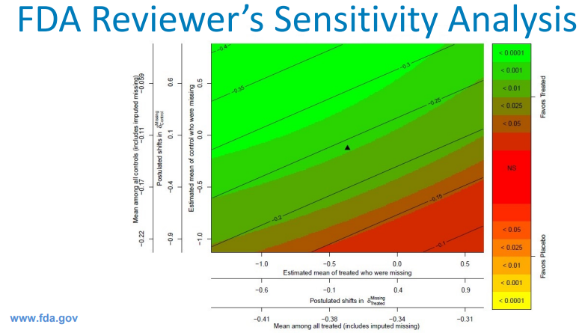

PSI Webinar: Tipping Point analyses – Introduction and case studies
Wednesday 26th January 2022
Time: 14:00 - 15:00 UK time
Click here to register
Overview
To assess the strength of clinical study findings regulatory authorities often request tipping point analyses. However what is a tipping point analysis, and how is one performed? What are the different approaches for continuous, binary and time to event data? Kevin and Juan present some practical examples.
Speakers are Kevin Ding (AZ), Juan Abellan (GSK)
Register here

