Slide 1
Statistical Challenges in Analytical Comparability and Biosimilarity Assessment
15th October 2019
Organised by PSI Scientific Committee members:
Martin Jenkins, Rosie Leach, Ioulietta Mulligan, Sarah Williams

Slide 2
Agenda
Thomas Lang (EMA BSWP / AGES)
Setting the Scene: The regulatory landscape – a journey through time
Bruno Boulanger (Pharmalex)
Analytical similarity and comparability: what is the question?
Johanna Mielke (Bayer)
The assessment of quality attributes for biosimilars: a statistical perspective on current practice and a proposal

Slide 3
Upcoming PSI Events
PSI & DIA Journal Club:
PSI One Day Meeting (Basel):
PSI Webinar
24 Oct 2019, 16:00-17:00 (BST)
29 Oct 2019, 14:00-15:00 (GMT)
18 Nov 2019 14:00-16:00 (GMT)
Subgroup Analyses
Time-to-event and Recurrent Event Endpoints in Clinical Trials
Longitudinal Modelling: Time to Take the Next Step
PSI Training Course (London):
PSI SIG Webinar Series
PSI Training Courses
19/20 Nov 2019
3/10 Dec 2019
Register Interest Now
ICH for Statisticians
Quantitative Decision Making Special Interest Group
PK Methods & Reg considerations
Bayesian Analysis Software
Adaptive Design Software
R for SAS Users

Slide 4
One day meeting: Time-to-event and Recurrent Event Endpoints in Clinical Trials
Novartis Campus, Basel 8.30am – 4.30pm, 29th October 2019
One day meeting: Time-to-event and Recurrent Event Endpoints in Clinical Trials
Novartis Campus, Basel 8.30am – 4.30pm, 29th October 2019
Overview
This PSI one-day event provides the opportunity to hear from knowledgeable speakers from health authorities, academia, and pharma. The speakers will share their thoughts, ideas and experiences, including case studies, on a range of particular issues relating to planning, conduct, and analysis of event-driven trials. The meeting will focus on analysis of time-to-event data and safety events and recurrent events with associated terminal events. A variety of non-standard time-to-event and recurrent event models for clinical trials will be presented and their implications for the estimand framework will be discussed.
Speakers are Andrew Thomson (EMA), Rob Hemmings (Consilium), Valentine Jehl (Novartis), Qing Wang (Roche), Filip De Ridder (Janssen), Patrick Schlömer & Arno Fritsch (Bayer), John Gregson (London School of Hygiene & Tropical Medicine), and Tobias Bluhmki (University of Ulm).

Slide 5
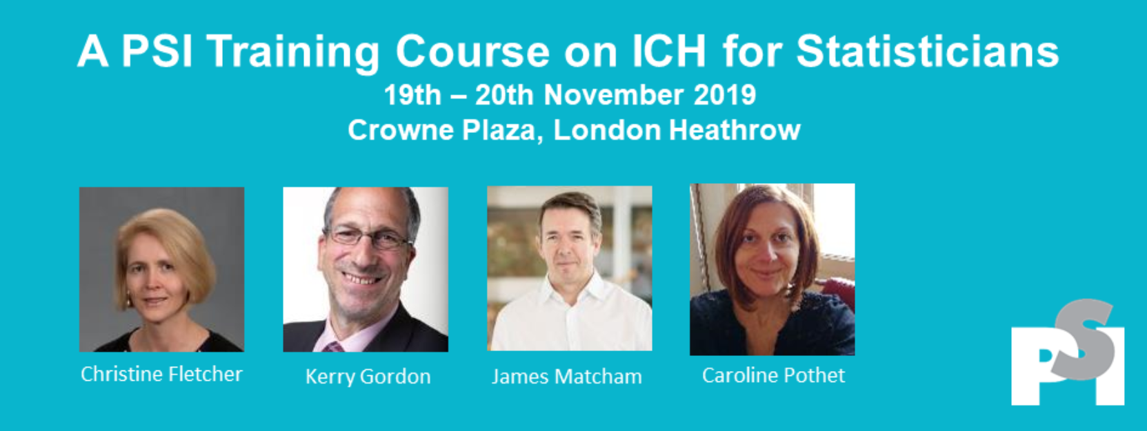
PSI Training Course:

Slide 6
PSI Conference 2020 - Barcelona
Abstract Deadlines: Oral 29th Nov / Poster 28th Feb
Keynote Speakers - Deborah Ashby / Simon Singh

Slide 7
Video on Demand – for PSI members only

Slide 8
Agenda
Thomas Lang (EMA BSWP / AGES)
Setting the Scene: The regulatory landscape – a journey through time
Bruno Boulanger (Pharmalex)
Analytical similarity and comparability: what is the question?
Johanna Mielke (Bayer)
The assessment of quality attributes for biosimilars: a statistical perspective on current practice and a proposal

Slide 9
Questions
We will have a short period for questions after each speaker
Please type them into the chatbox during the presentations!

Slide 10
Thank you

