Slide 1
Performance of MAIC for single-arm trials: a simulation study
Joint PSI/EFSPI HTA SIG Webinar: Indirect treatment comparisons – choosing the right tool for the job.
Richard Sizelove

Slide 2
MAIC for Unanchored Comparisons
Treatment comparisons are often desired when there is no comparator link between trials.
  Ex. comparisons between single-arm trials.
Focus on time-to-event endpoints due to relevance to oncology.
  Specify patient characteristics on which to weight.
  Calculate weights through method-of-moments.
  Input weights into a Cox regression model.
The assumptions required for matching-adjusted indirect comparisons (MAIC) are stricter in this setting than in the anchored setting.
  Conditional constancy of absolute effects: All differences between trials are explained by the variables included in the weighting scheme.
  All prognostic factors and effect modifiers need to be included.

Slide 3
MAIC for Unanchored Comparisons
Open need to assess MAIC’s performance for unanchored indirect treatment comparisons in this setting.
General notation: consider treatment A studied in trial A and treatment B studied in trial B.
  Individual patient data is available for treatment/trial A, but trial B only reports summary statistics.
The quantity of interest is the relative treatment effect, on the hazard ratio scale, of A vs. B in the trial B population.

Slide 4
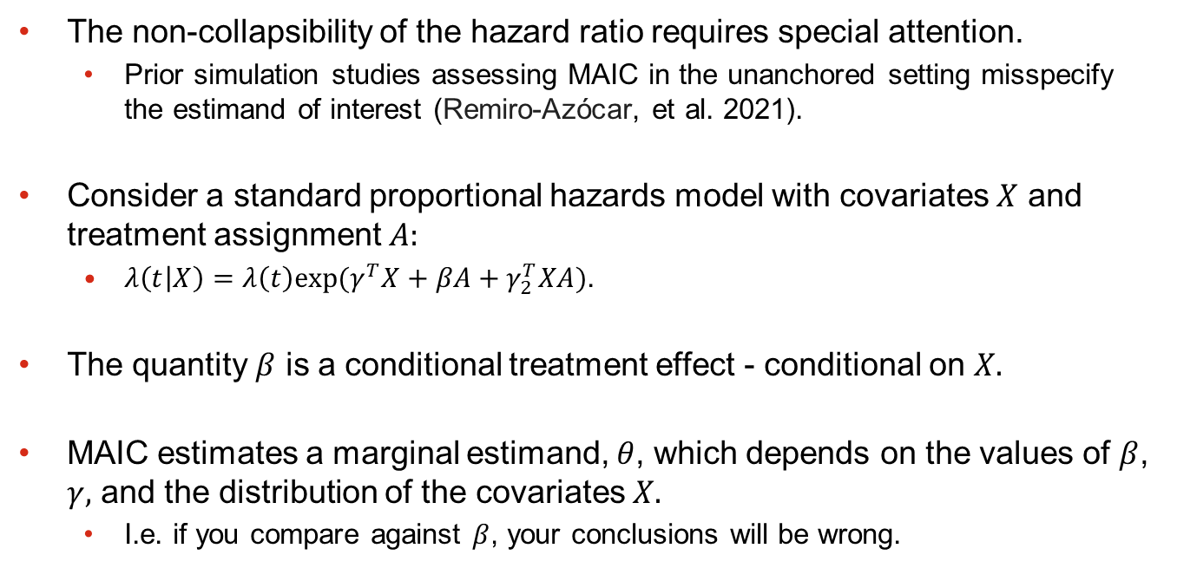
MAIC for Unanchored Comparisons
The non-collapsibility of the hazard ratio requires special attention.
  Prior simulation studies assessing MAIC in the unanchored setting misspecify the estimand of interest (Remiro-Azócar, et al. 2021).
Consider a standard proportional hazards model with covariates $X$ and treatment assignment $A:$
  $λ\left(t | X\right)=λ\left(t\right)exp⁡(γ^{T}X+βA+γ_{2}^{T}XA)$.
The quantity $β$ is a conditional treatment effect - conditional on $X.$
MAIC estimates a marginal estimand, $θ$, which depends on the values of $β$, $γ,$ and the distribution of the covariates $X.$
  I.e. if you compare against $β$, your conclusions will be wrong.

Slide 5
Layout
Goal: accurately assess the performance of MAIC in the unanchored setting against the correct (marginal) treatment effect.
In the upcoming slides, I’ll clarify a few points:
  data generation mechanism,
  which methods we’d like to assess,
  how to measure performance, and
  scenarios.
Additionally, we’ll illustrate the difference between marginal and conditional estimand in this context.

Slide 6
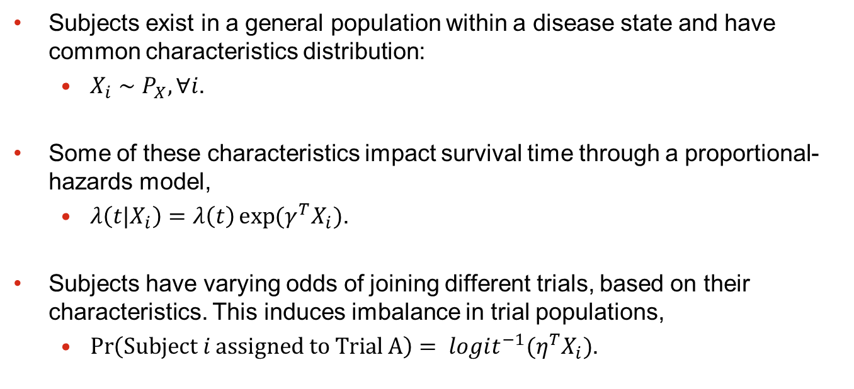
Data generation
Subjects exist in a general population within a disease state and have common characteristics distribution:
  $X_{i}∼P_{X}, ∀i$.
Some of these characteristics impact survival time through a proportional-hazards model,
  $λ\left(t|X_{i}\right)=λ\left(t\right)\exp{{(γ}^{T}X_{i})}$.
Subjects have varying odds of joining different trials, based on their characteristics. This induces imbalance in trial populations,
  $\operatorname{Pr}\left(Subject i assigned to Trial A\right)= {logit^{−1}(η}^{T}X_{i})$.

Slide 7
Methods
Conditional constancy of absolute effects: all prognostic factors and effect modifiers are included in the weighting scheme.
Methods to assess:
  A version of MAIC which excludes a prognostic factor from the weighting scheme,
  excludes an effect modifier,
  excludes both a prognostic factor and effect modifier,
  all variables are included,
  includes only factors which are prognostic or effect modifiers.

Slide 8
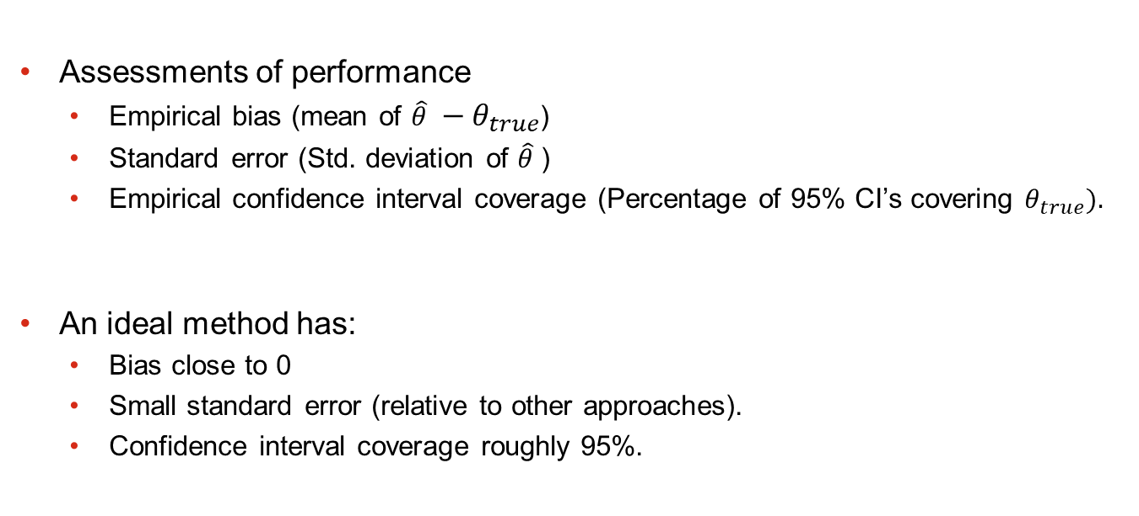
Measuring Performance
Assessments of performance
  Empirical bias (mean of $\hat{θ} −θ_{true}$)
  Standard error (Std. deviation of $\hat{θ}$)
  Empirical confidence interval coverage (Percentage of 95% CI’s covering $θ_{true}).$
An ideal method has:
  Bias close to 0
  Small standard error (relative to other approaches).
  Confidence interval coverage roughly 95%.

Slide 9
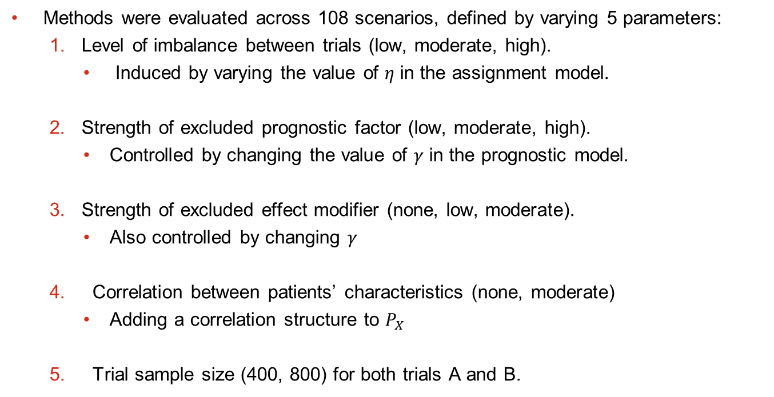
Scenarios
Methods were evaluated across 108 scenarios, defined by varying 5 parameters:
  Level of imbalance between trials (low, moderate, high).
    Induced by varying the value of $η$ in the assignment model.
  Strength of excluded prognostic factor (low, moderate, high).
    Controlled by changing the value of $γ$ in the prognostic model.
  Strength of excluded effect modifier (none, low, moderate).
    Also controlled by changing $γ$
  Correlation between patients’ characteristics (none, moderate)
    Adding a correlation structure to $P_{X}$
  Trial sample size (400, 800) for both trials A and B.

Slide 10
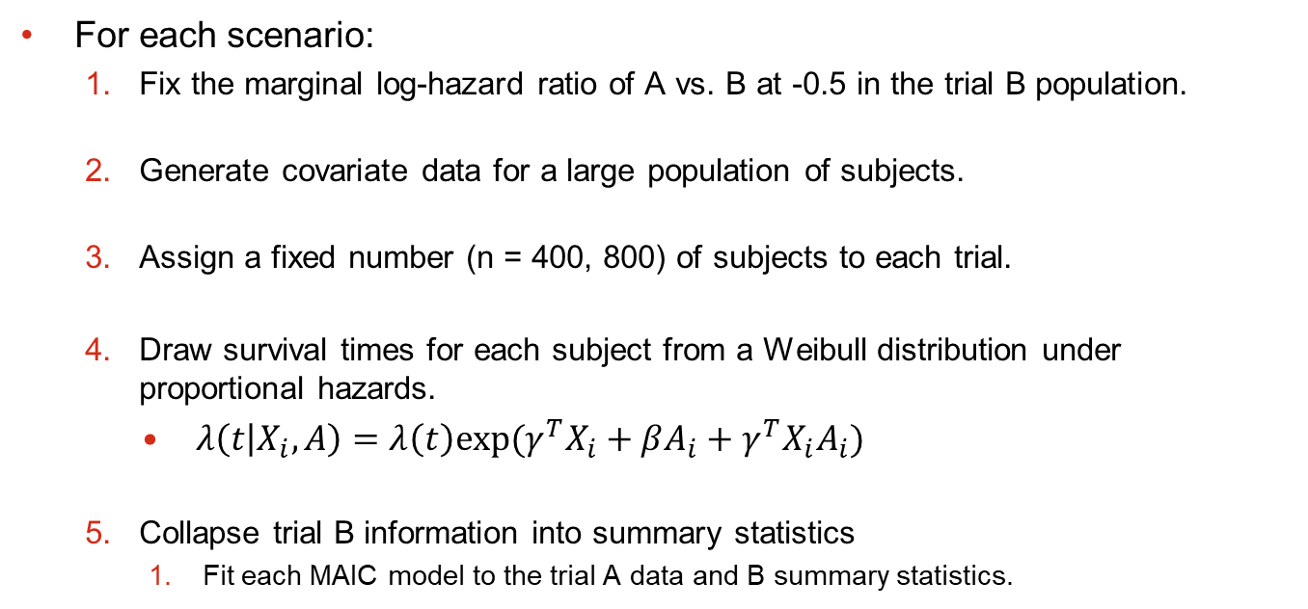
Simulation structure
For each scenario:
  Fix the marginal log-hazard ratio of A vs. B at -0.5 in the trial B population.
  Generate covariate data for a large population of subjects.
  Assign a fixed number (n = 400, 800) of subjects to each trial.
  Draw survival times for each subject from a Weibull distribution under proportional hazards.
    $λ\left(t | X_{i}, A\right)=λ\left(t\right)exp⁡(γ^{T}X_{i}+βA_{i}+γ^{T}X_{i}A_{i})$
  Collapse trial B information into summary statistics
    Fit each MAIC model to the trial A data and B summary statistics.

Slide 11
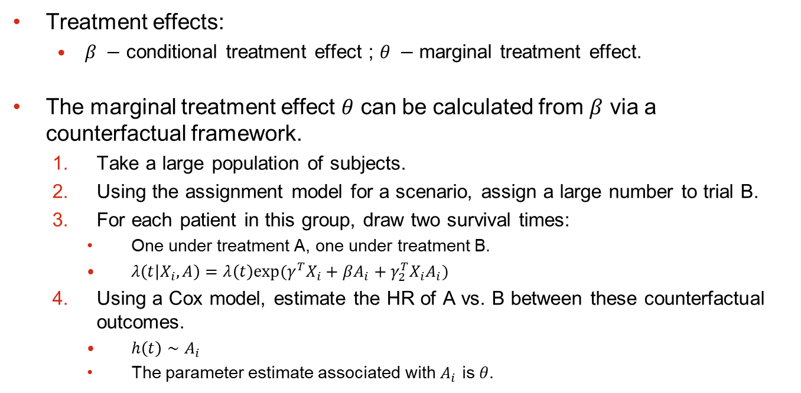
Marginal/Conditional effect
Treatment effects:
  $β −$ conditional treatment effect ; $θ −$marginal treatment effect.
The marginal treatment effect $θ$ can be calculated from $β$ via a counterfactual framework.
  Take a large population of subjects.
  Using the assignment model for a scenario, assign a large number to trial B.
  For each patient in this group, draw two survival times:
    One under treatment A, one under treatment B.
    $λ\left(t | X_{i}, A\right)=λ\left(t\right)exp⁡(γ^{T}X_{i}+βA_{i}+γ_{2}^{T}X_{i}A_{i})$
  Using a Cox model, estimate the HR of A vs. B between these counterfactual outcomes.
    $h\left(t\right)∼A_{i}$
    The parameter estimate associated with $A_{i}$ is $θ$.

Slide 12
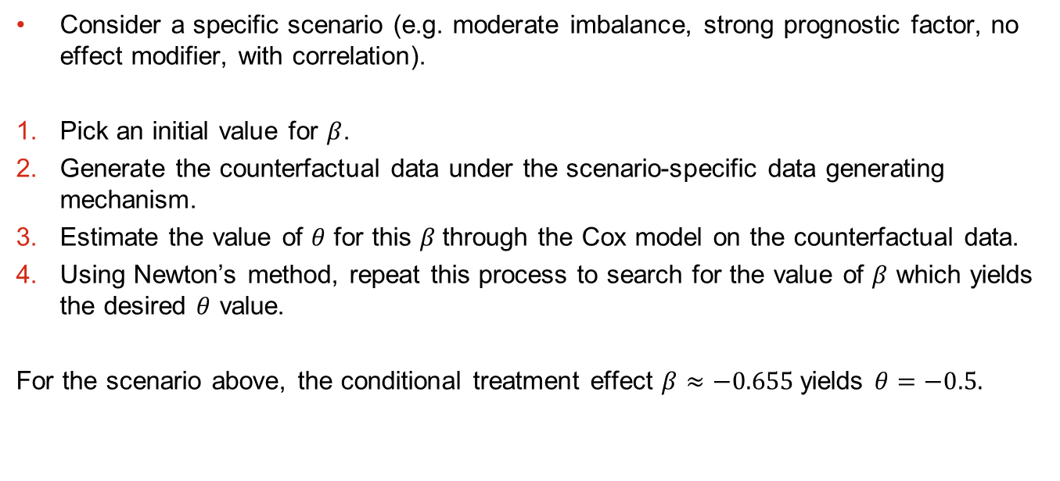
Marginal/Conditional effect
Consider a specific scenario (e.g. moderate imbalance, strong prognostic factor, no effect modifier, with correlation).
Pick an initial value for $β$.
Generate the counterfactual data under the scenario-specific data generating mechanism.
Estimate the value of $θ$ for this $β$through the Cox model on the counterfactual data.
Using Newton’s method, repeat this process to search for the value of $β$ which yields the desired $θ$ value.
For the scenario above, the conditional treatment effect $β≈−0.655$yields $θ=−0.5.$

Slide 13
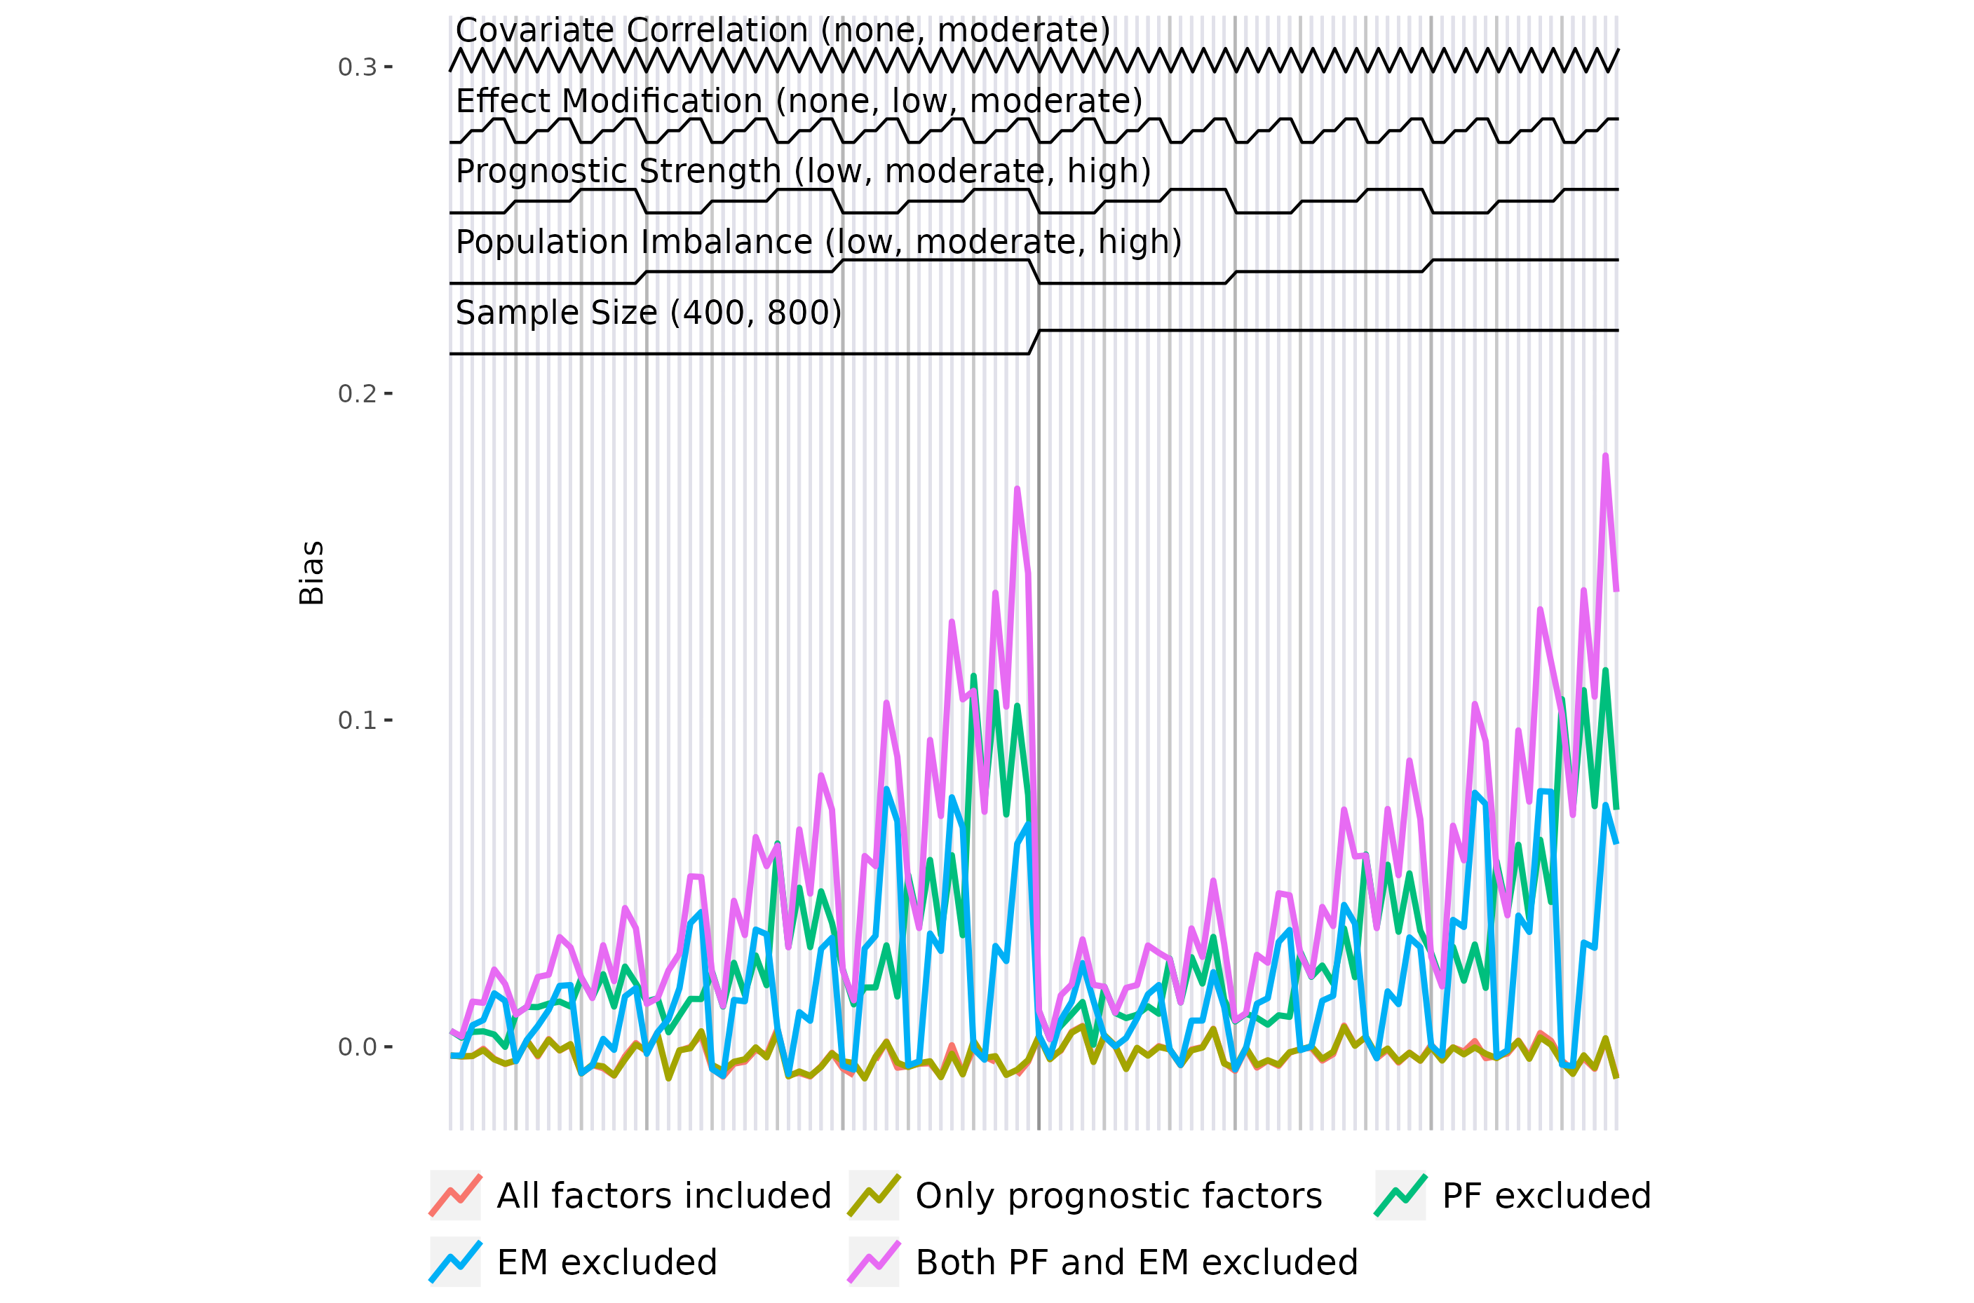

Slide 14
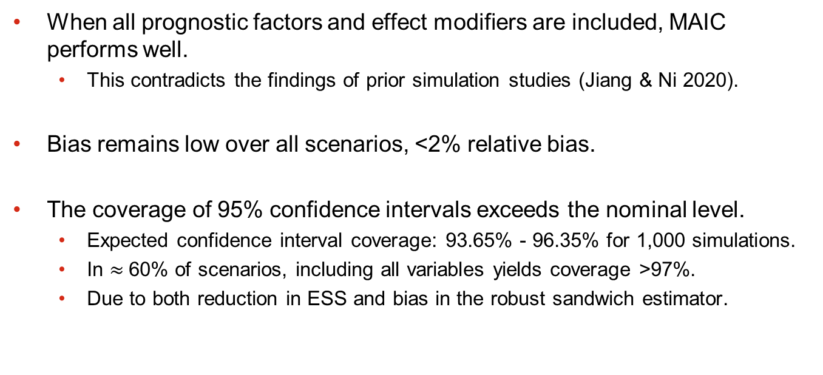
Results
When all prognostic factors and effect modifiers are included, MAIC performs well.
  This contradicts the findings of prior simulation studies (Jiang & Ni 2020).
Bias remains low over all scenarios, <2% relative bias.
The coverage of 95% confidence intervals exceeds the nominal level.
  Expected confidence interval coverage: 93.65% - 96.35% for 1,000 simulations.
  In $≈$60% of scenarios, including all variables yields coverage >97%.
  Due to both reduction in ESS and bias in the robust sandwich estimator.

Slide 15
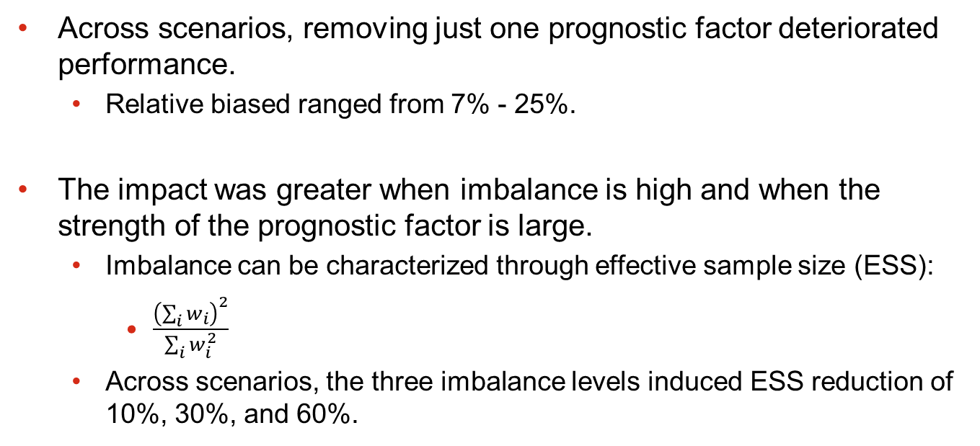
Removing prognostic factors
Across scenarios, removing just one prognostic factor deteriorated performance.
  Relative biased ranged from 7% - 25%.
The impact was greater when imbalance is high and when the strength of the prognostic factor is large.
  Imbalance can be characterized through effective sample size (ESS):
    $\frac{{\left(\sum_{i}{w_{i}}\right)}^{2}}{\sum_{i}{w_{i}^{2}}}$
  Across scenarios, the three imbalance levels induced ESS reduction of 10%, 30%, and 60%.

Slide 16
Removing effect modifiers
Across scenarios, removing an effect modifier also significantly impacted performance.
The impact was greater when imbalance is high and when the strength of the effect modifier was large.
Removing an effect modifier or prognostic factor of the same strength resulted in similar bias.
Removing both an effect modifier and prognostic factors has a roughly additive effect.

Slide 17
Correlation
The presence of correlation appeared to induce slight, negative bias into the performance of all models considered.
At first glance, this is unintuitive and contradicts the literature.
Prior simulation studies have noted that correlation between characteristics improves MAIC’s performance in the anchored setting (Remiro-Azócar, et al. 2020).

Slide 18
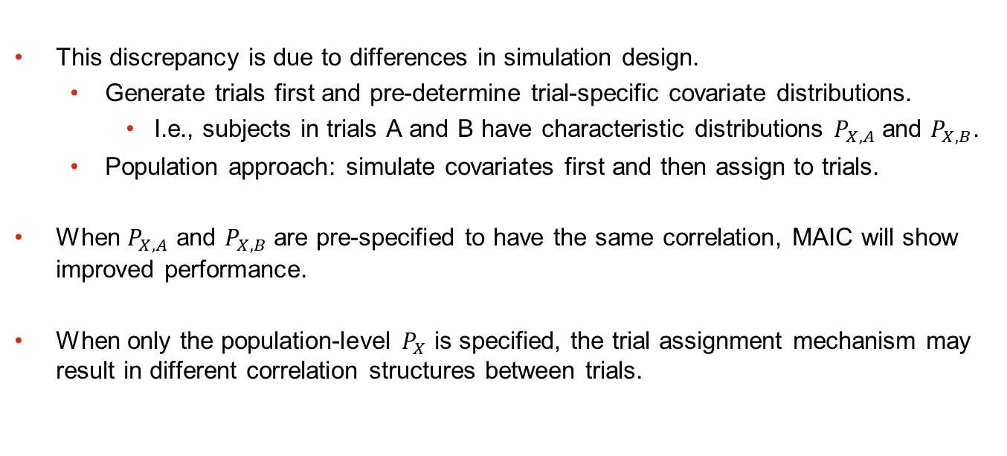
Correlation
This discrepancy is due to differences in simulation design.
  Generate trials first and pre-determine trial-specific covariate distributions.
    I.e., subjects in trials A and B have characteristic distributions $P_{X,A}$ and $P_{X,B}$.
  Population approach: simulate covariates first and then assign to trials.
When $P_{X, A}$ and $P_{X,B}$ are pre-specified to have the same correlation, MAIC will show improved performance.
When only the population-level $P_{X}$ is specified, the trial assignment mechanism may result in different correlation structures between trials.

Slide 19
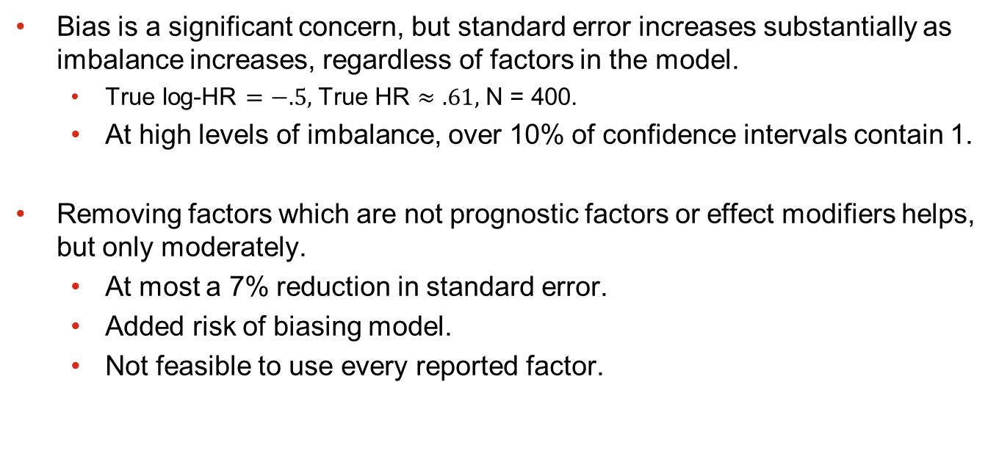
Some additional points
Bias is a significant concern, but standard error increases substantially as imbalance increases, regardless of factors in the model.
  True log-HR $=−.5,$True HR $≈.61,$ N = 400.
  At high levels of imbalance, over 10% of confidence intervals contain 1.
Removing factors which are not prognostic factors or effect modifiers helps, but only moderately.
  At most a 7% reduction in standard error.
  Added risk of biasing model.
  Not feasible to use every reported factor.

Slide 20
Variance estimation
Confidence interval coverage across scenarios was empirically high.
  95% CI’s often exhibiting 97-98% coverage.
  This problem is well-known for the weighted Cox model when using the robust sandwich estimator (Austin, 2016).
In most other scenarios, we’d use bootstrap.
  We can only bootstrap trial A which drastically underestimates variance.
  Bootstrap may not converge.
Unmet need to get variance right, given the results we’ve seen.

Slide 21
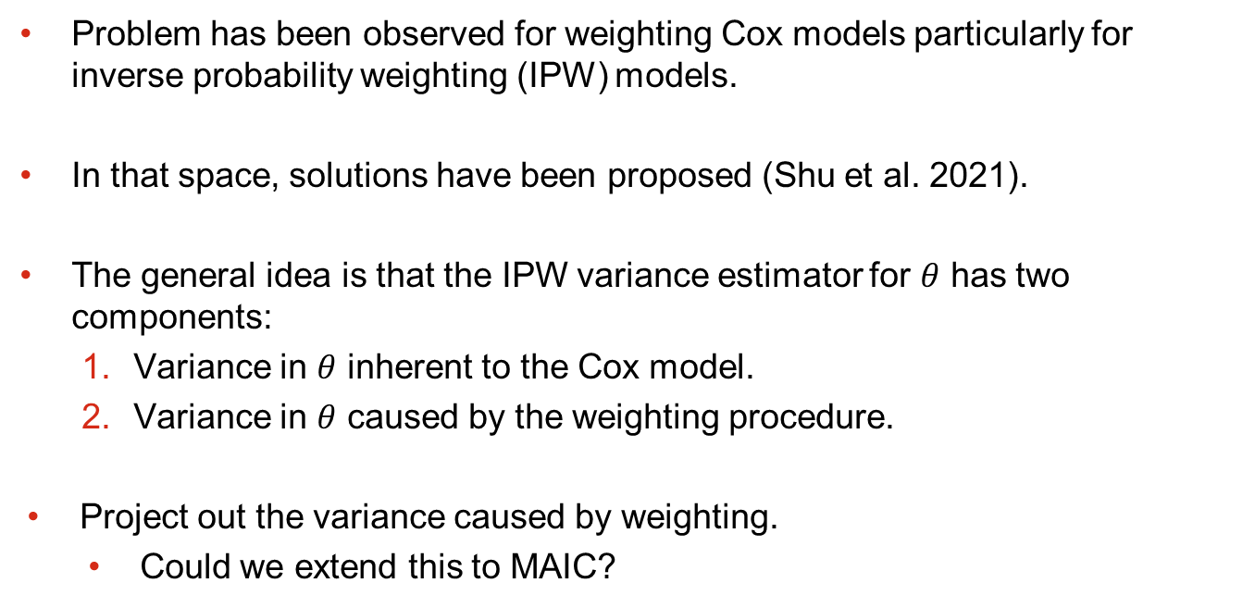
Variance estimation
Problem has been observed for weighting Cox models particularly for inverse probability weighting (IPW) models.
In that space, solutions have been proposed (Shu et al. 2021).
The general idea is that the IPW variance estimator for $θ$ has two components:
  Variance in $θ$ inherent to the Cox model.
  Variance in $θ$ caused by the weighting procedure.
Project out the variance caused by weighting.
  Could we extend this to MAIC?

Slide 22

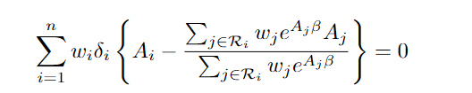

Adjusted variance estimator
MAIC estimating equations:
Weighted Cox model:
The weighted Cox model assumes that the weights are constants, which upwardly bias the variance estimator of $β.$

Slide 23
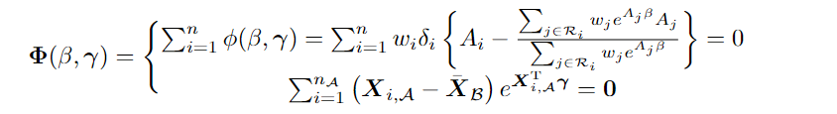
Adjusted variance estimator
Stack estimating equations into a single estimating equation and then derive the robust sandwich estimator proposed by Lin & Wei 1989.
Theoretical validity of this estimator follows from results on M-estimators.

Slide 24
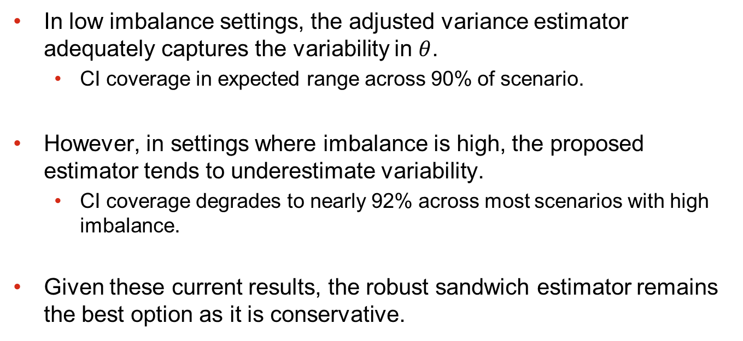
Adjusted Variance Results
In low imbalance settings, the adjusted variance estimator adequately captures the variability in $θ$.
  CI coverage in expected range across 90% of scenario.
However, in settings where imbalance is high, the proposed estimator tends to underestimate variability.
  CI coverage degrades to nearly 92% across most scenarios with high imbalance.
Given these current results, the robust sandwich estimator remains the best option as it is conservative.

Slide 25
Final points
MAIC exhibits high sensitivity to its assumptions.
  Significant bias can be introduced from weakly prognostic characteristics in settings with low imbalance.
  Researchers need to carefully consider the plausibility that the constancy of effect assumption is met.
What about model-based assessment of factors?
  Requires formal exploration and discussion of thresholds for inclusion.
  This doesn’t resolve impact of unobserved characteristics.
Variance estimation in the time-to-event setting is an open problem which needs more exploration.

Slide 26
References
  Remiro-Azócar A, Heath A, Baio G. Conflating marginal and conditional treatment effects: Comments on "Assessing the performance of population adjustment methods for anchored indirect comparisons: A simulation study". Stat Med. 2021 May 20;40(11):2753-2758. doi: 10.1002/sim.8857.
  Remiro-Azócar A, Heath A, Baio G. Methods for population adjustment with limited access to individual patient data: A review and simulation study. Res Synth Methods. 2021 Nov;12(6):750-775. doi: 10.1002/jrsm.1511.
  Jiang Y, Ni W. Performance of unanchored matching-adjusted indirect comparison (MAIC) for the evidence synthesis of single-arm trials with time-to-event outcomes. BMC Med Res Methodol. 2020 Sep 29;20(1):241.
  Austin PC. Variance estimation when using inverse probability of treatment weighting (IPTW) with survival analysis. Stat Med. 2016 Dec 30;35(30):5642-5655. doi: 10.1002/sim.7084.
  Shu D, Young JG, Toh S, Wang R. Variance estimation in inverse probability weighted Cox models. Biometrics. 2021; 77: 1101–1117. https://doi.org/10.1111/biom.13332
  Lin, D. Y., Wei, L.J. The Robust Inference for the Cox Proportional Hazards Model.”Journal of the American Statistical Association. 1989; 84: 1074–78. https://doi.org/10.2307/2290085.

