Slide 1
On the role of hypothetical estimand strategies in our clinical trials
Clinical Development & Analytics Biostatistics & Pharmacometrics
Jiawei Wei, Mouna Akacha, Frank Bretz
PSI, May 2021

Slide 2
Hypothetical strategies – ‘What if...’
According to ICH E9(R1):
“A scenario is envisaged in which the intercurrent event would not occur: the value of the variable to reflect the clinical question of interest is the value which the variable would have taken in the hypothetical scenario defined.
A wide variety of hypothetical scenarios can be envisaged, but some scenarios are likely to be of more clinical or regulatory interest than others.”
This results in a VERY broad class of estimands, examples include:
Effect if rescue medication had not been available
Effect if treatment switching would not have been allowed
Effect if all patients had adhered to their treatment regimen
Effect if the COVID-19 pandemic had not resulted in drug supply issues

Slide 3
Precise wording is crucial
According to ICH E9 (R1):
“If a hypothetical strategy is proposed, it should be made clear what hypothetical scenario is envisaged. For example, wording such as “if the patient does not take additional medication” might lead to confusion as to whether the patient hypothetically does not take additional medication because it is not available or because the particular patient is supposed not to require it.”
Multiple hypothetical strategies exist and a precise language is needed to avoid ambiguity, e.g. ’What would the treatment effect be,...’
... had rescue meds not been made available?
... had patients not needed rescue meds and behaved like other patients who did not take rescue meds?
... had patients not needed rescue meds and behaved like placebo patients?

Slide 4
Broad range hypothetical scenarios can be considered
What is the treatment effect if rescue meds were not taken? Is this precise enough?
What would the treatment effect be, had rescue meds not been made available?
May be plausible to ask this question if rescue was optional
Presumably patients would have more severe symptoms if rescue was withheld
What would the treatment effect be, had patients not needed rescue meds and behaved like other patients who did not take rescue meds?
Not clear what plausible scenario would lead to ‘patients not needing rescue’
Not clear why patients who needed rescue would behave like patients not needing rescue
What would the treatment effect be, had patients not needed rescue meds and behaved like placebo patients?
Not clear what plausible scenario would lead to ‘patients not needing rescue’
Not clear why patients who needed rescue would behave like placebo patients thereafter

Slide 5
Broad range hypothetical scenarios can be considered
What is the treatment effect if rescue meds were not taken? Is this precise enough?
What would the treatment effect be, had rescue meds not been made available?
May be plausible to ask this question if rescue was optional
Presumably patients would have more severe symptoms if rescue was withheld
What would the treatment effect be, had patients not needed rescue meds and behaved like other patients who did not take rescue meds?
Not clear what plausible scenario would lead to ‘patients not needing rescue’
Not clear why patients who needed rescue would behave like patients not needing rescue
What would the treatment effect be, had patients not needed rescue meds and behaved like placebo patients?
Not clear what plausible scenario would lead to ‘patients not needing rescue’
Not clear why patients who needed rescue would behave like placebo patients thereafter
Importantly, speaking of ‘THE hypothetical’ leaves too much room for ambiguity → a precise language is required.
Numerous hypothetical estimands can be formulated – some of which are more useful and clinically plausible than others.

Slide 6
‘Good’ and ‘bad’ hypotheticals
Good hypotheticals
Scenarios that change the study design might be of regulatory interest
For example: it may be plausible to consider a scenario where treatment switching was not possible in placebo controlled trials
Bad hypotheticals
Scenarios that change the patients’ behaviors might not be of regulatory interest, this holds in particular for scenarios that cannot possibly occur in clinical practice
For example: it may not be reasonable to hypothesize a scenario where patients fully adhere to their treatment notwithstanding serious adverse events
General consideration to help distinguish between ‘good’ and ‘bad’ hypotheticals
Can you intervene on the intercurrent event, or not?
If you can, then it might be of clinical (and regulatory?) interest, otherwise if you cannot intervene then the hypothetical strategy will usually not be of interest.

Slide 7
Regulatory perspectives – 1
Ongoing scientific discussions with regulators:
Hypothetical strategy is controversial
Some believe commonly used hypothetical estimands are not meaningful to patients or providers and therefore also not meaningful to regulators
Some believe hypothetical estimand could be useful (e.g. in the setting of the COVID-19 pandemic), but the choice must be balanced with the ability to estimate the estimand reliably and robustly

Slide 8
Regulatory perspectives – 2
CHMP guideline on the clinical investigation of medicinal products in the treatment or prevention of diabetes mellitus:
“Other important intercurrent events to consider are the changes to, or introduction of, other medication that will influence HbA1c values, including use of protocol-defined rescue medication. The impact of additional medication complicates the evaluation of the effect of the test product compared to placebo or active control. Therefore, the treatment effect can be estimated under the assumption that rescue medication, or use of other medications that will influence HbA1c values, was not introduced (hypothetical scenario), provided that a reliable estimate of that effect can be obtained.”

Slide 9
Regulatory perspectives – 3
CHMP guideline on the clinical investigation of medicines for the treatment of Alzheimer’s disease:
“Patients can be expected to initiate new medication or to modify the dose of concomitant symptomatic treatments, with or without discontinuing assigned treatment. The impact of those medication changes complicates the evaluation of the effect of the test product compared to placebo or active control. Therefore, providing that reliable methods of estimation can be identified, an appropriate target of estimation could be based on a hypothetical scenario in which the new concomitant medication or modifications in the dose of concomitant medications had not been introduced. Again, supplementary analyses targeting the types and amounts of other medications used would be of complementary interest.”

Slide 10
Estimation for hypothetical estimands
Requires prediction of hypothetical trajectories
Example for illustration:
Treatment discontinuation is an intercurrent event for which a hypothetical strategy is used
Data collected after trt discontinuation for Patient 1 and Patient 2 is irrelevant for estimating a hypothetical estimand
This does not constitute a missing data problem, rather we need to predict the hypothetical trajectories
Randomisation
Primary variable
Treatment discontinuation
Patient 1
Study
withdrawal
Patient 2

Slide 11
Prediction of hypothetical trajectories
Explicit or implicit predictions of hypothetical trajectories are needed
Assumptions for the predictions need to be aligned with the hypothetical strategy
From where/whom do we borrow information to predict the hypothetical measurements of interest?
Do we have sufficient data /
information to borrow from?
Need to adequately account for
prediction uncertainty, e.g. through
multiple predictions/imputations
Need to perform a sensitivity analysis

Slide 12
Prediction of hypothetical trajectories
Considerations for predicting hypothetical trajectories are similar in spirit to those for imputing missing data
Often missing data terminology is used when predicting hypothetical trajectories
Explicit or implicit predictions of hypothetical trajectories are needed
Assumptions for the predictions need to be aligned with the hypothetical strategy of interest
From where/whom do we borrow information to predict the hypothetical measurements of interest?
Do we have sufficient data/information to borrow from?
Need to adequately account for prediction uncertainty, e.g. through multiple predictions/imputations
Need to perform a sensitivity analysis

Slide 13
Prediction of hypothetical trajectories Explicit or implicit predictions
Explicit predictions
Longitudinal measurements after the intercurrent event are explicitly filled-in
Creates apparently complete hypothetical trajectories
Implicit predictions
Relies on model-based approaches for the longitudinal measurements (e.g. a joint multivariate model), the hypothetical trajectories are filled-in/assumed implicitly

Slide 14
Prediction of hypothetical trajectories Assumptions need to be aligned with the estimand
What would the treatment effect be, had rescue meds not been made available?
Presumably, patients would have more severe symptoms if rescue was withheld
Predicted trajectories should reflect a clinically plausible decay of symptoms
What would the treatment effect be, had patients not needed rescue meds and behaved like other patients who did not take rescue meds?
Assumptions should match ‘behaved like other patients who did not take rescue’
Want to ‘match’ the trajectory of a given patient who needed rescue with the trajectory of a ‘similar’ patient who did not need rescue
What would the treatment effect be, had patients not needed rescue meds and behaved like placebo patients?
Assumptions should match ‘behaved like placebo patients’
Want to ‘match’ the trajectory of a given patient who needed rescue with the trajectory of a similar placebo patient

Slide 15
Can we use a missing at random assumption to predict hypothetical trajectories?
Depends on the specific hypothetical scenario which is considered
Sometimes a MAR assumption is adequate
Sometimes a MNAR assumption is needed
Sometimes trial external data and assumptions need to be leveraged
Sometimes ....

Slide 16
Prediction of hypothetical trajectories From where/whom do we borrow information
What would the treatment effect be, had rescue meds not been made available?
Could borrow information from historical/external studies which did not give access to rescue trts
Could borrow information from a disease model
What would the treatment effect be, had patients not needed rescue meds and behaved like other patients who did not take rescue meds?
Predicted trajectories for a given patient can be informed through similar patients (in terms of covariates, trt and post-baseline information) who did not require rescue meds
Apply a specific MAR assumption aligned with the required ‘similarity’ assumption
What would the treatment effect be, had patients not needed rescue meds and behaved like placebo patients?
Predicted trajectories for a given patient can be informed through similar placebo patients
Apply a specific assumption aligned with the required ‘similarity’ assumption (e.g. J2R, CR,...)

Slide 17
Prediction of hypothetical trajectories From where/whom do we borrow information
In particular, the choice of a hypothetical estimand does not automatically result in a MAR-based analysis!
Also, no unique MAR assumption exists – every model implies a certain MAR assumption
Different MAR assumptions imply different ‘similarity’ assumptions!
What would the treatment effect be, had rescue trts not been made available?
Could borrow information from historical/external studies which did not give access to rescue trts
Could borrow information from a disease model
What would the treatment effect be, had patients not needed rescue trts and behaved like other patients who did not take rescue trts?
Predicted trajectories for a given patient can be informed through similar patients (in terms of covariates, treatment and measurement history) who did not require rescue medications
Apply a specific MAR assumption aligned with the required ‘similarity’ assumption
What would the treatment effect be, had patients not needed rescue trts and behaved like placebo patients?
Predicted trajectories for a given patient can be informed through similar placebo patients
Apply a specific assumption aligned with the required ‘similarity’ assumption (e.g. J2R, CR,...)

Slide 18
MAR in a nutshell
MAR implies a conditional independence assumption
Conditional on model information (i.e. covariates, trt indicator and longitudinal measurements) the statistical behavior of patients who take rescue meds is the same as the statistical behavior of patients who did not take rescue meds
In other words: Hypothetical trajectories for a given patient who took rescue meds can be predicted based on similar patients (in terms of covariates, trt and longitudinal measurements) who did not require rescue meds
Different parametric models include different covariate information and longitudinal measurements, i.e. different conditional independence assumptions and ‘similarity’ assumptions are made → different MAR assumptions are made

Slide 19
Prediction of hypothetical trajectories Sufficient data/information to borrow from?
Difficult to assess how much data is needed to inform hypothetical trajectories
Operating characteristics can be assessed on a case by case basis through clinical trial simulations
Warning: Parametric models usually extrapolate into areas where we don’t have data

Slide 20
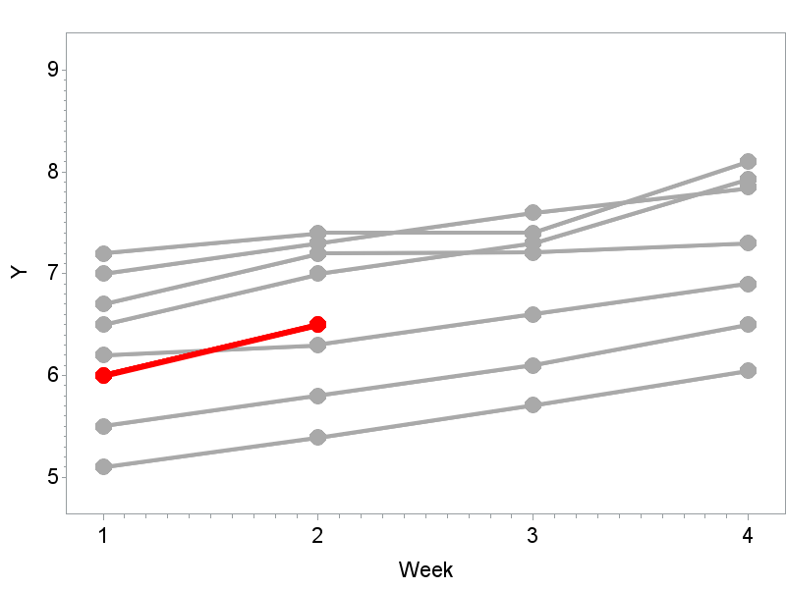
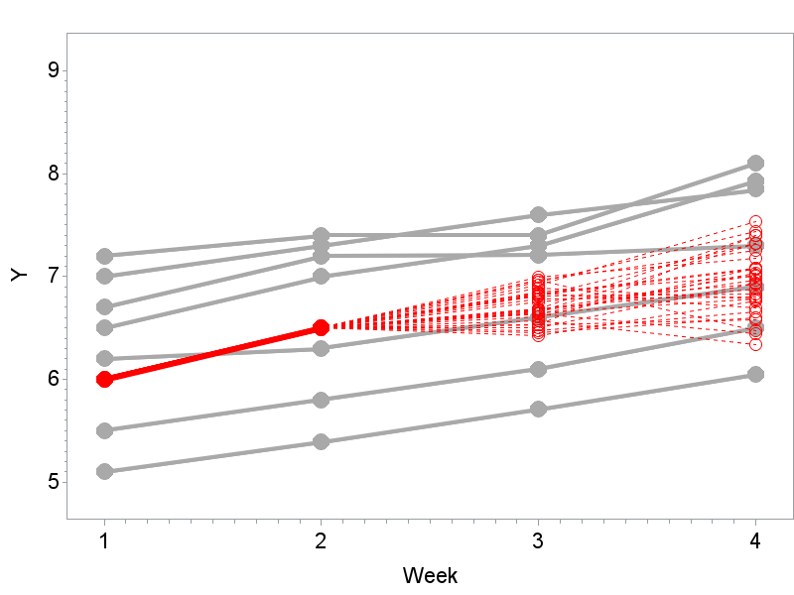
Prediction of hypothetical trajectories Account for prediction uncertainty
Single predictions underrepresent uncertainty
Need multiple explicit or implicit predictions
Approaches that fit this purpose include MI and maximum-likelihood methods for the longitudinal measurements
Illustration for multiple imputation (under MAR):
Red solid line: Observations of subject that has an intercurrent event at week 2
Grey solid lines: Observations of subjects in the same treatment arm who have similar baseline characteristics
Red dashed lines: ‘Predicted’ values under MAR

Slide 21
Prediction of hypothetical trajectories Need to perform a sensitivity analysis
According to ICH E9 (R1):
“A series of analyses conducted with the intent to explore the robustness of inferences from the main estimator to deviations from its underlying modelling assumptions and limitations in the data.”
Crucial component of the estimand framework
The series of analyses needs to be aligned to the same estimand
Not just a shopping basket of numerous estimation/imputation methods
Tipping point analyses are an attractive option for sensitivity analyses

Slide 22
Tipping point analysis
Assesses sensitivity to departures from the assumptions made for the primary analysis (← ‘anchor point’)
Tom Permutt (2015, Statistics in Medicine):
“Basically, the method is to predict the *missing outcomes* and then add values ${\text{δ}}_{i}$to the predictions in group 𝑖, varying the ${\text{δ}}_{i}$ over a plausible range. We think this is the most appropriate kind of sensitivity analysis for the missing data problem.”
The value of 𝛿 that overturns the primary results will represent a tipping point
An interpretation of the clinical plausibility of the assumption underlying the tipping point should be provided

Slide 23
Considerations for tipping point analysis
Make sure the anchor point and all subsequent analyses adequately capture the added uncertainty due to missing data (e.g. by using multiple predictions / imputations)
Apply 𝛿–adjustment only for investigational arm or also comparator?
Is it clinically plausible to assume more severe symptoms for *missing outcomes* only in the investigational arm? Or is an unsymmetrical approach driven by the aim to be conservative?
Apply 𝛿–adjustment regardless of reason for discontinuation or only for certain reasons such as AE?
Is it clinically plausible to assume more severe symptoms regardless of reason for discontinuation? Or only for reasons related to say efficacy or safety?

Slide 24
Considerations for tipping point analysis
Apply 𝛿–adjustment on an additive or multiplicative scale?
Which scale aids communication with the various stakeholders (e.g. absolute change versus percentage change)?
Apply 𝛿–adjustment within the imputation model or to the imputed values?
Suggest to apply the adjustment within the imputation model, e.g. for binary data on the probability scale.
For normally distributed data both approaches coincide
Apply 𝛿–adjustment to all imputed values or only to the primary endpoint of interest?
Suggest to focus on the primary endpoint – also in view of transparent communication

Slide 25
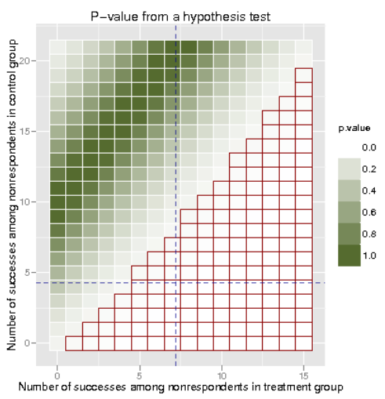
Graphical displays* for tipping point analyses
* See PhD thesis of Victoria Liublinska: Sensitivity analyses in empirical studies plagued with missing data, 2013, Harvard University

Slide 26
Some regulatory perspective on sensitivity analysis
FDA feedback on one Novartis program, Oct 2019:
“Please conduct a tipping point analysis to explore the potential impact of missing data. The tipping point analysis should be based on multiple imputation that takes into account the uncertainty in the imputation process.
“Such a tipping point analysis should be two dimensional (i.e., it should allow assumptions about the missing outcomes on the two arms to vary independently, and should include scenarios where dropouts on treatment have worse outcomes than dropouts on placebo).”
“The goal will be to evaluate the plausibility of the assumed expected values for missing outcomes on each treatment arm under which the conclusions change (i.e., under which there is no longer evidence of a treatment effect).”

Slide 27
Analysis flowchart
Remove irrelevant data collected after the intercurrent event of interest
Explicit or implicit predictions
Assumptions to be aligned with the hypothetical strategy
From where/whom do we borrow information?
Do we have sufficient data to borrow from?
Need to adequately account for prediction uncertainty
Separately for each arm (Placebo and Active):
Predict the hypothetical data after intercurrent event according to hypothetical scenario of interest using e.g. multiple imputation
Combine the observed and predicted data and perform the analysis of interest (ANCOVA, MMRM,...), potentially in combination with Rubin’s model
Sensitivity analysis (e.g. tipping point analysis)

Slide 28
Case study
Some aspects of the case study have been simplified and changed for the purpose of this training
Focus here on one intercurrent event for illustration

Slide 29
Case study –background
Study purpose
is to evaluate safety and efficacy of Drug X compared to placebo in patients with post-herpetic neuralgia (PHN).
Post-herpetic neuralgia (PHN)
is clinically defined as a persistent neuropathic pain following the appearance of the skin rash.
Investigational drug
an angiotensin II type 2 (AT2) receptor antagonist that has been shown to be active in established animal and clinical neuropathic pain models. The Drug X is administered twice daily.

Slide 30
Case study
Population: drug naive patients or patients receiving a stable dose of concomitant medication suffering from chronic pain with a moderate or severe pain intensity
Variable: change in weekly mean 24-hour average pain score (11-point NRS) from baseline to Week 12
Treatments: Drug X and placebo on top of allowed concomitant medications for pain (stable dose)
Intercurrent event: treatment discontinuation due to any reason
Hypothetical strategy: What would the treatment effect be, had patients not discontinued trt and behaved like other patients who did not discontinue trt?
Summary measure: the difference in variable means between both treatments

Slide 31
Hypothetical strategy
Randomisation
Primary endpoint
Drug
Patient 1
Patient 2
Patient 3
Control
Patient 4
Patient 5
Patient 6
Intercurrent event: Treatment discontinuations for any reason
Data collected after treatment discontinuation due to any reason are not considered meaningful

Slide 32
Hypothetical strategy
Randomisation
Primary endpoint
Drug
Patient 1
Patient 2
Patient 3
Control
Patient 4
Patient 5
Patient 6
Data after treatment discontinuation will be replaced by predicted values for both arms
Hypothetical trajectories had the patient not discontinued treatment need to be predicted based on plausible assumptions

Slide 33
Prediction of hypothetical trajectories
Predicted trajectories for a given patient can be informed through similar patients (in terms of covariates, treatment and post-baseline information) who did not discontinue treatment
A plausible ‘similarity assumption’ for pain scores can be based on:
Covariates: region (e.g. US, EU), randomized treatment, gender, age, use of concomitant pain medication (yes/no) and baseline (mean pain intensity) score
Available post-baseline average pain intensity scores
We apply a sequential imputation model:
Does not assume a joint normal distribution for all covariates and post-baseline scores
Instead uses a separate conditional distribution model for each imputed variable

Slide 34
Primary analysis model
For every imputed data set, the primary estimation method is based on an Analysis of Covariance (ANCOVA) model, adjusting for:
Region, gender, age, use of concomitant pain medication for PHN (yes/no), randomized treatment as factors and
baseline (mean pain intensity) score as covariate
Rubin’s rules are used to combine the ANCOVA results from the different imputed data sets into overall estimates and variances

Slide 35
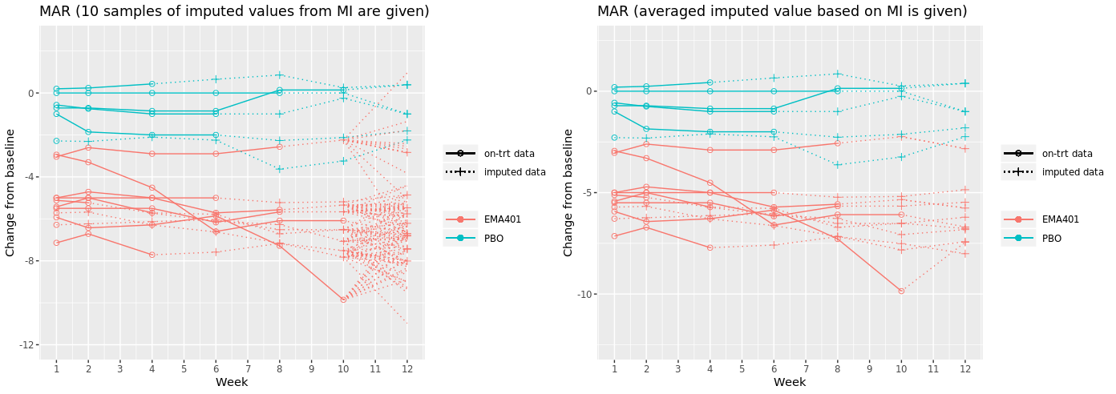
Case study Primary analysis results – MAR for both arms
Drug X
Drug X
Note: Analysis was performed using, in this sequence, PROC MI, PROC MIXED and PROC MIANALYZE, with 100 imputations

Slide 36
Case study Sensitivity analysis - tipping point analysis
One dimensional tipping point analysis: Apply 𝛿–adjustment only for Drug X arm using the MNAR option in PROC MI
The tipping point 𝛿 overturning the primary results is 22.3
The primary endpoint, NRS, is an 11–point scale. Hence, 22.3 is not a clinically plausible shift on the imputed values
Drug X

Slide 37
Summary
A broad range of ‘What if...’ questions can be considered
Some of these hypothetical estimands are of more scientific and regulatory interest than others
Estimation of hypothetical estimands requires careful considerations and assumptions (which are generally untestable)
It is important to align assumptions with the chosen estimand and to justify the plausibility of the assumptions
Transparent and easy to communicate sensitivity analyses play an important role in assessing the robustness of conclusions for hypothetical estimands (and beyond !)

Slide 38
Thank You !

Slide 39
Reference
Suzie Cro, Tim P. Morris, Michael G. Kenward, James R. Carpenter (2020): Sensitivity analysis for clinical trials with missing continuous outcome data using controlled multiple imputation: A practical guide. Statistics in Medicine, 39, 2815-2842
Ian R. White, Royes Joseph & Nicky Best (2019): A causal modelling framework for reference-based imputation and tipping point analysis in clinical trials with quantitative outcome. Journal of Biopharmaceutical Statistics, https://doi.org/10.1080/10543406.2019.1684308.
Francesca Callegari, Mouna Akacha, Peter Quarg, Shaloo Pandhi, Florian von Raison & Emmanuel Zuber (2020) Estimands in a Chronic Pain Trial: Challenges and Opportunities, Statistics in Biopharmaceutical Research, 12:1, 39-44, DOI: 10.1080/19466315.2019.1629997

Slide 40
Prediction of hypothetical trajectories Sequential imputation model
Imputation is performed in three steps:
Step 1: Impute the missing baseline pain scores based on a linear regression model adjusting for region, gender, age and use of concomitant pain medication (yes/no)
Step 2: Fill in any intermediate missing values by assuming a joint normal distribution for the post-baseline pain scores
Step 3: Within a given treatment arm, impute the missing post-baseline values at visit$j$based on a linear regression model adjusting for
region, gender, age and use of concomitant pain medication (yes/no)
pain scores at the previous visits $j−1, …, 0.$

