Slide 1
Treatment policy estimands for recurrent event data using data collected after cessation of randomised treatment
Missing Data in Clinical Trials - Past, Present and Future
PSI Scientific Committee One Day Meeting
Daniel Bratton
5th May 2021

Slide 2
Acknowledgements
James Roger
Oliver Keene
Bhabita Mayer
Juan Abellan
Pharmaceutical Statistics 2018; 18(1): 85-95

Slide 3
Outline
On- & Off-treatment data
Imputation of missing recurrent event data after study-withdrawal
Assumptions around off-treatment and post-study-withdrawal periods
SAS macros
Example: METREO trial, mepolizumab for chronic obstructive pulmonary disease (COPD) (NCT02105961)

Slide 4
Off-treatment data
A treatment policy estimand is often interested in the efficacy of treatment regardless of treatment discontinuation
In the past, many RCTs only collected on-treatment data, i.e. data collected up to the point of treatment discontinuation
Analyses restricted to imputing missing data under assumptions drawn from these data only
However, RCTs now commonly attempt to collect off-treatment data, i.e. after treatment discontinuation, but study-withdrawal still occurs
Reduces the amount of missing data in the study vs collecting on-treatment data only
Provides the opportunity to impute post-study-withdrawal data based on the observed off-treatment data
Thus allows potentially more plausible assumptions to be made for the missing post-study-withdrawal data which is also likely to be considered off-treatment

Slide 5
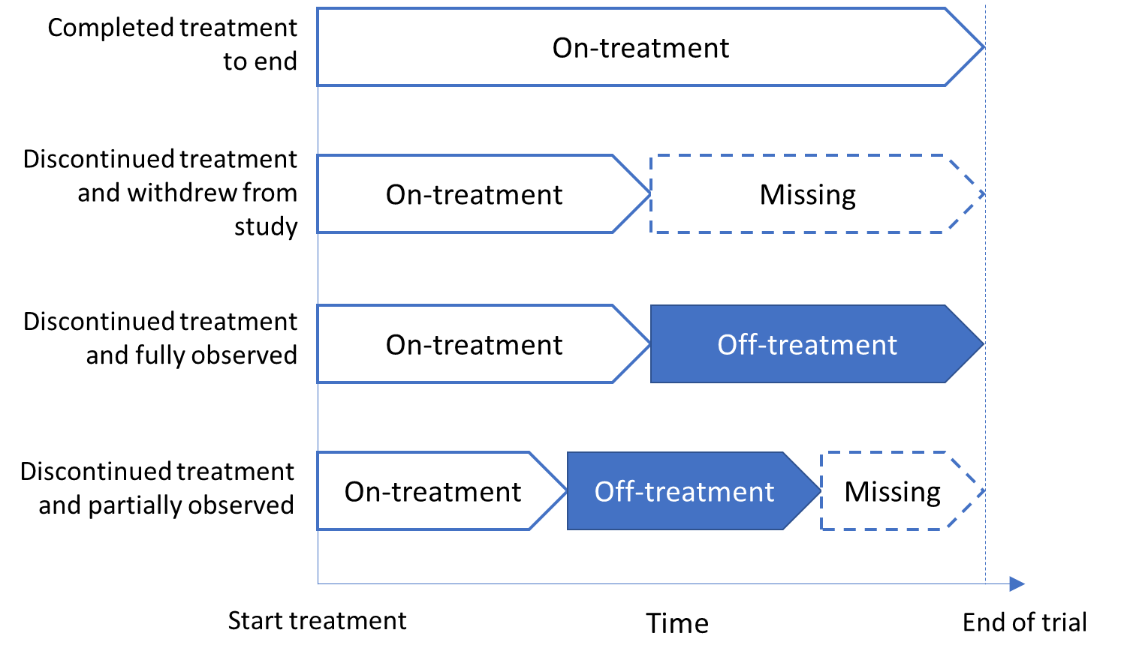
Patient trajectories

Slide 6
Common analysis approaches
Commonly used analysis methods may treat the observed data as coming from a single period, e.g.
Under missing at random (MAR) assumption, mean event rate after withdrawal is then a weighted mean of event rate during on- and off-treatment periods
Alternatively, in the usual Jump to Reference (J2R) approach all post-withdrawal data is imputed based on the observed placebo data
Such analyses do not distinguish between data collected on- and off-treatment which are likely to have differing underlying event rates
Unobserved outcomes may more closely mirror those observed during the off-treatment period
Therefore wish to assume that event rate after study withdrawal is the same as that during the off-treatment period (off-treatment imputation)

Slide 7
Imputation of missing recurrent event data
Period 1 Observed
On-treatment
Period 2
Observed
Off-treatment
Period 3
Unobserved
(Off-treatment)
Suppose a patient has y₁ exacerbations during Period 1 and then discontinues study treatment but remains in follow-up
During Period 2 the patient has y₂ exacerbations and then prematurely withdraws from the study
Alternatively a patient may withdraw from treatment and study simultaneously (y₂ = 0)
Want to estimate y₃, the number of unobserved exacerbations in Period 3 conditioned on y₁ and y₂

Slide 8
Assumed event rate for ‘Missing’ period
X = event
µ_{it} = event rate in period i for treatment t (0=Placebo, 1=Active)
Discontinue study treatment
Withdraw from study
Week 0
Week 52
?
X
X
X
 | On-treatment (i=1) | Off-treatment (i=2) | Missing (i=3)
True Rate | µ_{1t} | µ_{2t} | µ_{3t}
MAR (on+off) | µ_{*t} |  | µ_{*t}
J2R (on+off) | µ_{*t} |  | µ_{*0}
Off-treatment | µ_{1t} | µ_{2t} | µ_{2t}
On-treatment? | µ_{1t} | µ_{2t} | µ₁₁

Slide 9
Off-treatment imputation missing data assumptions
 | On-treatment | Off-treatment | Post-study withdrawal
True Rate | µ_{1t} | µ_{2t} | µ_{3t}
Off-treatment imputation | µ_{1t} | µ_{2t} | µ_{2t}
Post-study-withdrawal can be assumed to have same event rate as the observed off-treatment period in the same arm: µ_{3t} = µ_{2t}
Could lead to issues if there is little observed off-treatment data on a particular arm
At least 50% of the post-treatment-discontinuation period needs to be observed to avoid large reduction in precision of estimated effect (Roger et al 2018)
Alternatively, can assume patients have the same event rate post-treatment-discontinuation regardless of treatment assignment: µ_{3t} = µ_{2*}
Could be realistic if for example the treatment has a rapid washout period
May help to avoid imputation issues caused by a lack of off-treatment data relative to missing data on a particular arm

Slide 10
Multiple imputation methods
Set up dataset to provide appropriate assumption around the unobserved period (see later slide)
Two approaches to imputation model (Roger et al 2018):
Negative multinomial regression – number of missing events conditional on number of observed events is also negative multinomial (Keene et al 2014)
Negative binomial mixed model with subject-specific random effect
Apply usual MI methods:
Take multiple random samples from relevant imputation model for missing period
Compute total number of events for each subject (y₁ + y₂ + y₃)
Analyse each imputed dataset using same model as primary analysis
Repeat multiple times (e.g. 5000 imputations)
Combine estimates using Rubin’s rules

Slide 11
SAS macros
SAS macros for multiple imputation of recurrent event data written by James Roger are available from ‘DIA Missing Data’ page*:
NegBinMI: can perform multiple imputation in situations the observed and unobserved data are each assumed to come from a single period (Keene et al 2014). Uses negative multinomial approach
NM_Reg: generalisation of NegBinMI to any number of periods (i.e. on-, off- and post-study-withdrawal)
NM_Rand: Also performs multiple imputation for any number of periods, using joint modelling approach but tends to be slower than NM_Reg
Allow different references for the unobserved periods, for example in NM_Reg/Rand:
Off-treatment data within the same arm
All off-treatment data (e.g. all patients assumed to have similar outcomes once withdrawing from treatment)
Off-treatment reference in active arm only, no distinction between on-/off-treatment period in placebo arm
* https://www.lshtm.ac.uk/research/centres-projects-groups/missing-data#dia-missing-data

Slide 12
SAS Macros Data Set-up
1) Separate off-treatment periods by treatment group
P = Placebo, A = Active, D = Duration (months), Y = number of events
Raw dataset
Imputed outcomes (e.g.)
Analysis dataset
Pt. | Trt. * Period | D | Y | MI Trt.- Period
1 | P-On | 6 | 3 | P-On
1 | P-Off | 3 | 2 | P-Off
1 | P-Miss | 3 | ? | P-Off
2 | A-On | 10 | 0 | A-On
2 | A-Off | 1 | 1 | A-Off
2 | A-Miss | 1 | ? | A-Off
… | … | … | … | …
Imp. | Pt. | MI Trt.- Period | Y*
1 | 1 | P-On | 3
1 | 1 | P-Off | 2
1 | 1 | P-Off | 2
1 | 2 | A-On | 0
1 | 2 | A-Off | 1
1 | 2 | A-Off | 0
… | … | … | …
Imp. | Pt. | Trt. | D | Y
1 | 1 | P | 12 | 7
1 | 2 | A | 12 | 1
… | … | … | … | …

Slide 13
SAS Macros Data Set-up
2) Combining off-treatment periods by treatment group
P = Placebo, A = Active, D = Duration (months), Y = number of events
Raw dataset
Imputed outcomes (e.g.)
Analysis dataset
Pt. | Trt. * Period | D | Y | MI Trt.- Period
1 | P-On | 6 | 3 | P-On
1 | P-Off | 3 | 2 | Off
1 | P-Miss | 3 | ? | Off
2 | A-On | 10 | 0 | A-On
2 | A-Off | 1 | 1 | Off
2 | A-Miss | 1 | ? | Off
… | … | … | … | …
Imp. | Pt. | MI Trt.- Period | Y*
1 | 1 | P-On | 3
1 | 1 | Off | 2
1 | 1 | Off | 1
1 | 2 | A-On | 0
1 | 2 | Off | 1
1 | 2 | Off | 1
… | … | … | …
Imp. | Pt. | Trt. | D | Y
1 | 1 | P | 12 | 6
1 | 2 | A | 12 | 2
… | … | … | … | …

Slide 14
SAS Macros Data Set-up
3) Off-treatment imputation for active arm only; placebo on/off-treatment effect assumed equal
P = Placebo, A = Active, D = Duration (months), Y = number of events
Raw dataset
Imputed outcomes (e.g.)
Analysis dataset
Pt. | Trt. * Period | D | Y | MI Trt.- Period
1 | P-On | 6 | 3 | P
1 | P-Off | 3 | 2 | P
1 | P-Miss | 3 | ? | P
2 | A-On | 10 | 0 | A-On
2 | A-Off | 1 | 1 | A-Off
2 | A-Miss | 1 | ? | A-Off
… | … | … | … | …
Imp. | Pt. | MI Trt.- Period | Y*
1 | 1 | P | 3
1 | 1 | P | 2
1 | 1 | P | 1
1 | 2 | A-On | 0
1 | 2 | A-Off | 1
1 | 2 | A-Off | 1
… | … | … | …
Imp. | Pt. | Trt. | D | Y
1 | 1 | P | 12 | 6
1 | 2 | A | 12 | 2
… | … | … | … | …

Slide 15
Example - METREO study design
COPD patients at high risk of exacerbations despite SoC background therapy
52 week treatment period; patients dosed every 4 weeks
Double blind treatment
Subjects discontinuing randomised treatment encouraged to remain in follow-up off-treatment
Primary endpoint: rate of moderate/severe exacerbations during 52-week treatment period
Placebo SC (N=226)
Mepolizumab 100mg SC (N=223)
Mepolizumab 300mg SC (N=225)
Total N=674

Slide 16
Extent of off-treatment & missing data
Number of patient-years | Placebo (N=226) | Mepolizumab 100mg SC (N=223) | Mepolizumab 300mg SC (N=225)
On-treatment | 195.4 (86%) | 205.9 (92%) | 203.0 (90%)
Off-treatment | 13.2 (6%) | 10.0 (4%) | 10.8 (5%)
Missing | 18.1 (8%) | 7.3 (3%) | 12.0 (5%)
Percentages based on total time on-treatment, off-treatment and missing.
Total time missing for a subject withdrawing from study = 1 – number of years on-treatment and off-treatment

Slide 17
METREO: Results of Post Hoc Imputation Analyses
Rate Ratios vs Placebo

Slide 18
Results of Post Hoc Imputation Analyses
Exacerbation rates (Observed Margins estimates)
Analysis | Placebo (N=226) | Mepolizumab 100mg SC (N=223) | Mepolizumab 300mg SC (N=225)
MAR | 1.49 | 1.19 | 1.27
J2R | 1.48 | 1.20 | 1.29
Off-treatment | 1.43 | 1.16 | 1.29

Slide 19
Conclusions
Often wish to estimate effect of treatment regardless of the event of treatment discontinuation (treatment policy estimand)
Many confirmatory studies now continue to collect data after a patient has discontinued study treatment
Provides opportunity to use the observed off-treatment data to impute data post study-withdrawal which is also likely to be off-treatment, provided sufficient off-treatment data collected
For recurrent event data this can be achieved using negative multinomial modelling, or mixed modelling approach with subject-specific random effect
Flexible SAS macros available for implementing both methods of analysis
Can handle any number of assumed post-randomisation periods
Allows missing data assumptions to vary, e.g. specific to arm or patient
Require no more than ~50% of the off-treatment period to be unobserved for effective imputation

Slide 20
References
Akacha M, Ogundimu EO. Sensitivity analyses for partially observed recurrent event data. Pharmaceutical Statistics 2016; 15:4-14.
Carpenter JR, Roger JH, Kenward MG. Analysis of longitudinal trials with protocol deviation: a framework for relevant, accessible assumptions, and inference via multiple Imputation. Journal of Biopharmaceutical Statistics 2013; 23:1352-1371.
Keene ON, Jones MRK, Lane PW, Anderson J. Analysis of exacerbation rates in asthma and chronic obstructive pulmonary disease: example from the TRISTAN study. Pharmaceutical Statistics 2007; 6:89-97.
Keene ON, Roger JH, Hartley BF, Kenward MG. Missing data sensitivity analysis for recurrent event data using controlled imputation. Pharmaceutical Statistics 2014; 13:258-264.
Pavord DM, Chanez P, Criner GJ et al. Mepolizumab for Eosinophilic Chronic Obstructive Pulmonary Disease. New England Journal of Medicine 2017; DOI: 10.1056/NEJMoa1708208
Roger JH, Bratton DJ, Mayer B et al. Treatment policy estimands for recurrent event data using data collected after cessation of randomised treatment. Pharmaceutical Statistics 2018; 18(1):85-95

