Slide 1
Adaptive Designs with
Multiple Objectives
Carl-Fredrik “Caffe” Burman
Early Biometrics & Statistical Innovation, Data Science & Artificial Intelligence, R&D, AstraZeneca, Gothenburg, Sweden

Slide 2
Adaptive Designs
Adaptive Designs
with
Multiple Objectives
Multiple Objectives

Slide 3
Preliminaries
0

Slide 4
Keep it simple!
What’s important in this trial / project?
Does this methodology make sense?
Meaningful to medics, patients, payers?
“Optimal”: Real improvements or ε gains?
Measuring value
Bayesian & Frequentist
Prescriptive or descriptive?

Slide 5
“Everything” is (multi-variate) Normal
… due to the Central Limit Theorem
Transformations sometimes needed
Some exceptions to be wary of
  Small sample sizes
  Discrete data with few events
  Outliers
Examples MVN
  Placebo-adjusted efficacy for two different doses
  Interim and Final analysis
  All-comers (AC) and Biomarker positive (BM+) subpopulation

Slide 6
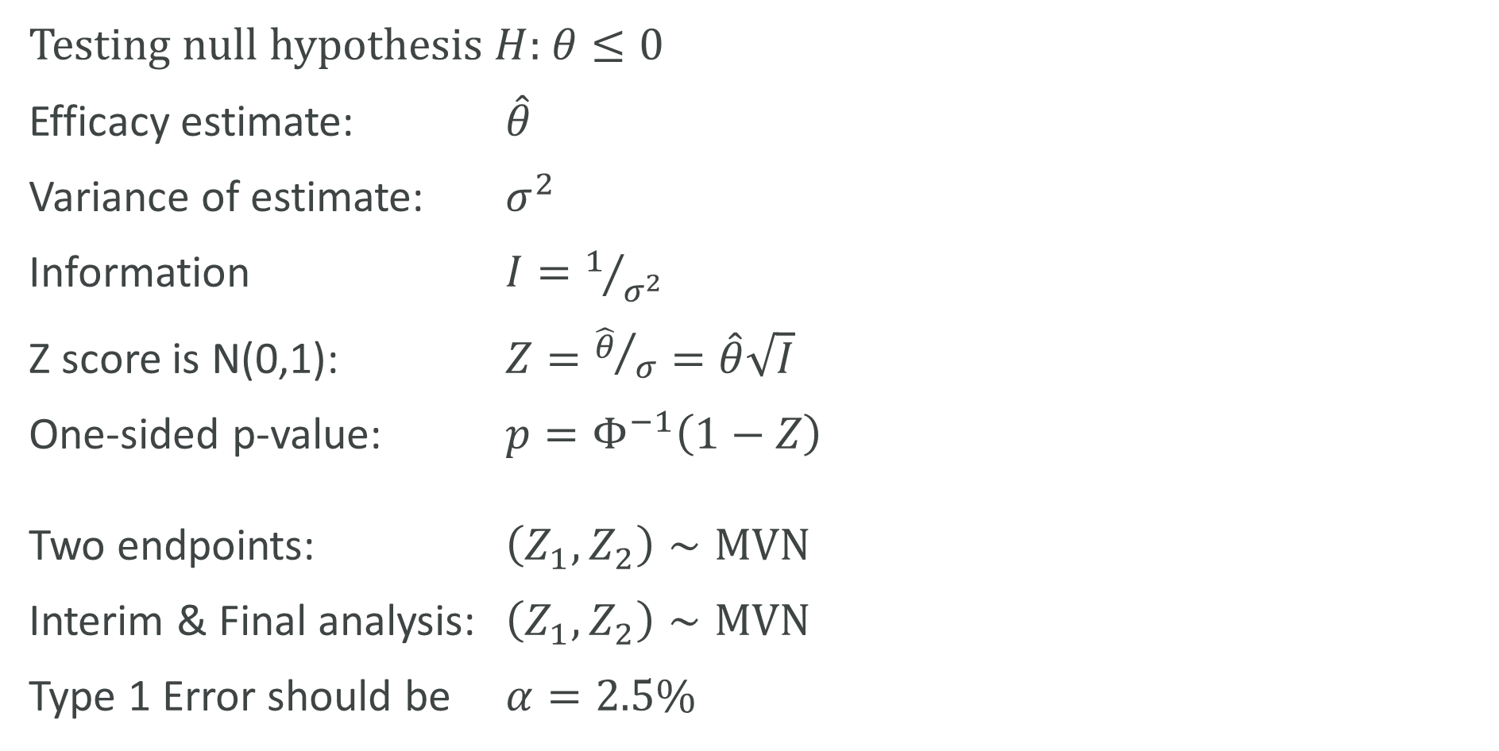
Some notation
Testing null hypothesis $H$: $θ≤0$
Efficacy estimate: $\hat{θ}$
Variance of estimate: $σ^{2}$
Information $I=1/{σ^{2}}$
Z score is N(0,1): $Z={\hat{θ}}/σ=\hat{θ}\sqrt{I}$
One-sided p-value: $p=Φ^{−1}\left(1−Z\right)$
Two endpoints: $\left(Z_{1},Z_{2}\right)∼MVN$
Interim & Final analysis: $\left(Z_{1},Z_{2}\right)∼MVN$
Type 1 Error should be $α=2.5\%$

Slide 7
Adaptive Designs
1
& Group Sequential Designs

Slide 8


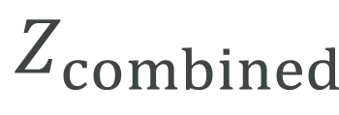
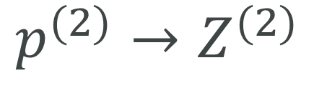
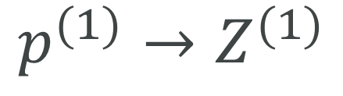

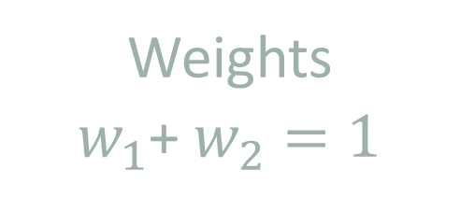
What is an Adaptive Design?
Can change design features mid-way. Pre-specify weights for stages
$$p^{(1)}$$
$$p^{(2)}$$
Independent under null
$$p^{(1)}→Z^{(1)}$$
$$p^{(2)}→Z^{(2)}$$
Inverse normal
Weights
$w_{1}$+ $w_{2}=1$
$$Z_{combined}$$
$$p$$
Notes:
Z_i=Phi^(-1)(1-p_i)
In a simple case, Z_i:s are the original test statistics. The formulation above can be used more generally (e.g. when test statistic isn’t normal or p-values are multiplicity adjusted)
Independence important
Adaptive design idea can be used recurrently. May have >2 stages of adaptive designs.
Z = sum sqrt(w_i) Z_i. If Z_i are independent
p=Phi(-Z) is p-value for entire trial

Slide 9
Any adaptation is OK mathematically …
… but we need to think about interpretability
Notes:
Based on the data we see at the Interim, may change:
Sample size
Treatment arms
(Sub)populations
Endpoints
Test statistic
Multiplicity adjustments
Etc.
Don’t use AD weighting if not needed. GSD often better than sample size re-estimation e.g.

Slide 10
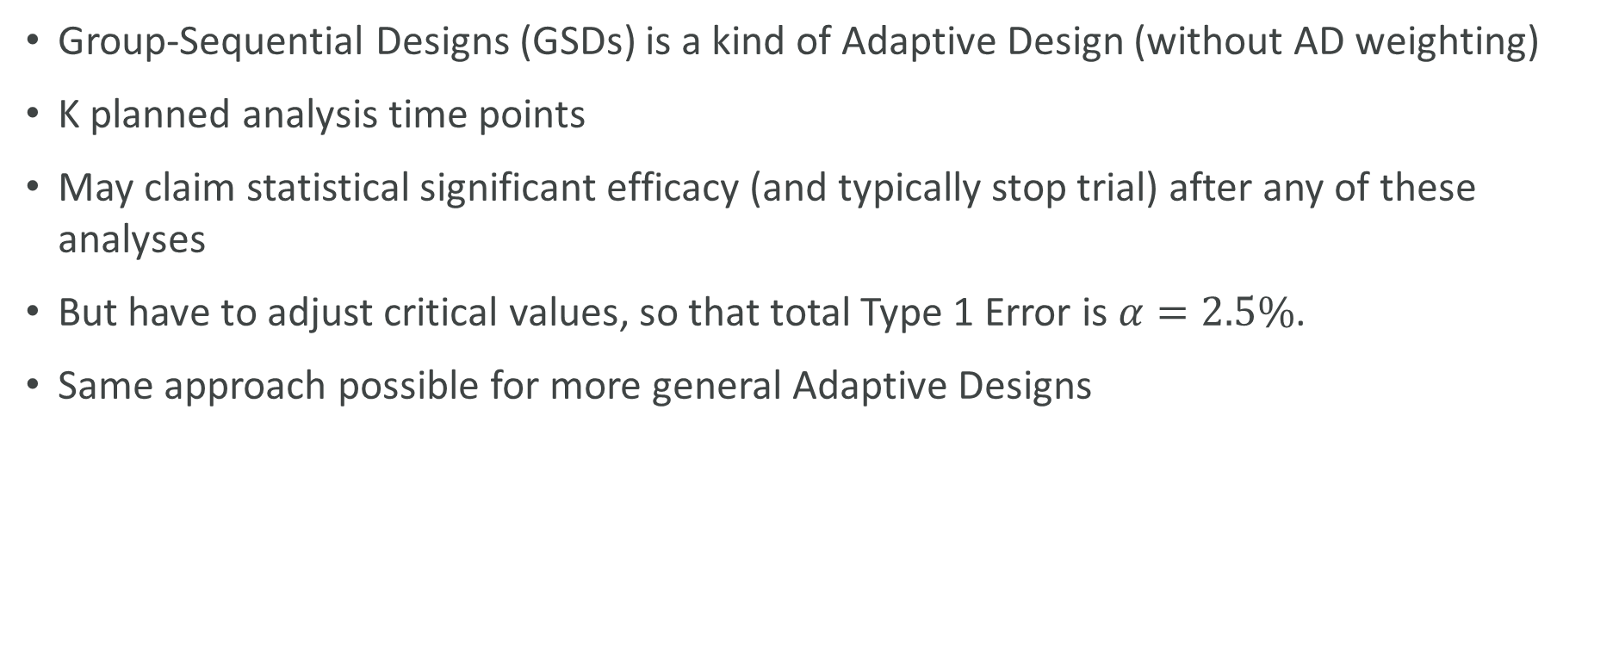
Early winning in Adaptive Designs
Group-Sequential Designs (GSDs) is a kind of Adaptive Design (without AD weighting)
K planned analysis time points
May claim statistical significant efficacy (and typically stop trial) after any of these analyses
But have to adjust critical values, so that total Type 1 Error is $α=2.5\%$.
Same approach possible for more general Adaptive Designs

Slide 11
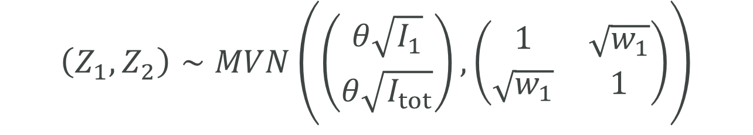



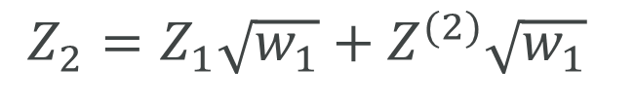
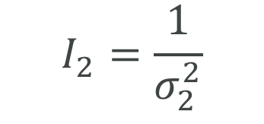
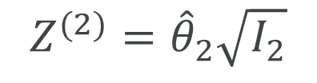
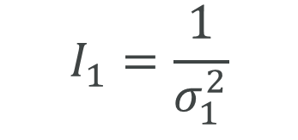
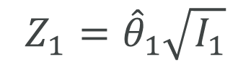

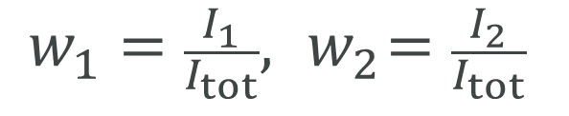
Group Sequential Design (GSD)
$${\hat{θ}}_{1}$$
$${\hat{θ}}_{2}$$
Independent under null
$$I_{1}=\frac{1}{σ_{1}^{2}}$$
$$I_{2}=\frac{1}{σ_{2}^{2}}$$
$$I_{tot}=I_{1}+I_{2}$$
$$Z_{1}={\hat{θ}}_{1}\sqrt{I_{1}}$$
$$Z^{(2)}={\hat{θ}}_{2}\sqrt{I_{2}}$$
$$w_{1}=\frac{I_{1}}{I_{tot}}, { w}_{2}=\frac{I_{2}}{I_{tot}}$$
$$\hat{θ}=w_{1}I_{1}+w_{2}I_{2}$$
$$Z_{2}={Z_{1}\sqrt{w_{1}}+Z^{(2)}\sqrt{w_{1}}}_{ }$$
$$\left(Z_{1},Z_{2}\right)∼MVN\left(\left(\begin{matrix}θ\sqrt{I_{1}} \\ θ\sqrt{I_{tot}}\end{matrix}\right),\left(\begin{matrix}1 & \sqrt{w_{1}} \\ \sqrt{w_{1}} & 1\end{matrix}\right)\right)$$

Slide 12

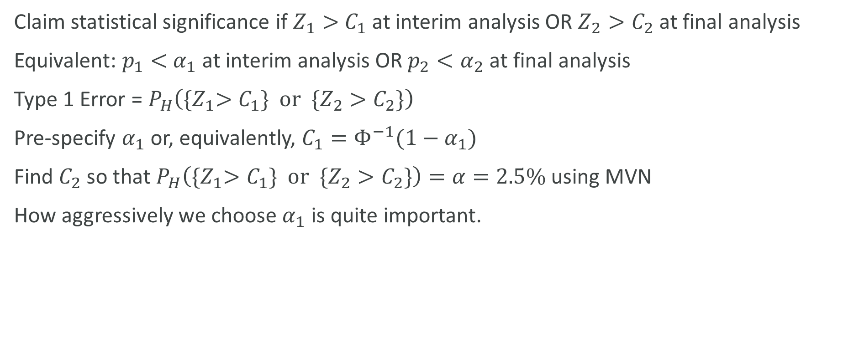

Critical values
$Z_{1}>$ $C_{1}$
$$Z_{2}>C_{2}$$
Claim statistical significance if $Z_{1}>$ $C_{1}$ at interim analysis OR $Z_{2}>C_{2}$ at final analysis
Equivalent: $p_{1}<$ $α_{1}$ at interim analysis OR $p_{2}<α_{2}$ at final analysis
Type 1 Error = $P_{H}\left({\{Z}_{1}>C_{1}\} or{ \{Z}_{2}>C_{2}\}\right)$
Pre-specify $α_{1}$ or, equivalently, $C_{1}=Φ^{−1}(1−α_{1})$
Find $C_{2}$ so that $P_{H}\left({\{Z}_{1}>C_{1}\} or{ \{Z}_{2}>C_{2}\}\right)=α=2.5\%$ using MVN
How aggressively we choose $α_{1}$ is quite important.

Slide 13
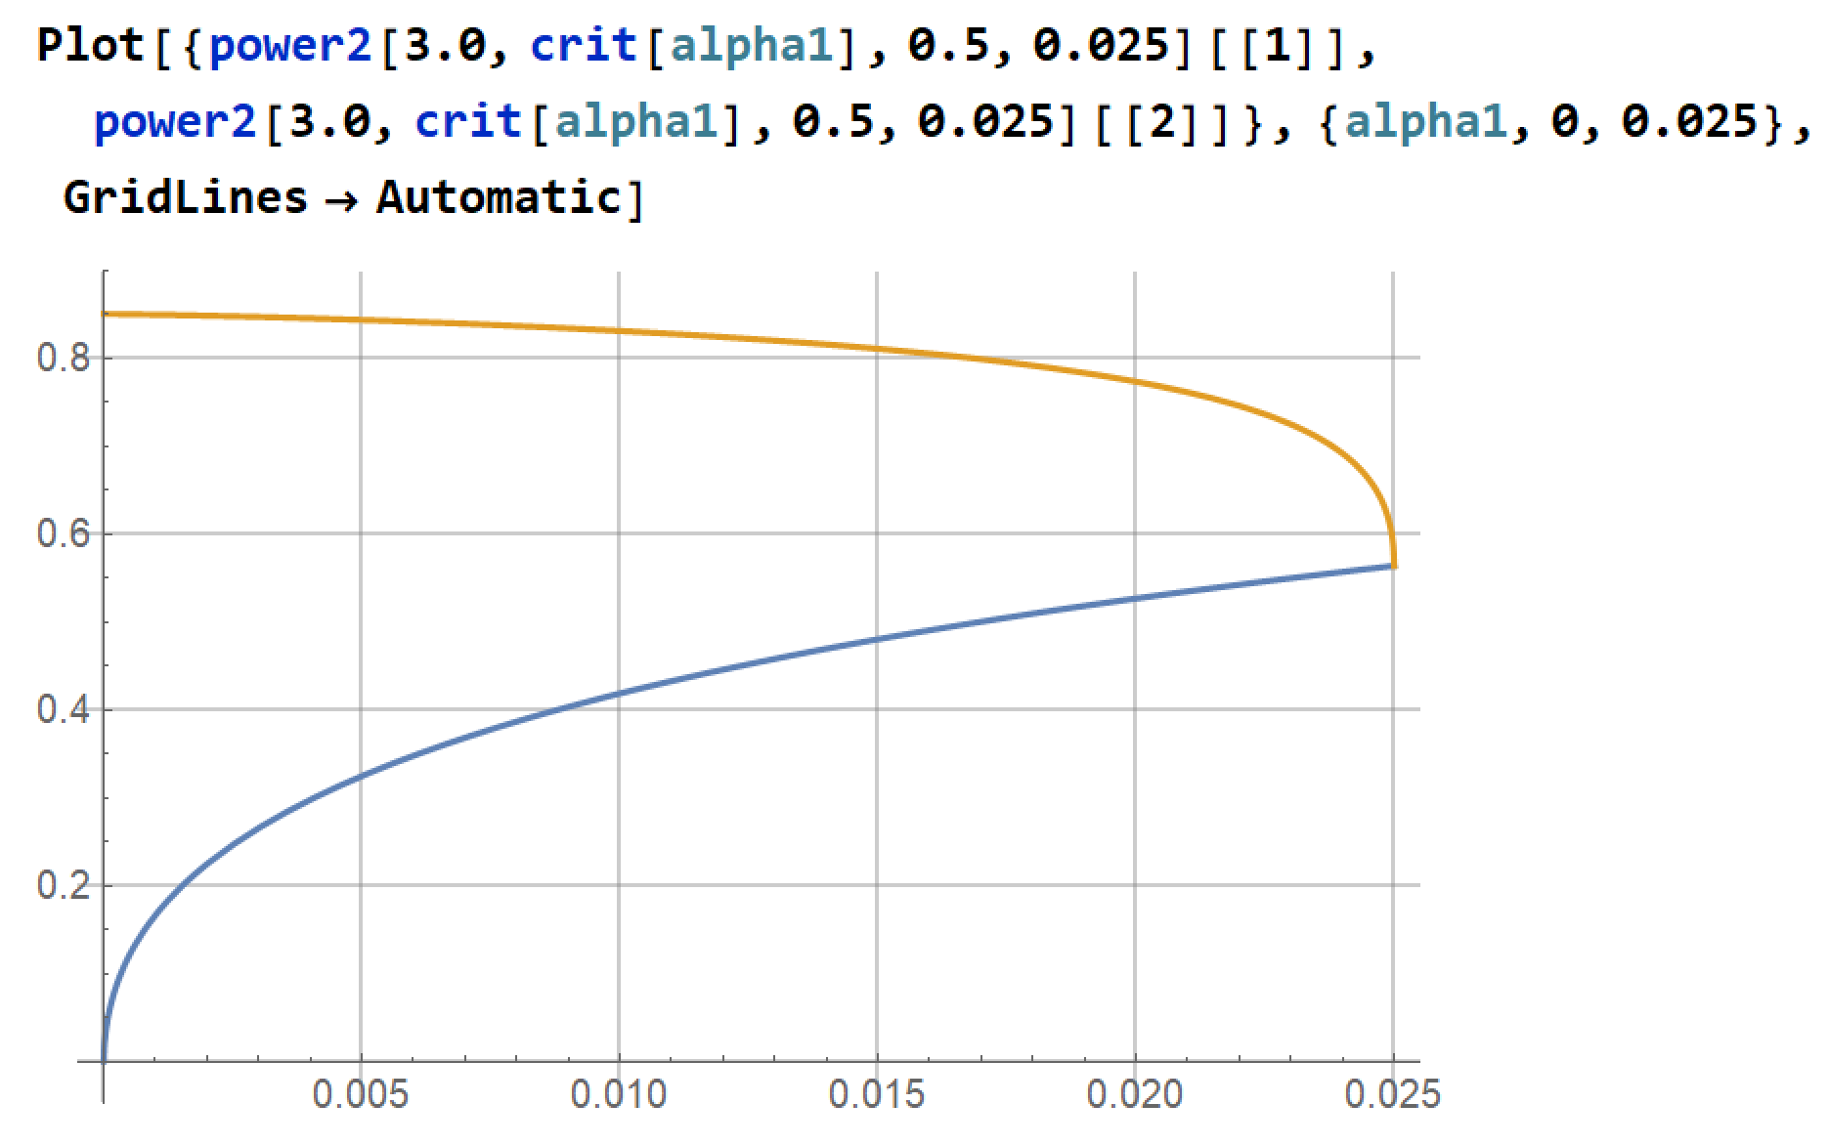
Power (yellow) and Prob(Early win), as functions of interim alpha

Slide 14
Comparing different (group-sequential) designs
 | Fixed | GSD Old standard | GSD Alternative
Interim time | NA | 24.0 months | 24.0 m
Prob(WIN early) | 0% | 25.3% | 39.1%
Final time | 36.0 m | 36.2 m | 36.7 m
Power (total) | 90.0% | 90.0% | 90.0%
E[NPV] | 90 | 95.8 | 98.7
Assume NPV increases by 2 units per month. (100 at 36m, 124 at 24m)
NPV=100 at 36.0 m (Index value 100 at fixed design read-out)
NPV=124 at 24.0 m (Assume 20% higher if gaining 1 year)
NPV=99.6 at 36.2 m (Delay 0.2m = 6days to get same overall power)
NPV=98.6 at 36.7 m (Delay 0.7m = 21 days.)
Fixed: E[NPV] = 90% * 100 = 90
GSD Old: E[NPV] = 25.3% * 124 + (90%-25.3%) * 99.6 = 95.8
GSD Alternative E[NPV] = 39.1% * 124 + (90%-39.1%) * 98.6 = 98.7

Slide 15
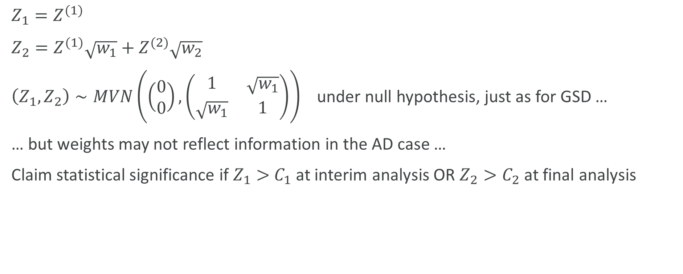
Win early in Adaptive Design
$$Z_{1}=Z^{(1)}$$
$Z_{2}=Z^{(1)}\sqrt{w_{1}}+$ $Z^{(2)}\sqrt{w_{2}}$
$\left(Z_{1},Z_{2}\right)∼MVN\left(\left(\begin{matrix}0 \\ 0\end{matrix}\right),\left(\begin{matrix}1 & \sqrt{w_{1}} \\ \sqrt{w_{1}} & 1\end{matrix}\right)\right)$ under null hypothesis, just as for GSD …
… but weights may not reflect information in the AD case …
Claim statistical significance if $Z_{1}>$ $C_{1}$ at interim analysis OR $Z_{2}>C_{2}$ at final analysis

Slide 16
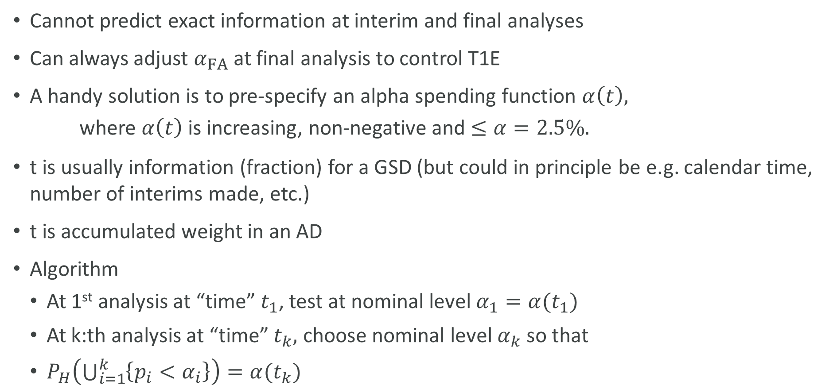
Alpha spending
Cannot predict exact information at interim and final analyses
Can always adjust $α_{FA}$ at final analysis to control T1E
A handy solution is to pre-specify an alpha spending function $α\left(t\right),$
  where $α\left(t\right)$ is increasing, non-negative and $≤α=2.5\%.$
t is usually information (fraction) for a GSD (but could in principle be e.g. calendar time, number of interims made, etc.)
t is accumulated weight in an AD
Algorithm
  At 1st analysis at “time” $t_{1}$, test at nominal level $α_{1}=α(t_{1})$
  At k:th analysis at “time” $t_{k},$ choose nominal level $α_{k}$ so that
  $P_{H}\left(\bigcup_{i=1}^{k}{\left\{p_{i}<α_{i}\right\}}\right)=α(t_{k})$

Slide 17
Multiple Objectives
2

Slide 18
Multiple objectives
(For now: Consider fixed, not adaptive design)
Multiple endpoints, e.g.
CV outcome trial: MACE, CVD, QoL
Oncology: PFS, OS
Heart Failure: Time-to-first, Number of HF hospitalisations
Multiple time points
Alzheimer: 26 and 78 weeks
Multiple doses
PEGASUS trial: ticagrelor 60 mg and 90 mg vs placebo
Multiple (sub)populations
Respiratory: biomarker positive (eosinophil high) and all-comer populations

Slide 19
Family-Wise Error Rate (FWER):
Prob of rejecting any true null hypothesis

Slide 20
Bonferroni-based Recycling
Two operations
  Splitting alpha between hypotheses (Bonferroni)
  Reuse alpha when winning (cf. Hierarchical procedure)
Does not utilise correlation structure

Slide 21





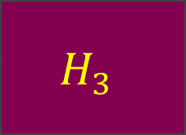
Splitting α
(weighted Bonferroni)
α
$$v_{1}$$
$$v_{2}$$
$$v_{3}$$
$$H_{1}$$
$$H_{2}$$
$$H_{3}$$

Slide 22


Recycling: Hierarchical procedure
α
$$H_{1}$$
$$H_{2}$$

Slide 23










Can combine Splitting & Recycling
α
α
v₁
v₂
v₃
$$H_{1}$$
$$H_{1}$$
$$H_{2}$$
$$H_{3}$$
$$H_{4}$$
$$H_{5}$$
$$H_{2}$$
$$H_{3}$$
$$H_{4}$$
$$H_{6}$$
… and combined recursively in any number of steps …

Slide 24
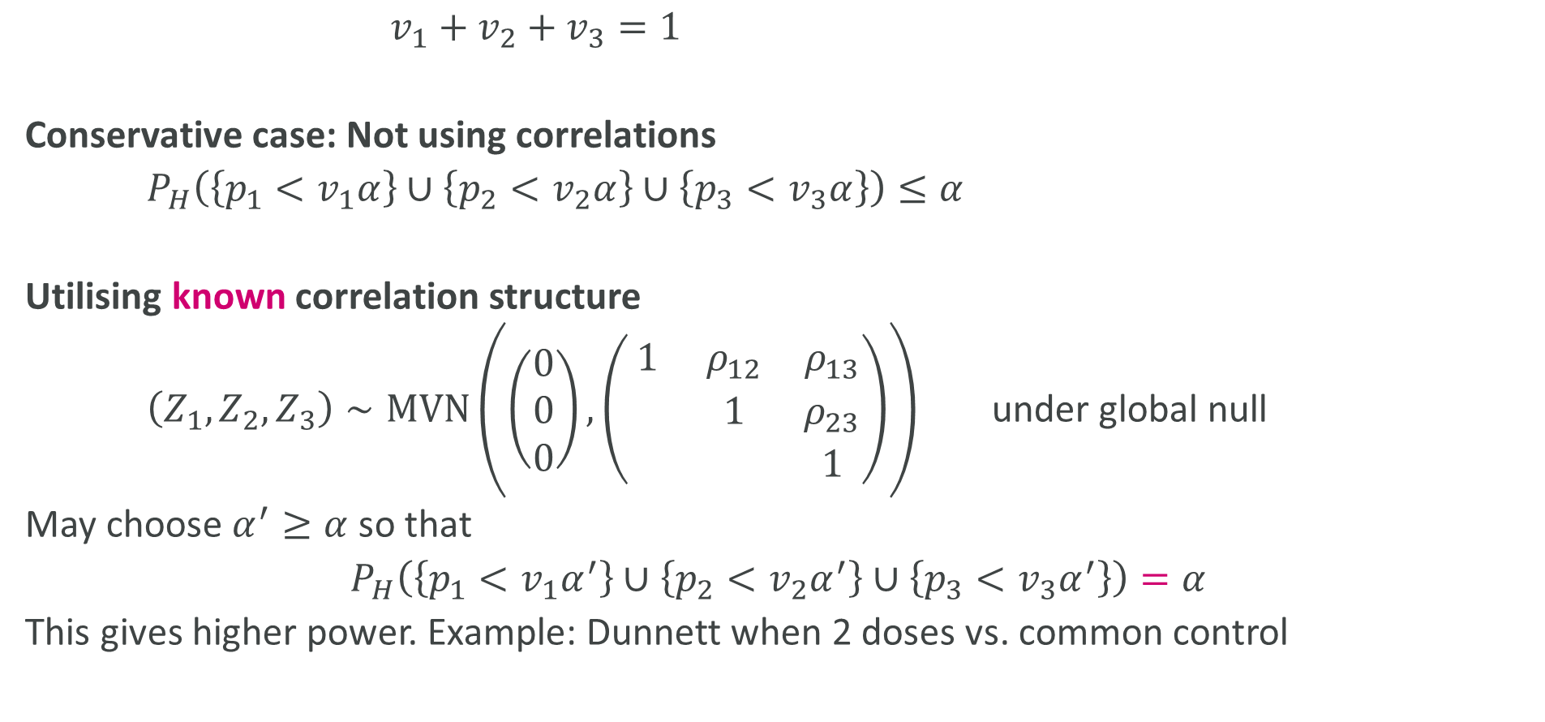






Improving Bonferroni by utilising correlations
α
$$v_{1}$$
$$v_{2}$$
$$v_{3}$$
$$H_{1}$$
$$H_{2}$$
$$H_{3}$$
$v_{1}+v_{2}+v_{3}=1$
Conservative case: Not using correlations
$P_{H}\left(\left\{p_{1}<v_{1}α\right\}∪\left\{p_{2}<v_{2}α\right\}∪\left\{p_{3}<v_{3}α\right\}\right)≤α$
Utilising known correlation structure
$\left(Z_{1},Z_{2},Z_{3}\right)∼MVN\left(\left(\begin{matrix}0 \\ 0 \\ 0\end{matrix}\right),\left(\begin{matrix}1 & ρ_{12} & ρ_{13} \\ & 1 & ρ_{23} \\ & & 1\end{matrix}\right)\right)$ under global null
May choose $α^{′}≥α$ so that
$$P_{H}\left(\left\{p_{1}<v_{1}α^{′}\right\}∪\left\{p_{2}<v_{2}α^{′}\right\}∪\left\{p_{3}<v_{3}α^{′}\right\}\right)=α$$
This gives higher power. Example: Dunnett when 2 doses vs. common control

Slide 25
Are correlations known?
Cf. GSD, where correlations between analysis times will be known at final analysis
Multiple arms (e.g. doses) vs same Control:
  Known correlation (approximately). Dunnett
All-comers and biomarker subpopulation:
  Known correlation (approximately). Spiessens-Debois
Multiple endpoints (or multiple times for same endpoint):
  Unknown correlation

Slide 26
Can we estimate correlation between endpoints?
Earlier trials
Current trial
  Correlation for variables
  Bootstrap for test statistics
  Randomisation test

Slide 27
Adaptive Designs with
Multiple Objectives
3

Slide 28





Primary & Secondary endpoint in Adaptive Design
$p_{P1}<$ $α_{1}$
$$p_{P2}<α_{2}$$
$p_{S1}<$ $?$
$p_{S2}<$ $?$
When Primary endpoint (P) is stat sign, stop trial and test also Secondary (S)
May recycle full $α$ from P to S
But may NOT test at full $α$ whenever P wins

Slide 29


Why could we get Type 1 Error inflation?
$p_{P1}<$ $α_{1}$
$$p_{P2}<α_{2}$$
$$p_{S1}<α$$
$$p_{S2}<α$$
The problem arises when there is an effect on Primary, but not on Secondary
Winning on Primary at interim could give information that Secondary endpoint estimate is random high. Thus, prob to falsely reject Secondary may be inflated.

Slide 30


We may test at same level as Primary
$p_{P1}<$ $α_{1}$
$$p_{P2}<α_{2}$$
$$p_{S1}<α_{1}$$
$$p_{S2}<α_{2}$$
How about power for Secondary?
Note that signal-to-noise is worse at interim, better at final.
If likely to win at interim on Primary, may want to spend more alpha for Secondary at interim

Slide 31

What we can do
Primary: any alpha spending
If and only if winning on Primary …
… recycle full $α$ to Secondary endpoint
  Use any alpha spending for Secondary

Slide 32
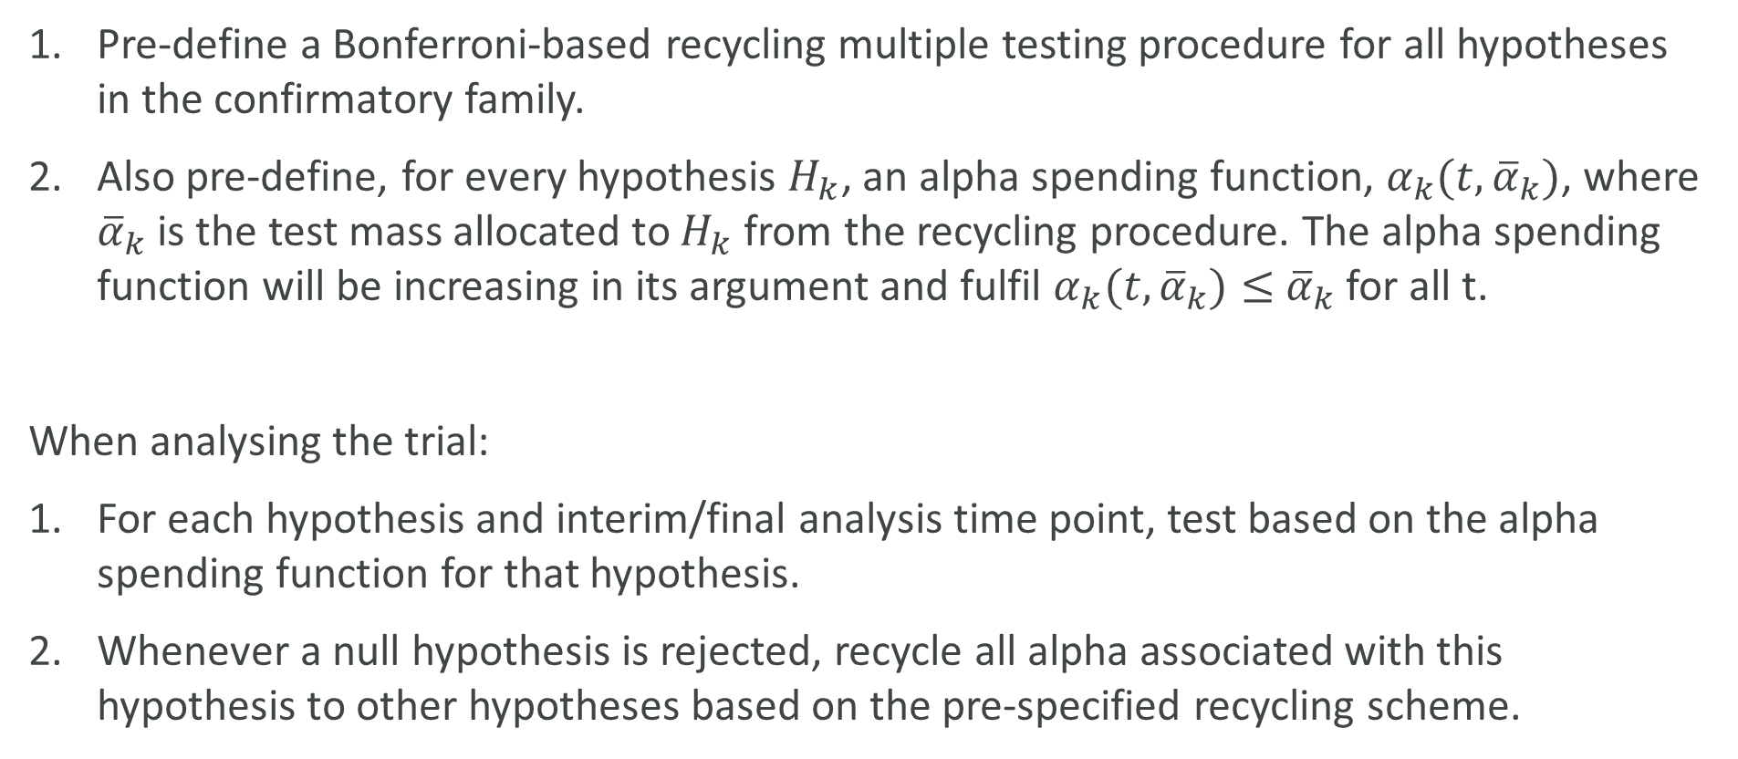
How to think (1)
Pre-define a Bonferroni-based recycling multiple testing procedure for all hypotheses in the confirmatory family.
Also pre-define, for every hypothesis $H_{k}$, an alpha spending function, $α_{k}(t,{\overline{α}}_{k})$, where ${\overline{α}}_{k}$ is the test mass allocated to $H_{k}$ from the recycling procedure. The alpha spending function will be increasing in its argument and fulfil $α_{k}(t,{\overline{α}}_{k})≤$ ${\overline{α}}_{k}$ for all t.
When analysing the trial:
For each hypothesis and interim/final analysis time point, test based on the alpha spending function for that hypothesis.
Whenever a null hypothesis is rejected, recycle all alpha associated with this hypothesis to other hypotheses based on the pre-specified recycling scheme.

Slide 33
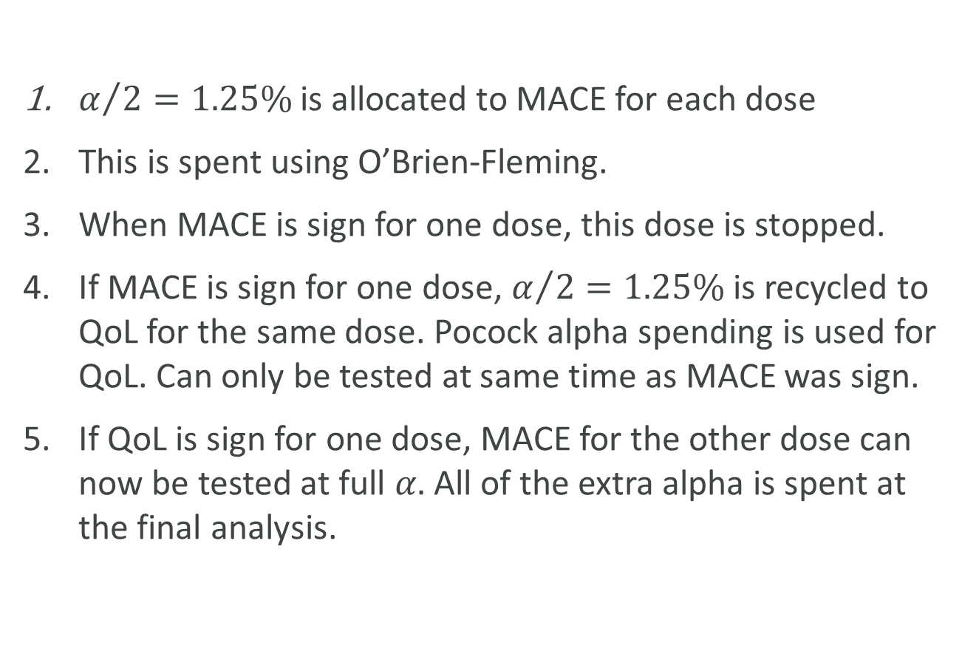

Example
α
0.5
0.5
$α/2=1.25\%$ is allocated to MACE for each dose
This is spent using O’Brien-Fleming.
When MACE is sign for one dose, this dose is stopped.
If MACE is sign for one dose, $α/2=1.25\%$ is recycled to QoL for the same dose. Pocock alpha spending is used for QoL. Can only be tested at same time as MACE was sign.
If QoL is sign for one dose, MACE for the other dose can now be tested at full $α.$ All of the extra alpha is spent at the final analysis.
Low dose
MACE
$$\text{H}\text{igh} \text{dose}$$
$$\text{MACE}$$
Low dose
QoL
High dose
QoL

Slide 34
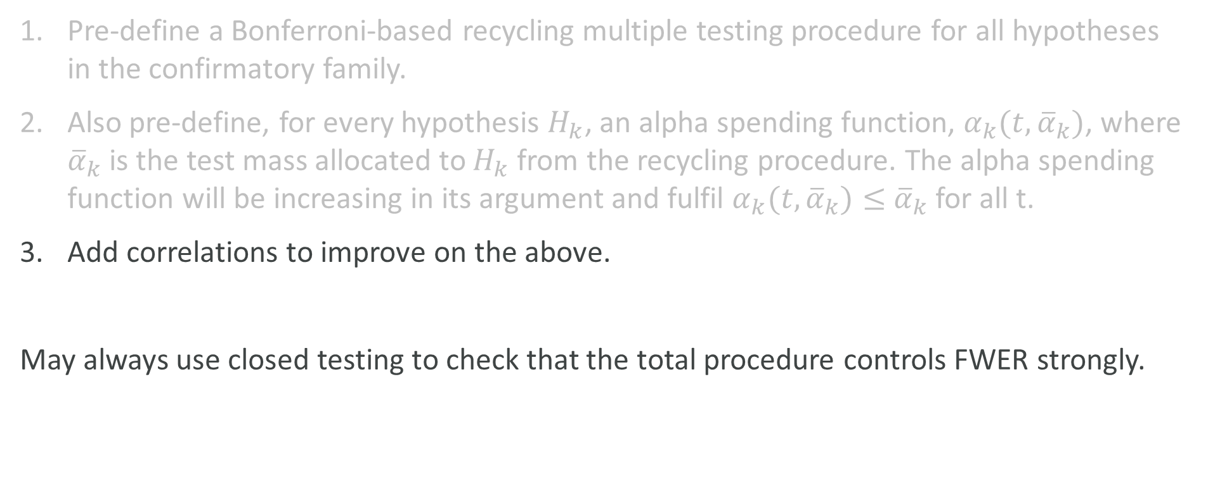
How to think (2)
Pre-define a Bonferroni-based recycling multiple testing procedure for all hypotheses in the confirmatory family.
Also pre-define, for every hypothesis $H_{k}$, an alpha spending function, $α_{k}(t,{\overline{α}}_{k})$, where ${\overline{α}}_{k}$ is the test mass allocated to $H_{k}$ from the recycling procedure. The alpha spending function will be increasing in its argument and fulfil $α_{k}(t,{\overline{α}}_{k})≤$ ${\overline{α}}_{k}$ for all t.
Add correlations to improve on the above.
May always use closed testing to check that the total procedure controls FWER strongly.

Slide 35
Discussion topics
(Use a societal perspective!)
Should we continue trials after winning?
Should we test null hypotheses that are obviously wrong?
Should we (regulatory agencies) request strong FWER control? Weak control?

