Slide 1
Integration of real-world data in oncology early development studies
My recent experience in brief
Archan Bhattacharya
Associate Director, Statistics & Decision Sciences
Janssen R&D, UK
May 25, 2021

Slide 2
Topics
Overview and purpose
Data source
Data quality
Protocol development
Covariate balancing and analysis of data
Process development
Q & A

Slide 3
Overview and purpose
Single-arm phase 1 trials are important
Lack of comparison with control arm is a problem
Types of comparisons:
new drug vs SOC
new drug vs. available physician’s choice
External Control Arm (ECA) studies are becoming a necessity
Health authority
Health economics modeling and market access application
Publications

Slide 4
What data do you need to run an ECA study?
External data are available from different sources
Electronic health records, publicly available database, registries, academic institutions
Data can be collected from these sources but here are some issues:
Very messy and incomplete data
May not be very useful for a specific population under consideration
Data vendors are useful resources especially
If you need data in a very specific disease area (even within oncology)
If a particular region-specific data is needed
If representation is needed from a mixture of practices (clinic practice data, academic institution data, special registry)

Slide 5
How fit for purpose are vendor data?
Before data acquisition and analysis, it is useful to have an idea about the quality and completeness of a vendor’s data:
Number of effective subjects (patient population used in the clinical trial)
Missingness (e.g., missing ECOG, missing labs)
Number of response assessments per line of treatment
Average treatment/follow-up time per patient per line
Add anything suitable for your requirement
If the analysis is protocol driven, it is not advisable to dig into the data too much at this stage, especially if you intend to use the results for regulatory submission.

Slide 6
Do I need a protocol to run an ECA study?
Well, it depends on purpose of the analysis
But irrespective of purpose, some key points are important:
Define inclusion/exclusion criteria for external data matching with clinical trials
External data usually contains patients’ follow-up through multiple lines
Decide which lines are most applicable to match trial population
Multiple qualifying lines require adjustments in analysis
Individual source comparison vs pooled comparison (for multiple data sources)
De-duplication across several database
Sensitivity analysis

Slide 7
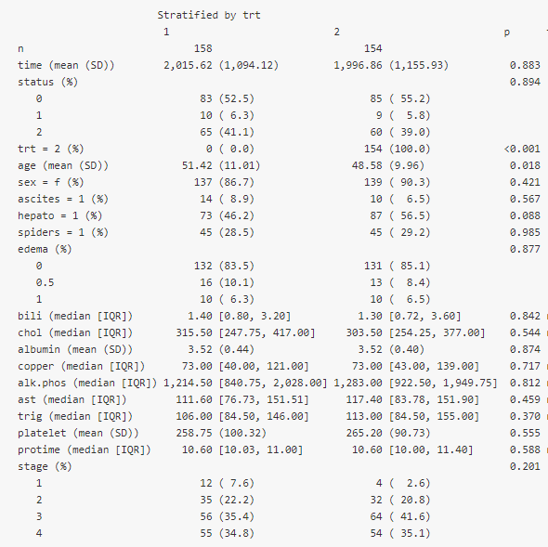
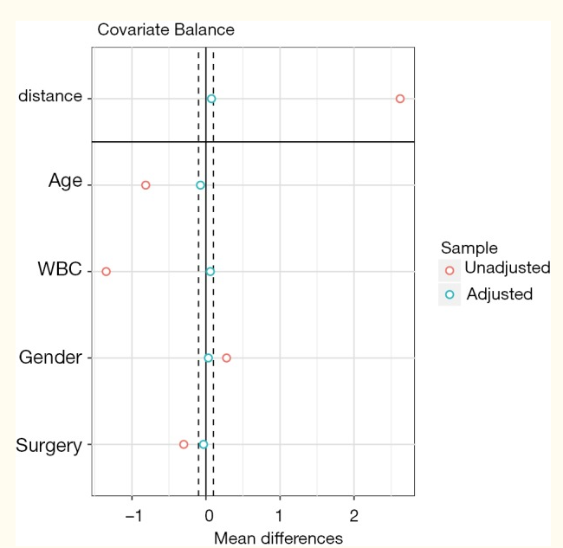
How to analyse external data?
Preparation of data
Several methods for covariate balancing (usually propensity score models using different types of weights)
Clinical input is crucial (model-based variable selection not critical)
Weighted baseline characteristics should show visible balance (not just the variables used for weighting, for others as well)
Balance diagnostics (e.g., SMD, Loveplots, extreme weights etc)

Slide 8
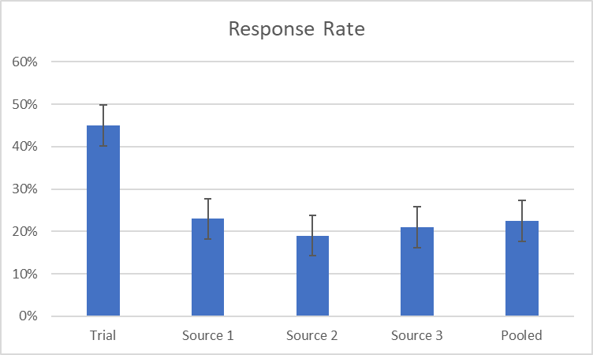
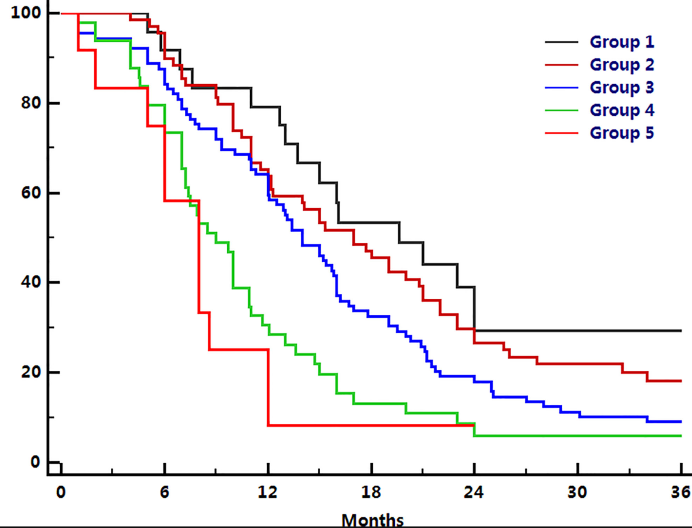
How to compare external to single arm CT data?
Weighted analysis of response and time to event data
Weighting needed to balance ECA sample size with single arm CT sample size
Response rate (difficult to get a RECIST data from external sources)
Progression-free survival
Overall survival

Slide 9
What are the main differences from typical clinical trial analysis?
Non-standard process compared to usual clinical trial data analysis
Use of R and/or SAS
Data preparation and some analyses are new to statistical programmers
CDISC compliance is required if included in the regulatory submission
Statistical expertise needed at development and QC level
Usually, no safety analysis due to lack of safety data

Slide 10
Any question?

