Slide 1
The Rise and Rise of Graphic Expectations
Aimee Gott
Consultant

Slide 2
Background

Slide 3
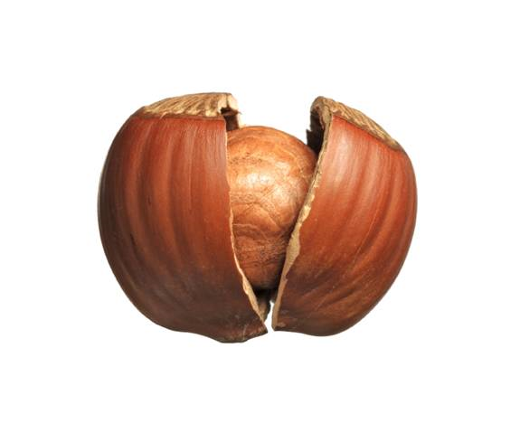
Who are Mango?
Provide data science and analytic implementation services
Premier providers of R Services in the world today
Private company founded in 2002
Offices in UK & China
Global Team of ~50
ISO 9001 Accredited
Notes:
2002 – saw non statisticians needed stats
Technology agnostic
IT frameworks to safely deploy
In 2002 many statisticians were effectively siloed within Pharmaceutical research groups and Quantiative analysis departments of Financial Institutions.
Today – Much broader use of stats, organisations need quicker decisions, access to diverse data
Since then the growing use of R and popularity of SAS saw the decline of SPLUS and in recent years there has been an explosion of new technologies designed to handle the huge growth in data volumes. Python and Hadoop are examples of useful open-source tools that have been designed to handle the huge growth in data over the last few years.
We will talk about Python later on.

Slide 4
My Background
Trained as a Statistician
Worked at Mango since 2012
Worked on many projects with the Pharma Industry
Training
Analysis
Application Development
Validation of R

Slide 5
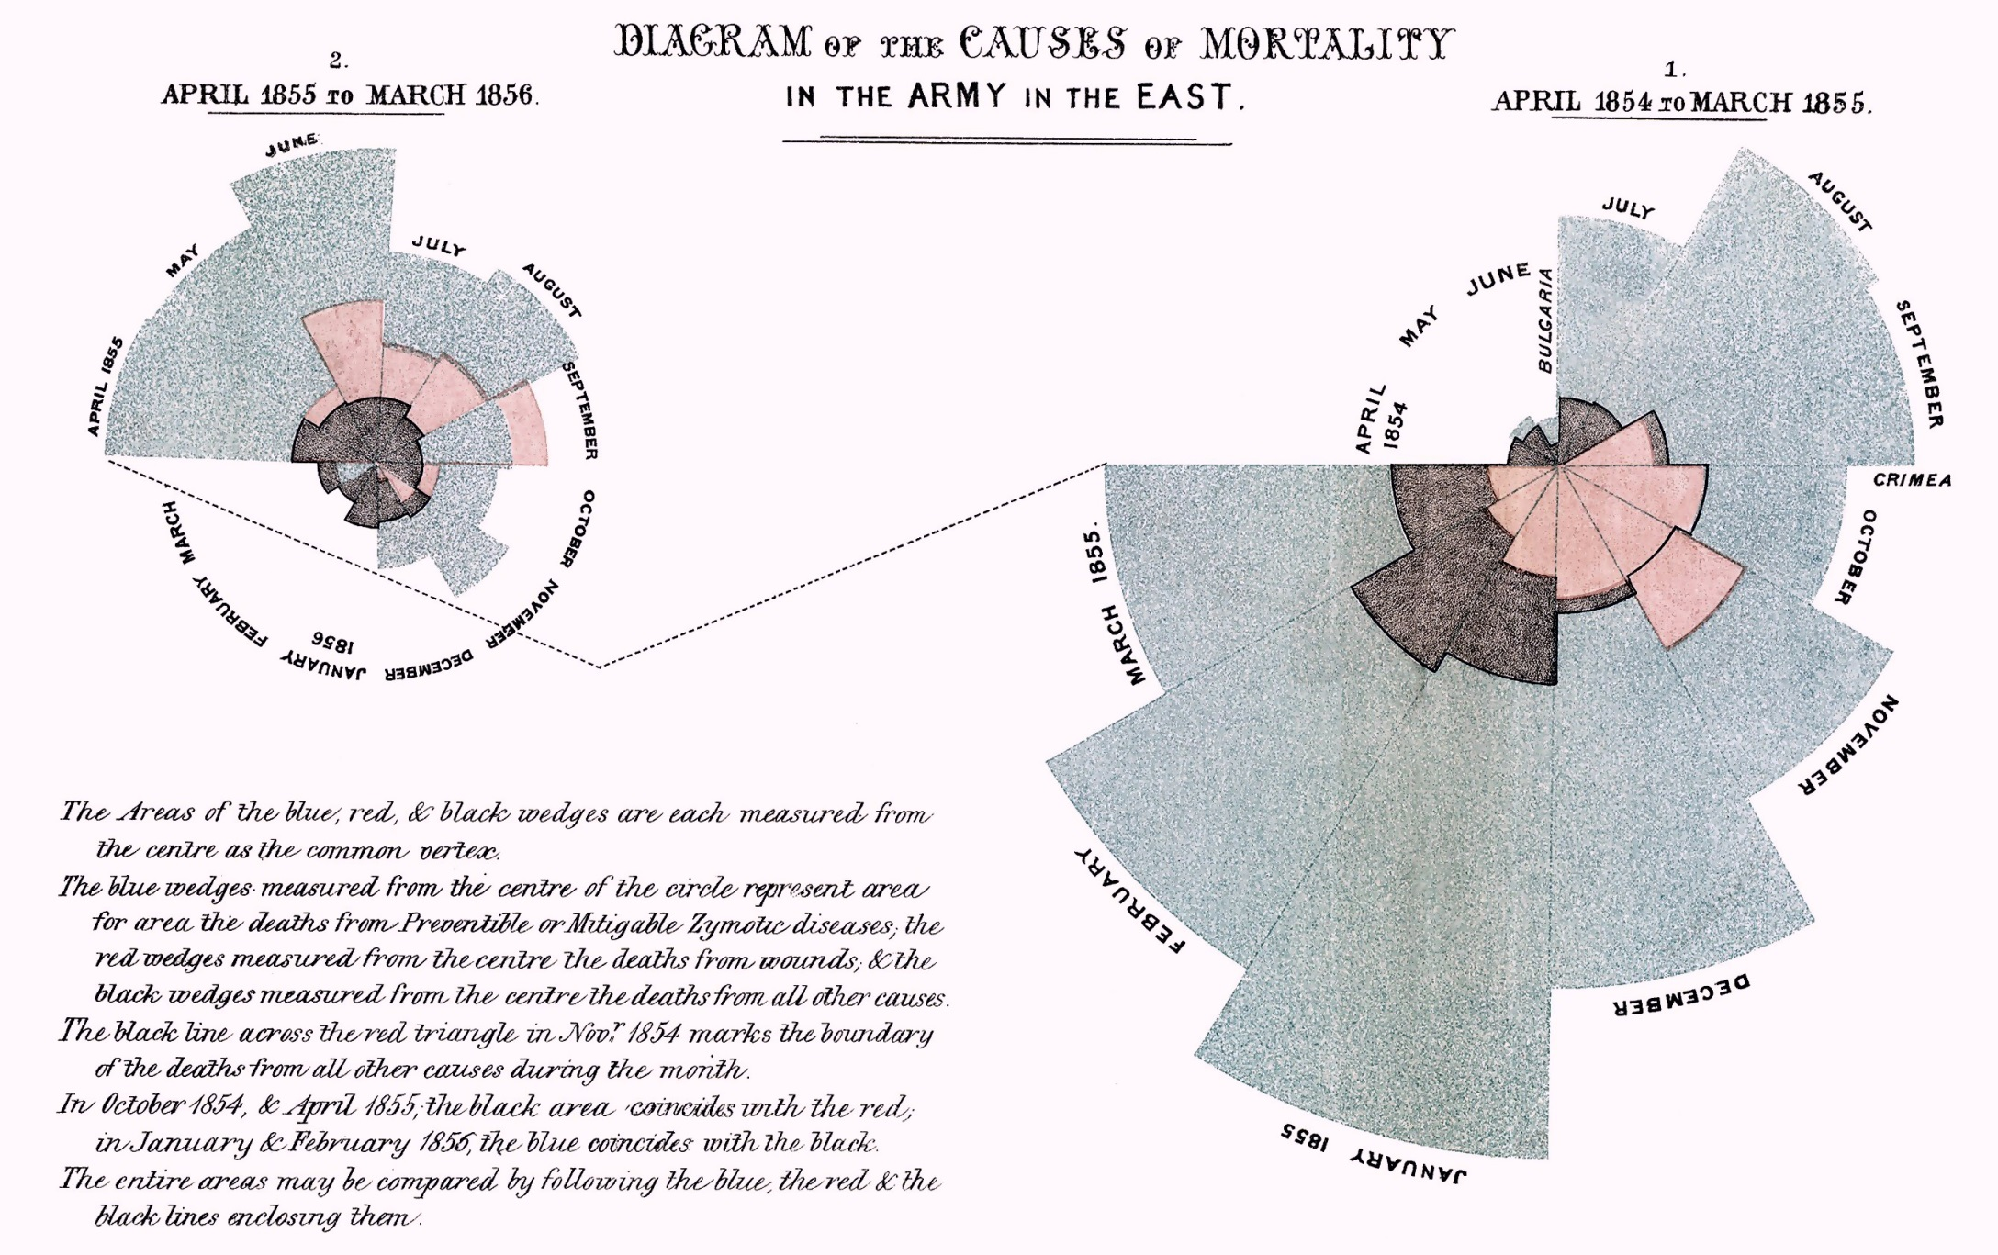
History

Slide 6
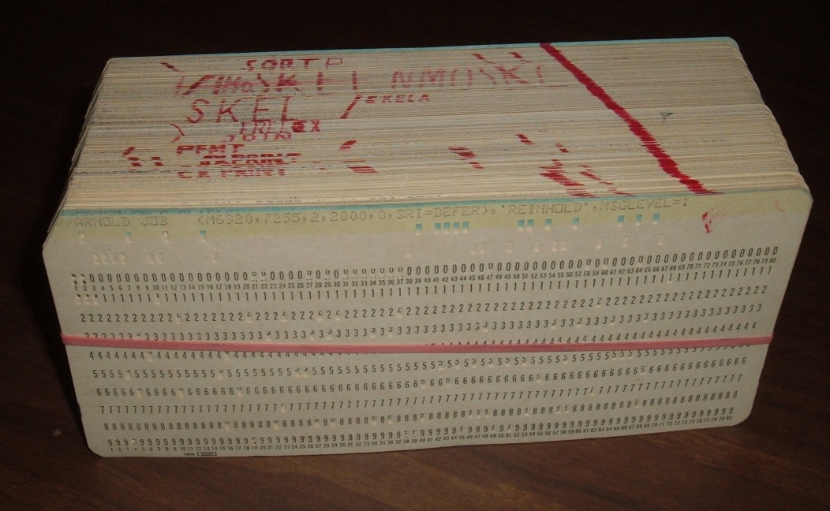
1970's
SAS requires hundreds of punch cards
S in its infancy
Graphics usage limited

Slide 7
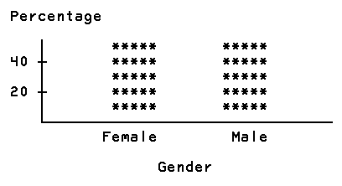
1980's
SAS/GRAPH released
Initial interactive graphics in S-PLUS

Slide 8
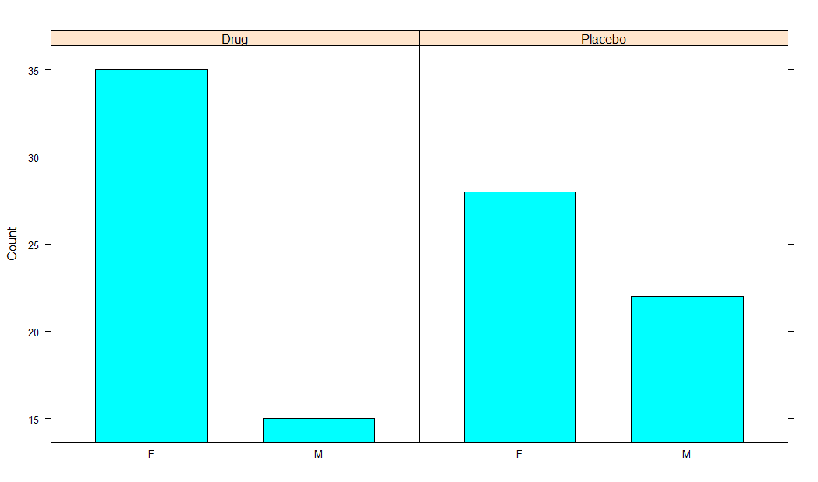
1990's
S-PLUS becomes a licenced product
R development begins

Slide 9
2002
Mango founded
Started working with Pharma companies using S-PLUS
R being more widely used, lots of support for graphics systems

Slide 10
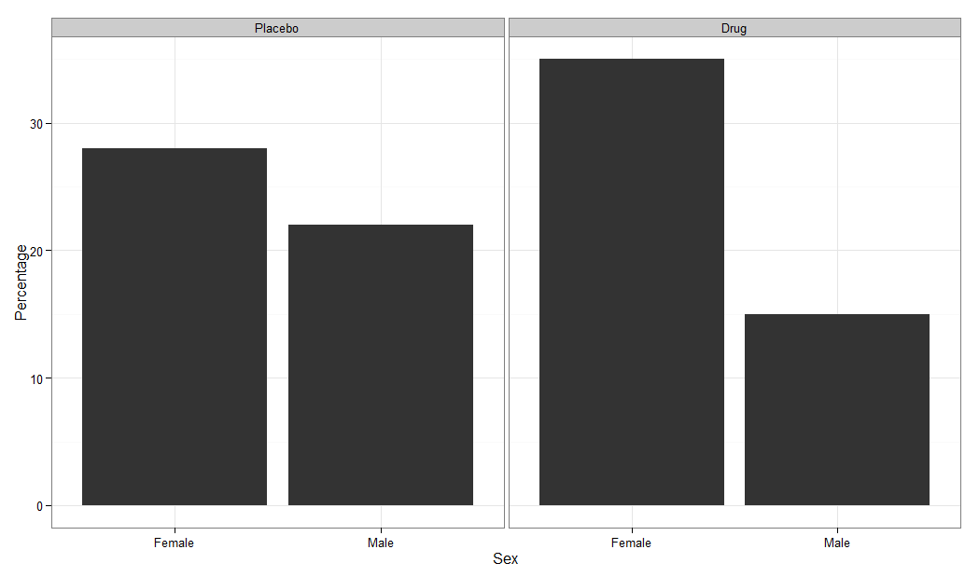
Late 2000's
ggplot2 is first released in R
Graphics being widely used
R starting to be used in Pharma, primarily for graphics

Slide 11
Now

Slide 12
The iGeneration
Graphics are everywhere
They have to be clear
They have to look good
They are interactive
Information is easy to access

Slide 13
What is Expected?
Sophisticated Graphics

Slide 14
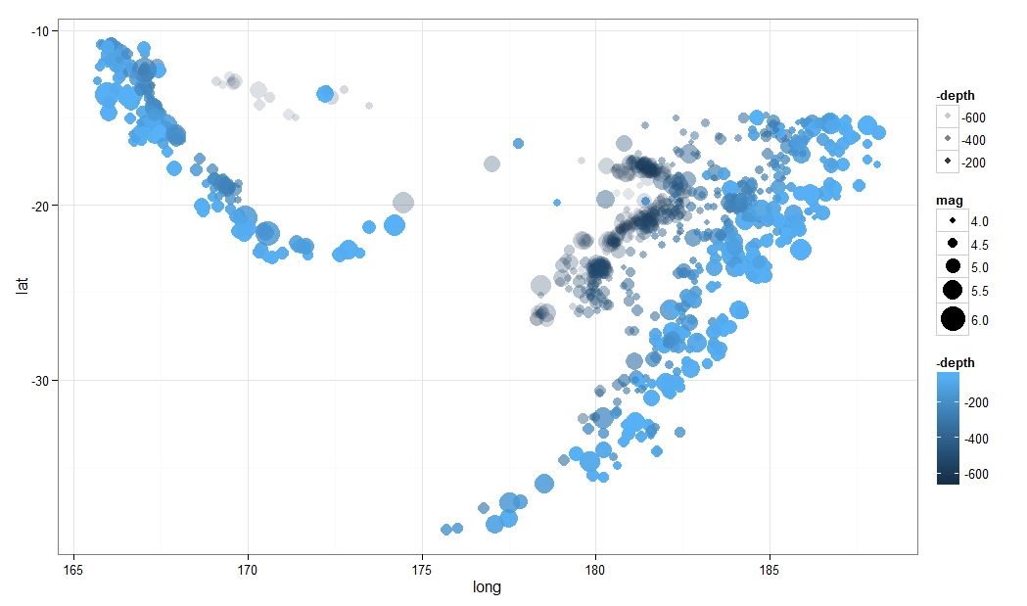

Slide 15
What is Expected?
Sophisticated Graphics
Interactive

Slide 16
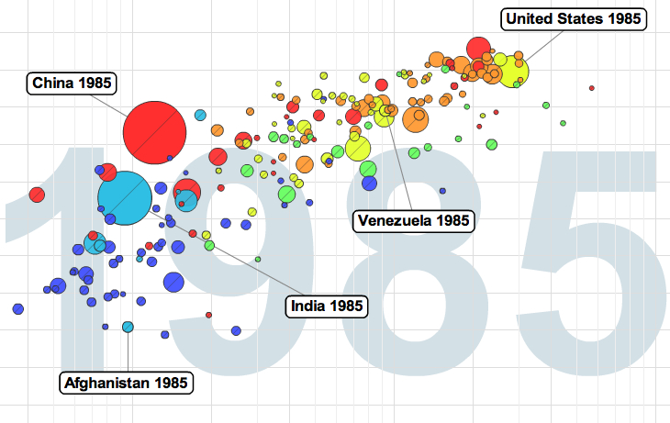

Slide 17
What is Expected?
Sophisticated Graphics
Interactive
Interactive documents

Slide 18
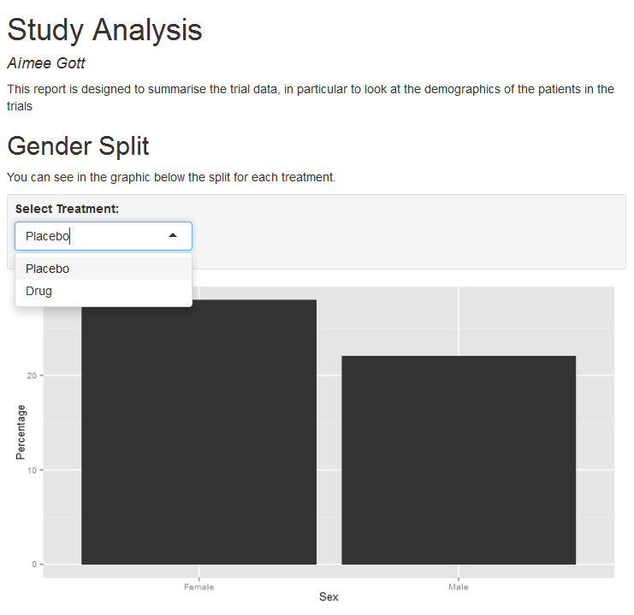

Slide 19
Challenges

Slide 20
Challenges in Pharma
Graphics for decision making
Analysis time shrinking
Multi-technology
Graphics must be reproducible?

Slide 22
Example 1
Area: PreClin - FTiH
Challenge: Traceability of Decisions
Solution: Interactive decision chart

Slide 23
What was the Challenge?
Teams use their "favourite" way to make a decision
Difficult to trace what data was used
Difficult to re-generate graphics

Slide 24
Solutions
Single solution for presenting data to safety board
Consistent production of informative graphics
Auditable repository of graphics

Slide 26
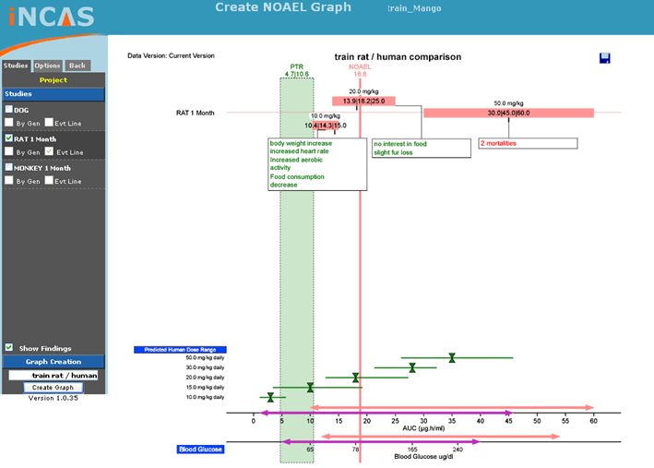

Slide 27
Example 2
Area: Trial Reporting
Challenge: Reduced time for reporting, lots of graphics
Solution: Automated reporting

Slide 28
Challenge
Very short timelines for generating reports
Reports contain lots of graphics
Data often changes at the last minute

Slide 29
Dynamic Reporting in R
Report + code in one file
Graphics re-generated automatically
Data can be changed and re-run

Slide 30
Example 3
Area: Clinical Reporting
Challenge 1: Consistency and quality
Challenge 2: Multiple Tools
Solution: SAS to R link

Slide 31
Requirements
High quality graphics
Consistent
Easily reproducible

Slide 32
Solution
Interface to R from SAS
R based library of standard graphics

Slide 33
Design
SAS
R
Write csv
Write R script
R Script
Call R

Slide 34
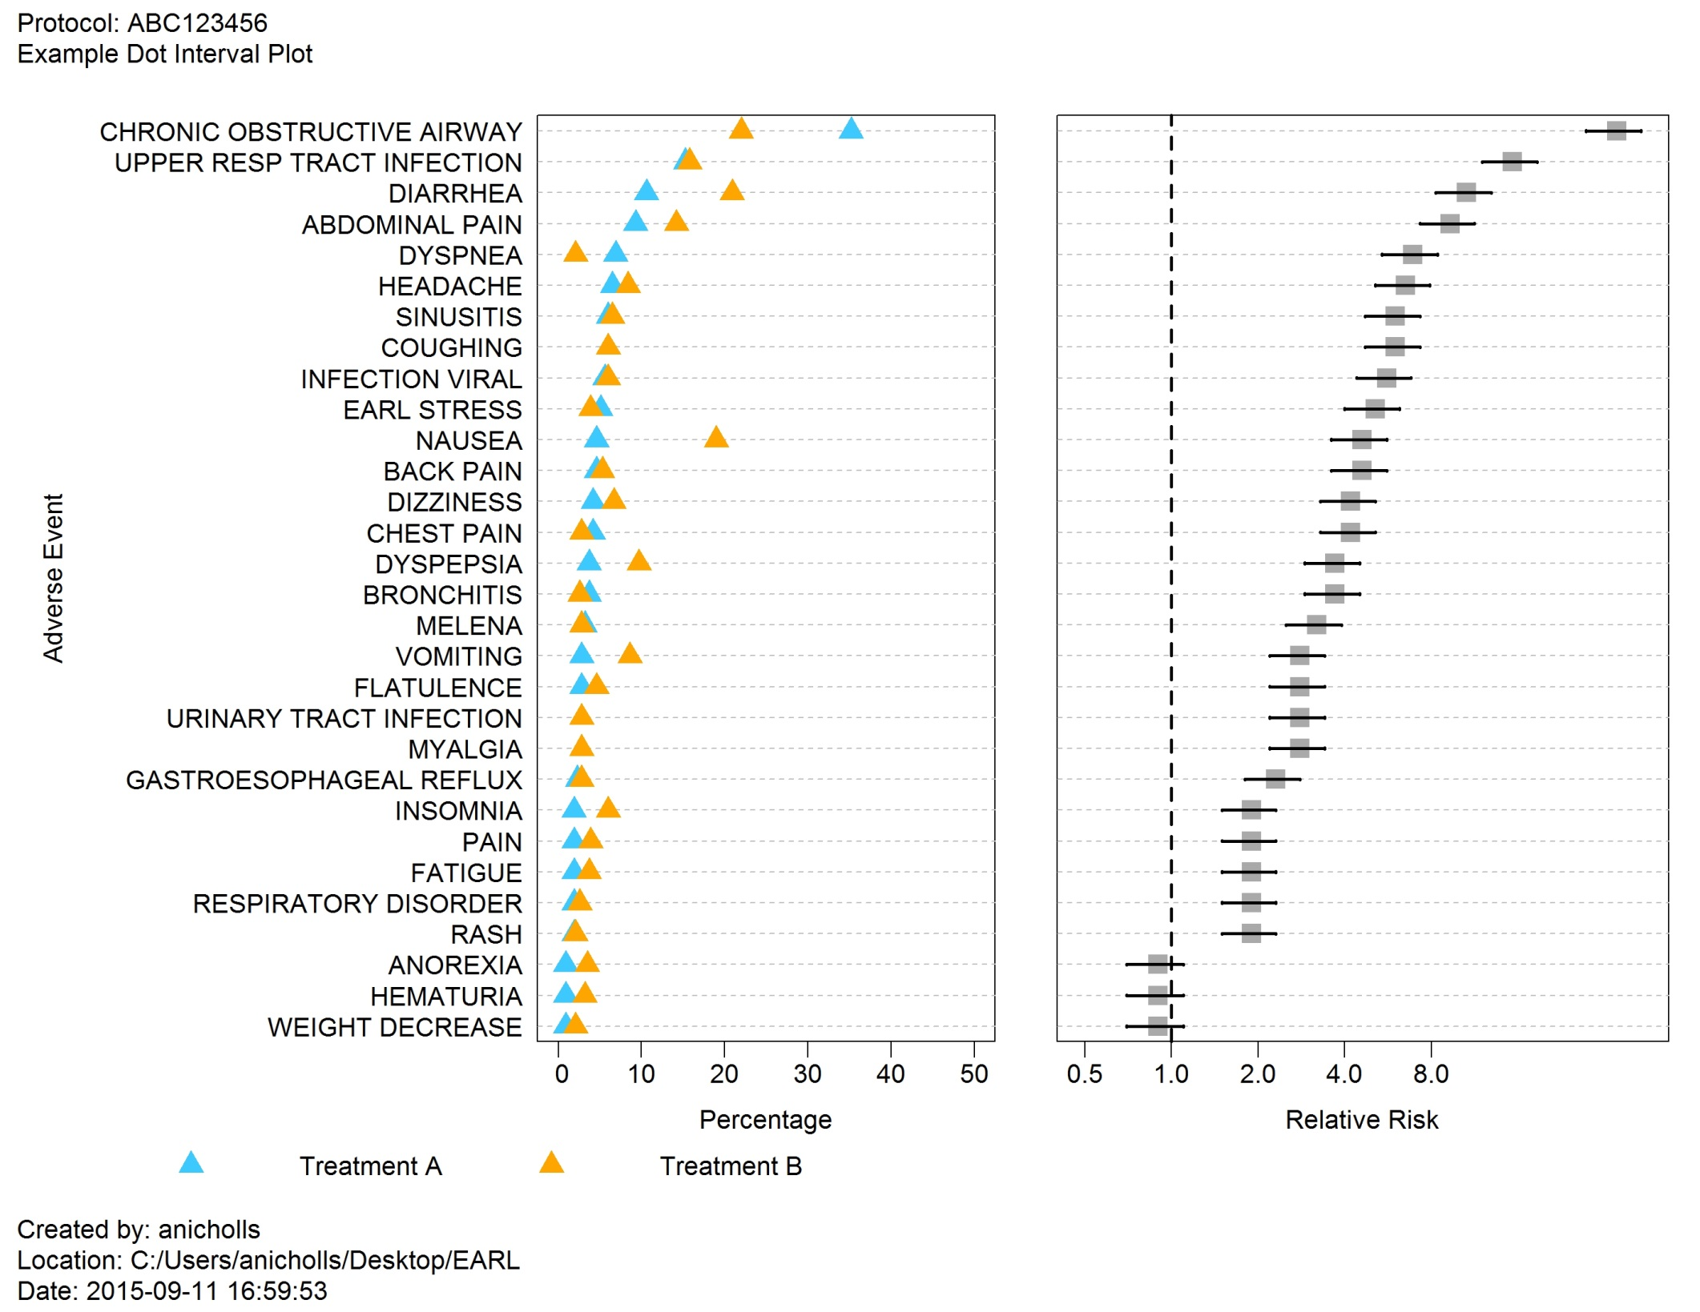

Slide 35
Example 4
Major Pharma company in Philadelphia
Challenge: Traceability of interactive graphics
Solution: Built a custom GUI that generates a script

Slide 36
Challenges
Traceability of decisions
Interactive graphics for decision making
Tool for non-programmers

Slide 37
Code Generating Interface
Users interact with custom GUI
Graphics updated based on selected options
All code generated for traceability
Graphics completely reproducible
Decision making tracked

Slide 38
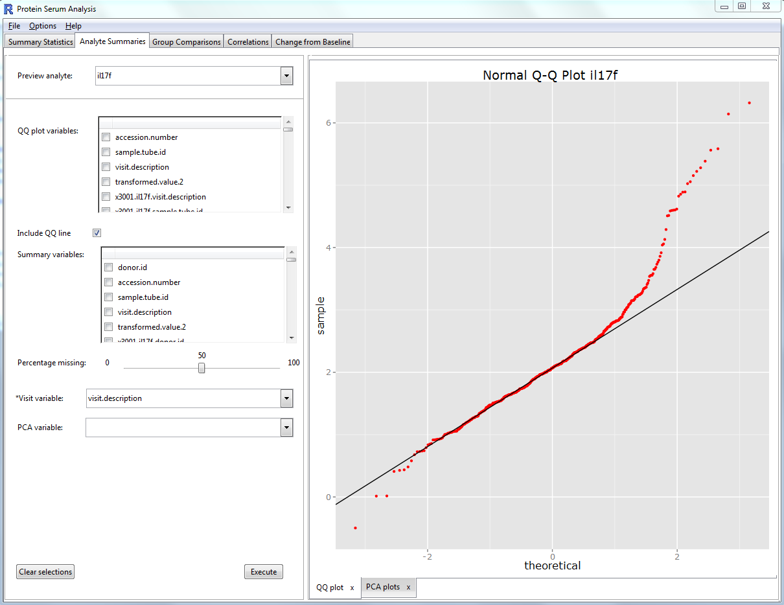

Slide 39
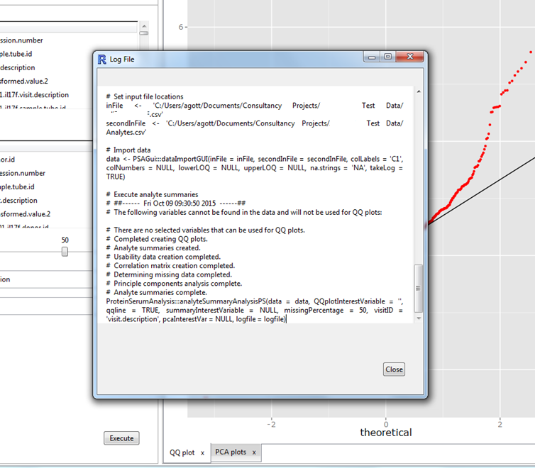

Slide 40
The Future

Slide 41
Future Challenges?
New tools to learn
Better graphical awareness
New coding standards
New tools to validate
R + shiny apps
JavaScript

Slide 42
Summary
Pharma industry leading stats computing
Graphics a huge part of reporting
Many open questions about interactive graphics...

Slide 43
www.mango-solutions.com
@MangoTheCat
@aimeegott_R

