Slide 1
Sample size re-assessment – some random observations
PSI, 2nd November 2016
Simon Day
simon.day@CTCT-Ltd.co.uk

Slide 2
The plan…
I was an author on one of the very early papers on sample size re-estimation (Birkett and Day, Stats in Med, 1994; 13: 2455–2463) and have since followed the field with much interest, some despair, and more than a little exasperation.
This talk will illustrate some of these facets – mostly based around such methods used in a regulatory context. Several personal experiences will be included (particularly the ones that went wrong) as well as some of the approaches and myths I see in my regular consulting work.
What’s “allowed” and what’s not? What makes sense and what doesn’t?

Slide 3
A recent request…
We did a very small exploratory study
We’re now doing a definitive phase 3 study with 2 doses (neither used in phase II) and placebo
Last patient will be recruited [next month]
Follow-up is for 6 months
Can we look at the data next month (when the last patient has been recruited), look at those who have finished the study already, and see what the overall, (pooled, blinded) response rate is?

Slide 4
A recent request…
?
Their point being:
Very little response on placebo (e.g. 10%)
Likely very good response on active (e.g. at least 50%)
So, expect to see about (10% + 50% + 50%) ÷ 3 ≃ 37% overall
Can we look at the data next month (when the last patient has been recruited), look at those who have finished the study already, and see what the overall, (pooled, blinded) response rate is?

Slide 5
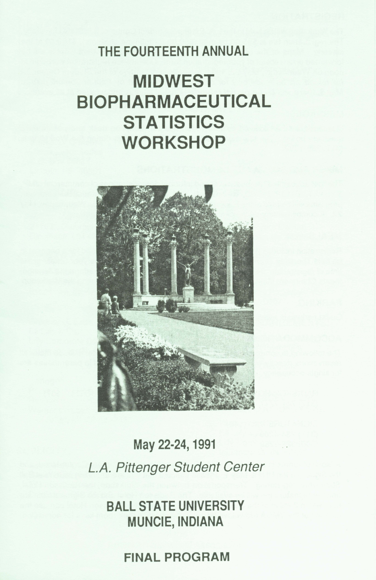
Where did I start in all this?
Wittes J (1991) Internal pilot studies and expediting drug development (abstract). Fourteenth Annual Midwest Biopharmaceutical Statistics Workshop, Muncie, Indiana: Ball State University.

Slide 6
Where (indeed!) did I start in all this?

Slide 7
It’s all pretty easy…
Do the sample size calculation
  Let’s say N = 1000
Go half way
  So N = 500
Recalculate the sample size
  OK, new N, let’s call it N*
Recruit total of N* patients
And then…
  Stop
  Unblind
  Analyse
  Publish
  Collect Nobel Prize

Slide 8
It’s all pretty easy…
Some questions and obstacles…
Why half way?
Why not?
Seems a bit irrelevant
(certainly if you’re in the 1000’s)
Thou shalt not allow N* to be
smaller than N

Slide 9
Questions…
Thou shalt not allow N* to be smaller than N
If we re-calculate N → N* at 50%, then…
  If N = 1000 and N* = 900; why can’t I reduce N to N*?
  If N = 1000 and N* = 600; can I reduce N to N*?
  If N = 1000 and N* = 400; can I stop recruitment?

Slide 10
Questions…
Solutions...?
Thou shalt not allow N* to be smaller than N
  If N = 1000 and N* = 900; I’m not allowed to reduce N to N*
  “Plan” (pretend!) N = 900 (or 800, or 700…)

Slide 11
Solutions...?

Slide 12
Key contribution(s)…
Does it matter “when” you do the re-calculation?
  Half way, or somewhere else?
Does it matter “how small” the internal-pilot stage is?

Slide 13
How small can the internal-pilot be?
3.09
Upper 95% CL
1.52
1
0.69
0.48
Lower 95% CL
10
50

Slide 14
How small can the internal-pilot be?

Slide 15
How small can’t the internal-pilot be?
“Birkett and Day recommend the sample size
re-estimation after 20 degrees of freedom”
We recommend the sample size re-estimation
after a minimum of 20 degrees of freedom

Slide 16
Questions…
Solutions...?
Thou shalt not allow N* to be smaller than N
  If N = 1000 and N* = 900; I’m not allowed to reduce N to N*
  “Plan” (pretend!) N = 900 (or 800, or 700…)
300 or 200 or 100???

Slide 17
Where does it all go wrong?
(At least, for me)
df
df
df
df
df
df
df
df
df
df
df
df
df
df
df
df
df
df
df
df

Slide 18
How small can’t the internal-pilot be?
We recommend the sample size re-estimation
after a minimum of 20 degrees of freedom

Slide 19
Where does it all go wrong?
(At least, for me)
One of my lessons learnt… don’t do this “too small”
Hence – don’t do it in “small” studies
And...by the way...what are we always looking for in rare diasess and orphan drugs...smart, efficient ways to do trials
In ultra-rare diseases... I usually don’t recommend this!

Slide 20
Where else has it gone wrong?
What can sponsors see?
Example
Acute respiratory distress syndrome (ARDS)
What matters?
Corpses matter
A story from a long time ago…

Slide 21
Where else has it gone wrong?
What can sponsors see?
A trial with a binary endpoint (death)
Sample size re-estimate planned after [?] patients
The new sample size (N*) is based on the ratio of observed proportion of deaths to “expected” proportion of deaths [as was in the original sample size calculation]
The statistician thought it was their job to do the recalculation
The project manager got their first
How did the project manager have access to the data!?

Slide 22
Where else has it gone wrong?
What can sponsors see?
The project manager got their first
How did the project manager have access to the data!?
The project manager knew before the “database knew” if a patient had died
  This is good study management!
The project manager was running a daily Excel spreadsheet plotting “re-calculated sample size” day by day

Slide 23
Where else has it gone wrong?
What can sponsors see?
The project manager got their first
How did the project manager have access to the data!?
The project manager knew before the “database knew” if a patient had died
  This is good study management!
Nothing necessarily wrong with this, but worrying potential for bias
  “Let’s do the re-assessment today”
  “Can we do another re-assessment?”

Slide 24
Again and again…
Broader question…
My view... Not good
Why do you need to?
You’ve done it too early and your estimate is too unreliable
Or if the variance really is changing that much, you’ve got too heterogenous a population!

Slide 25
Where else has it gone wrong?
What can sponsors see?
I see more and more paranoia!
Sponsors are afraid to be seen “looking at the data”
Often ask DMC to do this (but I won’t)
  (But that’s another issue…)
But sponsors should be looking at their data
Remember Dave?
What harm (aka “bias”) is there in looking at pooled, aggregate data?

Slide 26
The (general) issue is…
Can the sponsor look at blinded data?
“[Company X], the developer of Super-Special™ therapeutic antibodies, announced today that it held an investigators meeting to update clinicians and support staff on the overall status of the Company’s Phase III study in colorectal cancer.
“The data presented today to investigators summarized the major findings to date.
“Although the study was not unblinded and only aggregate data were presented, physicians and support staff involved in the study were given an opportunity to gain a better sense of the overall patient performance.
“The Company is providing the blinded data as requested so that physicians and other care givers may be better able to provide patients with expectations for overall outcomes, so that patients may be better informed when deciding whether to participate in this study.”

Slide 27
That recent request…
We did a very small exploratory study
We’re now doing a definitive phase 3 study with 2 doses (neither used in phase II) and placebo
Last patient will be recruited [next month]
Follow-up is for 6 months
Can we look at the data next month (when the last patient has been recruited), look at those who have finished the study already, and see what the overall, (pooled, blinded) response rate is?

