Slide 1
Machine Learning as an enabler of precision medicine
The PSI Biomarkers SIG Machine Learning / AI workstream group
Karl Köchert and Nils Ternès
November 16, 2023

Slide 2
Agenda
Precision Medicine and the potential of AI/ML in drug development
How regulators are picking up on AI/ML
The (fairly new) AI/ML group – a workstream of the Biomarkers SIG

Slide 3
Precision Medicine and the potential of AI/ML in drug development
Notes:
Karl: when we talk about AI/ML, often one of the first questions from clinical teams is what regulators think about it and what they require us to do to produce regulatory grade evidence for submissions.

Slide 4
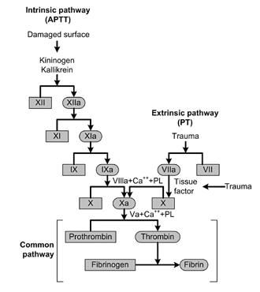
The complexity of biology
Some basic constituents of Homo Sapiens (far from being comprehensive):
19.300 protein coding genes (HGNC Oct 2023)
A multitude of possible variations (~80m SNPs, splicing, post-translational modification) results in ~82.000 proteins (UniProt Oct 2023)
1.900 miRNAs
~300 cell types in 78 organs
…
Over the last 2 decades technical progress enabled us to measure these building blocks of human biology at unprecedented resolution.
For some very important biological processes, we also have a good understanding how these building blocks interact and play together.
For most though, we don’t.
The coagulation cascade. APTT: activated partial thromboplastin time; PT: prothrombin time
Nephrology, 2009, DOI: (10.1111/j.1440-1797.2009.01128.x)
Notes:
Technologies to measure:
Sequencing of any kind incl. Single cell
Various proteomics technologies (AB based, mass spectrometry…)
imaging

Slide 5
Diseases add another level of complexity – patients are extremely heterogeneous
Given the utmost complexity of an individual patient‘s disease trajectory, in the setting of a multifactorial / multicausal disease, precision medicine is required to tailor a specific therapy.
As FDA describes it: “Precision medicine […] tailors disease prevention and treatment for individual variability (e.g., genetic and lifestyle differences among patients). The goal of precision medicine is to match the right treatments at the right dosages for each individual patient at the right time. The challenge for precision medicine is identifying the mechanistic basis for adverse events […] and differences in efficacy […]”
TP53 protein interaction network created with STRING v12.0
Notes:
TP53 is a critical tumor-suppressor gene that is mutated in more than half of all human cancers.
https://jhoonline.biomedcentral.com/articles/10.1186/s13045-021-01169-0

Slide 6
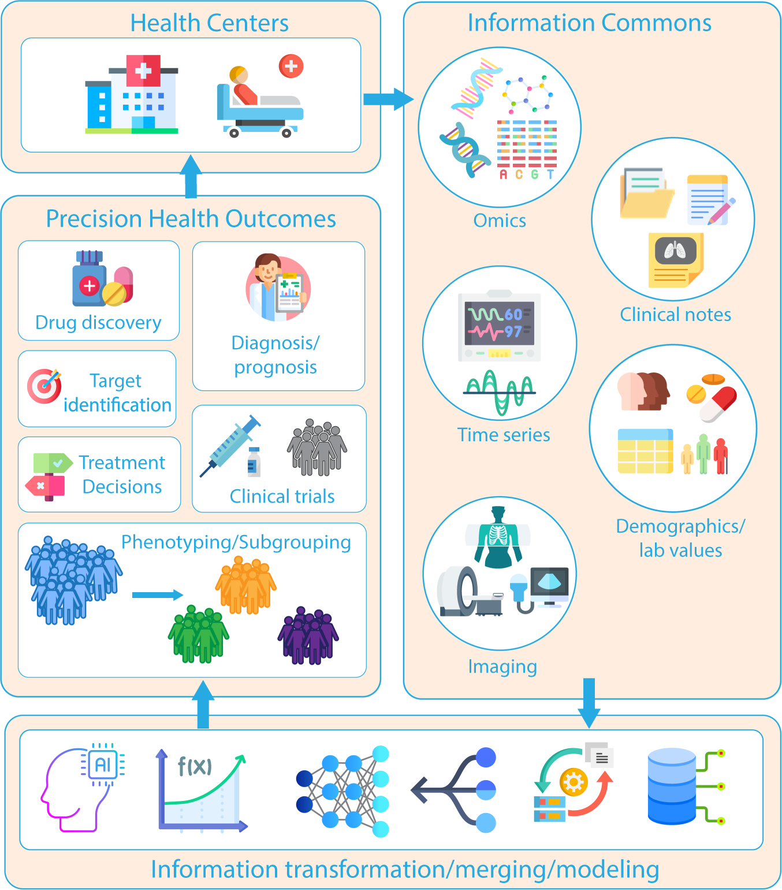
Precision Medicine & quantifying disease complexity in the 2020s
In this vein, (pharma) research & clinical development has already made good progress in the last couple of years in terms of measuring things: -omics data, digital biomarkers, imaging etc. are being assessed increasingly.
This has pushed the number of variables available in a typical interventional clinical trial from ~150 to much higher levels.
In other words – the testable hypothesis space has grown almost exponentially compared to ~20 years ago.
Kline et al., Nature Digital Medicine 2022

Slide 7
So how does AI/ML fit into the vision of precision medicine?
Classical approaches are “forcing” a hypothesis on the data & are limited to detection of strong, low-complexity signals using only a small amount of the variables (measured data) at one time, e.g., they are usually restricted to treatment, age, BMI, disease severity at baseline etc.
By deriving the best hypothesis given the data, Machine Learning (ML) is currently the best available methodology to create holistic mathematical models of complex (biological) systems using all available data and variables.
As such, AI/ML methodology is key in enabling true data driven decision making and a prerequisite for precision medicine since it complements classical approaches to enable as thorough as technically possible insights generation.

Slide 8
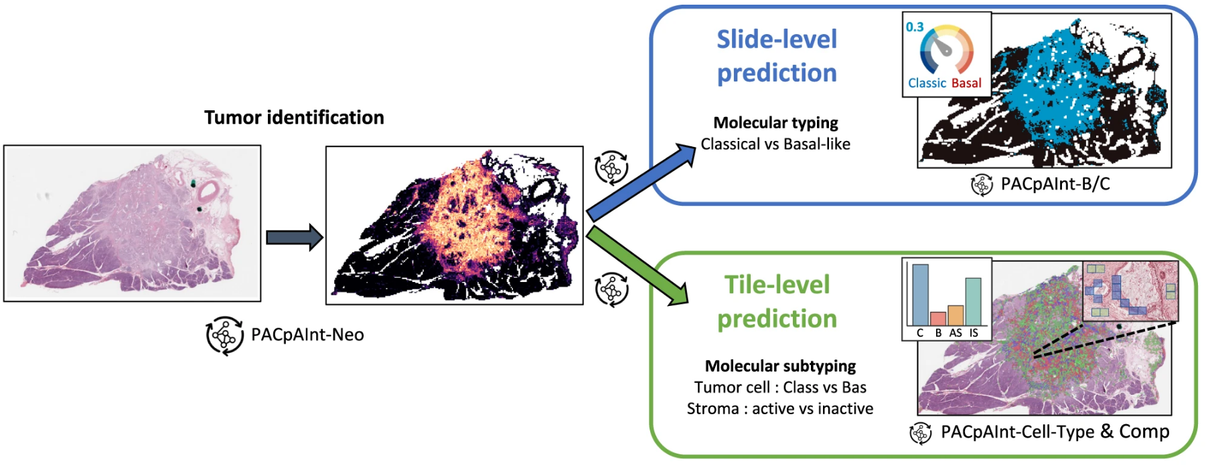
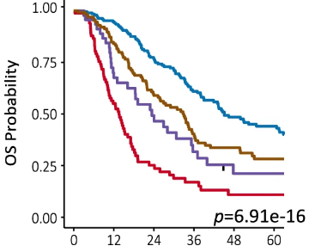
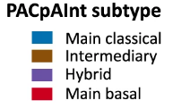
Case study using digital histology slides
PACpAInt: a histology-based deep-learning (DL) algorithm predicting pancreatic adenocarcinoma (PDAC) molecular subtypes (Saillard C, Nature Com. 2023)
Develop a rapid PDAC molecular subtyping
Better understand intra-tumor heterogeneity
Independent and strong prognostic value on DFS and OS

Slide 9
How regulators are picking up on AI/ML

Slide 10
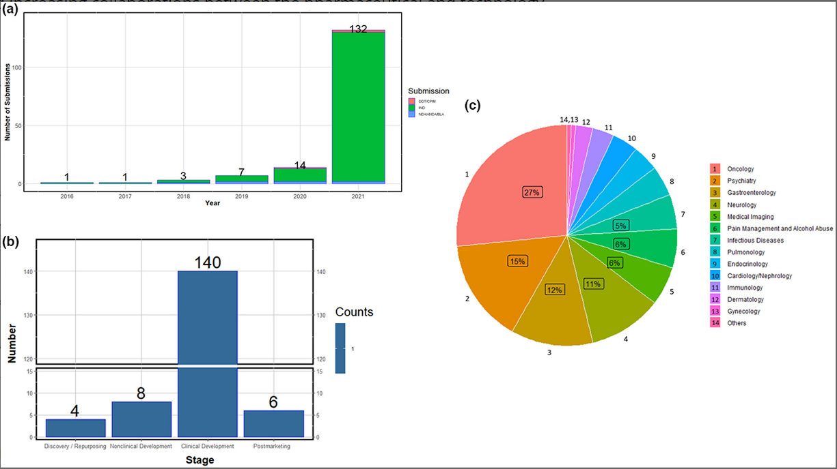
Landscape analysis of the Application of AI/ML in Regulatory Submissions
DOI: 10.1002/cpt.2668

Slide 11
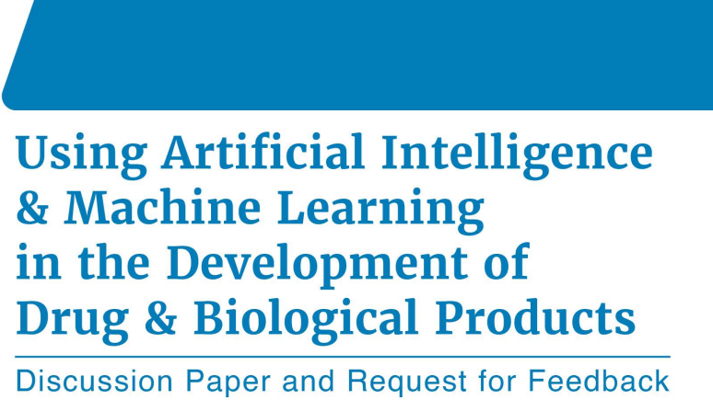
FDA discussion paper (May 2023)
To facilitate a discussion and promote mutual learning with stakeholders on the use of AI/ML in drug development
To help inform the regulatory landscape in this area
Is not a guidance or policy and does not endorse a specific AI/ML use or approach in drug development
Two main topics are discussed:
Landscape of current and potential uses of AI/ML
Considerations for the use of AI/ML + a series of questions for feedback

Slide 12
FDA discussion paper: Landscape of current and potential uses of AI/ML
Drug discovery
Non-clinical research
Clinical research
Post-marketing safety
Pharmaceutical manufacturing
Target identification and prioritization,
Compound screening
Advanced process control
Optimize inventory
Forecasting product demand
Optimize experimental design
PK/PD modeling
FDA highlights the potential impact of AI/ML across the drug development process
Process and evaluate ICSR submissions
Coding of adverse events
Design
Analysis
Operations

Slide 13
FDA discussion paper: AI/ML in clinical research
Design:
patient selection and/or stratification of the trial population
covariate adjustment to reduce variability
insight from RWD or other historical data
synthetic control arm
clinical endpoints assessment
Analysis:
automation of tasks
safety signal detection
large/complex datasets (e.g., EHRs, biomarkers, DHTs)
dose optimization
natural language processing
missing data handling
digital twins
federated learning
Operations:
recruitment
site selection and oversight
digital health technologies (e.g. digital BMs)
patient adherence and retention
data management

Slide 14
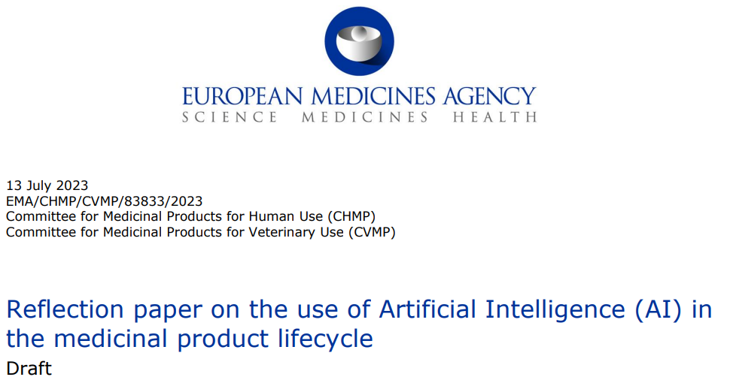
EMA reflection paper (July 2023)
To reflect on the scientific principles that are relevant for regulatory evaluation when these emerging technologies are applied to support safe and effective development and use of medicines.
To describe the current experience of EMA in a field where scientific knowledge is fast evolving.
Organized as follow:
Application of AI along the lifecycle of medical product
Important focus on technical aspects

Slide 15
EMA reflection paper: deep focus on technical aspects
Data acquisition
Bias (!); population representativeness
Training, validation; test
Data leakage (!); Prospective
Model development
Overfitting (!); generalizability; traceable; sensitivity
Model deployment
Pre-defined specs; version changes; monitoring; risk management plan
Interpretability
Transparent models; underlying rationale; explainable AI
Performance
Insensitive to class imbalance; cross-validation; a priori thresholds
“The higher the regulatory impact or risk associated with the use of AI/ML technologies, the sooner the Applicant should engage with regulators to seek scientific advice.”

Slide 16
EMA Qualification opinion for Prognostic Covariate Adjustment
The methodology comprises three steps:
Training and evaluating a prognostic model to predict outcomes under the control condition (generate prognostic score). The applicant utilized prognostic scores generated by two different models: a random forest and a deep learning model trained on historical data from clinical trials and observational studies.
Accounting for the prognostic score while estimating the sample size required for a prospective study.
Estimating the treatment effect from the completed study using a linear model while adjusting for the control outcomes predicted by the prognostic model.

Slide 17
EMA letter of support for DL-based prognostic covariate adjustment
Background: Trained neural networks (deep learning) using digitized pathology imaging from two Oncology indications in order to predict overall survival (OS)
Context of use: Prediction from the DL models be used as prognostic biomarkers for the adjustment of efficacy analysis on OS in RCT phase 2 and phase 3
Potential strength: gain in statistical power, not-impacted from inter-individual variability,
Not qualified but support further development (prospective validation, generalizability, methodological concern with adjusted Cox PH)

Slide 18
The (fairly new) AI/ML group – a workstream of the Biomarkers SIG

Slide 19
AI/ML workstream
Group set up in May 2023 as workstream of the PSI Biomarkers ESIG
Currently 17 members from 13 different companies and academic institutions
People with different backgrounds, working on different therapeutic areas, etc.
Main focus in the group: clinical development
Monthly 1h early morning meetings ☺
Currently co-lead by Nils Ternès (Sanofi) and Karl Köchert (Bayer)

Slide 20
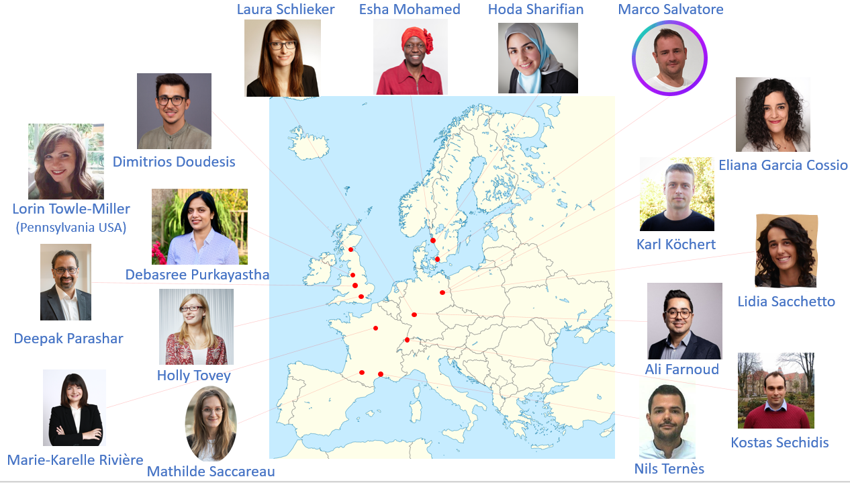
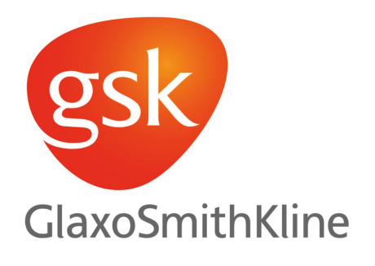
Team members

Slide 21
Ongoing activities from the group
Create a ML (biomarker-related) community across different institutions
Review of AI/ML papers from health authorities
FDA discussion paper (consolidated review sent to FDA, August 2023)
EMA reflection paper (review ongoing, consolidated review will be send in December 2023)
Presentations on applied ML methods
Random Forest (introduction, advanced discussions)
Penalized regression (introduction, advanced discussions)
Controlled variable selection via knockoffs

Slide 22
Looking forward
Remain constantly in a collaborative spirit
Journal club
Bring your own ML project / problem and receive feedback
Share practical implementations (code, tutorials, tips, etc.)
Brainstorm on technical ML aspects
Digital twins, advanced ML, subgroups identification, predictive markers, PROCOVA, etc.
Work together on simulations and real use cases
Develop a scientific paper
Contribute to topics that have the potential to impact drug development
Review documents from health authorities and share feedbacks
Develop awareness, guidance on the use of AI/ML, develop a white paper, etc.

Slide 23
Interested in joining the group?
Please contact us:
Nils Ternès (nils.ternes@sanofi.com, Statistical biomarker leader, Sanofi R&D)
Karl Köchert (karl.koechert@bayer.com, Head of Biomarker & Data Insights, Bayer AG)
➔ Personalized meeting with you to present the workstream and collect/understand your interest

