Slide 1
Frameworks for
Quantitative Decision Making
PSI/EFSPI SIG QDM – Webinar 2, 10 December 2019
Presented by juan abellan, GSK

Slide 2
Making decisions after study results
Scientific question(s) of interest
Study design
There should be a clear link between question(s) – design – results – decisions
Substantial effort put into design (inclusion/exclusion criteria, endpoints, assumptions for sample size,…)
But less attention paid to mapping results to decisions
Study results
Decisions
Toxicity?
Proof of mechanism?
Proof of concept?
Dose-response?
…
Rigorous and ethical scientific experiment
Informing around quantities of interest and associated uncertainty
Continue development?
(GO / No-GO)

Slide 3
Why a QDM framework?
We all have probably come across examples like these in study protocols:
  The sample size has been chosen based on feasibility
  The study team does not agree with quantitatively defining what constitutes study success due to the exploratory nature of the study
  The risk around having specific criteria (e.g., numbers) is that if we do not achieve these it could prevent progression
  This is an exploratory study, no formal evaluation of statistical hypotheses will be conducted
  Even if there are no significant differences in [primary endpoint] between the two treatment groups, there may be other assessments that may detect difference between the treatment groups

Slide 4
Why a QDM framework?
Being vague around how we will assess evidence at the end of the study and how we will proceed afterwards will increase the chances of making wrong decisions
  For example, we may end up retrofitting theories that could explain why the observed results are not what we expected and use that to justify a GO decision only to fail at a later stage
Scientific judgement is key to link results to decisions and we should make the most of it. But post-hoc may be prone to biases
Thinking ahead of the study what a successful outcome means is also good science
A quantitative decision-making framework is a scaffold set before the study takes place where we establish how decisions will be made based on study outcomes

Slide 5


A familiar decision framework
In the past, we have relied too much on ‘statistical significance’ for decision making
Decision criteria based on p-values are not good because a p-value on its own says little around the size of the treatment effect and associated uncertainty
(see ASA statement on p-values, The American Statistician, 2016 70:2, 129:133)
Study results
Decisions
If $p<0.05$
GO (meaning of GO is context-dependent)
If $p≥0.05$
No GO (in practice often STOP)

Slide 6
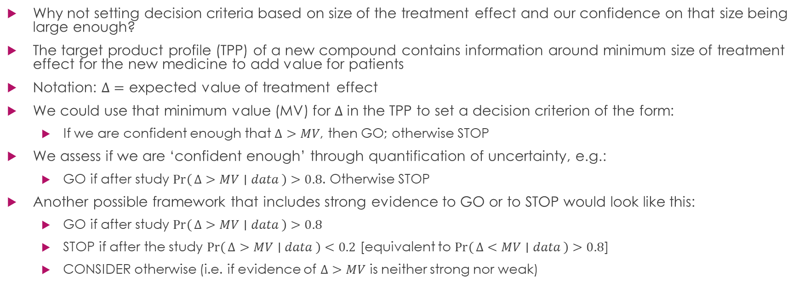
Basis for better QDM frameworks
Why not setting decision criteria based on size of the treatment effect and our confidence on that size being large enough?
The target product profile (TPP) of a new compound contains information around minimum size of treatment effect for the new medicine to add value for patients
Notation: $Δ=$ expected value of treatment effect
We could use that minimum value (MV) for $Δ$ in the TPP to set a decision criterion of the form:
  If we are confident enough that $Δ>MV$, then GO; otherwise STOP
We assess if we are ‘confident enough’ through quantification of uncertainty, e.g.:
  GO if after study $\operatorname{Pr}\left(Δ>MV ∣ data\right)>0.8$. Otherwise STOP
Another possible framework that includes strong evidence to GO or to STOP would look like this:
  GO if after study $\operatorname{Pr}\left(Δ>MV ∣ data\right)>0.8$
  STOP if after the study $\operatorname{Pr}\left(Δ>MV ∣ data\right)<0.2$ [equivalent to $\operatorname{Pr}\left(Δ<MV ∣ data\right)>0.8$]
  CONSIDER otherwise (i.e. if evidence of $Δ>MV$ is neither strong nor weak)

Slide 7

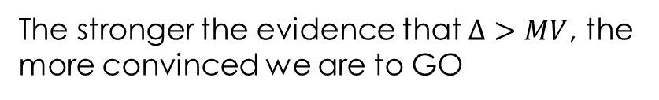
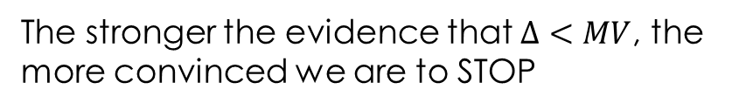
Graphically
The stronger the evidence that $Δ>MV$, the more convinced we are to GO
The stronger the evidence that $Δ<MV$, the more convinced we are to STOP
MV
Treatment effect ($Δ$)

Slide 8
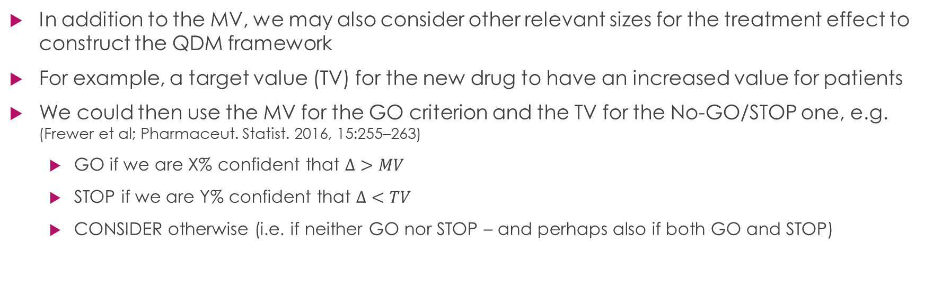
More elaborated QDM frameworks
In addition to the MV, we may also consider other relevant sizes for the treatment effect to construct the QDM framework
For example, a target value (TV) for the new drug to have an increased value for patients
We could then use the MV for the GO criterion and the TV for the No-GO/STOP one, e.g.
(Frewer et al; Pharmaceut. Statist. 2016, 15:255–263)
  GO if we are X% confident that $Δ>MV$
  STOP if we are Y% confident that $Δ<TV$
  CONSIDER otherwise (i.e. if neither GO nor STOP – and perhaps also if both GO and STOP)

Slide 9


Graphically
The stronger the evidence that $Δ>MV$, the more convinced we are we want to GO
The stronger the evidence that $Δ<TV$, the more convinced we are we want to STOP
Otherwise CONSIDER
MV
TV
Treatment effect ($Δ$)

Slide 10


Another option
The stronger the evidence that $Δ>MV$, the more convinced we are we want to at least CONSIDER
The stronger the evidence that $Δ>TV$, the more convinced we are we want to GO
Otherwise STOP
TV
MV
Treatment effect ($Δ$)

Slide 11
Conditional operating characteristics of a QDM framework
How often a decision framework leads to good decisions or bad decisions, over a range of possible scenarios?
Evaluation of OCs is crucial to determine the usefulness of a decision framework
Basically, we simulate clinical trial datasets over a range of true values of Δ, and count the proportion of times such datasets would trigger any of the possible decisions in the framework (e.g. GO/STOP or GO/STOP/CONSIDER)
Communicating OCs
  OCs are best summarised through graphics
  Criteria in QDM frameworks also map to observed results. This can be used to translate GO/STOP criteria into a more intuitive scale: the estimated value of the treatment effect

Slide 12
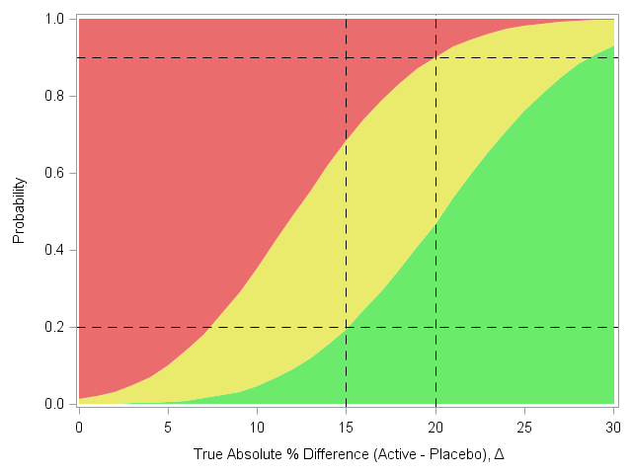
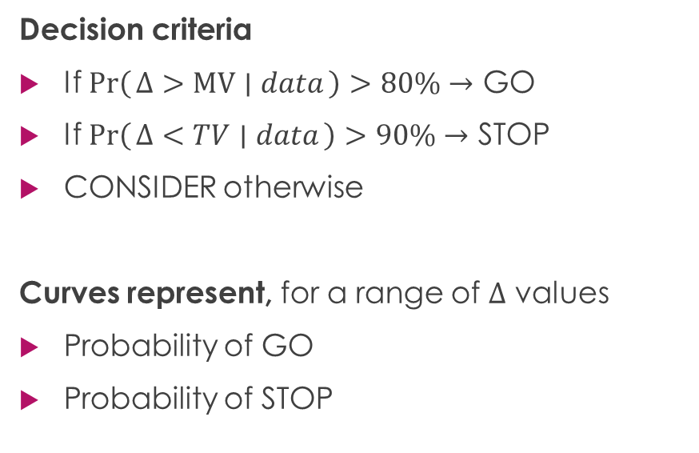
Conditional OCs
Decision criteria
If $Pr\left(Δ>MV ∣ data\right)>80\%→$ GO
If $Pr\left(Δ<TV ∣ data\right)>90\%→$ STOP
CONSIDER otherwise
Curves represent, for a range of $Δ$ values
Probability of GO
Probability of STOP
Pr(STOP)
Pr(CONSIDER)
Pr(GO)
MV
TV
$$Δ$$

Slide 13
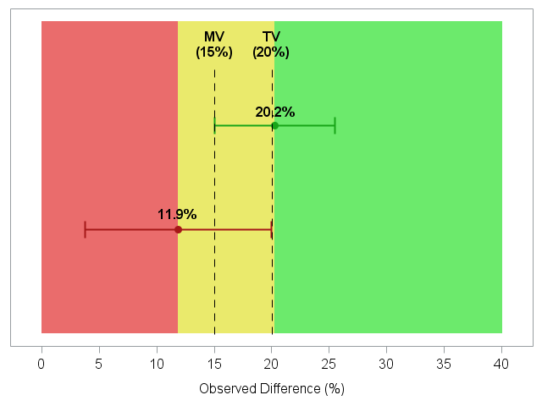
Mapping decision rules to results
60% credibility interval
80% credibility interval

Slide 14
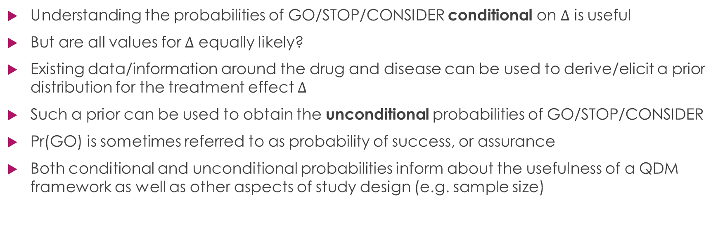
Unconditional operating characteristics of a QDM framework
Understanding the probabilities of GO/STOP/CONSIDER conditional on $Δ$ is useful
But are all values for $Δ$ equally likely?
Existing data/information around the drug and disease can be used to derive/elicit a prior distribution for the treatment effect $Δ$
Such a prior can be used to obtain the unconditional probabilities of GO/STOP/CONSIDER
Pr(GO) is sometimes referred to as probability of success, or assurance
Both conditional and unconditional probabilities inform about the usefulness of a QDM framework as well as other aspects of study design (e.g. sample size)

Slide 15
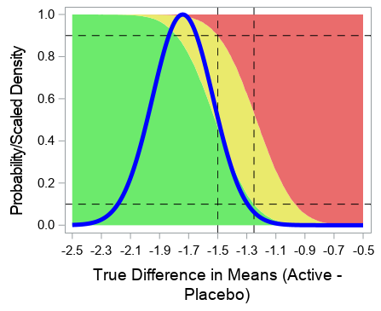
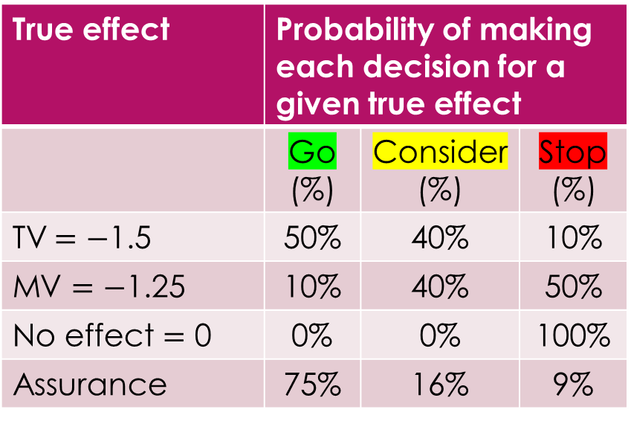
Probability of GO/CONSIDER/STOP
True effect | Probability of making each decision for a given true effect
 | Go (%) | Consider (%) | Stop (%)
TV$=−$1.5 | 50% | 40% | 10%
MV $=−$1.25 | 10% | 40% | 50%
No effect $=$ 0 | 0% | 0% | 100%
Assurance | 75% | 16% | 9%

Slide 16
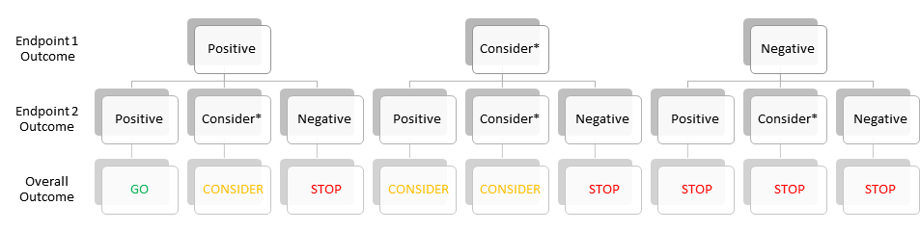
QDM framework with two endpoints
For each of the two endpoints, we set GO/STOP/CONSIDER criteria
Study team should decide how each of 9 outcomes will map to the possible 3 decisions

Slide 17
Discussion
Pre-specification of a QDM framework mapping study outcomes to GO/STOP/CONSIDER decisions is a driver for better decision making
Time/effort currently spent discussing results post-hoc and deciding what-next would probably be more useful if invested in establishing a QDM framework ahead of the study
QDM frameworks with decision criteria based on size of treatment effect are sensible.
For confirmatory studies however, the decision criterion will typically be a ‘significant p-value’
Understanding the operating characteristics of a QDM framework (both conditional and unconditional if a prior distribution is available) will help optimising the study design
The regular use of QDM frameworks in an organisation as part of a study design
  Should reduce cycle times: once results are available, the framework is applied and decisions are executed
  Enable standardisation of operating characteristics of a study design for discussion at review/governance boards
QDM frameworks combined with prior information enable predictions for future studies in the development programme

