Slide 1
Master Protocols – A Regulatory View
Andrew Thomson
PSI Webinar September 2020

Slide 2
Disclaimer
The views expressed are the personal views of the author and may not be understood or quoted as being made on behalf of or reflecting the position of the EMA or one of its committees or working parties.

Slide 3
Overview
Regulatory positions and thoughts
Concurrent Controls
Type I Error
Information leakage

Slide 4
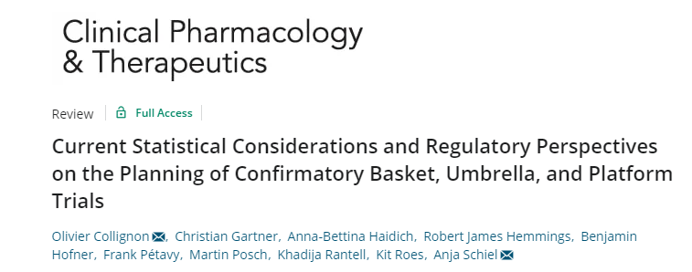
Regulatory positions
Neither of these are official EMA / CHMP / SAWP positions

Slide 5
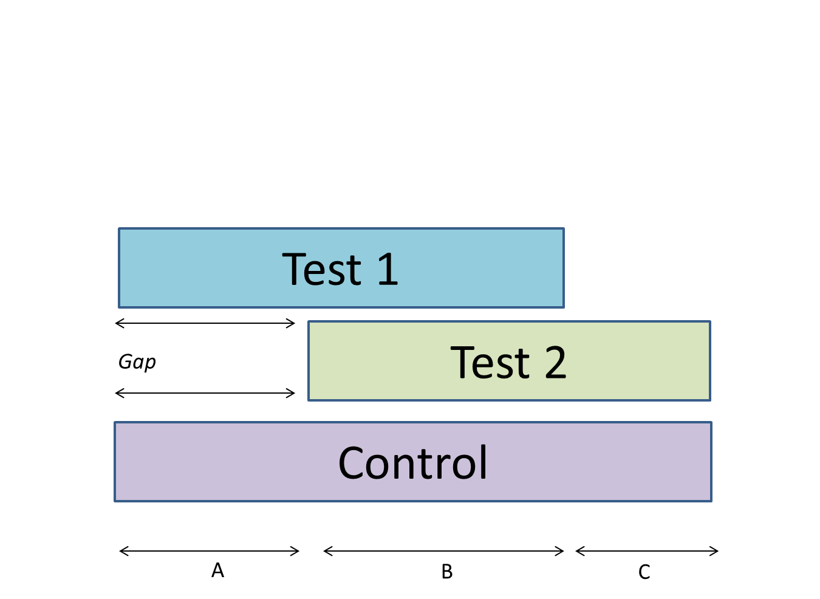
Concurrent controls

Slide 6
Concurrent Controls
Test 1 is compared to control subjects only from time epochs A and B
Test 2 is compared to control subjects only from time epochs B and C
This is non-negotiable
Do we need a period effect?
We know:
In some conditions placebo response depends on whether the trial is active control
Randomisation ratios can affect response
Enrolled patient characteristics can change over time
Some diseases change over time, especially infectious disease epidemics

Slide 7
Type I Error Control
We can’t be strict
If Test 1 fails, then Test 2 does not have a chance? Why would Test 2 developer include their product in the platform?
But we can’t be lenient
2 doses of the same drug
Why is dose different?
We can hierarchically order doses. Knowledge of a successful lower dose implies (usually!) successful higher dose
Converse is not true, hence hierarchy possible
Independence of test arms is key – incumbent upon developers to convince us

Slide 8
Information Leakage
Perhaps not as widely appreciated
Focus is on Interim Analyses (very common in these proposals)
Different types of information
Affects trials differently depending on the design chosen
Regulatory impact depends on design chosen
Hence why relevant to statisticians – impact of trial design on study integrity

Slide 9
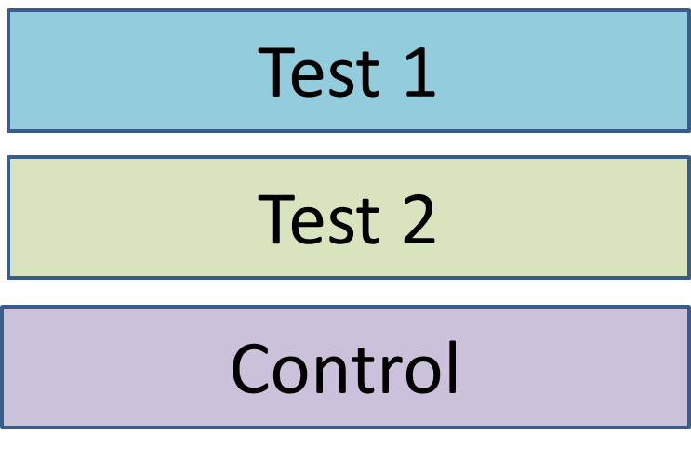
Example – Event driven analyses
Interim analysis (IA) after a certain number of events
Events on test arm and control
E.g. after 120 events on Test 1 + Control for the Test 1 IA
After 120 events on Test 2 + Control for Test 2 IA
Event is a ‘bad’ outcome
Pre-specified – and the same for each arm
Test of proportions

Slide 10
What does this mean in practice?
Lets say we need 120 events to trigger the IA
Success criteria is pre-defined such that 40 events on test and 80 events on control (or better) will be considered a success
Test 1 reaches IA first and is a success
Total events = 120, Total events on Control >=80
What do we know about Test 2?
Total events < 120, Total events on Control >=80, Total events on Test 2 < Total events on Test 1. Test 2 is numerically better than Test 1. So is also significant.
Test 2 will be better or as good as, at every possible analysis up until Test 2 + Control has 120 events. If Test 1 is positive, Test 2 is, and T1E is controlled

Slide 11
Conclusions in this case
Not possible to have a SAP-defined stop as waiting for IA criteria to be met
Even though we know Test 2 is better
Information leakage is 100%
Don’t even need to know the actual results
Just knowing Test 1 is positive is enough to infer Test 2 is
If you have multiple arms – numerically worst product ‘wins’ first
What happens if this become SoC – so e.g. Test 1 replaces placebo as control
What does Test 2 now need to beat?
Sample size for non-inferiority v Test 1 >> Superiority versus placebo

Slide 12
Extending the case study
Test 1
Lets assume A = 2, B = 6
Test 1 reports out after 8 months
Is a success
What do we know about Test 2?
Test 2
2 months
Control
A
B
C

Slide 13
What do we know about Test 2?
At the end of 8 months total (C=0, Test 2 studied for 6 months), not that much
Lets take C = 2, i.e. Test 2 has been studied for 8 months
Test 1 took 8 months
If you want to make some assumptions:
Uniform enrolment rate across epochs A and C
Uniform event rates across A and C
Then, you will conclude Test 2 is better
Chance you might want to take, not guaranteed
Data exists which can inform those assumptions – enrolment rate (blinded) is relevant information for this analysis

Slide 14
Conclusions from this example
Not 100% information leakage
However, we may still have information about the trial which is relevant
Enrolment rate matters
Knowing the total number of events in a blinded fashion is informative
With 3 arms, it tells you all, 4 or more, back to probabilities
Even if you don’t know the result of Test 1 v Control, you know the boundaries
Make predictions with high accuracy and precision about Test 2
A clear plan about who has access to what data and when is crucial
Sponsor? Platform Owner? Steering Committee?

Slide 15
Good v Bad events
Example assumes event is a bad outcome – death, disease progression, etc
What if it is good? Improved symptoms within 28 days
Everything is flipped around
E.G. We need 80 events on Test and 40 events on Control
What does this mean for the interim analysis?
Back to simple scenario of 2 Test products starting at same time

Slide 16
‘Good’ events – Interim Analysis
80 events on Test 1, 40 events on Control
If the analysis is successful:
We know the number of events on Test 2 + Control < 120
Number of events on Control =< 40
That’s it! Can continue quite happily
If the analysis is not successful, Test 1 continues, so Test 2 continues
May raise question about futility of Test 2 – numerically worse than Test 1
If Test 1 is futile, Test 2 is futile
Information leakage although real, is not a regulatory risk

Slide 17
What other approaches might we have?
Continuous outcomes
Time-to-event instead of pure proportions
Not the 100% guarantee of success, just very, very likely
Interim analyses based on time epochs and not cases
Potential for small amount of information between analyses (No small steps)
Time based interim analyses with minimum information?
Analyses every X weeks, as long as an additional Y cases have been observed?
IAs based on total information – i.e. after 160 cases across all arms
Difficult unless all arms start at once

Slide 18
Conclusions on case studies
The following sources of platform information may allow inferences to be drawn, or probabilities of success to be estimated, depending on the endpoint chosen and the design of the platform
Whether one arm was successful or not
The actual results if that arm was successful or otherwise
Blinded event data without knowledge of treatment arm allocation
Trial accrual rates
Any changes in underlying disease throughout the study

Slide 19
Conclusions
The more platforms we see, the more we learn
Some regulatory positions are very well set
Sometimes there are no easy answers
There is no shortage of research opportunities to address these issues

Slide 20
Any questions?
With Thanks to Benjamin Hofner and Lukas Aguirre Dávila
andrew.thomson@ema.europa.eu
Official address Domenico Scarlattilaan 6 ● 1083 HS Amsterdam ● The Netherlands
Address for visits and deliveries Refer to www.ema.europa.eu/how-to-find-us
Send us a question Go to www.ema.europa.eu/contact Telephone +31 (0)88 781 6000
Follow us on @EMA_News
Notes:
Note: This slide is OPTIONAL. It uses the 'Closing slide' layout. Delete if not needed.

