Slide 1
Estimators and Estimands for safety events in time-to-event studies: a regulatory perspective
Andrew Thomson
PSI Meeting, Basel

Slide 2


Why do we analyse and present data the way we do?
Because that is what the legislation tells us to
Because that is the way we’ve always done it

Slide 3
Why is safety data different?
Trials not powered to detect differences
Difficult to prove a negative (the drug is safe)
Patients who withdraw from a study can be assumed to have not benefited
  Missing = Failure is often conservative
  Impute a conservative value e.g. using placebo mean imputation
No reason to assume that patient who has withdrawn had a specific safety event
Traditional approach – use a per-protocol denominator as more conservative
Greater weight applied to estimation than testing

Slide 4
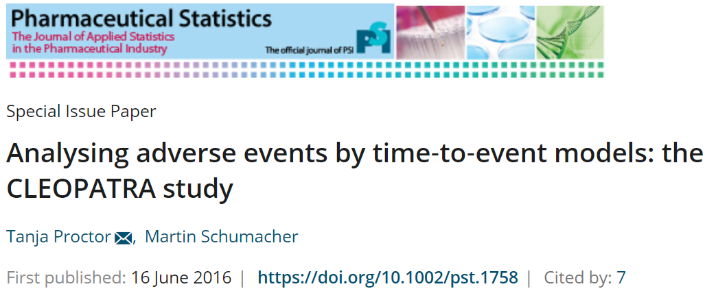
Drivers for change – understanding methodology
Products seem to show a positive benefit, but the risk profile ‘points in the wrong direction’
Could this just be an artefact of the data, rather than an actual effect?

Slide 5
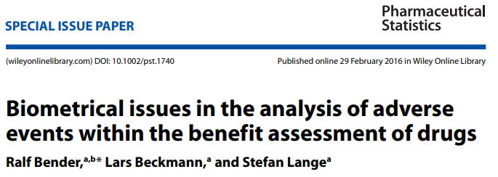
Drivers for change – understanding methodology
“Methods applied in the analysis of adverse events commonly include simple standard methods for contingency tables. However, the results produced may be misleading if observations are censored at the time of discontinuation due to treatment switching or noncompliance, resulting in unequal follow-up periods.”

Slide 6
How big a problem is it? (1) (Example from Bender et al)
“Vandetanib has been approved… in for adult patients suffering from aggressive and symptomatic medullary thyroid carcinoma with unresectable, locally advanced or metastatic disease.”
“Patients could switch treatment after disease progression. About two-thirds of them switched from the control group to open treatment with vandetanib. Consequently, the median duration of treatment in the vandetanib group was considerably longer than in the BSC group (88.6 weeks vs. 37.1 weeks).”
“estimated relative risk (RR) of 1.87 with 95% conﬁdence interval (CI) [1.01, 3.48]”.
“when survival time methods were used …HR = 1.4, 95% CI: [0.74, 2.63]”

Slide 7
How big a problem is it? (2) (From Bender et al)
Abiraterone – Prostate cancer (PFS, OS) + AEs / SAEs.
“The monitoring of adverse events was stopped after treatment discontinuation. In the abiraterone group, this was the case after a median of 13.8 months, whereas in the control group, the median time to disease progression was 8.3 months. This means that the duration of treatment and follow-up differed greatly between the two groups.”
Estimated Relative Risk of SAEs: 1.28 (95% CI: [1.07, 1.54] p=0.007
Estimated Relative Risk of AEs: 1.02, 95% CI: [1.01, 1.04], p=0.007
The number of adverse events per 100 patient years (1156 in the abiraterone group vs. 1264 in the control group – crude RR = 0.915).

Slide 8
Drivers for change – examples
Everything is fine until we are faced with a product that challenges the system
The challenge may not be scientific
  It may not be about the benefit-risk of a drug
Communication of the issues is key
Audience is used to hearing things a certain way
If it looks ‘wrong’, need to explain why it is not
  What is wrong with the ‘old way’ of doing things
  Why is this a better way?

Slide 9
PAH GL – What does it say about mortality?
The inclusion of this endpoint in the investigational plan, in particular in patients with severe disease, is strongly encouraged... Any new drug should at least be shown to have no detrimental effect on survival
Need to estimate mortality
If the true effect is null, the method should (ideally) estimate a null effect
Estimation, and not a testing issue
  Safety issue
  But oftentimes part of composite endpoint, so efficacy issue

Slide 10
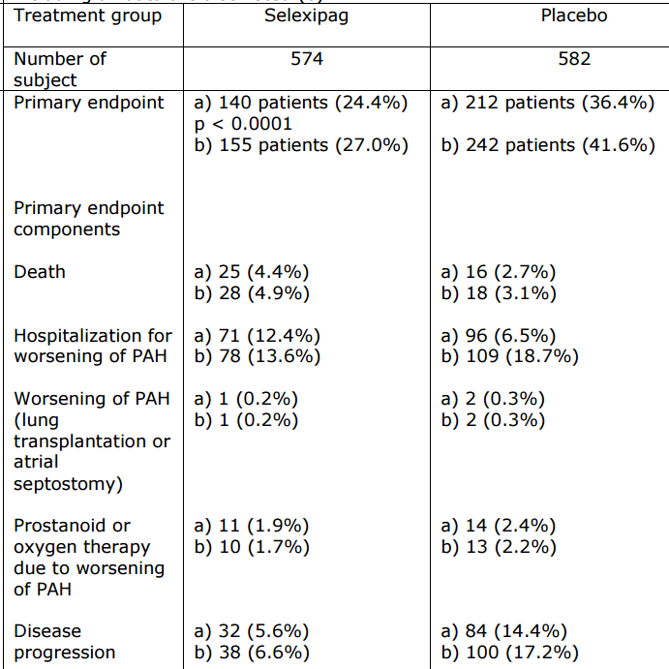
Uptravi Results
Uptravi used time to first event as analysis
Reported all individual endpoints
P-value for mortality = 0.087
But clearly a very efficacious drug in terms
of the composite endpoint
How do we interpret the mortality?
Crude OR from this table = 1.61
Notes:
Different N are due to the cut-point of the data for priamry analysis, nd then a later cut with more events.

Slide 11
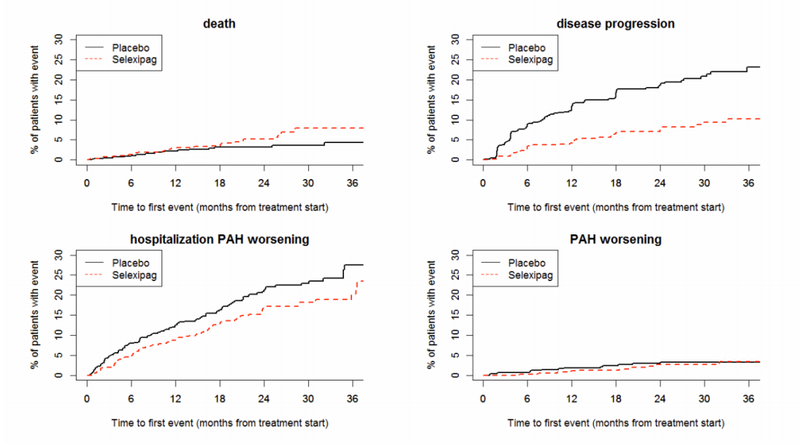

Slide 12
Interpreting mortality
Mean and median duration of study treatment in GRIPHON was 70.7 and 76.4 weeks respectively, in the selexipag group, compared to 63.7 and 71.2 weeks in the placebo group- total exposure was 7% higher.
Since more morbidity events occurred in the placebo group, more patients at high risk were excluded from further follow-up in the placebo group than in the selexipag group with a consequence that follow-up is shorter in the placebo group and follow-up from more patients that are at higher risk is excluded from the placebo group, resulting in bias.
Due to the study design, the risk profile of the patients changed during the course of the study, favouring placebo group at the end of the trial despite of randomization. This is consistent with the observation that the imbalance did not emerge before month 18.
Notes:
Data and text direct from EPAR

Slide 13
Conclusions
The more effective a drug is on the rest of the components, the worse it looks for mortality, as measured by the Odds Ratio
We need to describe this properly
Links exactly with work of Proctor & Schumacher, and Bender et al
  Motivated in an entirely different indication, for different stakeholders
Safety and efficacy have become ‘blurred’
  Mortality is part of efficacy endpoint, but now needs to be thought of as ‘safety’
  Where else has this arisen?

Slide 14
Drivers for change – Guideline Revision
Cardiovascular studies – ACS GL (published June 2018)
Even though cardiovascular death is an adequate clinical outcome that reflects the disease process targeted by treatments for ACS, all-cause mortality may in many cases be the preferred choice. The use of all-cause mortality as an endpoint (or as a component of a composite endpoint) simplifies statistical analysis since all deaths are treated as events rather than non-CV deaths needing to be handled through a statistical model with associated assumptions and risks of bias. This is of specific importance in trials when the expected incidence of non-cardiovascular mortality is difficult to predict.

Slide 15
Drivers for change – Guideline Revision
Including Non-CV mortality: Is it an important problem or not?
Yes? Then important that it is included in the endpoint
No? Then it shouldn’t matter if it is included in the endpoint

Slide 16
An important aside - labelling
EU way of thinking: The label (specifically section 4.1) indicates the patient population who will have a positive benefit-risk balance
  We don’t label endpoints
US way of thinking: It is a legitimate aim of the label to describe to prescribers what the drug is expected to do
EU Corollary: Patients don’t care why they die, they care that they die
  Non-CV mortality could/should be part of the primary endpoint
US Corollary: If no effect is expected on non-CV mortality, why would you include it in your primary endpoint

Slide 17
Learning from the Guideline development
Things happen (e.g. non-CV death) that we need to think about how we handle carefully
Often terminal events
Standard Cox PH models may not always be the best way of analysis
  We can either consider it as censored, or as an event
  Or we can impute a new time value
  But this does not make sense – the probability of dying from a CV event after having died of a non-CV event is 0 – massively informative censoring
  Here’s what we would have observed had they not died of a non-CV death?
  Estimand framework gives a good way of describing the problem

Slide 18
Estimand Framework
An estimand defines the target of estimation for a particular trial objective (i.e. “what is to be estimated”)
The description of an estimand will not be complete without reflecting how potential intercurrent events are addressed in the scientific question of interest.
  Events that occur after treatment initiation and either preclude observation of the variable or affect its interpretation
Intercurrent events have the potential to occur after treatment initiation and either preclude observation of the variable or affect its interpretation, e.g.
  use of an alternative treatment, perhaps a rescue medication
  discontinuation of treatment
  terminal events such as death

Slide 19
Estimand Framework
Study discontinuation, loss-to-follow-up or other missing data are not intercurrent events and are not reflected in the estimand, but instead represent limitations to the data to be addressed in the analysis
Different strategies are available for how to address potential intercurrent events to reflect the scientific question of interest
With an agreed estimand, and a pre-specified statistical analysis that is aligned to that estimand, sensitivity analysis can focus on sensitivity to deviations from assumptions in respect of a particular analysis, rather than sensitivity to the choice of analytic approach

Slide 20
Estimand Framework
Various strategies are named
  Treatment policy, composite, hypothetical, principal stratum, while on treatment
Historically, treatment policy has been of most regulatory interest (explicitly mentioned in ICH E9)
Motivation for studies with fixed periods of observation
  Imputation clear
Less clear for time-to-event
  What and how do we impute
  Work ongoing for efficacy endpoints

Slide 21
Estimation
Once we have decided on our estimand, we need to estimate it
Good if we can do this in an unbiased fashion
Historically, acceptable if we can estimate it with a bias that only goes against the product
However, as PAH example shows, this is not good enough if we need to ‘rule out’ raised ‘safety’ risk
If we can’t, raises two alternatives
  Estimate another estimand in an unbiased fashion
  Accept the bias – easier said than done when talking about mortality!

Slide 22
Sources of bias
Algebra
  If you follow one randomised group for longer, you get more events.
  So the Odds Ratio is not a good estimate of the risk
Informative Censoring
  Patients who have the competing event are more likely to have subsequently died, than those who had not had the event
  Time to death as a first event is may not be a good measure if this is true.
  Remove worst patients from control arm risk set
Crossover
  Difficult to adjust for – case-by-case basis depending on results

Slide 23
Informative censoring
More than one way to describe what it is
Definition for now:
  “The distribution of the event of interest is different after the censoring event than it was before”
Aligns nicely with the estimand framework
Gives us a language to describe what the problem is, and how to request analyses that would satisfy regulators
Move from censoring intercurrent events
Or even from censoring intercurrent events + censoring events

Slide 24
Language matters!
Now have a language to describe intercurrent events / censoring
Those at the end of the study – “administrative censoring” unlikely to be informative censoring
  No reason to believe the distribution has changed before and after the censoring event
Other subjects who are censored before the end of the study (may) have an intercurrent event – but we have a ‘missing data’ problem
Describe what happens after the intercurrent event, using different distributions
Aim is to make sure the estimand is a relevant one
  Side effect – automatically deals with informative censoring
Properly applied, the estimand framework makes ‘informative censoring’ problems disappear

Slide 25
Bringing it all together
Safety Statistics
Guideline
Development
Estimand
Framework
Better understanding of TTE issues
Better assessment of TTE studies
in general

Slide 26
Where next?
Clear understanding of how estimation methods and estimands align
  What estimands does a particular method estimate?
  Is the estimand zero when it should be?
  Who cares about this estimand?
Are we doing what we are doing because we are wedded to the Cox Model?
  Are there alternatives?
  What estimand do they target?
  What assumptions do they make?
  Can these assumptions be tested to see whether they are true?
  Are there sensitivity analyses to test the strength of departure

Slide 27
What features should new methods have?
They must allow both testing (p-value) and estimation (point estimate)
  Confidence Interval construction is a benefit
Assumptions behind the model need to be clear
  If not testable, suitable sensitivity analyses need to be developed
Need to be able to account for informative censoring
  At least through sensitivity analyses
Be able to handle crossover would be a huge benefit

Slide 28
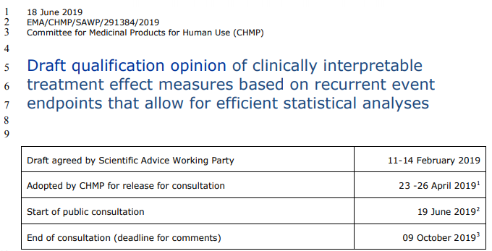
What to do with new methods? Qualification

Slide 29
How does this help with safety?
“Intercurrent events, particularly if terminal / absorbing or impacting differentially (i.e. to a different degree on treated and control patients) on duration of observation by other mechanisms, cause obvious problems with the independent interpretation of treatment effect estimates for differences in recurrent events.”
“None of these (methods) directly offers an opportunity to model terminal intercurrent events”
“In that context, it might be possible to support the use of approaches to analysis such as NB and LWYY, but only in situations where there is well established knowledge that the effect on the terminal event is not negative.”
Same issues I outline today remain unresolved

Slide 30
Final conclusions
Lots of drivers around on how to think about time-to-event studies
  Analysis and communication
Lots of regulatory thinking has gone into this
Still remain unanswered questions
  Methodological work needs to be ongoing
  Come to regulators with good methodology
Estimand framework gives a good way of describing this
Everything is harder with time-to event

Slide 31

Any questions?
Further information
andrew.thomson@ema.europa.eu
Temporary visiting address Spark building ● Orlyplein 24 ● 1043 DP Amsterdam ● The Netherlands
For deliveries refer to www.ema.europa.eu/how-to-find-us
Send us a question via www.ema.europa.eu/contact Telephone +31 (0)88 781 6000
Follow us on @EMA_News

