Slide 1

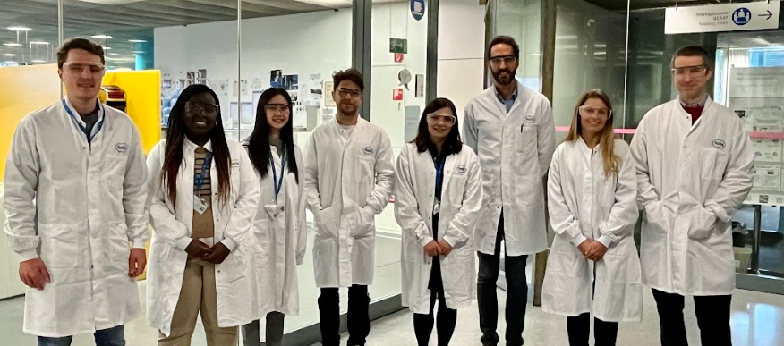
Applications open soon!
Introduction to Industry Training 2024/2025!
The ITIT course will take 25 delegates new to the industry on a complete drug development experience from discovery to marketing. They will visit 6 companies from ~October 2024 to July 2025 to learn about 6 topics from experts in their field. The ITIT course will have sessions in both continental Europe and in the UK. It promises to be a truly memorable course.
Applications open 1st April 2024 and close 21st June 2024
Six 2-day sessions:
Research & Drug Discovery
Toxicology
Data Management & CROs
Clinical Trials
Reimbursement
Marketing
Next course starts October 2024
PSI member: £1300 + VAT
Non-PSI member: £1410 + VAT (including 1-year membership)
Please ensure you have manager approval before you apply!
To find out more you can visit: https://psiweb.org/careers/events/psi-itit or contact Zelie Bailes (Zelie.a.bailes@gsk.com)

