Slide 1


Medical Statistics Careers Event
Careers and Academic Liaison Committee (CALC)
Amanda Darekar
Wednesday 7th December 2022

Slide 2
Welcome! (and Agenda)
13:00 – 14:40 | - Welcome and Introduction from PSI Chair and CALC Chair - New Starter presentation - Medical statistics panel discussion with some of our company volunteers
14:40 – 17:00 | Face-to-Face exhibition session - Meet company representatives and visit exhibition stands - Tea/coffee available
17:00 | Official close of Event
We hope you have also been able to take a look at the following pre-recorded presentations:
Overview of pharmaceutical industry video
The role of a medical statistician
Three New Starter presentations (CRO, CTU and Pharma)
Next steps: Advice on job search, applications and interviews
These are available on our website (https://psiweb.org/careers/psi-careers-event/students/student-videos)

Slide 3
GSK House Emergency Procedures
Welcome to GSK House
To ensure your safety and the safety of your colleagues and guests, please take a few minutes to read over the fire safety procedures at GSK House at the beginning of your session.
Smoking
Please note that smoking is only permitted in the designated smoking areas
Fire Signage & Exit Routes
Please note all fire and exit signage, and the location of your nearest fire exit
Voice Alerts & Evacuation
In the event of a fire alarm being activated you will hear either a ‘standby’ message or an ‘evacuation’ message
If you hear the ‘standby’ message please remain where you are (if you are mobility restricted prepare to evacuate), and wait for further instructions
If you hear the ‘evacuation’ message leave the building immediately. Calmly walk to the closest fire exit and report to the nearest fire assembly point. Please follow any instructions given by the fire wardens, fire marshals or Security. Fire assembly point maps can be found at every exit
GSK House does not use traditional roll calls but employs ‘sweep clearing’ of the building using security staff and fire wardens. If you get separated from other colleagues or guests, do not return into the building in an attempt to find them

Slide 4
GSK House Emergency Procedures
Welcome to GSK House
DON’T:
Collect personal belongings
Use the lifts
‘Migrate’ to another part of the building
Emergency Assistance:
In the event that someone requires first aid or if you require assistance, please call the emergency number ext 3333 or 0208 047 3333

Slide 5
About PSI
Global member organisation dedicated to leading and promoting best practice and industry initiatives for statistics
Founded in 1977
>1000 Members mainly from Europe
Membership includes: statisticians, statistical programmers, academics, consultants and data scientists
Across pharmaceuticals, healthcare and medical research

Slide 6

More about PSI
“We are a community dedicated to leading and promoting the use of statistics within the healthcare industry for the benefit of patients.”
Careers
Training
Annual conference
Scientific meetings
Publications
Regulatory
Expert groups
Collaborations
PSI isn’t just here to aid you in getting a job; it’s here to support you throughout your career
PSI’s Four Strategic Objectives
Empower members in their profession by strengthening and broadening their technical and influencing skills
Nurture and expand a collaborative and engaged community
Advance healthcare by being a leading partner in the application of statistics
Promote the value of career opportunities related to the use of statistics in healthcare

Slide 7
PSI Careers and Academic Liaison Committee (CALC)
CALC are organised into subteams, each focussing on different stages of education:
  Schools
    Workshops
    Careers Fairs
    Schools Events
  University students (undergraduates and postgraduates)
    Podcasts
    Placement opportunities
    Undergraduate Prizes
    MEDMathS
    Medical Statistics Careers event
    Student Newsletter
There are also other general careers activities that we are all involved with.
Careers presentations
Careers fairs
Education policy
& issues
Careers materials & website
Apprenticeships
PSI Conference Student Day
Collaborations

Slide 8
Thank you CALC!
Name | Company, country | Role
Amanda Darekar* | Pfizer, UK | Chair
Heather White | Brunel University, UK | Website
Deanna Galloway | Roche, UK | MEDMathS, University prizes
Stella Zhan | University of Warwick, UK | MEDMathS, Student Newsletter
James Lay-Flurrie | Bayer, UK | MEDMathS
Emma Crawford* | MSD, UK | Careers Event
Rachel Phillip* | CTRU, University of Leeds, UK | Careers Event
Alexander Todd* | AZ, UK | Careers Event
Lizzi Pitt* | UCB, UK | Careers Event
Tomas Rouse | AZ, Sweden | Website
Alicia Aylott | GSK, UK | Student Newsletter
Sam Adams | Bayer, UK | MEDMathS
* CALC Careers Event organising committee

Slide 9

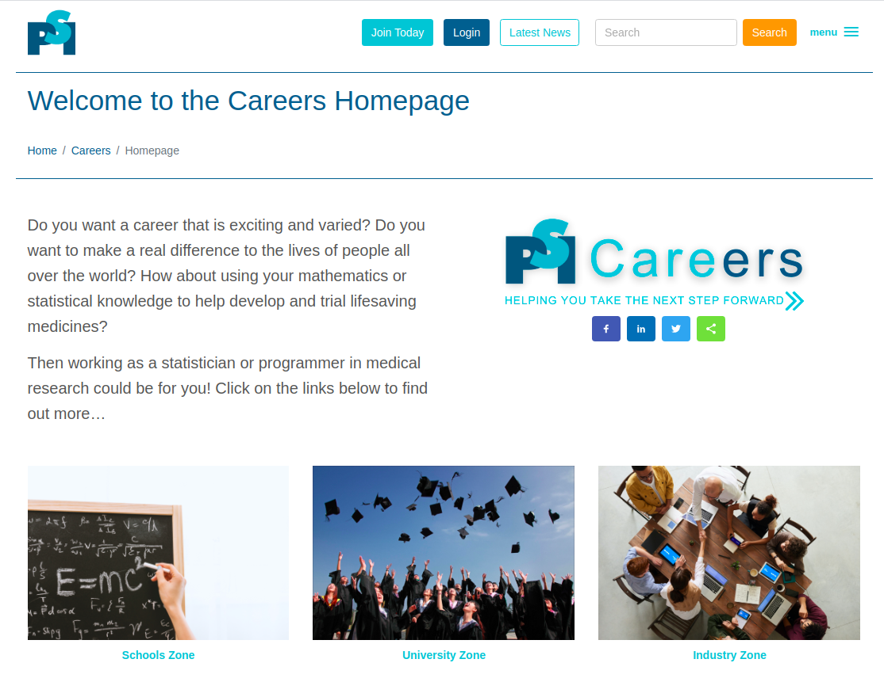
www.psiweb.org/careers
For more information on what we do visit our website.
Within the PSI Careers website, there is a specific University Zone aimed at students.
In addition, there is a Schools Zone and also an Industry Zone for those already working as statisticians.
Other useful careers information available at:
            http://careers.abpi.org.uk
      http://www.statslife.org.uk/careers

Slide 10
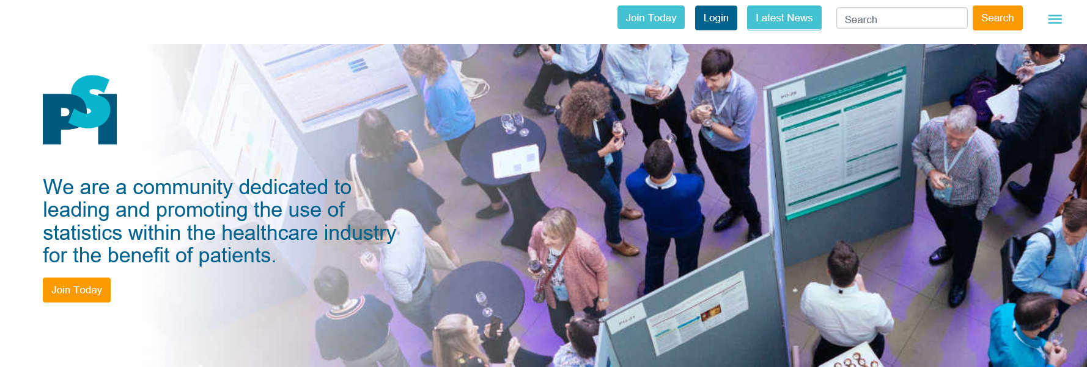
Student membership
Free to all students & teachers! Apply now on our website!
Valid from January – December 2022 (renewal every January)
What you get:
Quarterly newsletter (SPIN)
Reduced fees at training courses and annual conference
Access to the members-only area of the web site
And much more!
Benefits:
Looks good on your CV
Start building your professional network
Access to job ads
Keep up to date with relevant news in the industry!
And much more!

Slide 11

PSI Conference
The PSI Conference 2023 will in-person in London between 11 - 14 June 2023
This is regarded as the principal annual event for statisticians in the pharmaceutical industry
The conference will include plenary sessions, parallel sessions and a poster display. Material will be also be available on demand plus there will be a exhibitor area.
A Student Day Pass** is available on Monday 12 June for £30, including a Career Young Statistician session and other student sessions (**you will need to register as a PSI student member first)
If you can’t make it to the conference then do still consider becoming a PSI student member as many of the sessions will be recorded and available online after the conference.
PSI usually alternates its conference between a UK city and mainland Europe each year - so keep an eye out in future years if the conference is near you.
Find out more at:
https://psiweb.org/conferences

Slide 12
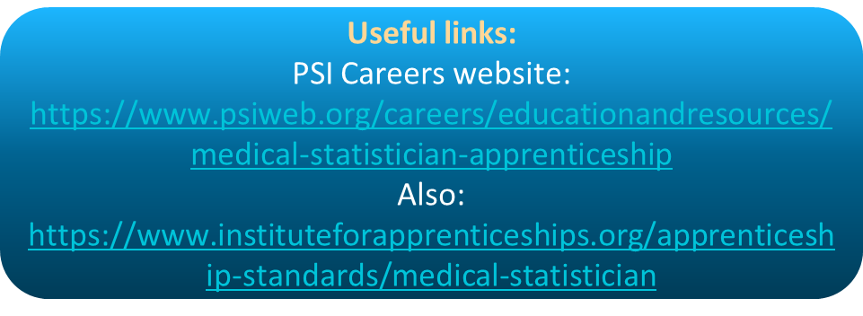


Medical Statistics Apprenticeship
The new Medical Statistics Level-7 Apprenticeship has been approved!
This new apprenticeship will be an important new option available to educate and train the next generation of medical statisticians within the UK.
This is aimed at students who have completed an undergraduate degree in a numerate subject
  You would study for a MSc to be completed part-time over 2-3 years, alongside gaining on-the-job experience by working (and earning a salary) at a company.
The University of Strathclyde is the first university to be registered as a training provider and would provide the academic portion of the apprenticeship. We expect other providers to be available soon.
Keep a look out for companies that may be advertising apprentice positions (as you would apply to the company rather than the university) – try the PSI website Jobs Board or Medical Stats Apprenticeship page.

Slide 13
Exhibitors today
Pharmaceutical Companies
Abbott
Amgen
AstraZeneca
GSK
Janssen, Johnson & Johnson
MSD
Pfizer
Roche
UCB
Contract Research Organizations (CROs)
Adelphi Values
Exploristics
ICON
IQVIA
Labcorp Drug Development
Phastar
Quanticate
Veramed
Clinical Trials Units (CTUs)
CTRU, University of Leeds
OCTRU, University of Oxford
CRUK CTU, University of Birmingham
CTUs of Oxford Population Health, University of Oxford
Universities
Bristol
Leicester
Imperial College London
Professional Societies
Royal Statistical Society - Young Statisticians Section
UKCRC, Registered CTU Network

Slide 14
Feedback
Your feedback is really important to help us plan future events
Please complete the feedback form you received at registration and return these to us before you leave
Also feel free to leave your email address with exhibitors as they won’t be receiving a delegate list today
We will also be doing some short interviews to use in the future - so please go and find Elena if you are happy to take part
Thank You!

Slide 15
New Starter in Medical Statistics at a Clinical Trials Unit (CTU)
Ellie Van Vogt
NIHR Pre-doctoral Fellow
Imperial Clinical Trials Unit (ICTU)
PSI Medical Statistics Careers Event 2022

Slide 16
Contents
About me – my path to becoming a medical statistician
What methods do I use?
A day in the life
The joys and the challenges
      What’s good about my job?
      What’s challenging?
First year expectations
Why work as a medical statistician at a CTU?
16
Notes:
16

Slide 17
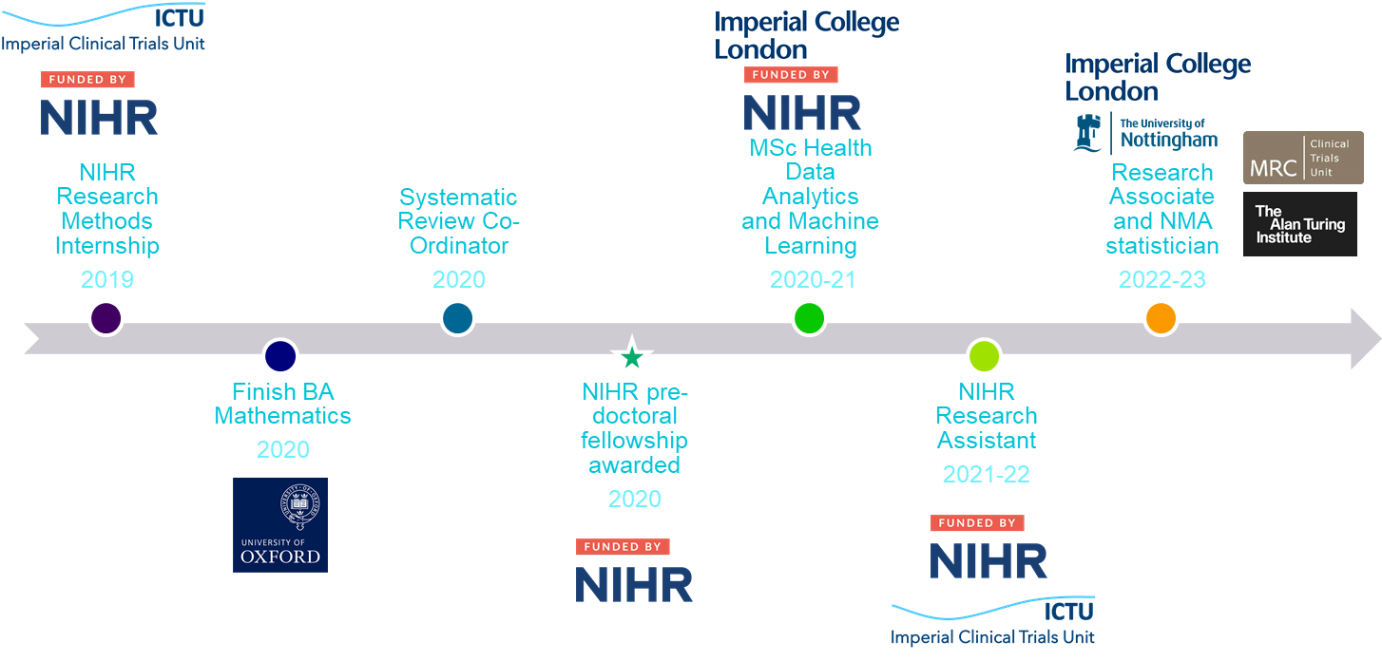
About me
17
Notes:
17
17

Slide 18
A day in the life
Learning
Reading
Coding
Writing

Slide 19
A day in the life
Public engagement and outreach
Social media
Research away days
Website development

Slide 20




Developing causal machine learning methods for the detection of heterogeneous treatment effects in randomised controlled trials, with application to critical care trials
Ellie Van Vogt, MSc
Imperial Clinical Trials Unit

Slide 21
What methods do I use?
Trials
Frequentist
Bayesian
Research
Causal machine learning
Simulations
21
Notes:
21

Slide 22
The joys and the challenges
The joys:
  Varied work
  Collaborative environment
  Self-directed
The challenges:
  Self-directed
22
Notes:
22

Slide 23
What is expected from me in my first year?
Trial statistician / research assistant
systematic review
Methods case studies
publications and conferences
establish collaborations
23

Slide 24
Should you work as a Medical Statistician at a Pharmaceutical CTU?
YES!
24
Notes:
24

Slide 25
Should you work as a Medical Statistician at a Pharmaceutical CTU?
Work across medical disciplines
Involvement in whole process
Develop methodology
Teaching and supervision
PhD pathways
25
Notes:
25

Slide 26
Any Questions?
26
Notes:
26

Slide 27
PSI Medical Statistics Careers Event
Panel Discussion
Careers and Academic Liaison Committee (CALC)
Emma Crawford
Wednesday 7th December 2022

Slide 28
Please submit your questions by going to https://pollev.com/psicareers on your phone* and we will pick some to answer towards the end of today’s session
*You will need to enter your name and you can submit as many questions as you wish.
And you can also “like” questions already submitted by others to indicate the popular questions to ask.

Slide 29
Introduce yourself
Name, Current Company & Position, Summary of your career path to date

Slide 30
What have you enjoyed about post-pandemic working?

Slide 31
What do you enjoy the most about your role?

Slide 32
What is the most challenging aspect of your role?

Slide 33
What is the most unusual/ interesting project you’ve been involved in?

Slide 34
What motivates you for the work you do?

Slide 35
What has been your most nerve-wracking experience so far?

Slide 36
What has been your proudest achievement so far?

Slide 37
As a student, what would you have liked to know then, that you do know now?

Slide 38
For new starters at your company, how much time do they need to be in the office and why?

Slide 39
What do you look for in candidates during a job interview? Do you have a typical question you would ask?

Slide 40
Exhibition Session
Session open until 17:00
Remember to find Elena if you are happy to be interviewed!

Slide 41
Back-up Questions

Slide 42
Have you had to travel anywhere interesting for work?

Slide 43
What are you hoping to achieve in your career in the future?

