Slide 1
A Visualization Tool Measuring the Performance of Biomarkers for Guiding Treatment Decisions
Hui Yang (Amgen Inc), Rui Tang (Vertex Pharmaceuticals), Michael Hale (Shire Plc), and Jing Huang (Veracyte Inc.)
March 22, 2017

Slide 2
Overview
2
Motivation and Background
Weighted Predictiveness Curve
Visualization Tool in R
Conclusion

Slide 3
Overview
3
Motivation and Background
Weighted Predictiveness Curve
Visualization Tool in R
Conclusion

Slide 4
Motivation and Background
4
Most cancer treatments benefit only a minority of patients to whom they are administered
Being able to predict which patients are likely to benefit
Save patients from unnecessary toxicity
Enhance their chance of receiving a drug that helps them
Control medical costs
Improve the success rate of clinical drug development

Slide 5

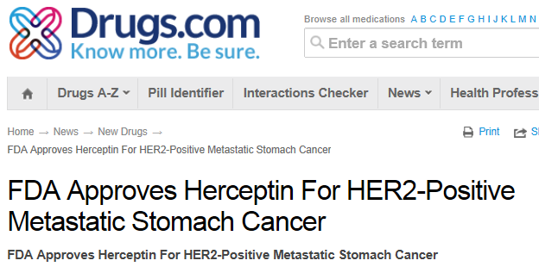
Motivation and Background
5
Get the drug to the right patients at the right time!
Investigation in role of candidate biomarkers in patients outcome.

Slide 6
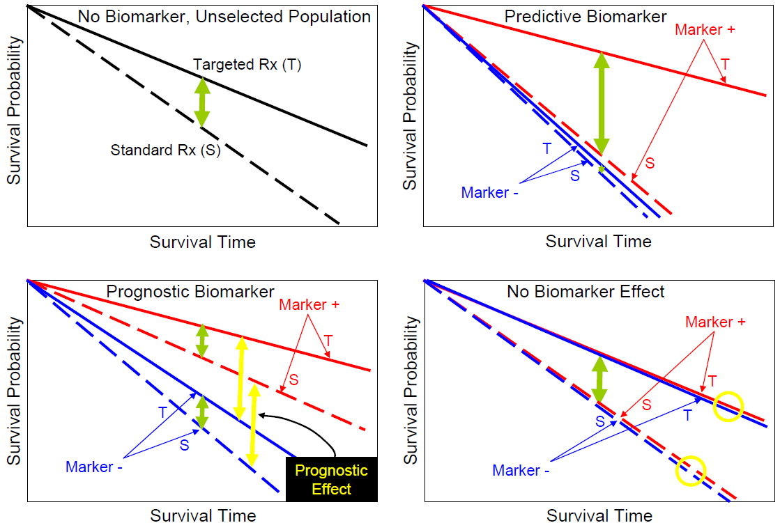
Prognostic & Predictive Biomarkers
6
Robert L. Becker, Jr., M.D., Ph.D, Chief Medical Officer, FDA/CDRH/OIVD
Prospective vs non-prospective design in companion drug/diagnostic studies

Slide 7
Overview
7
Motivation and Background
Weighted Predictiveness Curve
Visualization Tool in R
Conclusion

Slide 8
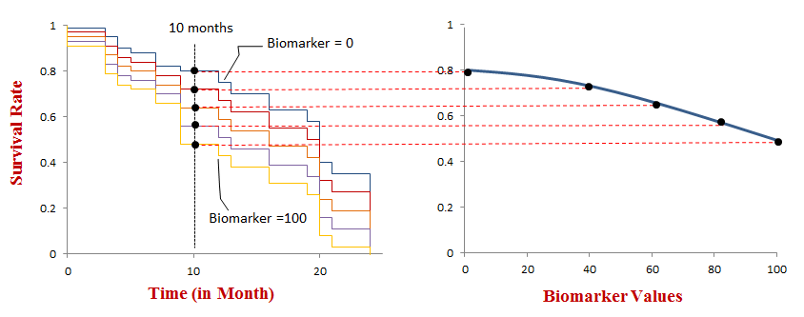
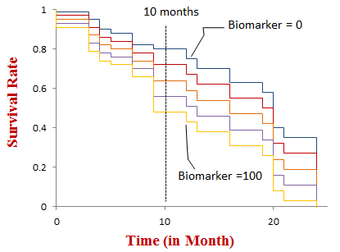
Visualization of Treatment x Biomarker on Survival
8
Survival rate vs. Time – Kaplan Meier plot
Survival rate vs. Biomarker – Weighted Predictiveness Curve (WPC)[1]
[1] Yang, H., et al. (2015). "A visualization method measuring the performance of biomarkers for guiding treatment decisions." Pharmaceutical Statistics

Slide 9
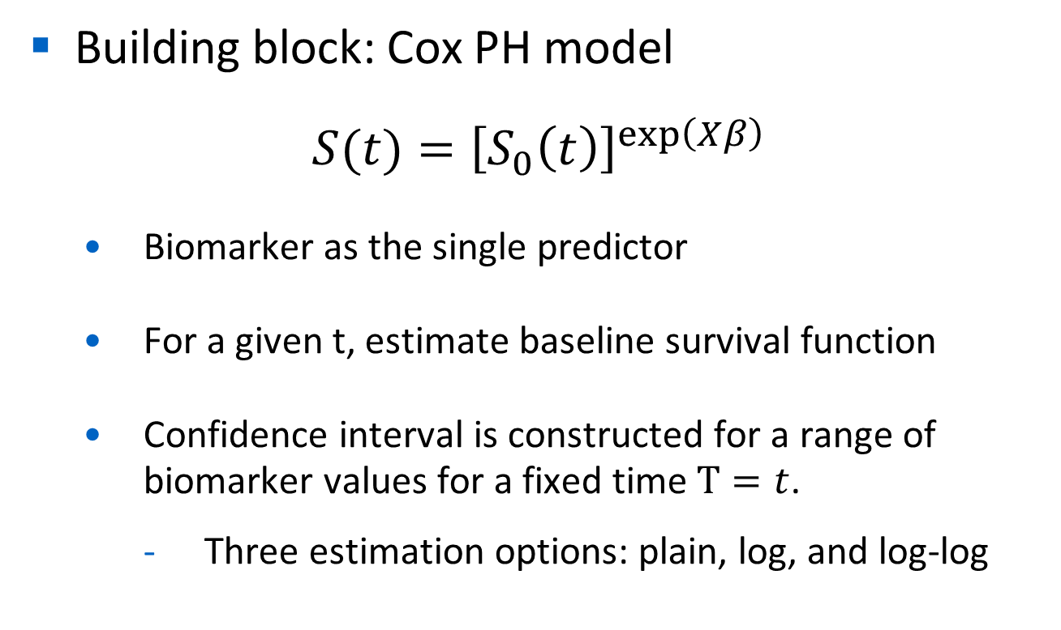
Weighted Parametric Predictiveness Curve
9
Building block: Cox PH model
$$S(t)={\left[S_{0}\left(t\right)\right]}^{exp⁡\left(Xβ\right)}$$
Biomarker as the single predictor
For a given t, estimate baseline survival function
Confidence interval is constructed for a range of biomarker values for a fixed time $T=t$.
Three estimation options: plain, log, and log-log

Slide 10
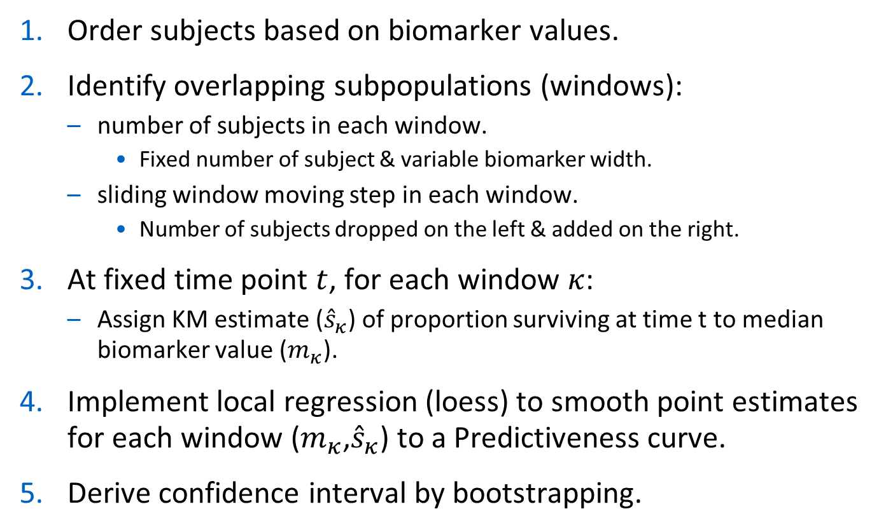
Weighted Nonparametric Predictiveness Curve
10
Order subjects based on biomarker values.
Identify overlapping subpopulations (windows):
number of subjects in each window.
Fixed number of subject & variable biomarker width.
sliding window moving step in each window.
Number of subjects dropped on the left & added on the right.
At fixed time point $t$, for each window $κ$:
Assign KM estimate (${\hat{s}}_{κ}$) of proportion surviving at time t to median biomarker value ($m_{κ}$).
Implement local regression (loess) to smooth point estimates for each window ($m_{κ}$,${\hat{s}}_{κ}$) to a Predictiveness curve.
Derive confidence interval by bootstrapping.

Slide 11
Overview
11
Motivation and Background
Weighted Predictiveness Curve
Visualization Tool in R
Conclusion

Slide 12
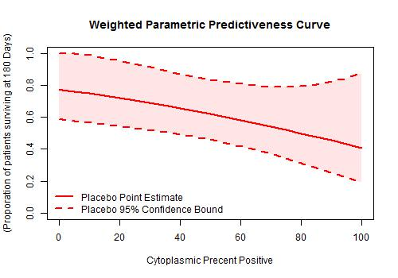
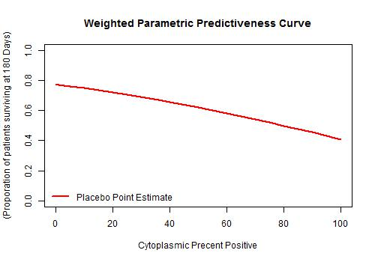
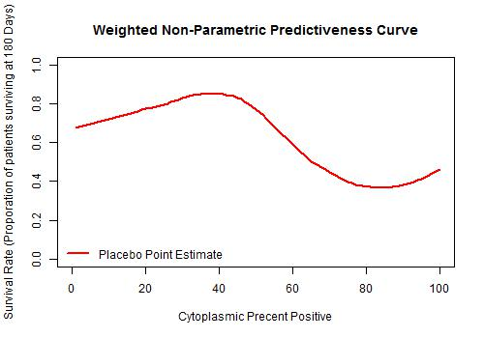
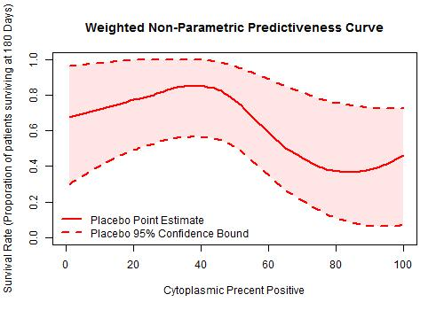
Single Curve “SoloWPCCurve” – Parametric and Non-Parametric WPC
12

Slide 13
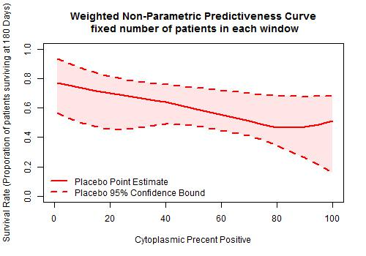
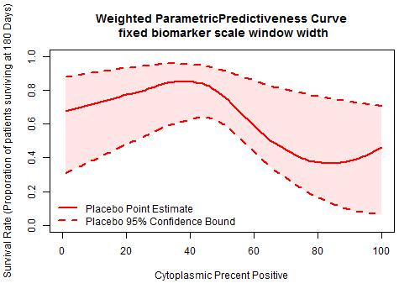
Non-parametric Curve – Window Selection
13
Apply different methods to identify overlapping windows:
fixed number of subjects & variable biomarker width.
Window width - number of subjects in each windows.
Sliding speed - sliding window moving step in each window.
fixed biomarker width & variable number of subjects.
Window width - biomarker width of each window.
Sliding speed - sliding window moving step by the unit of biomarker value.

Slide 14
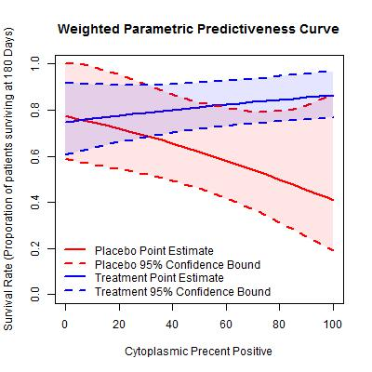
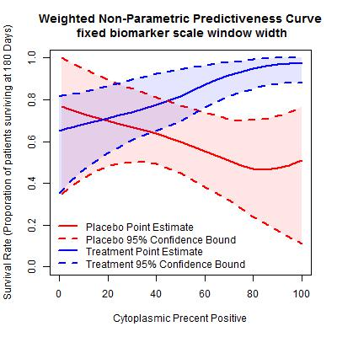
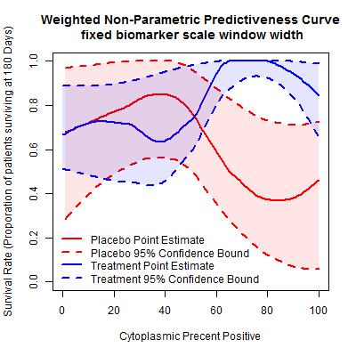
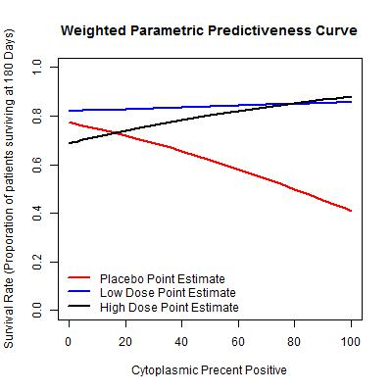
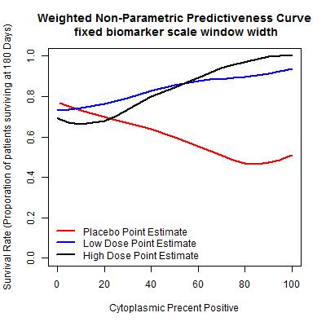
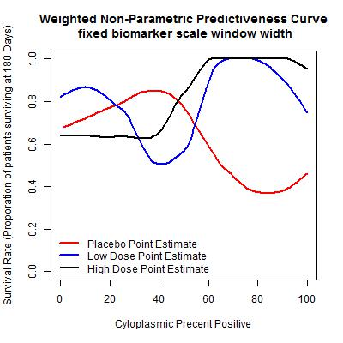
Multiple Curves for Comparison – “DuoWPCCurve” and “TrioWPCCurve”
14

Slide 15
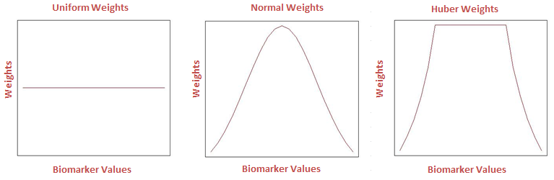
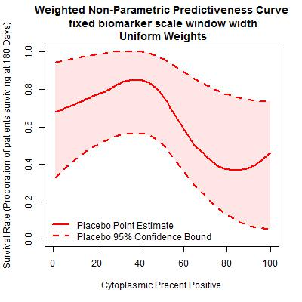
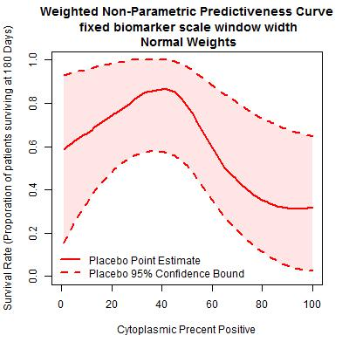
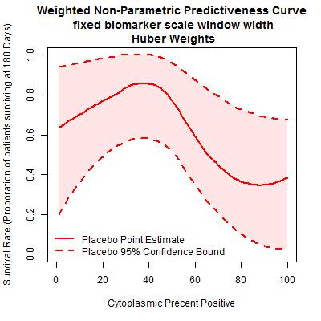
Non-parametric Curve – Weight Function Selection
15
Implement weighted Kaplan-Meier estimates:

Slide 16
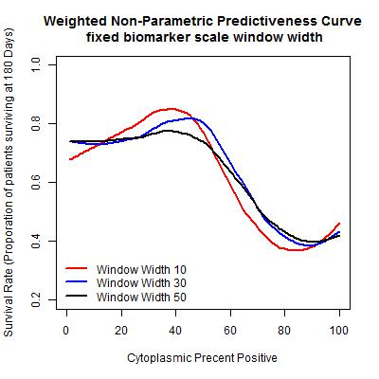
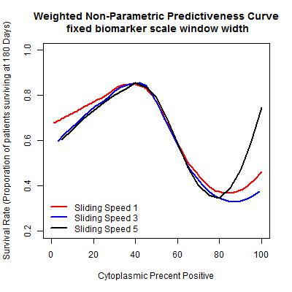
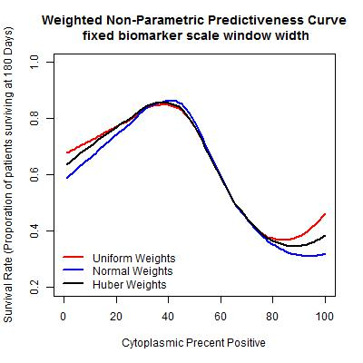
Parameter Comparison - Nonparametric
16
Weighted Nonparametric Predictiveness Curve
Window Width
Sliding Speed
Weight Functions

Slide 17
Simulation Conclusions
17
Different Methods – COX and NPC.
Cox Predictiveness Curve.
Superior only under strict assumptions.
Nonparametric Predictiveness Curve.
More flexible and superior in various general scenarios.
NPC with different parameters.
Small moving step and window size works better.
More centralized weight works better.
Normal > Huber > Uniform.

Slide 18
Overview
18
Motivation and Background
Weighted Predictiveness Curve
Visualization Tool in R
Conclusion

Slide 19
Our tool provides flexibility
19
Allows users to visually evaluate treatment effect on survival as a function of biomarker!
One vs. two vs. multiple curves
Estimate only vs. paired with CI band
Allow different methods to identify overlapping windows
fixed number of subjects & variable biomarker width.
fixed biomarker width & variable number of subjects.
Allow different methods to estimate survival rate
Window Width / Sliding Speed / Weight Functions

Slide 20
Our tool provides Visual Assessment
20
The tool is built in R and can be used to:
Compare treatment effects
Detect high-impact biomarkers
Distinguish b/t prognostic vs. predictive
Design biomarker-based treatment regimens

Slide 21
Thank you

Slide 22
Key Advantages of WPC - Flexibility
Capture nonlinear patterns and local sharp change by incorporating overlapping sliding window procedure.
Avoid overfitting by facilitating smoothing technique.
Robust under many scenarios by requiring minimum model assumptions.
Convenient exploratory evaluation by using Predictiveness curve.

