Slide 1
Riding the Data Explosion
Simon Tilley
SAS

Slide 2
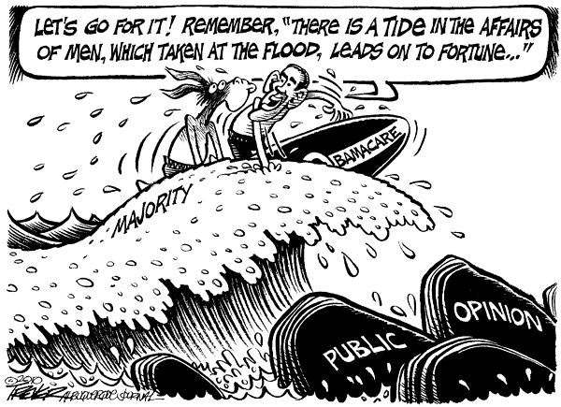

Slide 3
Data Explosion
Where are we?
Unprecedented growth… very big… and only going one way…
Scientific – genome, image, patient record…
Non-Scientific – mobile, activity, telemetry, voice…
Both – smart devices… blister packs, pill bottles, IoT…
Meets exploding compute capacity...
Evolution of the corporate cortex
Altering the balance in the Intelligence continuum! Capt’n ☺

Slide 4
Balance…
In what?
The Intelligence Continuum…
Complex tools and techniques with statistical legitimacy and mathematical rigour
Wild West
For Business: Not great… but all they’ve had…
For Science: Outstanding… but very hard and computationally expensive…
Sophisticated Statistical and Analytical modelling
Simple reports
Mind The Gap
Statistics and Analytics are getting more approachable
Tools are getting more sophisticated

Slide 5
…but
The challenge is… to Mind the GAP
Good tools in the wrong hands just makes it easier to draw the wrong conclusions more quickly

Slide 6
…and
The therein lies the opportunity…
Risk of wrong = Opportunity for you

Slide 7
The SAS
View of the world
Advanced Analytics
The Power to Know®

Slide 8
The SAS
View of the World
Fully formed, commercial off the shelf
Data Source
Advanced Analytics
Levers
Clusters
Networks
Fraud
Quality
Customer
Data Source
Data Management
Packaged IP
Full range of solution completeness – All provide Faster time to Value
Data Source
Interesting Idea / wrapped up IP
Lay a solid data foundation
Know
Get to Value… Fast!
Notes:
Step 1 – What is Advanced Analytics?
SAS is the undisputed leader in Advanced Analytics
38% Market Share according to IDC
Bigger than 2-10 added together
But what is Advanced Analytics?
3 things… give us loads of data and we will identify the:
levers that are in the data – how things you care about (KPIs) are driven by other things…
clusters that are in the data – which things look like each other, how similar they are and how different they are from other things that are similar
networks – how things relate to each other
Levers
Once you understand how the levers operate then you can gain control over the business… you can:
Forecast / simulate what will happen as you adjust the levers
Optimise – figure out where all the levers need to be to maximise or minimise values
Step 2 – Data Management
If you want to analyse the data to drive key decisions then you need to have a high level of confidence in the data that is feeding it
SAS has a full Data Management capability that is in the Gartner leaders’ quadrant in its own right
Step 3 – Go to market strategy
You can apply and derive value from any part of the business lifecycle with Analytics and as SAS has broadly done the same thing for 38 years it has seen many of these problems and addressed them
SAS wraps up learnings, IP and even fully formed applications and puts them on the shelf for you to get the fastest possible start in delivering value to your business
At SAS we have hundreds of solutions – they range in their completeness from fully formed, commercial off the shelf packages right through to “we’ve thought about that before”
In fact SAS has gone further – we have recognised business applications where embedding Analytics can make a significant impact on the effectiveness
For example… Multi-channel marketing. By embedding analytics into the marketing process we see massively improved response rates through better engagement
Step 4 – Summary
SAS really understands the complexity of delivering Advanced Analytics
It is at the core of our business and has been since its foundation in 1976
However… to deliver the full benefit of Analytics, SAS has honed a market leading data management platform and has productised its decades of expertise
The net effect is gaining a true insight into the way that your business works to make better decisions to move it forwards and to do that faster and more surety than you can with anybody else

Slide 9
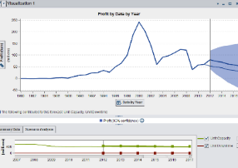
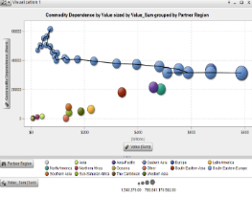
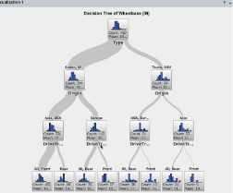
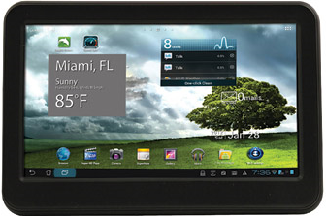
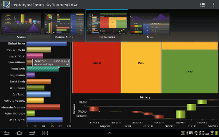
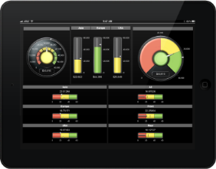
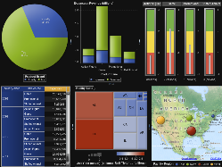
SAS
Moving the point of application for Analytics…
Analytics & Statistics Centre of Excellence
Analytics moves to the Front-Office
Analytics & Statistics sat in the back-office
HPA / Cheaper Compute Power
Explore
Share
Question
Analyse
Score
Advanced Analytics
Levers
Clusters
Networks
Realtime Analytics / Statistics & Visualisation
Interactive exploration
Easy distribution
Understand why… not just what…
Immediate Consumption in the Business
?
More Meaningful Hypotheses
Expensive – GBP and Computationally
Mathematically complex
Tightly controlled governance
MOBILE
Notes:
Step 1 – How it has always been
SAS Analytics is used to significant benefit by 91% of the world’s largest companies
It has historically been expensive and complex to do and therefore restricted to companies with enough scale
However… compute power is getting MUCH cheaper…
Step 2 – Democratising access to analytics
With cheaper compute power it is becoming possible to perform the millions of calculations possible for Analytics in fractions of a second
This makes it possible to visual explore sets of data using Analytical methods and statistics that previously you could only look at with BI
I like to say that Analytics is to BI as X-Ray is to Photography… BI has been used to drive decision making – but however pretty it looks – it is still superficial
Analytics allow you to see inside the data – understand how it really works… how it relates to itself and others… it really allows you to see why… and not just what
Step 3 – Sharing the understanding
With fast and flexible visual exploration comes the need to build dashboards and distribute the understanding / viewpoint to mobile devices and the web
This allows better understanding to be derived more quickly and acted on immediately to drive shorter cycle times in the business
However… the visual exploration of data cannot hope to make your average sales manager a PhD Statistician… it can however allow more sophisticated hypotheses to be created and given to Analytical teams
Step 4 – Building and Refining more complex models
The frontline in the business can now ask different questions of the analytical team, questions that are better formed and more likely to be deliverable
What was the Analytical Back Office can now become an Analytical Service organisation, managing the data, ensuring congruence and sharing best practice and Analytical scores / propensity scores across the business
Step 5 – Summary
SAS has brought Analytics out of the back-office to empower the business frontline… it doesn’t reduce the role of traditional analytics – it fuels it
If you are a company that has not got an analytics group, then it doesn’t matter – you can take it as a service from SAS…
SAS will take your data, build the models, score the data and deliver it to your business for exploration and consumption
All of the benefits that have been exploited by the largest companies for many years… now available to all…

Slide 10
Opportunity lies
In Three Key Dimensions…
Compression of cycle time for same task
Reduced statistical and analytical exploration time allows new business process
New Business Process allows change in role for the Statistician
Moves out of the back room and in front of the executive
Statistician becomes collaborative partner in gaining true insight
Expansion into new parts of the business
Access to Analytics and Statistics becomes available to new users
Either because of expansion from the left of the continuum or from the right
Massive expansion of need for Statistical and Analytical understanding
More of the Same
Build a Centre of Excellence to answer the new and better hypotheses from the business
Shorter cycle times = higher octane analytics

Slide 11
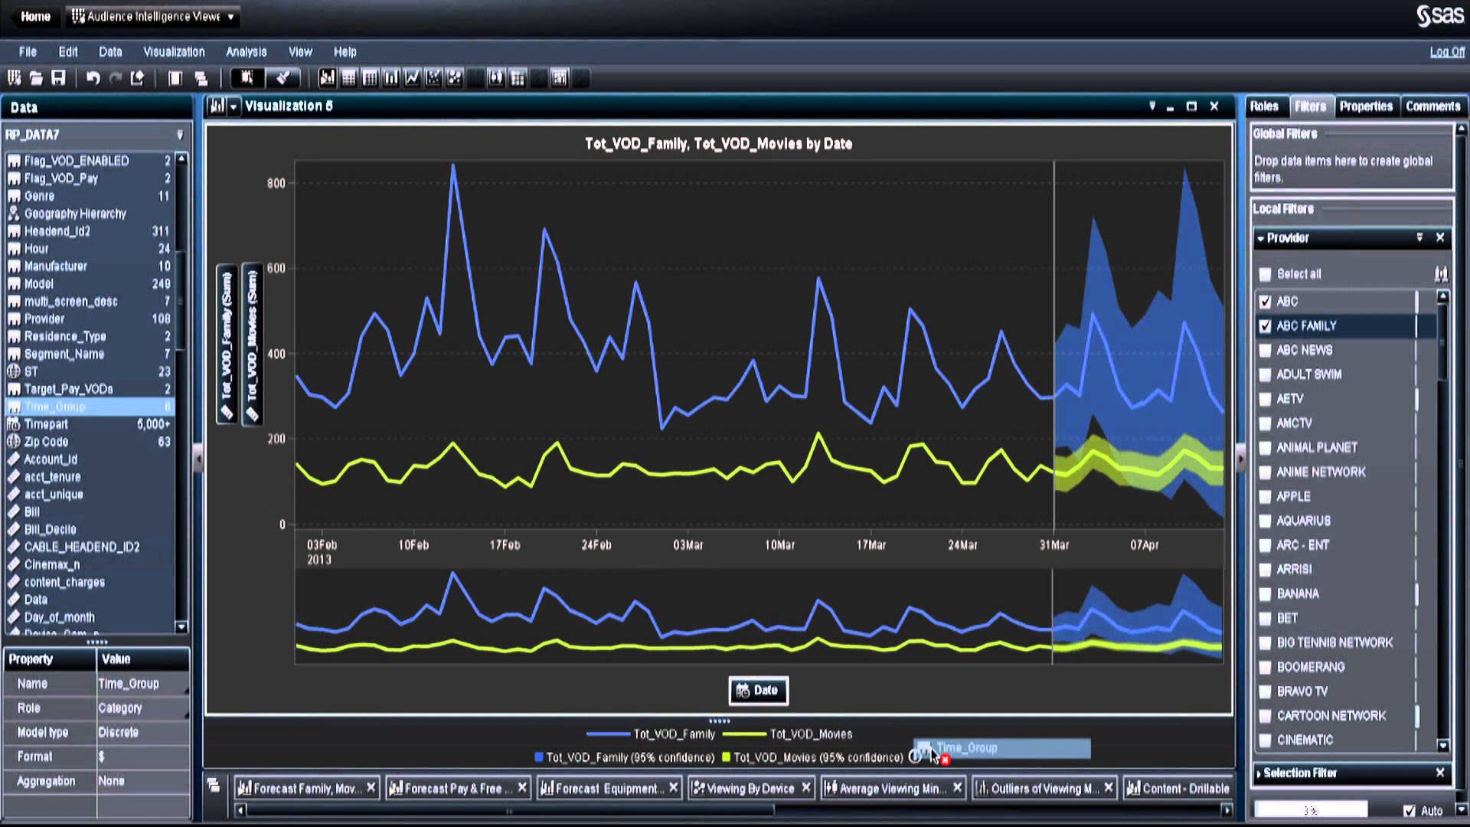
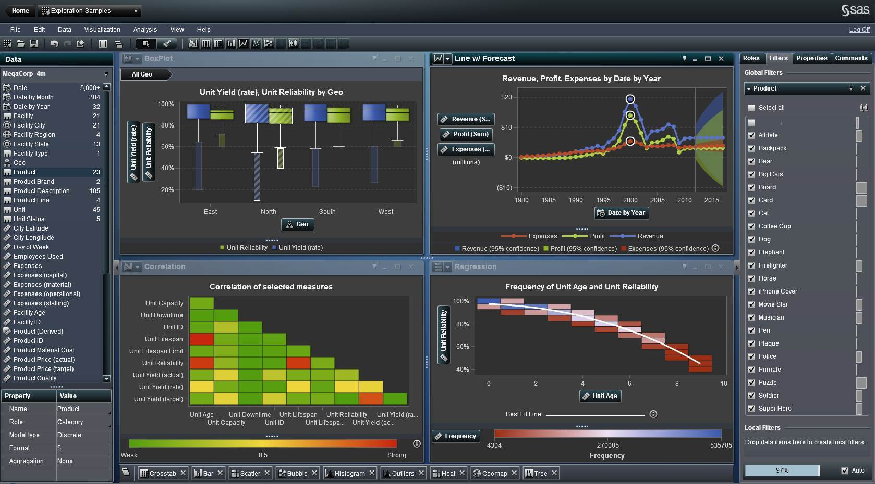

Slide 12
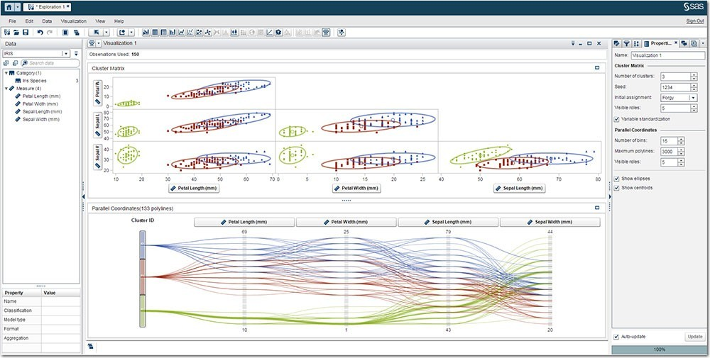
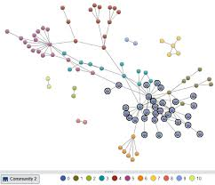

Slide 13
Something
Is definitely going to happen…

Slide 14
The Power to Know®
Real-time Analytics and Visualisation
Identify and calibrate the levers
Find and understand the clusters
Uncover and map the networks

